Slide 1
Evidence-Based Practice: Evaluating our collections and services
Clare Thorpe
@thorpe_clare #2018ANZTLACONF
Notes:
EBP – WIIFM?

Slide 2
EBP – What’s in it for me?
A short history of evidence-based practice in libraries and information services
Build your own evidence-based practice backpack (including tips for solo practitioners)
Some real life examples
Notes:
What is it?
Where have we come from and where are we going to?
How can you apply this in your library? Can you go it alone?
Some examples of what we’re doing at my library and in my practice
As we go along this afternoon, you might realise that I’m putting a label on something you already do in your library. That’s fantastic – hopefully we’ll have time as we go to hear a few stories from the floor about what you are doing.

Slide 3
My evidence-base practice story
Notes:
I first heard about evidence-based practice when I was invited by my colleague Helen Partridge to join the organising committee for the third International Evidence Based Librarianship conference in 2005. At the time, I’d never heard of this concept but it made a lot of sense to me and resonated with my approach to my work and decision making.
Following that conference I undertook some research with Helen and Sylvia Edwards to tease out the concept of evidence-based practice more and understand how librarians understood it and experienced it. Then again in 2015, I helped organised EBLIP8.
In my current role at USQ, I am responsible for library quality and planning, and I am very fortunate to have a Coordinator of Evidence Based Practice working in my team. So evidence-based practice has been an important contributing factor to my career progress and it is a topic that I’m quite passionate about.

Slide 4
In the beginning…
Evidence-based medicine
Evidence-based librarianship
Notes:
EBL first appeared as a term in 1997 (Eldredge), was eagerly embraced by health librarians. A series of conferences began in 2001 and have run biennially since, with the next one scheduled to be held in Glasgow June 2019. Many other disciplines have also adopted the ‘evidence-based’ tag, including health care, management, executive coaching, career development, public policy, education and librarianship.
EBLIP adopted fairly early on as a more inclusive description of library and information services and practices in all their diverse forms.
Evidence-based library and info practice Initially focussed heavily on systematically reviewing research-derived evidence. Early models and tools focussed on critical appraisal of research literature as the only source of evidence for decision making

Slide 5
What is evidence-based practice?
A structured process of collecting, interpreting and applying valid and reliable research and evidence to support decision-making and continuous service improvement in professional practice.
(Howlett & Thorpe, 2018)
Notes:
What is it not? Not just gathering data and statistics; KPIs and annual reports. Rather it is an approach that is ongoing and reflective in nature, an approach to continuous service improvement and professional practice
EBP is about Improving professional practice by individuals, in libraries as organisations and more widely across the profession. The definition on screen is one we’ve adopted at USQ Library to explain evidence-based practice in our library context.

Slide 6
Doing and being
Not just a one-off but:
Questioning our practice
Gathering or creating evidence
(if we don’t already have it)
Using evidence wisely to make and inform decisions (especially about our value, impact or worth)
(Koufogiannakis & Brettle 2016)
Notes:
To understand evidence-based practice in libraries, research about it as a concept shifted a decade ago to explore – not just what does it look like in practice but what does it mean to be an evidence based librarian?
So it’s a concept that is not just about a one-off events or just about decision making.
To paraphrase a well used political slogan, evidence based practice is about Making libraries (and librarians) great!
The book on screen is a great introduction to evidence based practice and includes case studies from different sectors, including academic, special, public and school libraries.

Slide 7
Other perspectives from research
Evidence-based practice is:
Not always straight-forward or linear (messy)
Holistic
Deliberate or unintended (serendipitous)
Used immediately or filed away for future use
Impacted by time, accessibility and the availability of evidence
Highly contextualised and influenced by the librarian’s workplace
Notes:
There’s been a small flurry of research in this space over the past decade and I’ll have references to available in the accompanying paper but to sum up my slide -
there’s no one right way to do or be evidence based. The way your apply this in your practice is up to you. Whether it is reactive or proactive, whether is continuous or as required.
In fact, the right way to be evidence based is to focus on and be relevant to your library’s context.

Slide 8
Stop - Think - Check
Have you ever had to/wanted to?
Defend your funding? Make a case for funding?
Defend your space? Understand how your space is used?
Prove your return on investment, your value/impact?
Understand your clients’ needs better?
Evaluate your collection?
Notes:
Hands up if you ever had to or wanted to….
You can use evidence-base practice to do all these things.
Take a minute – write down one thing you really want to know about your library, its users, its services, its collection.

Slide 9
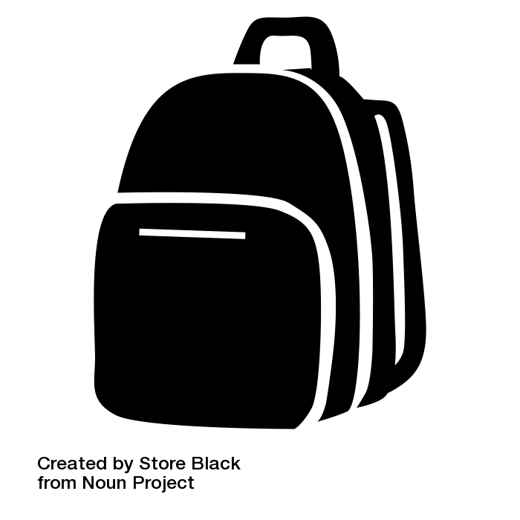
Fill your evidence-based backpack
A backpack full of stories, statistics and evaluations that can be used with authority and conviction is required if advocacy is to be successful.
(Bell et al 2017)
Notes:
So today I thought I’d use the metaphor of a backpack to look at different strategies, tools and methods you can use to bring an evidence-based practice approach to your work.

Slide 10
Sources of evidence
Professional Knowledge
Local Evidence
Research Evidence
Research evidence/literature
Books
Journal articles
Conference papers
Systematic reviews
Benchmarks and standards
(Koufogiannakis, 2011)
Notes:
So what is evidence anyway?
Early discourse promoted, and focused primarily on research evidence as the only type of evidence.
In 2011 Denise Koufogiannakis from Canada suggested two other types of evidence LIS professionals may draw upon for making decisions – local evidence and professional knowledge.
Research evidence is fairly obvious – it’s the quality publications we teach our students to use. And it’s important that we continue to draw on published and validated research to learn from and get inspiration for our own libraries. It’s also important for us to share our stories in this space and make the effort to document our successes and failures. A great place to start is the open access journal called Evidence Based Library and Information Practice – EBLIP which publishes research papers, summaries of research articles, commentaries and editorials.

Slide 11
Sources of evidence
Professional Knowledge
Local Evidence
Research Evidence
Local evidence
Statistics
Client feedback
Surveys & evaluation forms
Policy and procedure documents
Observations and anecdotal evidence
Budgets and staffing numbers
Stakeholder engagement
(Koufogiannakis, 2011)
Notes:
Local evidence is found within the working context that is directly applicable to the very communities library and information services seek to serve.
You probably already have a lot of these sources available to you – think about how you use these sources to inform your work. If you collect circulation or e-resource usage statistics, how do you use these to make decisions about your collections?

Slide 12
Sources of evidence
Professional Knowledge
Local Evidence
Research Evidence
Professional knowledge
Expertise
Professional experience
Tacit knowledge
Input from colleagues
What other libraries do
Intuition
Non-research literature (blogs, commentaries, tweets)
(Koufogiannakis, 2011)
Notes:
LIS professionals bring their knowledge and experience to the problems and questions they seek to solve on a daily basis through critical thinking and reflection. So what you know as a professional librarian and the information you have about your library services and collections are valid sources of evidence.
So to wrap up – three types of evidence you may already be using in your work. All are valid sources and most importantly, no one type of evidence stands alone. The type of evidence you use is going to depend on the question/problem you are considering and the need for information (Jamali, 2018).
The mix and type of evidence you use depends on the task, the availability of data, the outcome you are aiming for. This might be different every time. It might be the same – benefits of trend analysis if you are looking at longer trends or patterns over time.

Slide 13
Putting it in practice
Interpret | Apply
Measure | Communicate
Notes:
So all these types of evidence may sound reasonable and interesting but how do you actually do it?
At USQ, we’ve developed a model or lens for evidence-based practice that we’re using to explain our way of working in this space. We’ve developed a framework that can be applied to individual situation, team plans or at an organisational level. We’re using this framework to explain and apply evidence-based practice in our day-to-day work. And we are using this framework in our strategic thinking and planning as we aim to develop a mature culture of working that is evidence-based.
Unfortunately I can’t show you the final version of this model as we are revealing it at the Asia Pacific Library and Information Conference in two weeks but I can explain the four key elements of the model to look at what you can put in your EBP backpack.
Our framework is multi-directional and iterative. At each stage evidence is gathered, analysed, used and applied.

Slide 14
Interpret – Strategic direction & goals
Design outcome-driven services based on strategic priorities. Use evidence for strategic purposes. (Grieves, 2017)
The choice of methods (evidence) must be tied to the mission of each specific institution. (Tenopir, 2013)
Notes:
The first phase is to interpret.
Earlier I asked you to write down one thing you really want to know about your library. How does this relate to your organisation’s strategic goal?
Evidence-based practice shouldn’t be done in a vacuum – it can help you work smarter - work with a purpose.
Understanding what the environment is that your library operates in is an important starting point.
Is your libraries a Storehouse or a Tool Shed? The strategic environment your library sits within may influence the sources and types of evidence you choose to use.
On your worksheet, I’ve written a prompt for you to write down, in relation to your question – how does this relate to the priorities in my library or institution?

Slide 15
Apply – Services, Collections, Spaces
Build your service offer so as to generate bespoke evidence around the outcome and impact of engagement (Grieves, 2017)
What do your services, collections and spaces tell you about your performance and achievements?
Notes:
So if you are making changes based on a change of direction in strategic priorities or you are trialling a new service or resource, then at the start consider how you can generate local evidence to determine it’s success or failure.
What professional knowledge and experience, workflows and processes, do you need to make day to day decisions and identify service improvements?

Slide 16
Measure – Outcomes & Impact
Measures and metrics are the means – they are the process not the product.
Measure plus meaning – what does the evidence mean?
Combine quantitative and qualitative data to form analytics and insights. (Grieves, 2017)
Notes:
When you heard the term evidence-based practice, I suspect some may have immediately thought of statistics and data.
Measuring numbers is reasonably easy – libraries are pretty good at collecting and keeping statistics.
However gathering numbers is not the end – it’s a process and it may need to be supported by different types of evidence, such as focus groups or clients comments and feedback.

Slide 17
Communicate – Influence & Advocacy
Tell someone! Use your evidence to influence and advocate.
Combine statistics with stories to craft and present meaningful narratives
Quantitative data can show return on investment and trends. Qualitative data can tell a story or put a personal face on data. (Tenopir, 2013)
Notes:
This element, if all others are done effectively, generates influence and advocates for what the library is and what it achieves for the institution. (Howlett & Thorpe, 2018)
At USQ we’re looking at developing Key performance indicators for our library to show our impact alongside stories that illustrate and put a face on the data. Monash Uni is doing this already quite successfully. People remember stories more than statistics.
On your worksheet, you might like to think about how you need to convince and influence – the evidence and the story you need to tell this person might inform that methods you use to prove your worth.

Slide 18
An example from real life – SLQ
INTERPRET From the Local Evidence, we identified that:
Clients wanted space to study, often for long periods of time | Audience research
High demand for quiet/silent study space | Occupancy counts, Audience research, Client feedback
High use of study spaces on Levels 2 and 3 where bags are permitted | Occupancy counts, Client feedback
Low use of quiet study space on Level 4 where bags are restricted | Occupancy counts
Notes:
So I have two examples of how this framework is applied in real life – both from my previous role at State Library of Queensland where I was Manager, Visitor Experience.
Client facing example: This evidence supported a proposal to review the Level 4 reading room to reconfigure access, with the dual aim of providing additional quiet study spaces
and enhancing the space for researchers using our Queensland collections, especially rare and original materials. Funding was sought and granted for this project based on the evidence in the business case presented on screen.

Slide 19
An example from real life
APPLY Reconfigure space on Level 4.
Professional knowledge used to design a new service offering. This included library staff expertise in conservation and architects’ expertise in design.
Research evidence from literature used to support our funding application to show that our clients’ experiences were not unique.
MEASURE
We measured the outcome and impact of the change, gathering Local evidence – occupancy counts, client feedback and staff feedback.

Slide 20
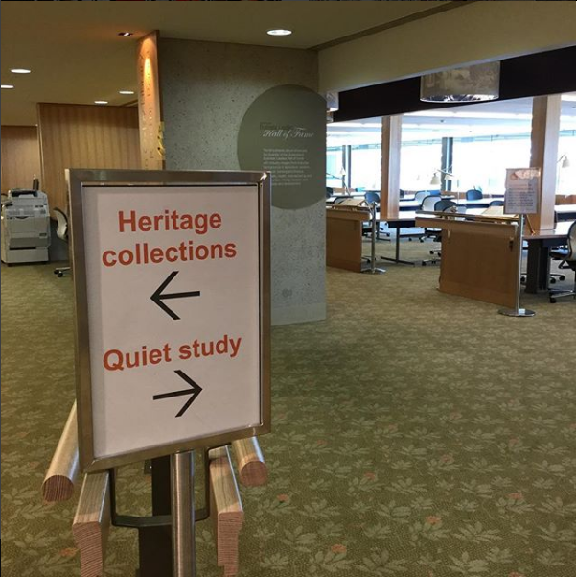
An example from real life
COMMUNICATE for influence and advocacy
We communicated the change and outcomes (Local evidence, Research evidence)
to clients – via website, social media, feedback received;
to staff – via staff meetings, project acquittal report, feedback received
to industry – via conference presentations and journal articles
Instagram post 25/7/2016 https://www.instagram.com/p/BIRBHWzh1is/?hl=en&taken-by=statelibraryqld

Slide 21
Another example - SLQ
Interpret – Strategic need to evaluate and demonstrate the level of service offered by Information Desk staff.
Apply – Team members collaborated to develop a Service Commitment which they would all commit to.
Measure – Peer observations used to measure performance against each element of the Service Charter across all Information Desks. Aggregated scores gave a measure of performance for the whole team.
Communicate – Findings were discussed with the team and shared with senior leaders. Gaps were identified for skills development.
Notes:
Staff facing example – also from the Visitor Experience team. I was asked to evaluate the quality of service offered at our information desks.

Slide 22
What goes into your backpack?
What do you want to know?
Use and apply what you have
Find/gather what you don’t have
What does it mean?
Tell the right audience (or not)
Notes:
Or not – last year we did a seating survey at the three campus libraries of USQ. It showed we had very low occupancy as a ratio of the available seats.
We haven’t shared this evidence outside the library as it’s not favourable.
This survey was done prior the refurbishment of our Springfield library which will open to students next week – so it’s valuable trend or baseline information so we can do a pre- and post- refurb comparison.
However it didn’t paint the library in a favourable light so we kept to our management team for the moment.

Slide 23
Information Services
Mystery shoppers
Observations of clients, of staff
Statistics – number of info desk queries, long and short term trends
Chat transcripts (READ scores)
Client feedback
Surveys and event evaluations
Focus groups, interviews, personas
Anecdotes/stories
Heuristics
Notes:
So let’s get practical – what tools and methods can you put in your evidence based practice backpack?
I’ve pulled together some ideas – these are not exhaustive lists and I’m interested in hearing any other ideas from you today that you might to share with us. I’ve put a couple of references on the reverse of your handout for some of the more obscure or detailed methods that you might like to explore later and of course I’ll have a more extensive list of references in the forthcoming paper.

Slide 24
Print Collections
Usage and holdings data – borrowing and ILL statistics, stocktakes
Return on investment evaluation– item usage plus cost of housing the resource (current and future value)
Large scale collection review – consider importance, quality and coverage in terms of student and research success, institutional reputation, uniqueness
Significance assessment – for a single, group or cluster of items (uniqueness, rarity)
Accessibility, readability, discoverability
Notes:
Content importance, quality and coverage – consider doing a one-off large scale collections review
Significance assessment - I recommend the Reviewing Significance 3.0 report from January 2018.
Define what makes a healthy collection for your library.
Well-crafted libraries can be powerful tools in making the values of intellectual responsibilities and rigor visible and attractive to a wider public.
You all have distinctive collections, whose distinctiveness once identified can be used to further highlight their unique institutional character. Library holdings can become a means of promoting institutional character.

Slide 25
Electronic and Digital Collections
Usage and non-usage (turnaway) data from vendors and discovery layers (COUNTER, JUSP)
Duplication, currency (embargoes), accuracy and completeness
Patron driven acquisition
Search logs; webpage analytics
Vendor support and supply – pricing models, access rights, trials, training (current and future states)
Functionality, accessibility, ease of use
Technical feasibility, integration with other tech, security, privacy
Notes:
Again I’m probably not telling you anything you don’t already know.
At USQ we’re currently developing an electronic content evidence based framework that will help us develop an open and transparent process around purchasing and decommissioning e-resources.
We’ve also just implement Alma as our library management system and are looking forward to using the analytics available to determine our high cost low use packages that we may be able to find some collection budget savings. Ashley Keogh had a great paper on this at VALA2018 which I’d refer you to. And my colleagues will be presenting on this framework at Info Online next year.

Slide 26
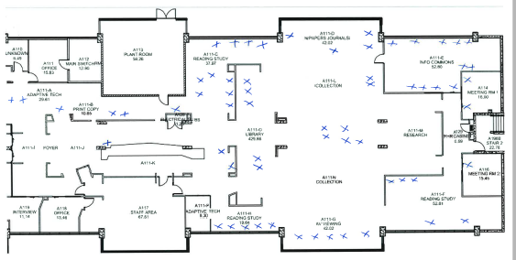
Spaces and Facilities
Observations
Journey maps
Occupancy counts, seating surveys, gate counts, wi-fi heat maps
Client feedback
Focus groups, interviews
Seating survey map of Springfield Library
August 22, 2017
Notes:
If you are worried about client privacy or security issues, just ask them for permission. E.g. put up a sign, send out email. University of Lancaster did a major research project around space and asked students if they had concerns about participating – they didn’t get a single complaint.

Slide 27
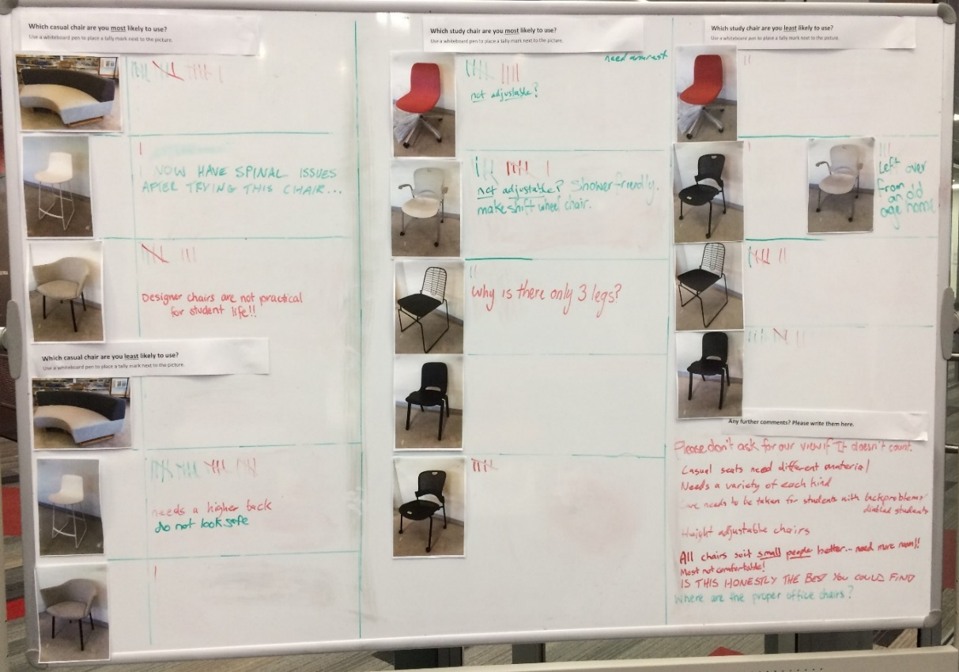
Stakeholder engagement
One of your best sources of evidence is your stakeholders.
Can be lightweight – doesn’t always have to in-depth UX
Develop a proactive approach that includes seeking, interpreting and using the input of faculty, students and community and that articulates the value of your library. (ASU Library, 2017)
Evidence from the Goldilocks experiment
Notes:
Goldilocks experiment – students really appreciated the opportunity to have a say and consult on seating options. Their feedback had a significant impact on what furnishing were purchased for the Springfield library – in fact every option was reviewed and changed.
Just don’t forget to close the loop – share the outcome and the success with them.

Slide 28
Working solo
Pick one thing, start small, keep it local
Read widely, think critically, actively reflect and share your adventures
Find your tribe (people, tweeters)
Develop your skills and fill your backpack with a variety of evidence sources and stories
“No one can stop you being evidence based.” (Lewis & Wilson 2015)
Notes:
Can you be evidence-based in a one-person library? Yes – in fact it may be easier as you potentially have a greater locus of control.

Slide 29
A reminder of the why
Being data driven creates a healthy service culture.
It’s not about how good we are.
It’s about, “This is how good we are with our customers.”
Masud Khokhar, University of Lancaster, June 2018
Notes:
Evidence-based practice can be empowering. It proves what you know or suspect about your work, your clients and services and builds a platform from which you can convincingly demonstrate your worth to your parent institution, to your clients, and to your industry.

Slide 30
What I’m working on
How can evidence-based practice become a whole of library experience?
How can we measure the maturity of our library to determine if we are evidence-based?
Research project: Towards a evidence-based practice maturity model for Australian academic libraries
Notes:
Research project: Towards a evidence-based practice maturity model for Australian academic libraries
easy if one-person library; harder for me at a 60 person library)
We’re presenting some of our new ways of working at APLIC in three weeks time.

Slide 31
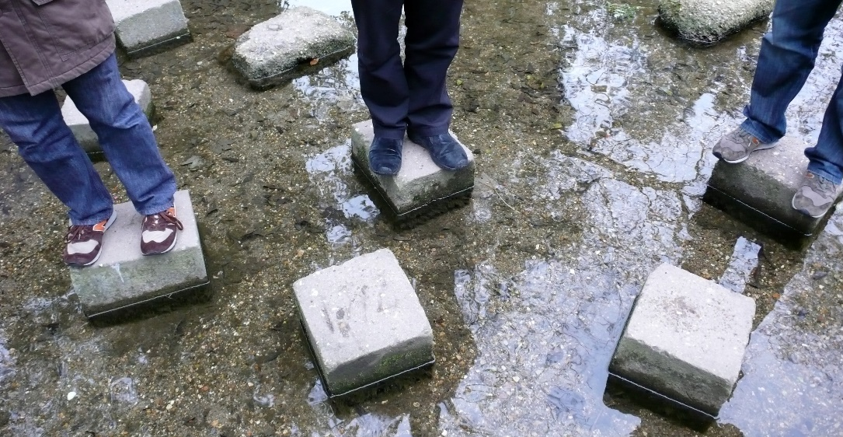
One step at a time
An evidence based culture in your library can be the first of many stepping stones to a sustainable future.
(Bell et al, 2017)
“Spring Stepping Stones” by Paul Downey is licensed under CC BY 2.0

Slide 32
Thank you
@Thorpe_clare
Clare.Thorpe@usq.edu.au
Thorpe_clare

