Slide 1

Literacy and Communication Issues and Concerns for Nursing Students from Non-English Speaking Backgrounds (NESB)
Tatra Palfery
Diane Duff
Heejin Chang
Rowena McGregor
Daniel Crane

Slide 2
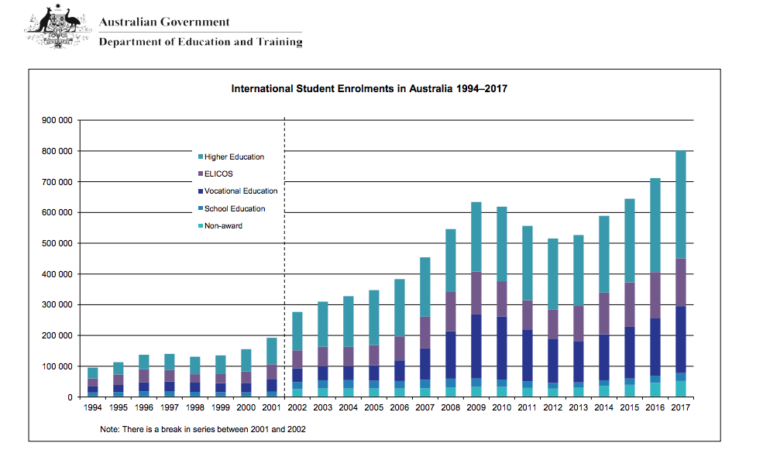
Background
~ 25% of students in Australia are international students

Slide 3

Demand for Nurses in Australia
Background
Australia’s Future Health Workforce Report (2018)
Shortage of 85,000 nurses predicted by 2025;
Increase to 123,000 shortage by 2030
Shortage rural>urban

Slide 4
Nursing and Midwifery Board of Australia Registration Standard: English Language Skills
Background

Slide 5
Bachelor of Nursing: English Language Entrance Requirements
Background
Effective communication is both a vital graduate and professional attribute
Language requirements for professional registration exceed entrance requirements into program (in Nursing ~ half of universities in Australia require IELTS 7.0 (or equivalent) for program entry (recently ENs→ IELTS 7.0)

Slide 6
English Language Proficiency Test Requirements - USQ
Background
Nursing is a Category 3 program
Minimum IELTS 6.5 (or equivalent – e.g. TOEFL, or PTE ) with no component lower than 6.0, or
Minimum B in all subjects of EAP 2 (which has an entrance requirement of IELTS 5.5, or equivalent)

Slide 7
Project purpose
In this small mixed methodology study, NESB/International nursing students and graduates, academic staff, and library and learning support staff were surveyed and/or interviewed and/or participated in focus groups to elicit their perspectives on unmet literacy and communication needs.

Slide 8
Data to date includes:
Working party consisting of two learning advisors and two Open Access College academic staff who:
  Reviewed the relevant literature, and
  Current supports for NESB students university-wide
Followed 16 English for Academic Purpose (EAP) students in a randomly selected cohort from EAP from 2016—to the end of first academic year in Nursing in 2018
Conducted 2 interviews with graduates who were Internationally Educated Nurses→RNs
Continue to interview students, grads and collect more institutional data in 2019 and evaluate and refine preliminary strategies

Slide 9

Challenges identified by USQ for NESB students-by student support and academic staff
Difficulty understanding lectures/tutorial content and discipline terminology
English language comprehension
English language articulation…[including] poor academic writing
Pressure of studying a full-time course load
Reluctance to seek academic support…
Derrington, Wilson, Clarke, Thangavelu, 2018)

Slide 10

Strategies from Working Party
Short-term:
  liaise and information sharing between academic and library support
  More recorded resources
  Conversation club
Mid-term:
  Have a portal for NESB students
Long-term
  Training materials
  Academic staff survey
Targeted
help

Slide 11
Admission data for commencing BNUR students 2014-2016
Admission Basis | 2014 | 2015 | 2016
Secondary education undertaken at school, VET or other Higher Education Provider (Australian or overseas equivalent) | 99 | 165 | 116
A higher education course (Australian or overseas equivalent; complete or incomplete) | 119 | 153 | 133
A professional qualification | 11 | 18 | 10
A VET award course other than a secondary education course (Australian or overseas equivalent; complete or incomplete) | 154 | 298 | 244
Mature age special entry provisions | 13 | 11
Other Basis | 194 | 187 | 147
Grand Total | 590 | 832 | 650
Previous Study | 2014 | 2015 | 2016
Completed TPP or EAPP | 138 | 137 | 99
Other entry | 452 | 695 | 551
Grand Total | 590 | 832 | 650

Slide 12

Randomly Selected Cohort from 2016
Entering the Bachelor of Nursing Program
N=16
(46% of this EAP Cohort recommended for university studies went into Nursing; reviewed cohorts showed 42-58%)
75% admitted to Year 1
25% admitted to Yr 2 with 8 exemptions
100% FT

Slide 13

Results of first year studies
Aggregated results
Range of GPA
2.1-5.3
Mode 4 (C)
X=4.1 (C)
2 students who failed left the program(12.5%)
So how did we
do?????

Slide 14

Interviews with Internationally educated nurse who have graduated X2
IEN 1: Not just language also culture
…I was given exemption…but we had no research training at all [in IEN program]…older nursing as well because there is no aged care back home. So it was very novel to me…our elderly people are looked after at home…so that is maybe a cultural difference not just language…
Notes:
So while research methods is a course they need to do, they miss out on language and library introduction in first year courses as well as care of elderly in being granted credit for NR1299

Slide 15

IEN #1 mismatched credit exemptions
So I pretty much worked until I finished my degree, but in the lab based content I didn’t find it challenging, because we knew exactly what was going on…
Notes:
Mismatched credits

Slide 16
IEN #1 Lots of challenges
I found it really challenging initially, because I am really attached person, to a family. So I am missing my family, missing mom, crying for days and days, my solitude with myself on top of cultural shock, is wasn’t speaking good English at the time. And I had to pick up things and I made association with Australian, because I pretty much didn’t want to claim with my own community…I have to learn and learn….the methodology, assignment writing, little challenges, lots of challenges…

Slide 17

IEN #1 First job in rural/remote
My last placement was very rural and remote place, my visa was running out and the Director of Nursing was keen to keep me so she sponsored me… I did not do any postgraduate program I just worked there for four years…
Notes:
Students without great language or personal supports

Slide 18
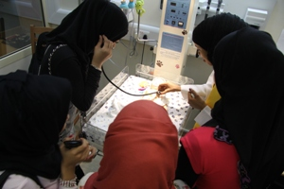
IEN #2
Education system is really different
It was really, really different. I really had to start all over again
We pretty much rote learned, books after books, and then write an exam…so very less assignments, no APA referencing
My best advice is forget what you did, just clean your slate and start from one, because that was my problem…

Slide 19
Proposed strategies/interventions to improve language proficiency outcomes for NESB Nursing Students
Advocate for increased/discipline-specific language training before program entry
Post Entry Language Assessments
Embedded language/cultural activities in curriculum
Additional language training/support during program – Mandatory? Intensive?
Better collaboration between faculty and language specialists
Increase understanding of academic staff of challenges for NESB students and useful strategies

Slide 20

Questions?? Always remember…

