Slide 1
Session 3: Finding the fit – the role of government and not-for-profit organisations
A/Prof Ben Lyons
Director, Rural Economies Centre of Excellence

Slide 2
Economic tools innovation value Chains policy translation
/
/
/

Slide 3
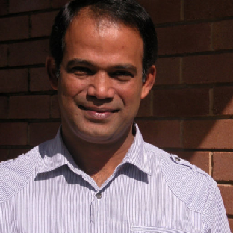
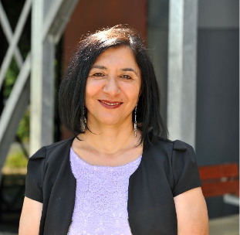
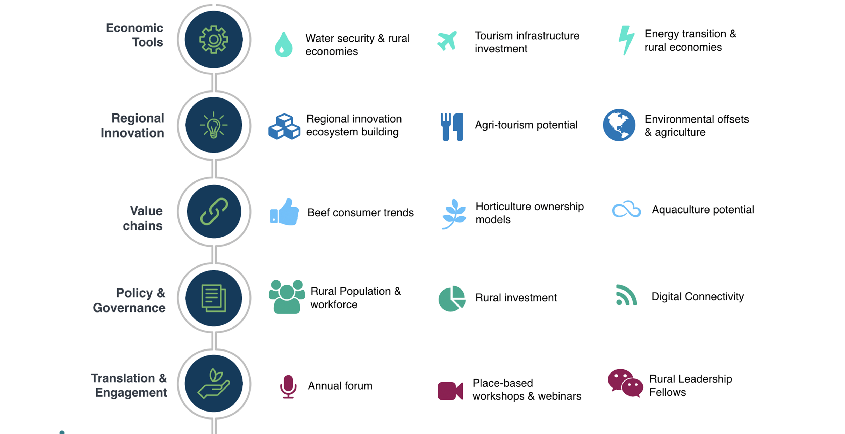
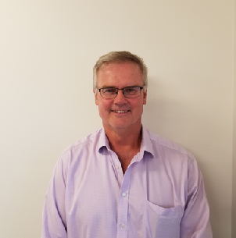
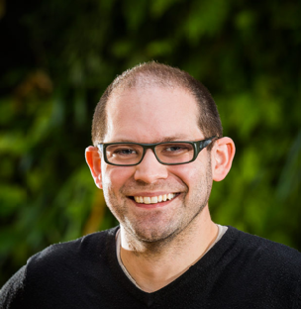
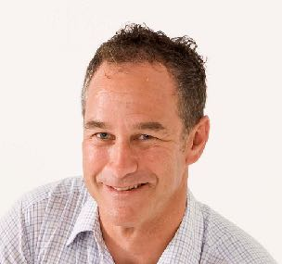
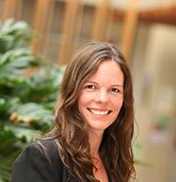
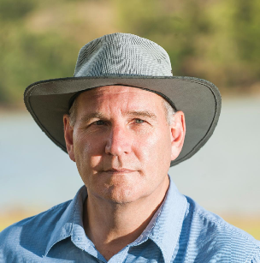
RECoE expertise & capability
A diverse, focussed collaboration

Slide 4
Session 3: Finding the fit – the roles of regional economic development within land management
Sed ut perspiciatis unde omnis iste natus error sit voluptatem accu quae ab illo inventore veritatis et quasi architecto beatae vitae dicta sunt explicabo. santium doloremque laudantium, totam rem aperiam, eaque ipsa quae ab illo inventore veritatis et quasi architecto beatae vitae dicta sunt explicabo.
Findings from a few RECoE projects in this space
Local government response case study
Role of government/NGOs

Slide 5
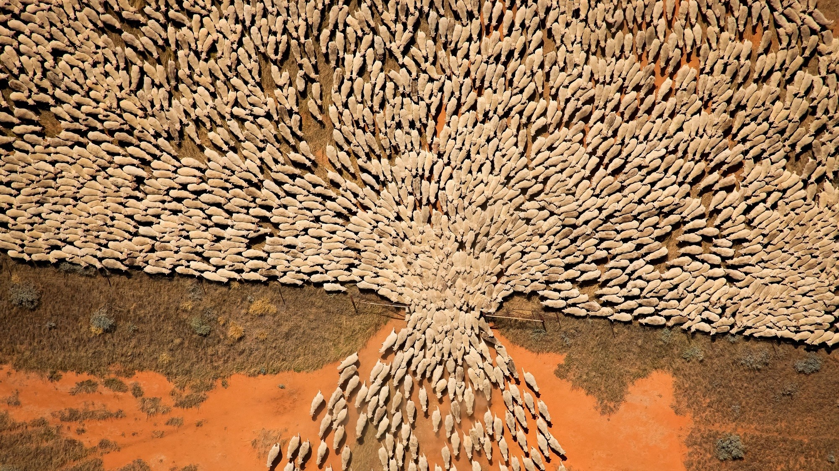

Slide 6
Our Research
QLD’s beef value chains
Will concerns over credence factors (health, animal welfare, environment) affect future consumer demands for meat in Aust.?
Australia-wide consumer demand study on importance of credence factors
Test for impact of COVID on meat consumption
Estimates of future consumption trends for beef, chicken, pork and lamb

Slide 7
Regional innovation – environmental offsets
Granite belt region. Adoption and navigating the regulatory landscape in environmental offsets
Creative Image Slide
Beef value chains and credence
Beef consumers seem happy with quality
Strong demand for leaner meats (Health)
• Animal welfare important
• Little willingness to pay for lower CO2
• Hormone free important, organic less so
Summary of findings
Regional Drought Resilience Planning
Sed ut perspiciatis unde omnis iste natus error sit voluptatem. Sed ut perspiciatis unde omnis iste natus error sit voluptatem.
Drought Innovation Hubs, Drought Resilient Leaders. 14 QLD regions
Cluster fencing in Central Western Queensland
Local government versus state funding arrangements comparison: South West and Central West Queensland
7

Slide 8
Our Research
Quilpie Wellspring
Circular economy approach for community development. Every family needs a farmer…every farmer needs a regional town

Slide 9
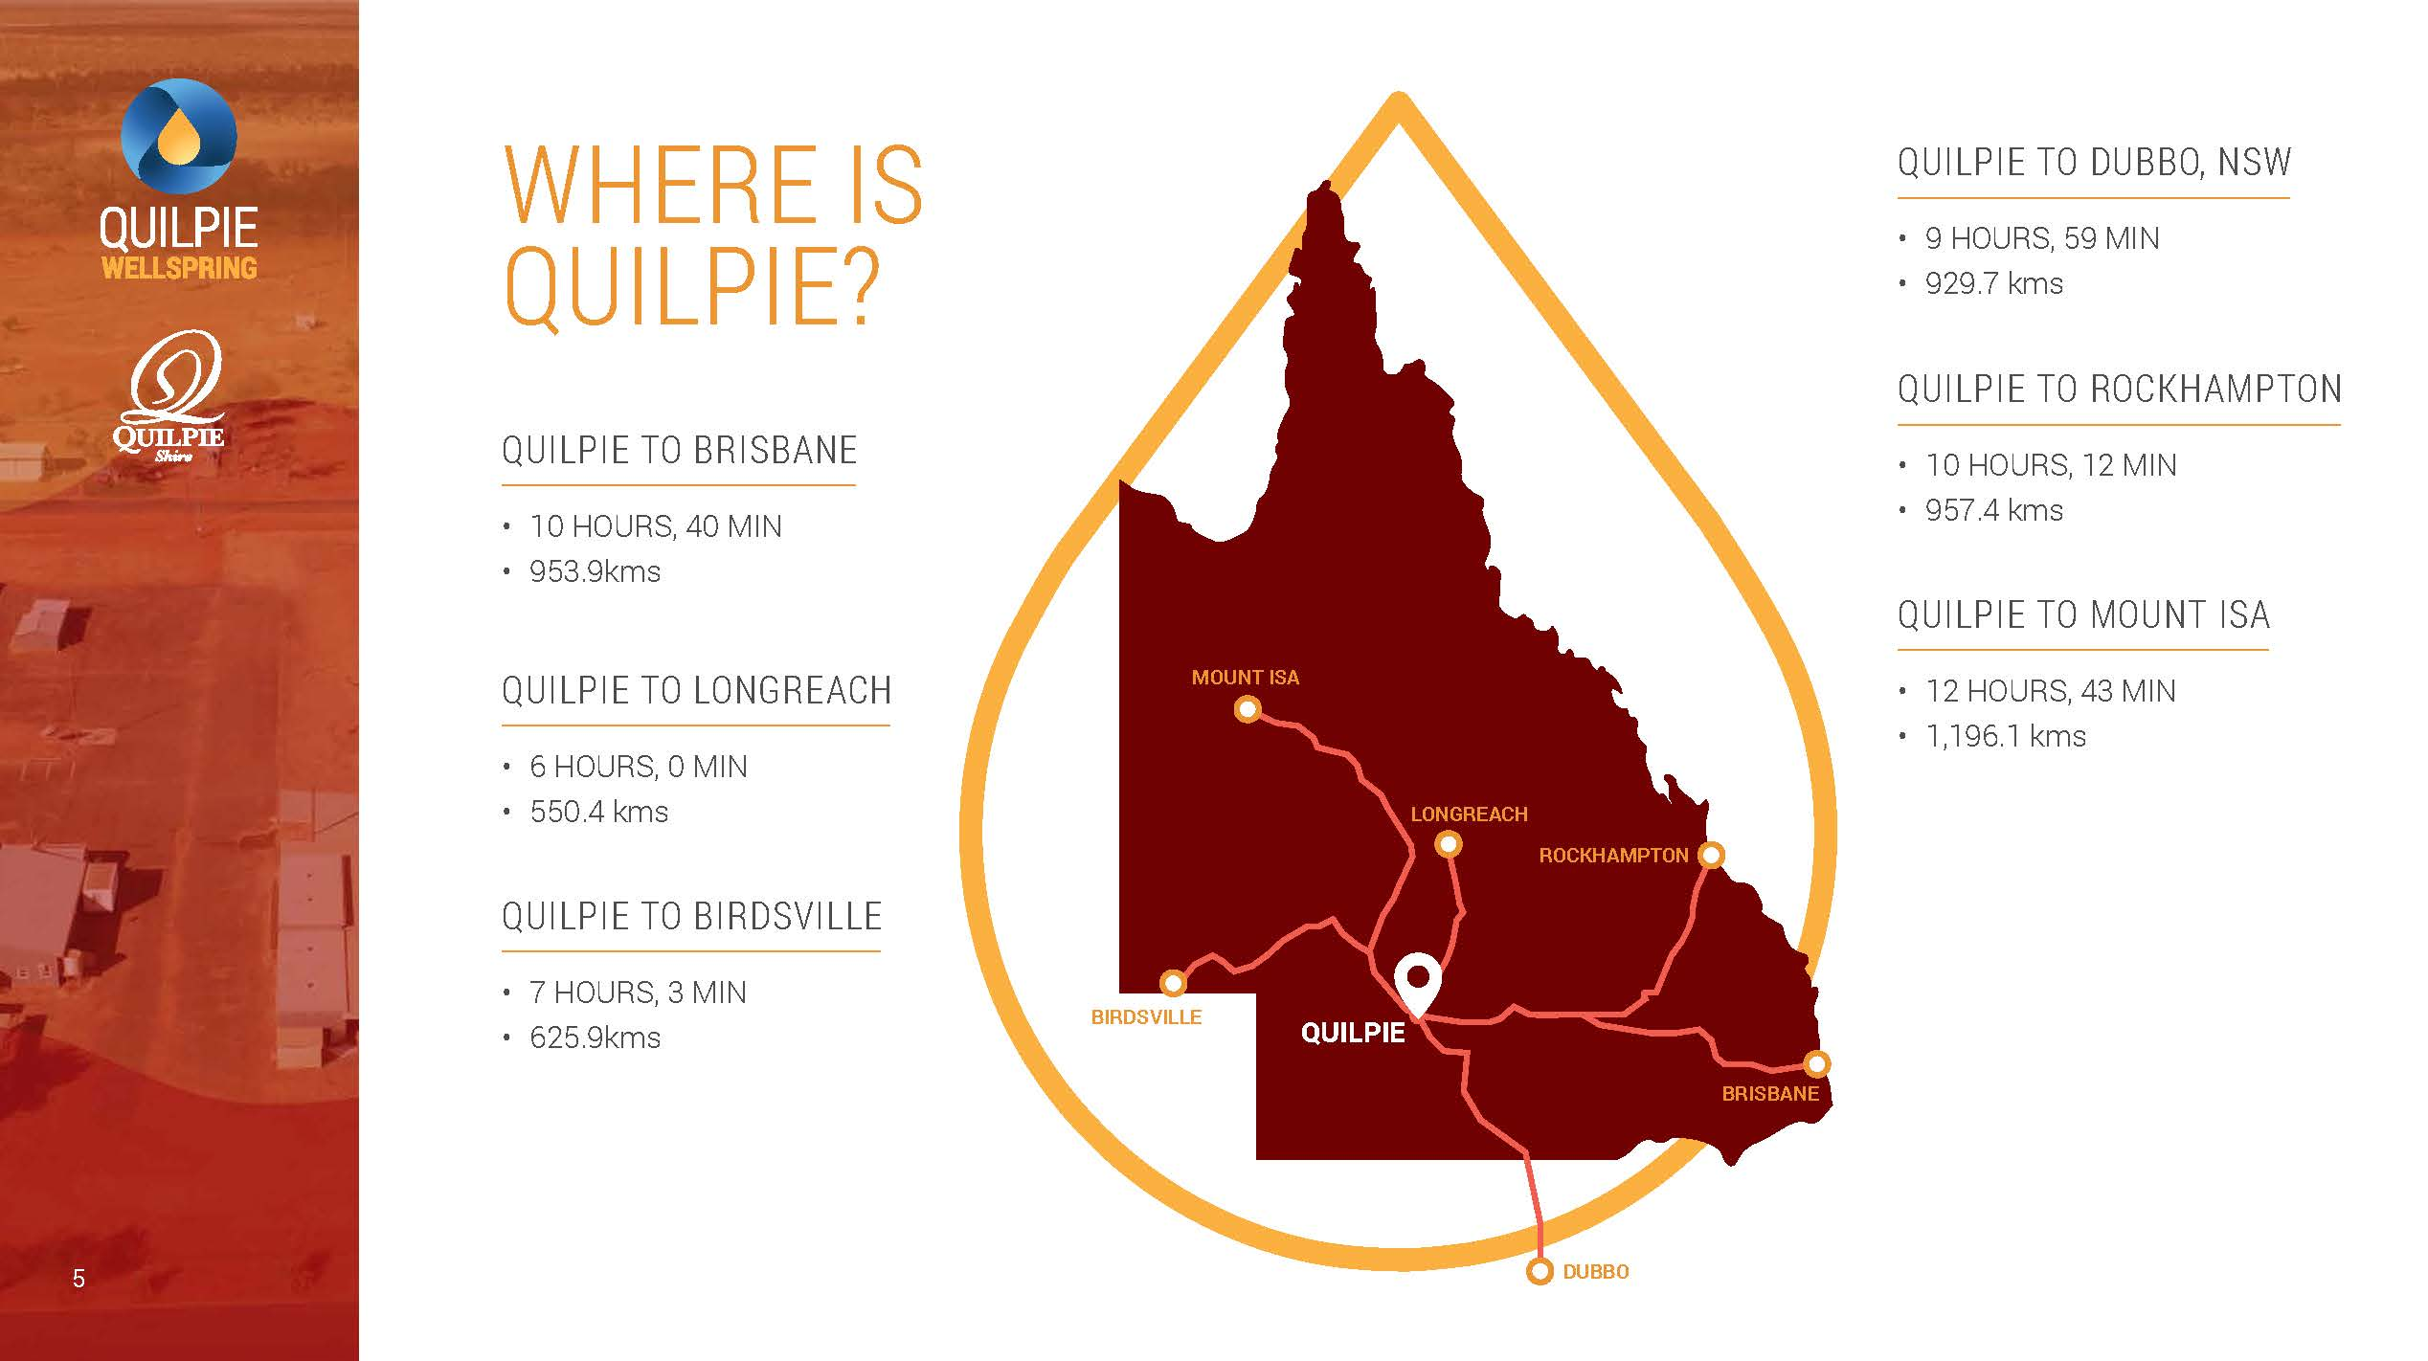

Slide 12
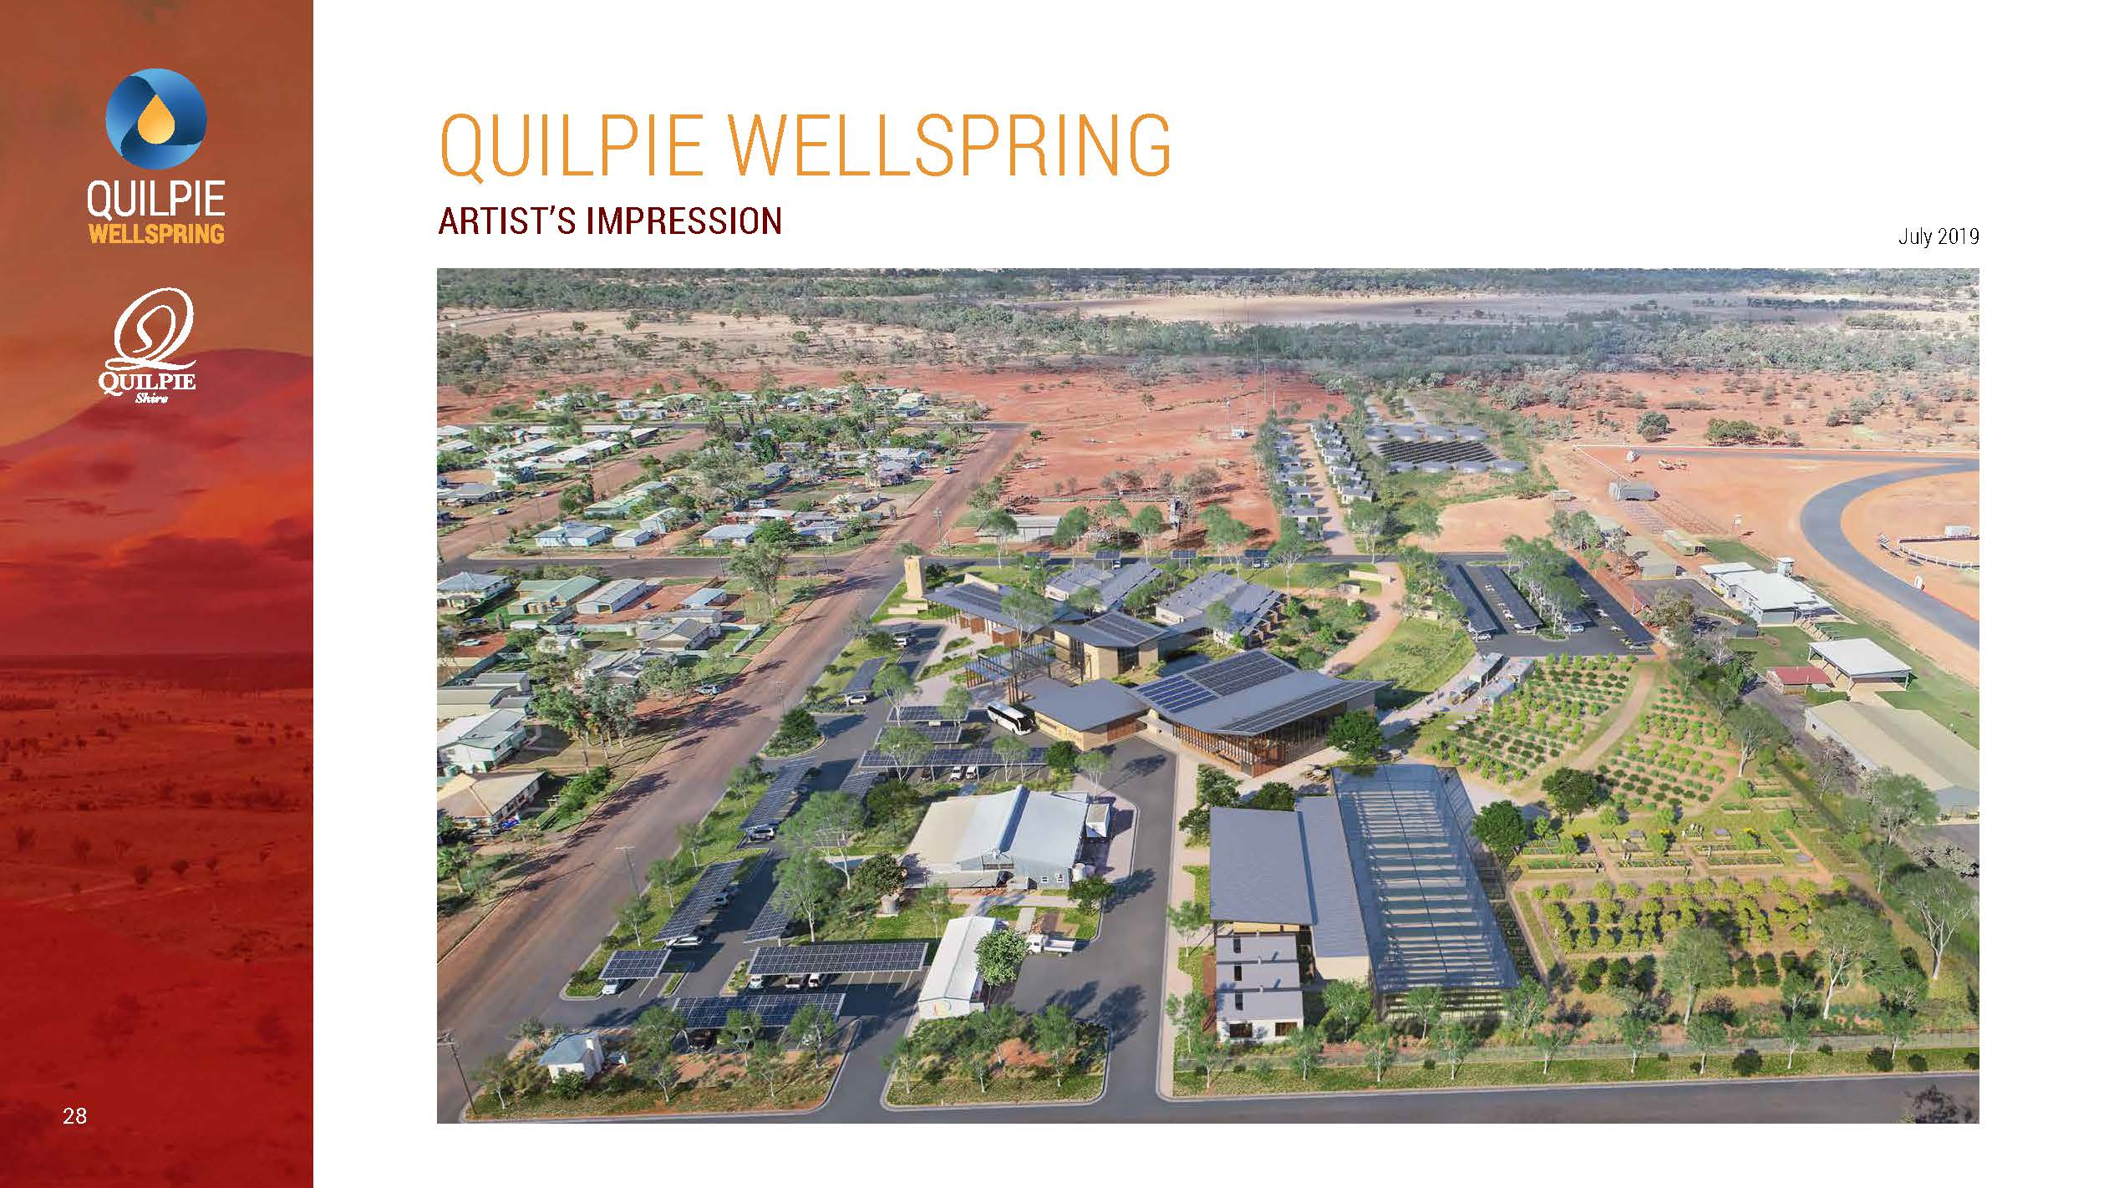

Slide 14
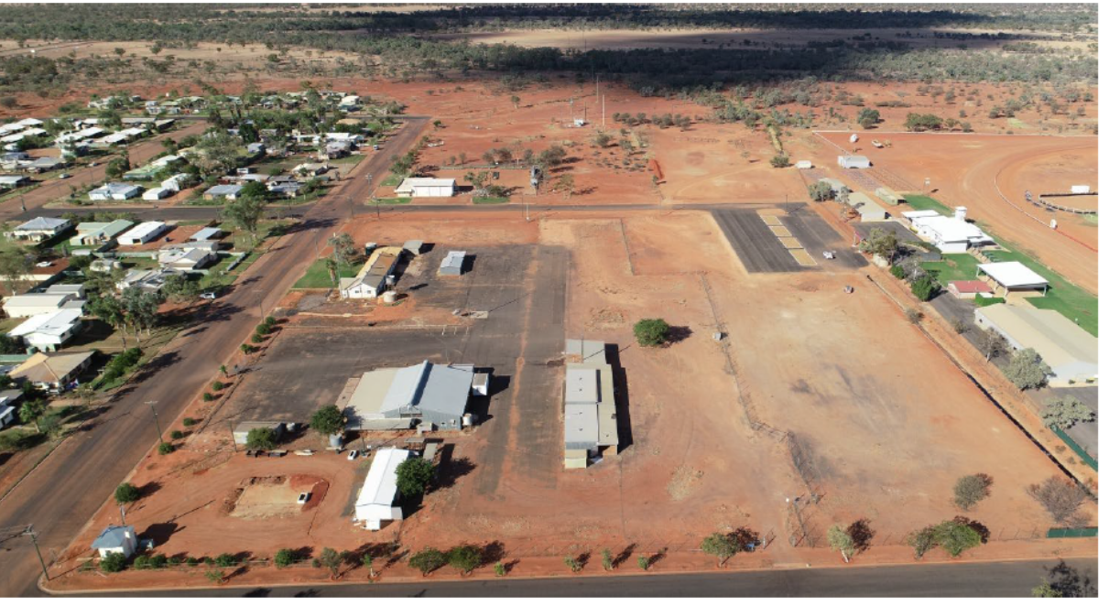
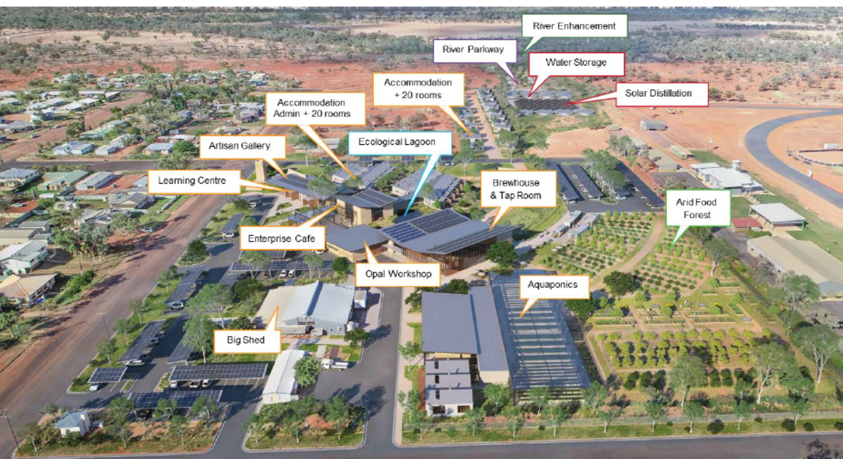
Quilpie Wellspring: a community resilience project

Slide 15
Sed ut perspiciatis unde omnis iste natus error sit voluptatem accusantium doloremque laudantium, totam rem aperiam, eaque ipsa quae ab illo inventore veritatis et quasi architecto beatae vitae dicta sunt ex voluptatem accusantium doloremque laudantium, totam rem aperiam, eaque ipsa quae ab illo inventore veritatis et quasi architecto beatae vitae plicabo.
vitae dicta
What is the role of government or NGOs?

Slide 16
Notes:
The role of government and NGOs – in encironmental offsets:
Market is “hot” 40% increase in carbon pricing __> means that a lot of projects are now “viable”
Supply and demand – needs a facilitator owing to complexity
ANU Stewardship project
Quilpie has 23 carbon projects according to regulator → impact on community
Can communities generate their won carbon or environmental credits?
What I a good carbon credit?

Slide 17
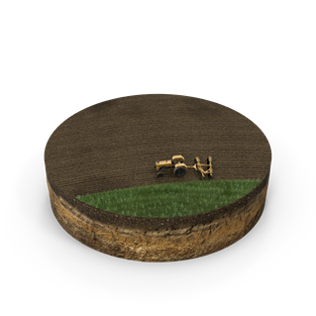
Our agricultural demand is largely international
Asian consumers are key to our future demand

Slide 18
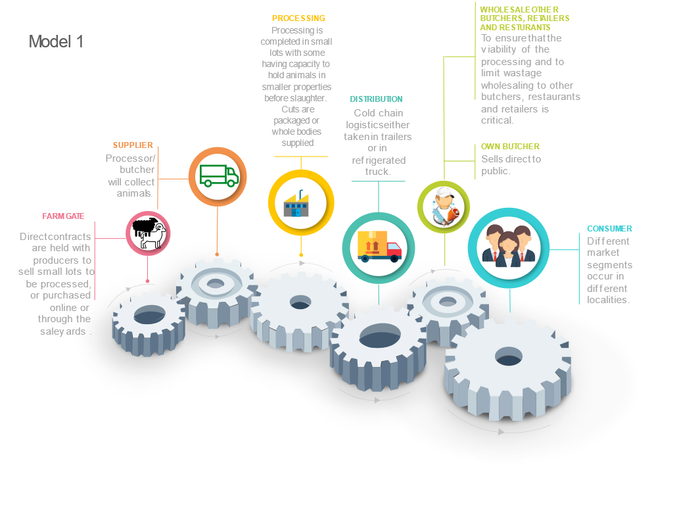
What is the role of government and NGOs? Summary
Complex collaboration (Federation policy structures, Neoliberalism vs Keynesian planning, reductionism, Adoption, regulation, market signals)
Definition of roles is important
What is a good carbon credit or environmental offset?
What is the consumer demand → production decisions (NRM) friction
Premiums are hard to quantify in a value chain for credence attributes
Image: Potential model for Sheep and Goat meat Supply chains in Queensland
Source: Star, Rolfe & Lyons (2021)

Slide 19
References

Slide 20
End
Ben.Lyons@usq.edu.au

