Slide 1
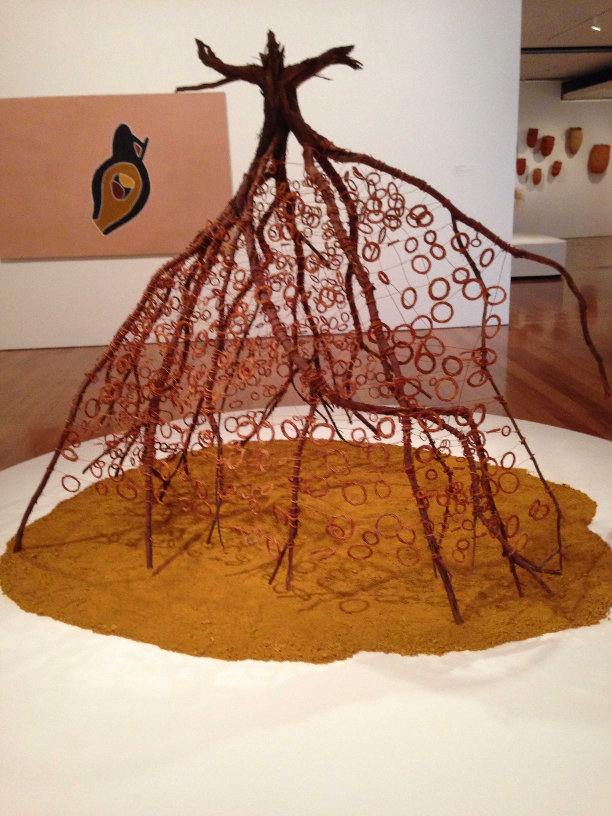
Aesthetics and Ethics Informing an Exhibition of Artworks by Indigenous Youth
Dr Janice K Jones
Senior Lecturer Arts Education
School of Linguistics, Adult and Specialist Education
Faculty of Business, Education, Law and the Arts
University of Southern Queensland (USQ)
With thanks to:
Whaddup! Indigenous Youth community, their families and Elders
Dr Lindy Abawi and student arts facilitators from USQ
Wingreeguu (2012) Spinifex on a base of ochre. By Shirley Macnamara Indilandji/Alyawarre people, QLD. Queensland Art Gallery.
Photograph, Janice Jones.

Slide 2
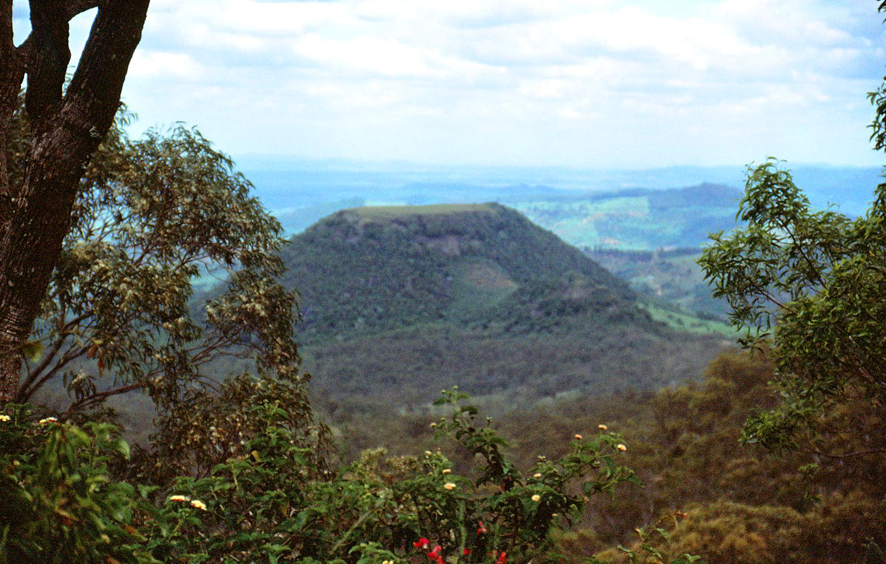
Acknowledgement of Country
I acknowledge the Gaibal, Jarowair, Ugarapul and Butchulla peoples of Queensland - traditional custodians of the lands where my teaching and research are conducted. I honour the wisdom of Elders past, present and future, seeking to walk together in the spirit of reconciliation.
Tabletop mountain view from picnic point, Toowoomba. Brian Ireland (Feb 10, 2017)
Notes:
Its fine I can hear you.

Slide 3
Positioning the Field: Indigenous Education
Colonial and genocidal history
10.6 years lower life expectancy for people of Indigenous backgrounds
X13 times higher imprisonment (2016)
University seen as ‘The Big House’ (Tuhiwai Smith, 2012)
How to build bridges to Higher Education?
Individual practitioners build trust
But mistrust of institutional power remains
This study: 2 years of relationship building
Notes:
For the Aboriginal and Torres Strait Islander population born in 2010–2012, life expectancy was estimated to be 10.6 years lower than that of the non-Indigenous population for males (69.1 years compared with 79.7) and 9.5 years for females (73.7 compared with 83.1). (Australian Institute of Health and Welfare) http://www.aihw.gov.au/deaths/life-expectancy/
Australian Bureau of Statistics: 4517.0 - Prisoners in Australia, 2016
Despite improving rates of school attendance and completion of young Indigenous Australians in 2014-15
“After adjusting for differences in the age structure of the two populations, Aboriginal and Torres Strait Islander people aged 15 years and over were less than half as likely as non-Indigenous people to have completed Year 12 or equivalent (rate ratio of 0.4) (Table 1).
http://www.abs.gov.au/ausstats/abs@.nsf/Lookup/by%20Subject/4714.0~2014-15~Main%20Features~Education~5

Slide 4
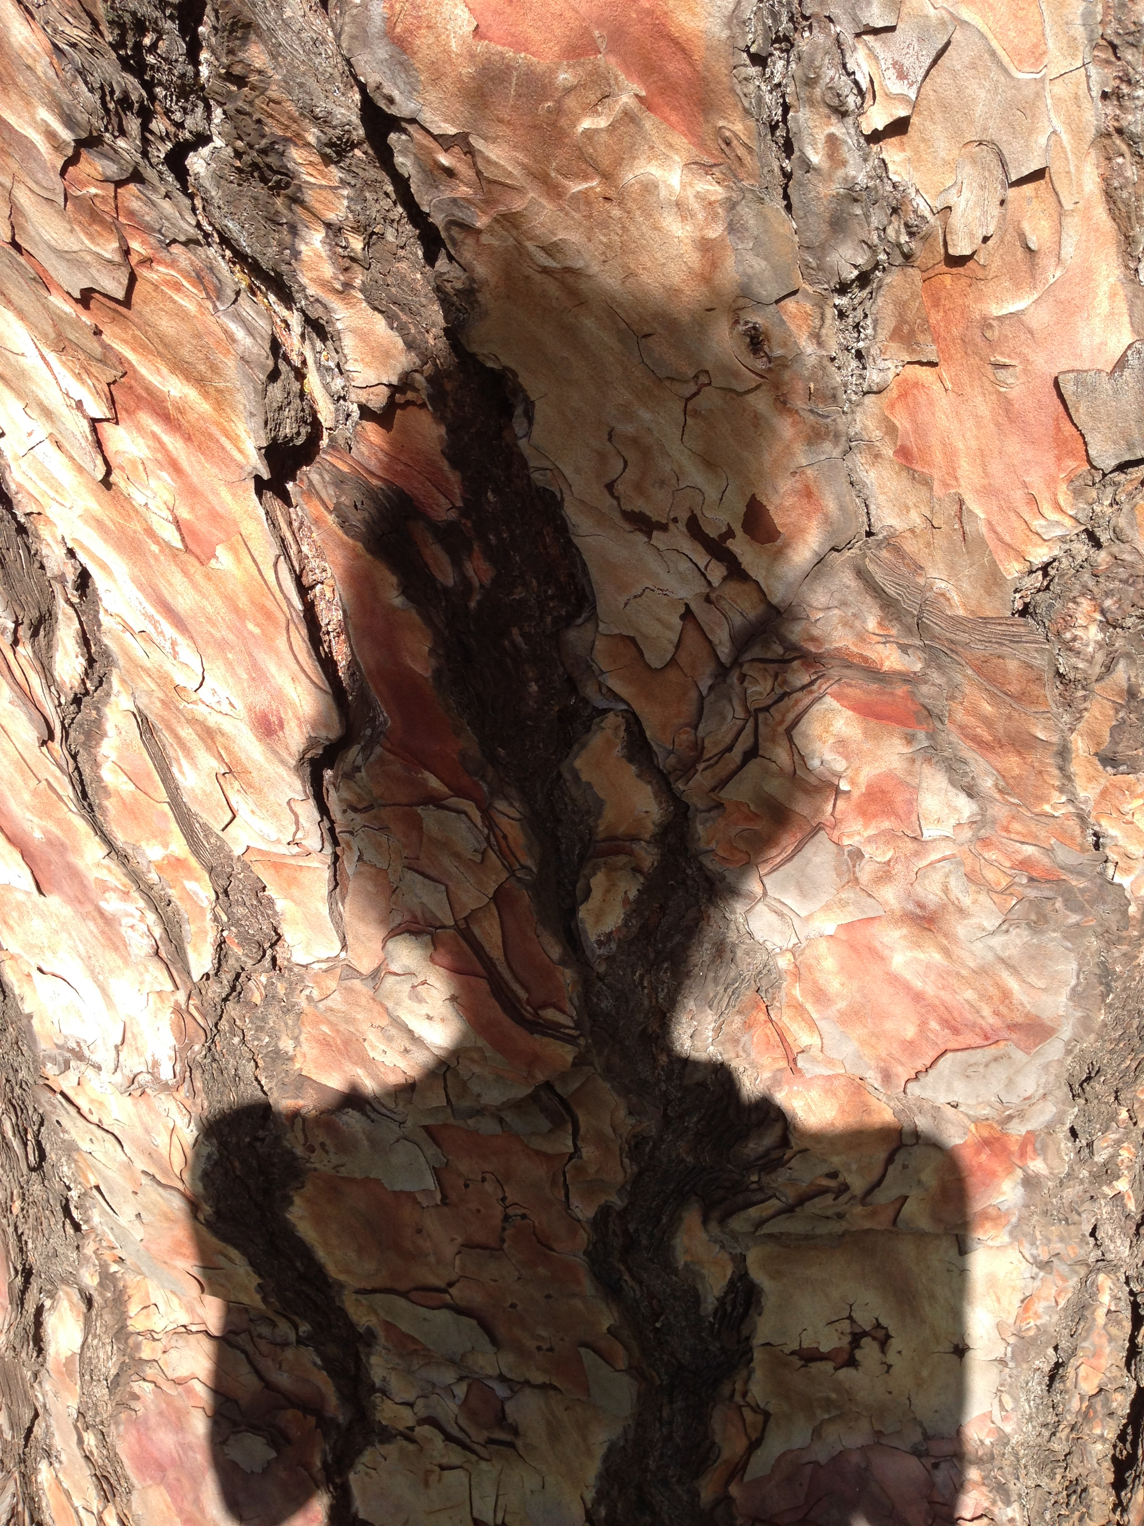
Self Positioning - Disruptor? Coloniser?
Intent: Not ‘doing research’ but shared learning with community
White
Educated
Middle class
Immigrant
Celtic diaspora
Teaching: Formal and informal – ‘Alternative’ education – Language and Arts Pedagogies
Practising Artist
Research: Culture, identity, Arts, Open Education, Social Justice

Slide 5
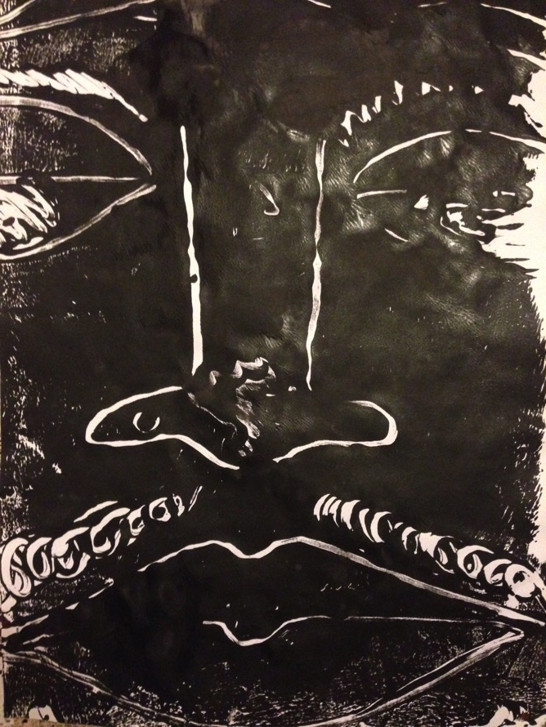
The Indigenous Youth Group
Friday nights: ‘Deadly’ focus: Pride in culture, family and community: sport, arts, healthy cooking, organised trips
Transport provided
Volunteer workers include Aboriginal and Torres Strait Islander youth leaders, PCYC, schools, parents, Elders
2 university lecturers (Jones and Abawi, 2015) with student volunteers
Untitled: Ty Suey 2015
Acrylic monoprint 420x590mm:
Notes:
PCYC – Police-Citizens Youth Club.
Entangled, emergent, emboldened: an indigenous youth arts group and non-indigenous arts and literacies facilitators talk back to the ‘Big House'(University)JK Jones, LA Abawi
Proceedings of the 2015 Annual International Literacy Conference

Slide 6
Facing – one another, ourselves, outwards
Working together in preparation for an ‘outward facing’ exhibition presents challenges for ethical and respectful practice, but also offers huge opportunities for personal and cultural understandings
Providing arts workshops, became a service learning experience for academics and student volunteers as their partnership with community members demanded ‘facing others together’ through
Collaborating and problem solving on the exhibition
This brought deep ‘inward facing’ reflection (Bartleet, Sunderland, and Carfoot, 2016)

Slide 7
An Augmented Reality Art Exhibition?
60 Young artists aged 4 - 17 create art works, music, dances and use iPads to capture stories - dreams for the future. Celebrating the voices of young people of Indigenous heritage
Relationship building
30 artists agreed to exhibit 45 works in the Regional Art Gallery
8 works had Augmented Reality overlays (viewed through Aurasma App) allowed film to play

Slide 8
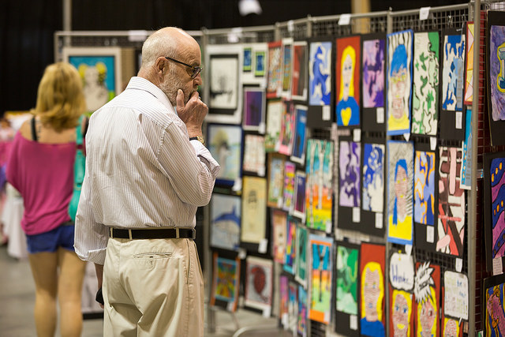
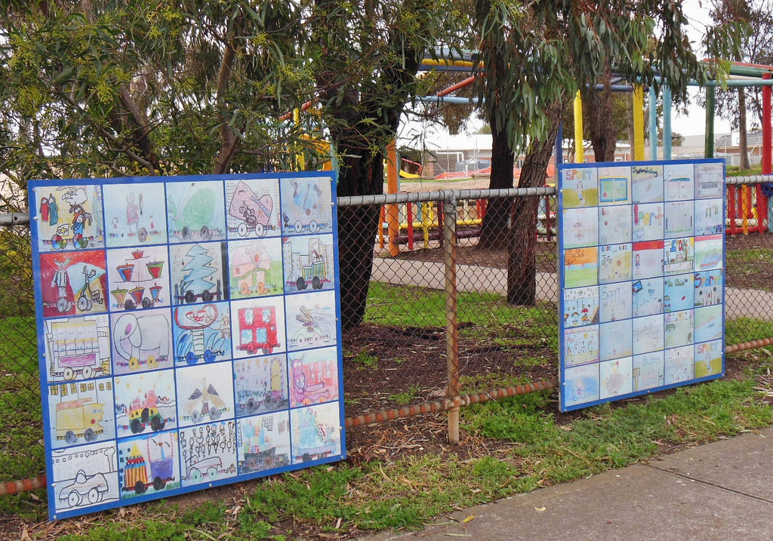
Aesthetics? Mounting an Art Exhibition
North Charleston USA, Arts Festival Premiere Weekend (April 30th 2016)
photo by Ryan Johnson Flickr CC by SA License
Adelaide, Australia Kids art work on display (Aug 27 2012)
photo by Michael Coghlan Flickr CC by SA License
Notes:
As

Slide 9
Colourful Card Mounts for Display?
Before
After

Slide 10
Making works ‘stand out’…
Before
After

Slide 11
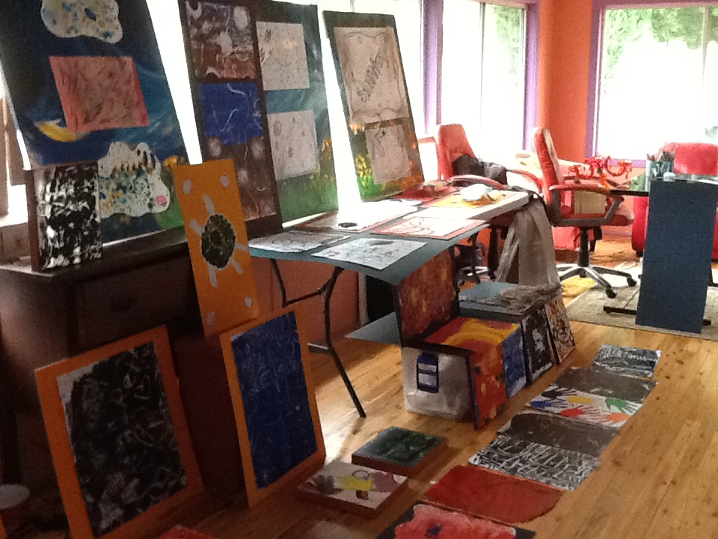
Background supports…
Colours of the Aboriginal Flag: Black, Yellow, Red

Slide 12
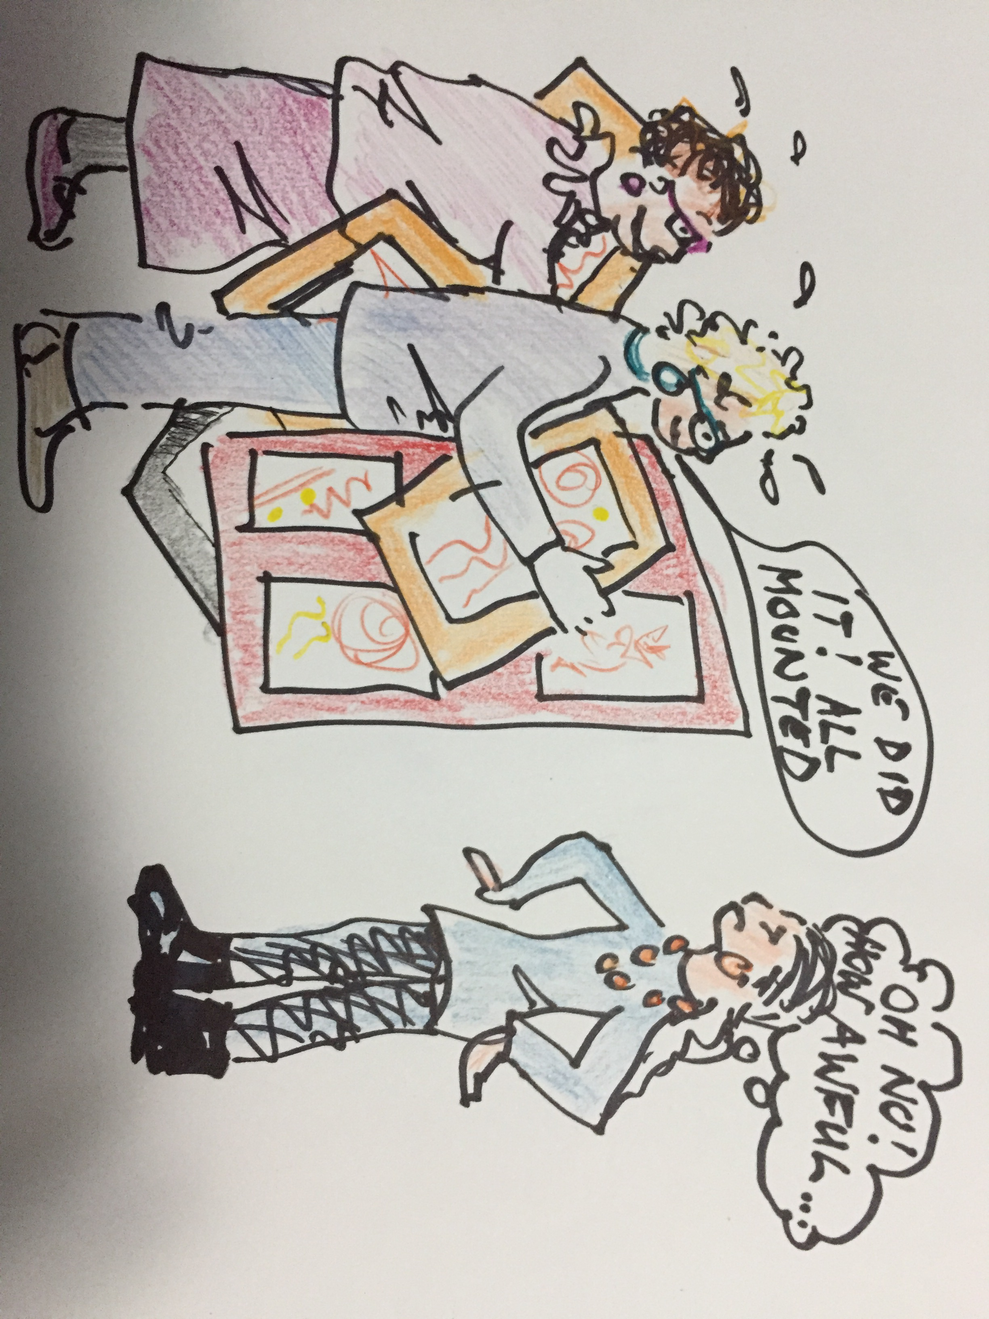
Aesthetics of display

Slide 13
Discourses of power revealed
We wanted to show the strengths and abilities of young Indigenous people.
In ‘school’ exhibitions do teachers select and ‘re-frame’ a child’s work to better reveal the quality and voice of the artist – or that of the institution?
Our assumptions about what ‘looks like an art exhibition’ mirrored the unexamined processes by which adults colonise children’s life-world and works
Stripping away our hard work in mounting the art works was uncomfortable and educative. It revealed how colonising thought is enacted through presentation juxtaposition and labelling of original works.

Slide 14
We removed colourful card mounts in preference for the unadjusted originals – smudge marks, torn edges, and all
Works were placed at child height in the gallery
The variety and range of works challenged concepts of ‘aesthetic’ display running counter to the ‘prettification’ of children’s work
No ‘labels’ were placed next to works. Instead, numbers and titles were listed in a catalogue – and an artists’ statement was crafted and agreed by the community

Slide 15
Let the children’s work speak…

Slide 16
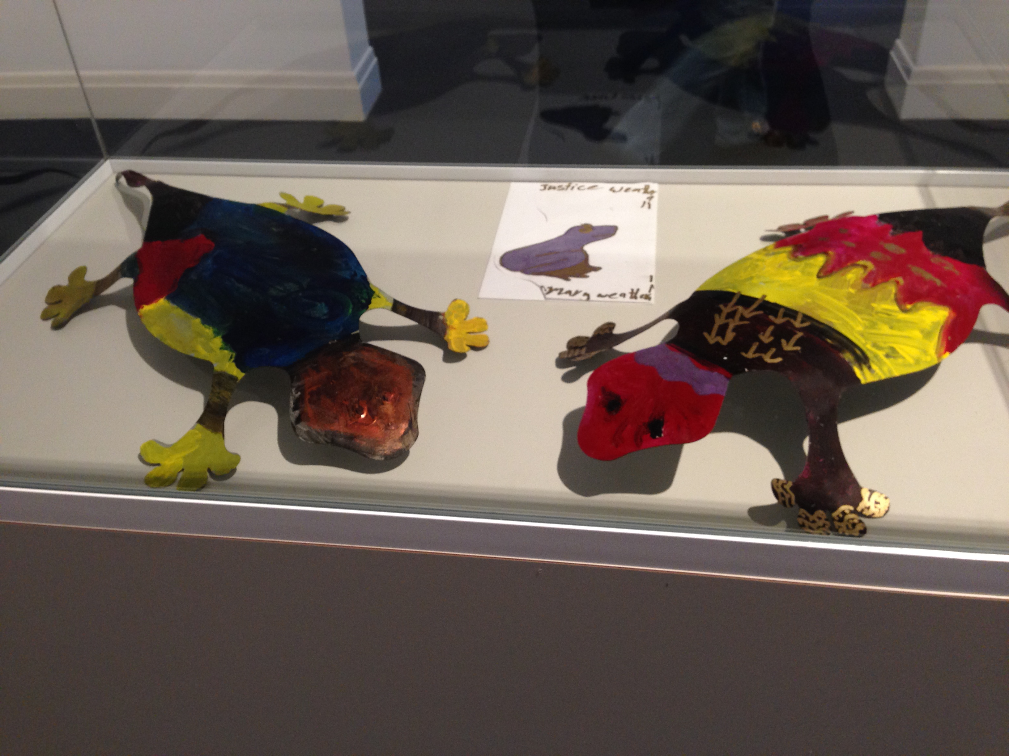
Yeah…but I wanted red earth…(would that ruin the cabinet?)
Our colours and shapes show up well this way….

Slide 17
Even greater complexity in editing films
The augmented reality films played over artworks presented even greater issues for balancing aesthetics and ethics.
Scenes were captured in informal settings – young people dancing as a group, speaking seriously (and gently mocking one another) about their imagined futures
The most compelling films were those with minimal editing, and approved by the children.
I want to counsel people
I’m going to go to TAFE and University
We’re cleaning up our town
I’m going to be a police, a teacher or a nurse…

Slide 18
Learning from community
Over 5 months the arts engagement developed into planning and launch of a NAIDOC week exhibition and celebration
A delicate dance between the formal processes and deadlines of the ‘Big House’ – (planning, advertising and launching), and the complex and nuanced webs of communications between families. The logistics and protocols did not always sit comfortably.
As artists and educators we as facilitiators became deeply aware of the power relationships, colonising thought patterns, discourses and practices. Art can indeed transform lives!

Slide 19
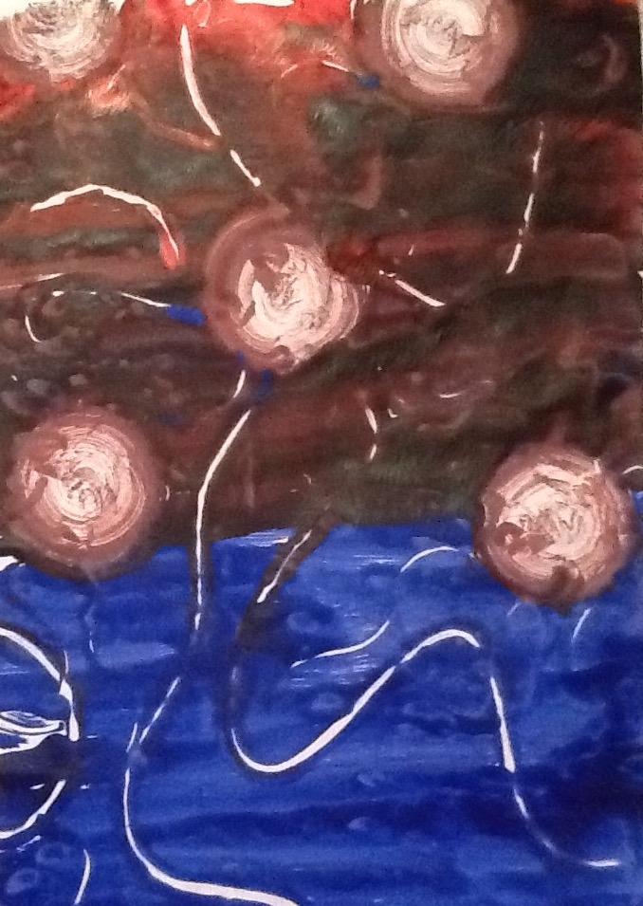
Untitled: Jada Dennison 2015
Acrylic monoprint 297x420

Slide 20
References
Bartleet, B-L., Sunderland, N., Carfoot, G.(2016) Enhancing intercultural engagement through service learning and music making with Indigenous communities in Australia. Research Studies in Music Education. Vol 38, Issue 2, pp. 173 - 191
Jones, J.K. (2015). The Big House closing the gap:dreams and dissonant discourses. International Conference on Deep Languages Education Policy and Practices University of Southern Queensland, Australia.
Jones, J. K. & Abawi, Lindy-Anne (2015, 26-27 June) Entangled, emergent, emboldened: an indigenous youth arts group and non-indigenous arts and literacies facilitators talk back to the ‘Big House' (University). In: 2015 Annual International Literacy Conference: Resisting the Standard: Language, Literacy & Power, 26-27 June 2015, Sheffield, UK.
Tuhiwai Smith, L. (2012). Decolonizing Methodologies: Research and Indigenous Peoples. Zed Books.

