Slide 1

Smith Family Performance 2024
Play / Drama / Theatre
Alexandra Lawson (UniSQ) and Travis Dowling (UniSQ)
2024

Slide 2
The Smith Family Performance was a socially engaged theatre project I co-developed and co-led, focused on identity, confidence building, belonging and place. Curated by Alexandra Lawson and Directed by Travis Dowling the performance designed a series of dialogic, performance-based workshops culminating in a performance where participants became makers, storytellers, and performers. This outcome contributes to community-engaged performance by offering a relational model for theatre-making grounded in collaboration, social context, and access to university.
Primary researchers: Alexandra Lawson, Travis Dowling
Other Involved parties/persons: Smith Family Organisation

Slide 3
RESEARCH STATEMENT – Smith Family Performance (Theatre / Drama)
Background: The Smith Family Performance (2024) was developed at the intersection of social practice, community theatre, and curatorial approaches, exploring how theatre-based, site-responsive workshops can result in a performance and function as both creative outcomes and pathways to higher education. Informed by Claire Doherty’s concept of the “event-based” curatorial model and Shannon Jackson’s framing of the “social turn” in performance (2011), this project examines how participatory theatre-making can foster agency, belonging, and collaborative authorship—particularly among young people from low socioeconomic, regional backgrounds. The key research question asks: how can curating theatre work and developing a performance outcome become a socially embedded practice that cultivates creative expression, belonging and access to university?
Contribution: The Smith Family Performance was a socially engaged theatre project I co-developed and co-led, focused on identity, confidence building, belonging and place. As co- facilitator and co-curator, I designed a series of dialogic, performance-based workshops culminating in a performance where participants became makers, storytellers, and performers. This outcome contributes to community-engaged performance by offering a relational model for theatre-making grounded in collaboration, social context, and access to university.
Significance: Commissioned and competitively funded by The Smith Family and the University of Southern Queensland, the performance outcome was delivered in UniSQ’s theatres in collaboration with teaching artist Travis Dowling. The work has informed UniSQ’s outreach and engagement strategies and its impact is evidenced by testimonials from students articulating they intend to enrol into the university’s theatre program, demonstrating the project’s cultural and educational significance within socially engaged theatre and access-focused creative practice located within a university.

Slide 4
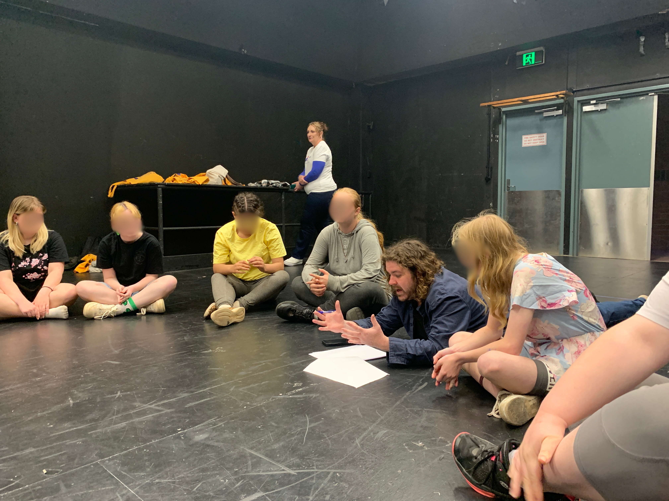
Travis Dowling Directing Smith Family Participants

Slide 5
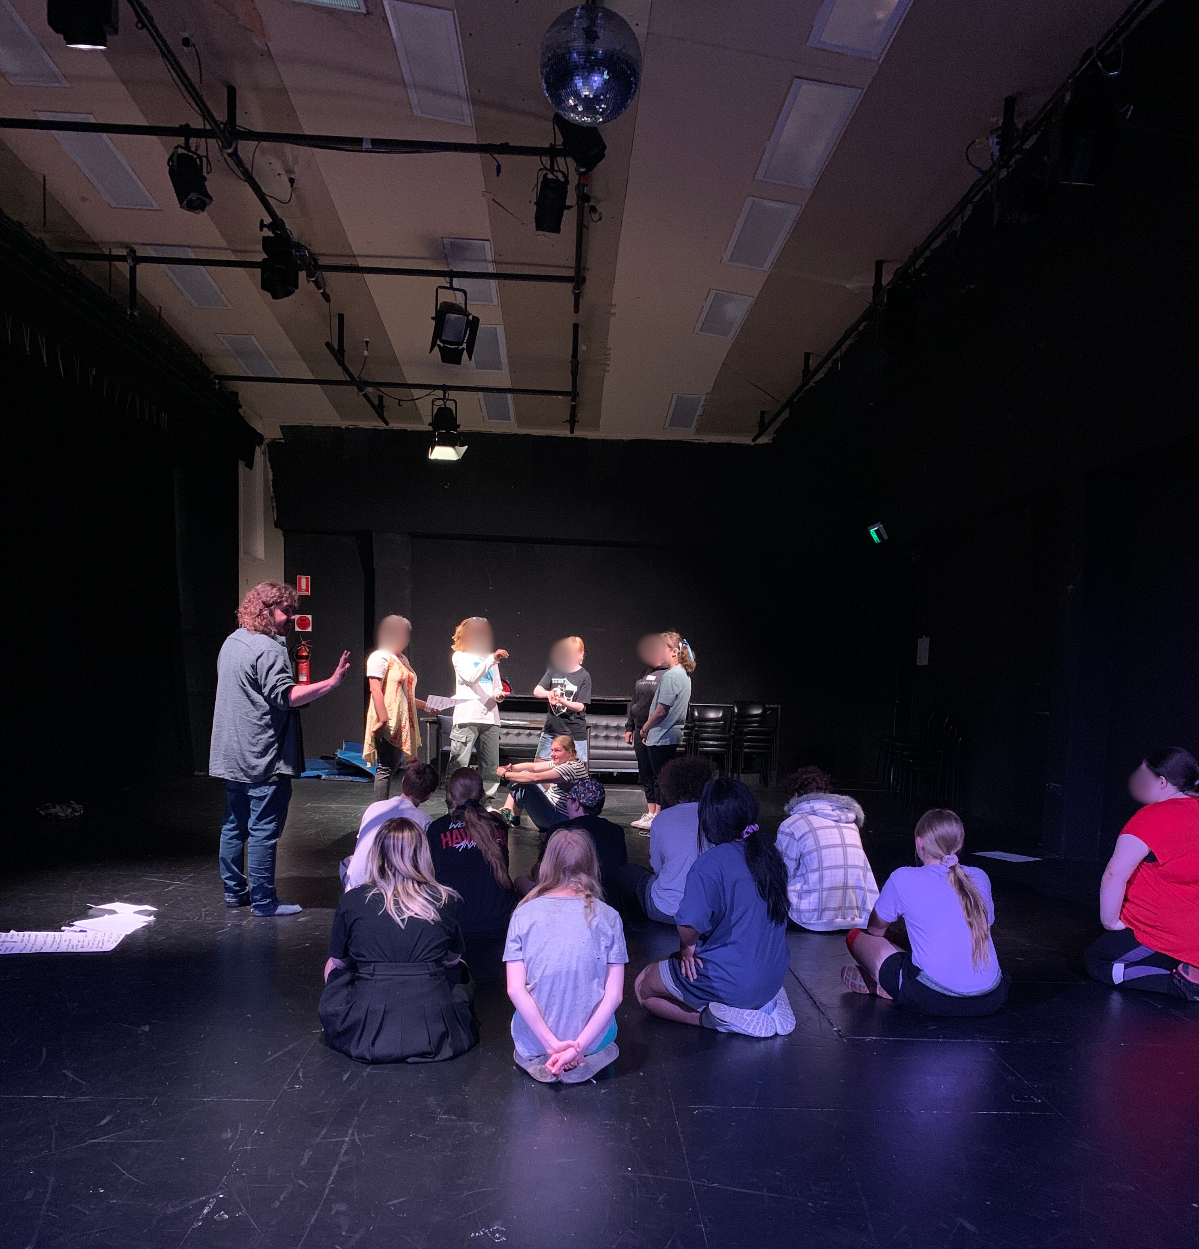
Travis Dowling Directing Smith Family Participants

Slide 6
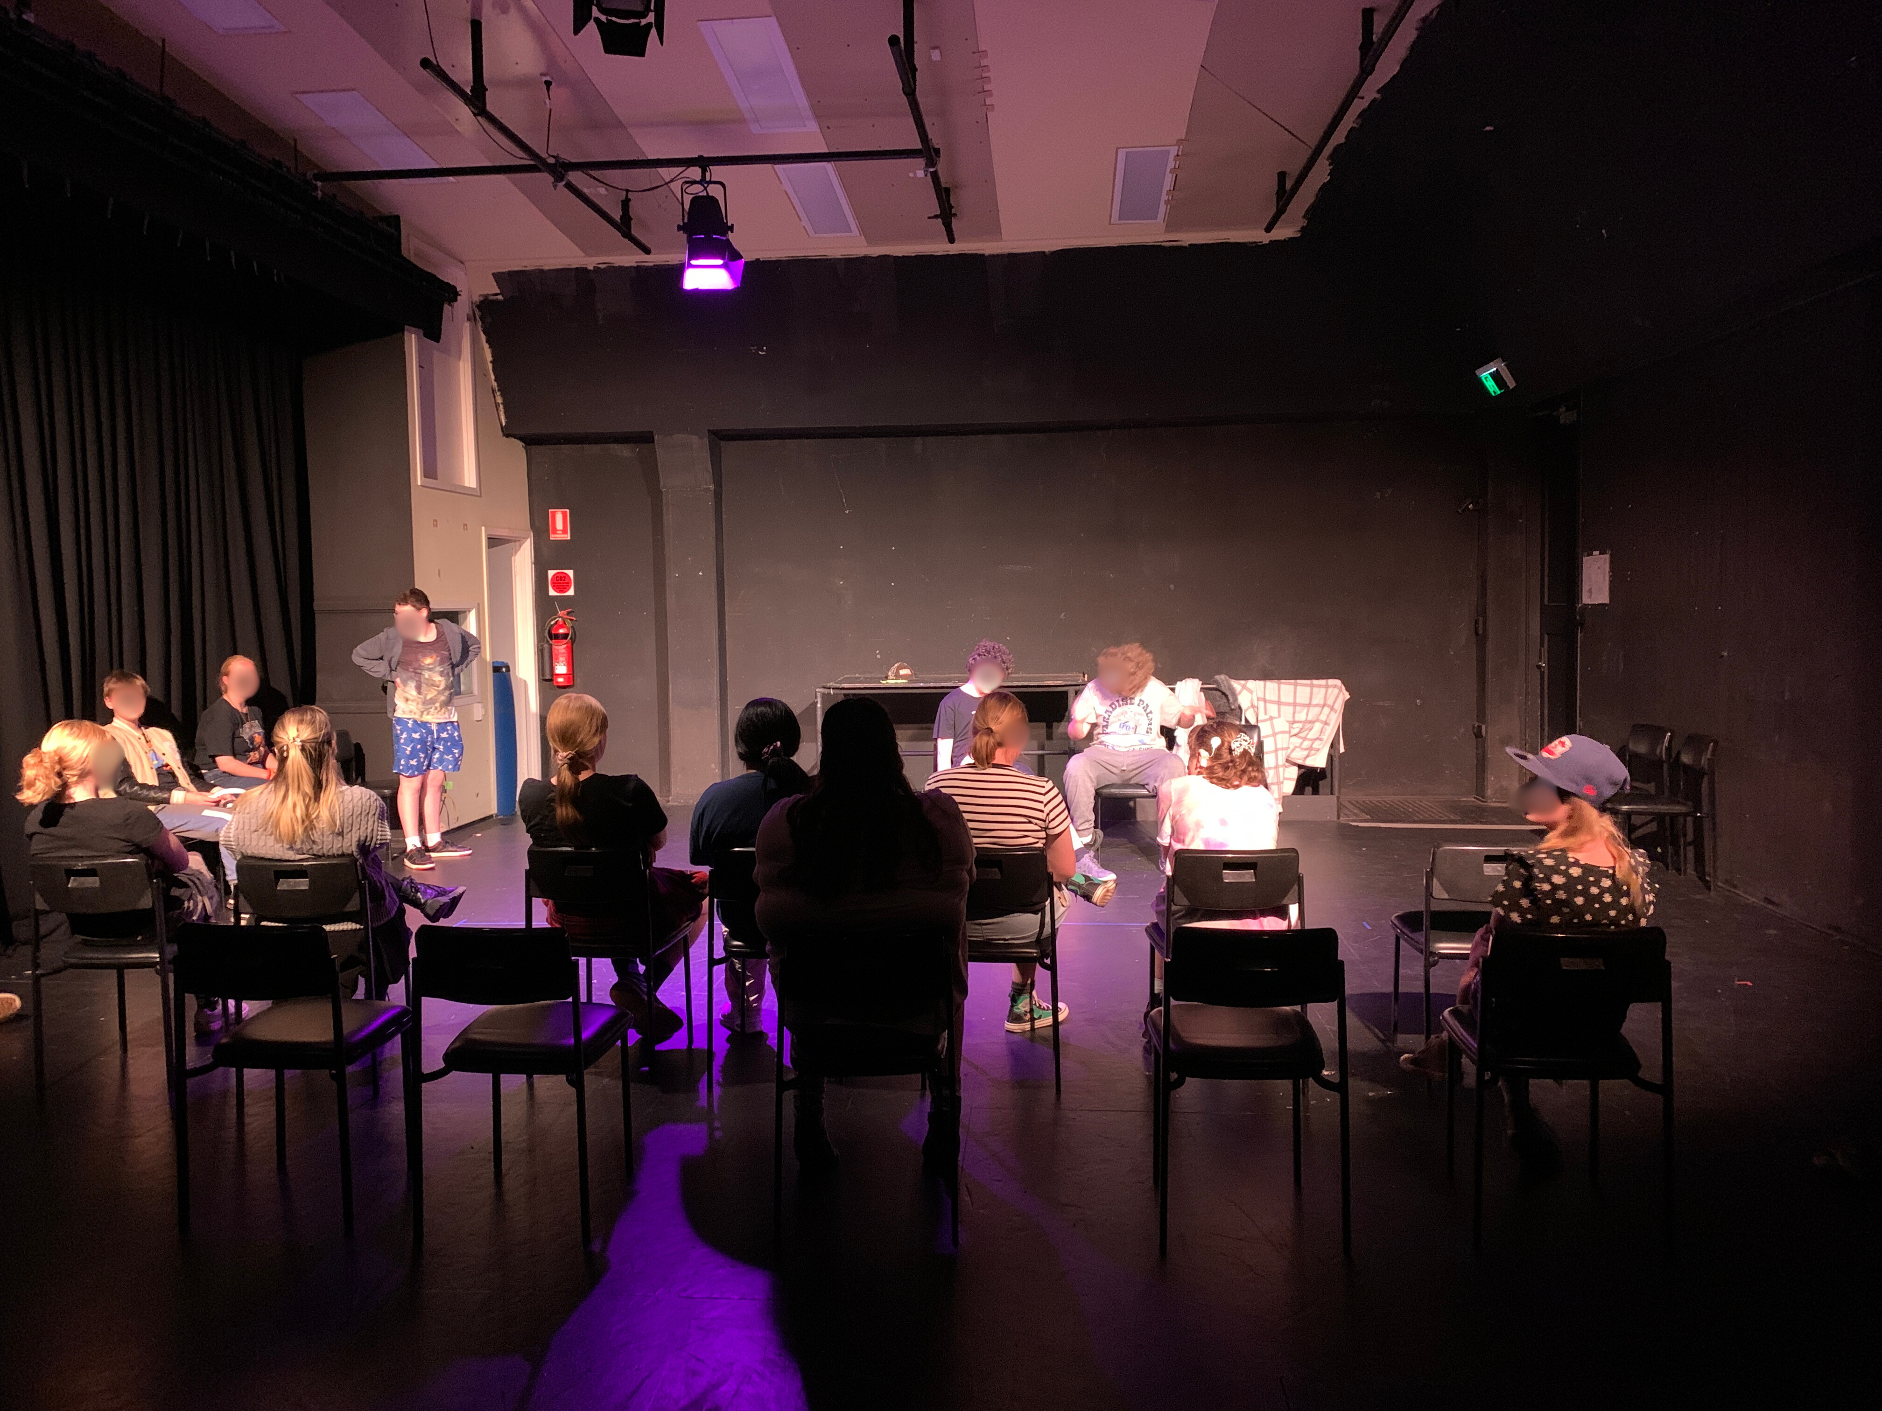
Performance Outcome for Smith Family Participants (closed performance due to Child Safety concerns)

Slide 7
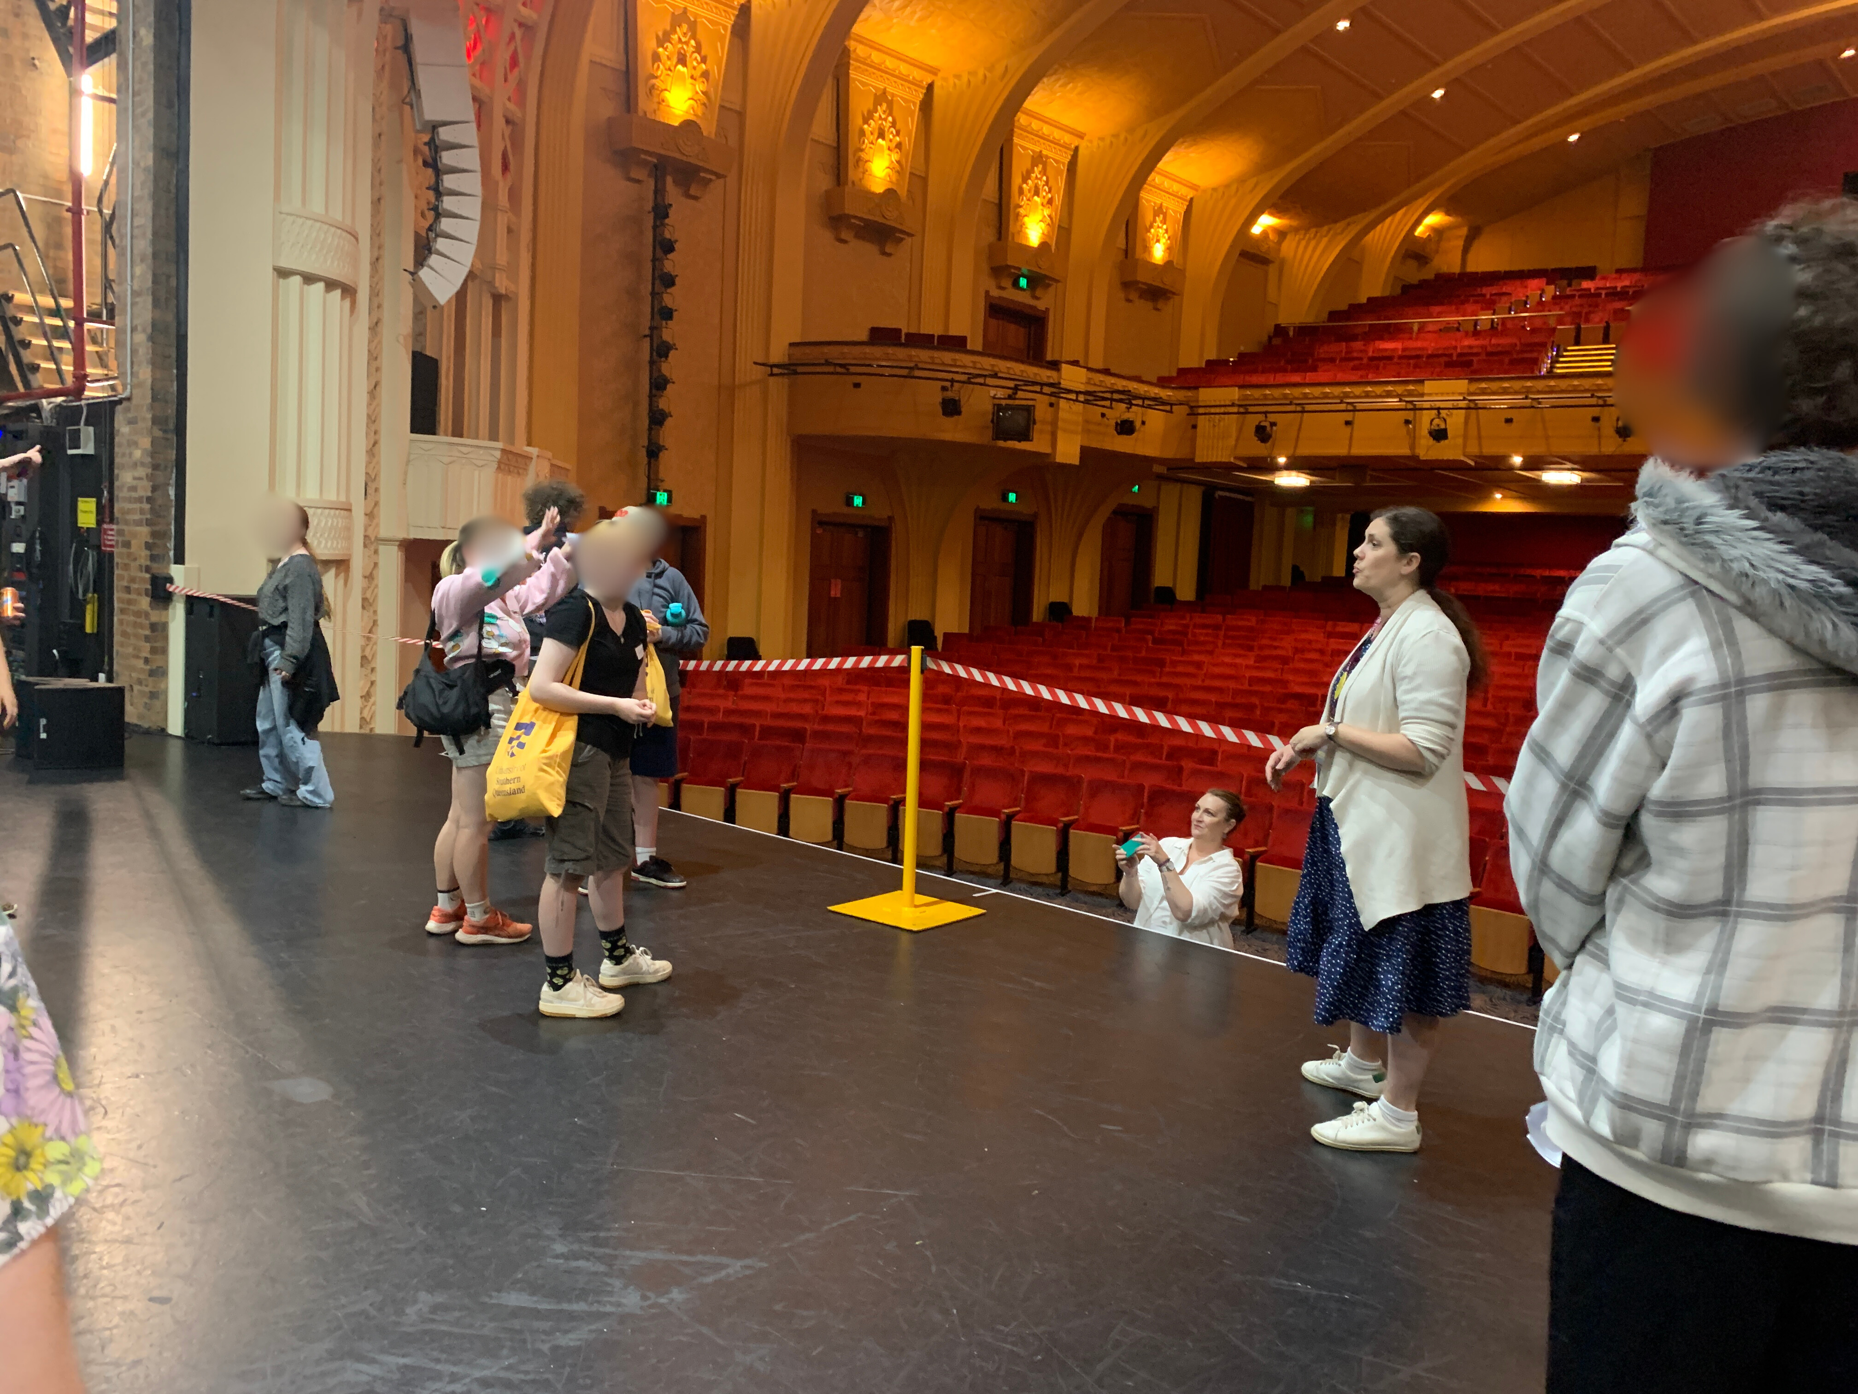
Tour of the Empire Theatre as a component of the Smith Family Workshops prior to the performance.

