Slide 1
Creating connections and building belonging: Using scholarship to create more than “just another online library class.”
Rowena McGregor, Liaison Librarian | Kate Derrington, Learning Advisor.
Image source: https://pixabay.com/photos/t-for-two-together-partnership-1723941/
Notes:
https://pixabay.com/photos/t-for-two-together-partnership-1723941/

Slide 2
Online learning provides both an opportunity and a threat for traditionally underrepresented cohorts.
Online students more at risk of attrition and can feel under valued - “second class citizens” and invisible.
The HE sector is familiar with importance of “belonging” & concepts such as “transition pedagogy” however what do these look like for online students?
How do we as library staff support students when we are not embedded in core course teaching teams across a semester?

Slide 3
USQ context
75% online
Mature age
CALD
Low SES
First in Family
Existing support
The gap
The pilot strategy.
National Guidelines for Improving Student Outcomes in Online
Learning (Stone, 2016) - selected principles.
USQ Library, Ipswich campus
Photo by USQ Photography

Slide 4
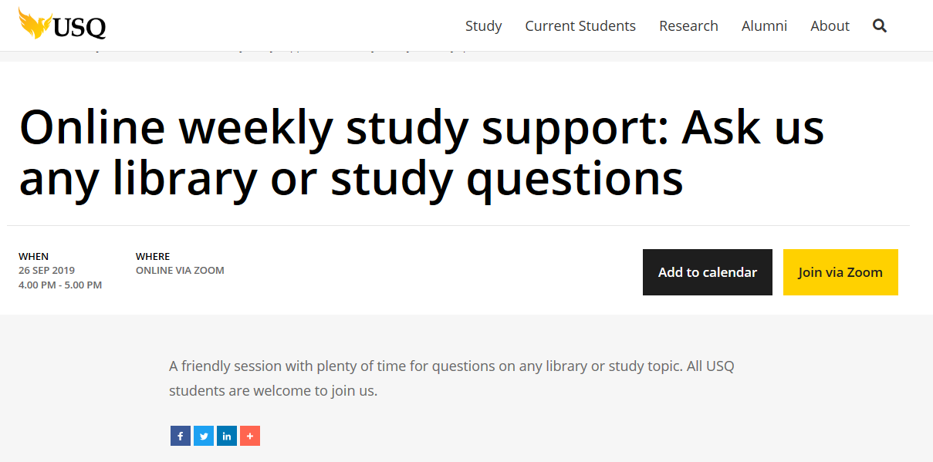
Another database please!
got u
👌
Im doing civil engg
studying Business Commerce - literally just started
You've helped me Rowena, thank you
… my concern is where I can seek help from apart of lecturer and tutor?
Human services
can do 🙂 thank you
hey!
👍 makes sense so far, but may I ask for a copy of the resources/links in the slides?
I'm a nursing student:)
business
thankyou
Can you repeat the folder and email again please?
Thanks Kate and Rowena!
Notes:
Rowena 5 minutes: What does this look like?
Program (first nine weeks)
18 July Orientation: Review of key library and study topics
25 July Understanding assignment questions
1 August Find ‘scholarly’ information
8 August Effective reading & notetaking strategies
15 August Academic writing: Paraphrasing & synthesis
22 August Understanding referencing: APA & Harvard
29 August Academic writing: Proofing & editing
5 September Exam preparation
12 September Using feedback to improve your work
how this translates to zoom. Main point: context, theory (and to an extent budgetary & tech constraints) drive the choice & use of technology
The program has been run in Semester 1 and 2 of 2019. Attendances range from 1-11 students per week. One third of these students attend regularly. Incidental feedback indicates that students appreciate the opportunity to connect with the university, and their peers.

Slide 5
Early intervention with students to connect, prepare and engage … | “studying Business Commerce - literally just started…”
‘Teacher-presence’ plays a vital role in building a sense of belonging to the learning community | “Thanks Kate and Rowena!” “You've helped me Rowena, thank you”
Content, curriculum and delivery … need to be engaging, interactive, supportive and designed to strengthen interaction amongst students. | “I was told that I have to write a Bang section in my Introduction for my essay. Could you tell me what is a Bang section?”
Regular and structured contact between the institution and the student is important in providing connection and direction along the student journey. | “are those consultations available online or on campus only?”
Stone, C. (2016). The National Guidelines for Improving Student access, participation and success in higher education in Australia. | Student comments provided via chat
Guideline 3: Intervene early to address student expectations, build skills and engagement | Guideline 4: Explicitly value & support the vital role of ‘teacher presence’ | Guideline 6: Engage & support through content & delivery | Guideline 8: Contact & communicate throughout the student journey
Need to explore expectations and present a realistic picture of online study and link to other contacts and resources. | Outlines use of sufficient teaching time & appropriate technology to provide students with interactive environment that is co-created to reduce isolation & increase connection. | Stresses importance of asynchronous delivery and interactivity due to flexibility of online delivery & time pressures of students to ensure all students can participate. | Academic and professional staff involved ensuring that students are contacted at the most relevant time by the most relevant member of staff.
How are we addressing these in the Online weekly study support sessions?
At start of semester we build confidence in new study environment. Explicit explanations - expectations (workload). Introduce students to range of support services & resources to develop skills and ongoing engagement with library resources. Demystify support seeking. | We aim to achieve this through allocation of short time for content and rest of session is Q&A. In our teaching time through this we aim to be student lead but not the capacity for co-creation. | Interactive not asynchronous option. Reasons for not recording sessions. Access to resources. Interactive through Zoom – use share screen for demonstrations, chat function and encourage discussions amongst students. | Provides regular weekly contact to provide information, offer support and increase engagement. Some students have come to multiple sessions across the semester – “check in”.
Notes:
KATE
We are available through the student journey and our session is frequented by new undergraduates through to PhD students. Our content is available in time for students to use the skills (exam preparation, referencing)
We are placing ourselves in the role of teacher as support staff. Our program is all about presence and connection – to the university, to us as support staff, and to other students.
We use zoom capacities as required: chat, video, & voice, screen sharing presentations and demonstrations including student-guided and look forward to further developments. Some students prefer to use chat function.
Students are invited to connect once a week, during Semester.
We do this in other areas (videos, presentations, presence in Forums etc.)

Slide 6
Early intervention with students to connect, prepare and engage … | “studying Business Commerce - literally just started…”
‘Teacher-presence’ plays a vital role in building a sense of belonging to the learning community | “Thanks Kate and Rowena!” “You've helped me Rowena, thank you”
Content, curriculum and delivery … need to be engaging, interactive, supportive and designed to strengthen interaction amongst students. | “I was told that I have to write a Bang section in my Introduction for my essay. Could you tell me what is a Bang section?”
Regular and structured contact between the institution and the student is important in providing connection and direction along the student journey. | “Are those consultations available online or on campus only?”
Stone, C. (2016). The National Guidelines for Improving Student access, participation and success in higher education in Australia. | Student comments provided via chat
Notes:
KATE
We are available through the student journey and our session is frequented by new undergraduates through to PhD students. Our content is available in time for students to use the skills (exam preparation, referencing)
We are placing ourselves in the role of teacher as support staff. Our program is all about presence and connection – to the university, to us as support staff, and to other students.
We use zoom capacities as required: chat, video, & voice, screen sharing presentations and demonstrations including student-guided and look forward to further developments. Some students prefer to use chat function.
Students are invited to connect once a week, during Semester.
We do this in other areas (videos, presentations, presence in Forums etc.)

Slide 7
What next?
An Online Engagement Framework for Higher Education (Redmond, Heffernan, Abawi, Brown, & Henderson, 2018).
Formal evaluation partnering with School of Education.
cognitive
social
behavioural
collaborative
emotional
Notes:
ROWENA slide 6: engagement model

