Slide 1
Putting the “E into STEM
Professor Frank Bullen
Dr Carole Haeusler
University of Southern Queensland

Slide 2
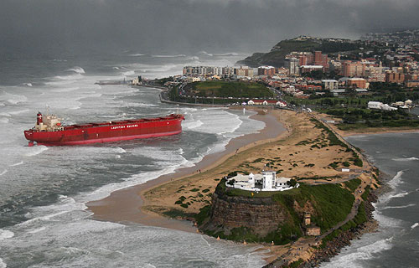
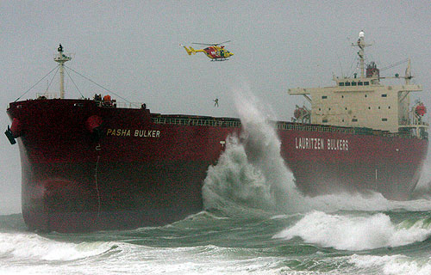
The Update
Wednesday Australian: University Dreams start in primary school (Coates, AUSSE).
When: 40% in Primary and 23% in Lower Secondary
Why: 79% to study area of interest and 50% to improve job prospects
Friday Australian: State rejects PM’s curriculum as substandard.
NSW Board of Studies views K to 10 in first four subjects of English, maths, science and history as substandard.
Garret – “the reform is too important to be allowed to slide because of some minor concerns about one aspect”

Slide 3
How did Queensland lose the “e”
Consider the 2007 discussion paper “Towards a 10 year plan for science, technology, engineering and mathematics (STEM) education and skills in Queensland” (DETA 2007).
“We’re already making progress with initiatives like the $20 million Queensland Academy for Science, Mathematics and Technology”

Slide 4
The USA lost the “T” and the “E”
The report “Preparing for the Perfect Storm”, concluded that, if the United States intends to lead, it needed to ensure that it had “a strong and secure workforce that includes sufficiently large numbers of engineers who innovate and create”.
The report echoes the theme of the strategic importance of STEM and that the “S” and “M” are well supported, but that the “T” and E” seem to have got lost in the middle.
(PTC-MIT Consortium 2006)

Slide 5
Is the E really important?
A USA report “Preparing for the Perfect Storm”, concluded that, if the United States intends to lead, it needed to ensure that it had “a strong and secure workforce that includes sufficiently large numbers of engineers who innovate and create”. (PTC-MIT , 2006).
ACED 2010 “Good engineering – the creative design and instantiation of robust solutions to complex problems under physical, environmental, economic, organisational and cultural constraints – invariably integrates mathematics science and technology”.

Slide 6
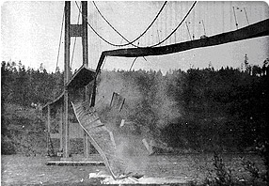
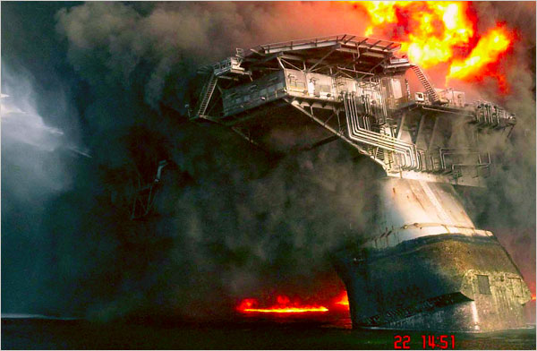
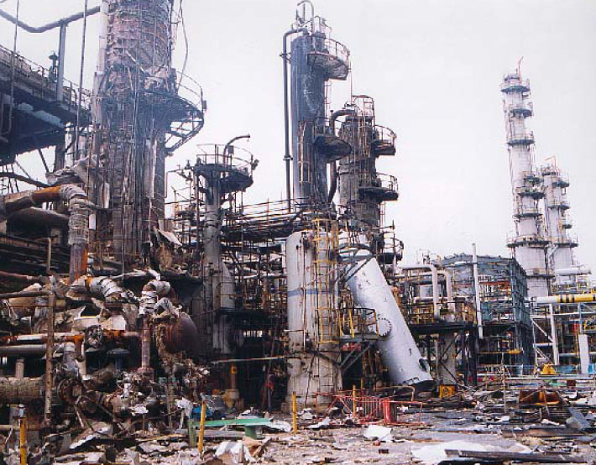
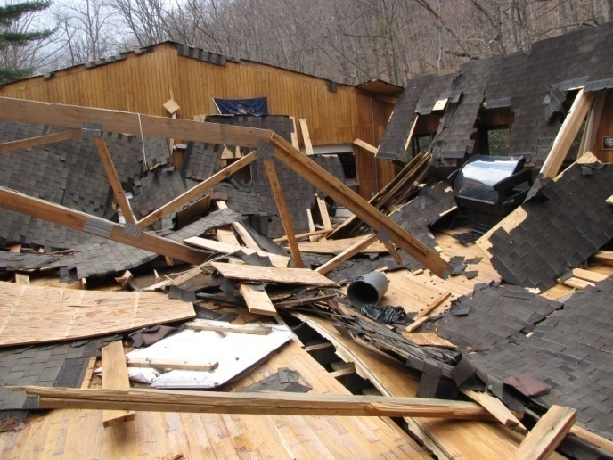
It's not broken – don’t try to fix it!
Hypothesis: The current education system imparts students with a thirst for knowledge in the E-STEM areas and provides highly motivated student for universities to develop into highly competent E-STEM professionals.
Well perhaps not – are there consequences?
http://www.google.com.au/images

Slide 7




The Cycle of Deficiency
Inadequately prepared graduates fail to turn children onto science due to their own poor experiences with science.
A lack of interest of students to take science post compulsory years
Inadequate school classroom experience with science.

Slide 8

A Lack of expertise and CDP
Discipline | Grades 5-8 | Grades 9-12
Mathematics | 58% | 30%
Physical Science | 93% | 63%
Life Sciences | - | 45%
Chemistry | - | 61%
Physics | - | 67%
USA - Students taught by teachers with no Major or Certification (National Academes 2007).
Only 18% of Australian primary teachers believe that they have the expertise to teach primary science. (Stanley, 2009)

Slide 9
Contributing to the cycle of deficiency
Universities drop entry requirements to maintain a reasonable cohort of students qualified to entry to study STEM.
For example the entry requirement for tertiary courses such as engineering is only Mathematics B.
Academics decry the need to provide elementary science and math course within their professional degrees.
Science Faculties blame Education Faculties for not including “their” discipline but not recognising their own lack of collaboration.

Slide 10
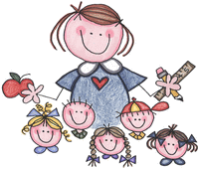
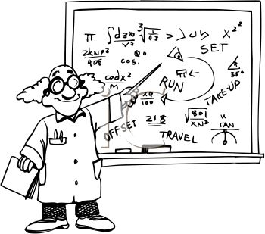


The Cycle of Reinforcement
The professions provide integrated support at all levels
Highly qualified teachers, well supported with material and CPD.
Students continue to study STEM into teaching
An exciting and motivating STEM experience at school

Slide 11
The Cycle of Reinforcement
The engineer’s flow chart perspective

Slide 12

Engineers and scientists are trying
Science and Technology Education Leverage Relevance (STELR)
Science Education Assessment Resources (SEAR)
Scientists, Mathematicians in Schools (SiS), (MiS)
The Re-Engineering Australia (REA) Foundation
The Science and Engineering Challenge (SEC)
EngQuest
The Engineering Engagement Project, UK “aims to widen participation in STEM by supporting teaching and learning”, by providing CPD for teachers, curriculum resources and support, guidance and access grants for after-school science and engineering clubs.
http://www.clipartof.com/details/clipart/209887.html

Slide 13
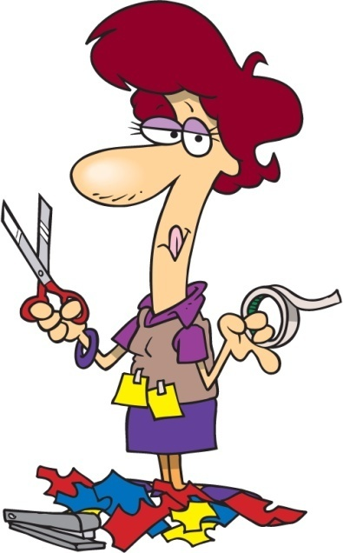
Teachers and other researchers are innovative
Multimedia Magic
Extreme Challenge
Dengue Fever
E-Hotseat
I-STEM
Game-O-Rama
Math Puzzles
Digital Marine Challenge
LEGO Robotics
Scratch Programming

Slide 14
Universities playing a proactive role
At the University of Colorado at Boulder, learning assistants (LA) are recruited from the traditional undergraduate mathematics and science areas to work with academic staff member from those areas.
Traditionally taught large classes of 200+ are broken into learning teams of 6 to 20 students led by a LA.
The LAs provide formative feedback to the lecturer and take a weekly course in science education theory and practice led by an education academic staff and a K12 teacher.
The impact on undergraduates transferring into teaching has been significant. In 2004 -2005, prior to the introduction of LAs, only 1 mathematics/science student enrolled in a teacher certification course. In 2005-2006 when LAs were introduced, 14 of LAs entered teacher education.
From 2003 to 2009 out of 331 LAs that were hired, 41 of those enrolled in teacher certification programs. Over 8000 undergraduate students have been involved in the learning teams.

Slide 15







Why students like stem
$ = lifestyle
Factor | Very important | Important
Good employment prospects | 48.7 | 45.9
Good at STEM subjects | 34.6 | 52.4
Wanted a STEM career | 31.3 | 50.0
Influenced by teachers | 23.8 | 49.0
Influenced by school science | 15.8 | 39.1
Employer supported study | 10.1 | 20.2
Influenced by careers advice | 8.0 | 28.4
It’s a buzz
I love STEM
(NCVER, 2008)

Slide 16


Females: the lost “E” cohort
WHY?
Science teachers play a leading role and often are poor role models.
Males are stereotyped as being better at science and mathematics.
School careers advice is only influential in a negative sense.
Parents need to be supportive of their daughters' abilities.
Perception and belief becomes reality.
STEM

Slide 17




Female Participation in tertiary “e”

Slide 18

The trends are encouraging
% Female
Year
If we work hard, change workplace attitudes, teaching approaches and are lucky, we may hit 25% in 20 years!

Slide 19


The solution
x
The new National Curriculum will solve everything
Or maybe the monster will be set lose on teachers, students, universities and the nation.

Slide 20


teachers
It’s your fault Bob

Slide 21
Teachers: The Key Ingredient
A USA Commission stated that: “teachers need to be trained to be sensitive to gender differences when teaching all subjects, especially in math and science. Teacher training would include ways to engage students in the face of gender-based peer pressure and parental expectations”. (AAUW 2010).
A 2008 NCVER report study found that; “clearly shows the importance of science and mathematics teachers motivating students to enjoy STEM and do well in STEM subjects if we want them to work in STEM occupations and develop a long term career in these areas.”

Slide 22
How to Support Teachers with the E
Supporting teachers to put the E into school:
The rate of development in STM supporting the E well transcends the ability for curriculum to maintain the same pace and retain relevance.
Partnerships between engineering, science and education faculties, schools systems and industry are needed to develop engineering resources to support and link math, science and technology in the school curriculum.
The partnerships provide consistent, current, well structured and relevant high quality education resources linked to Science and Mathematics in the new Australian National Curriculum.

Slide 23
A Framework to insert the E
Students attitudes towards science and mathematics are formed in primary schools so it is imperative that initiatives start in the primary years of schooling (Turner & Ireson, 2009).
Science, Mathematics and Technology Curriculum could be delivered in an engineering context for primary and middle schools students.
Year 4 provides the most opportunity for embedding engineering concepts as a nexus for to apply mathematics and science to real-world problems that are solved through innovative engineering. This would greatly deepen students’ understanding of the underpinning science and mathematics principles.

Slide 24
Mapping “E” to the NSC, QEL and NMC

Slide 25
E as the Glue in the STEM
A MODEL for putting the “E” back into STEM for the Primary and Middle School
Science as a Human Endeavour
Engineering Problem
SCIENCE CONTENT
MATHEMATICS CONTENT
Technology
Design process
Design
Construct
Appraise
SCIENCE INQUIRY SKILLS
Questioning & predicting
Investigation methods
Using equipment
Managing risk
Observing & measuring
Analysing results
Developing explanations
Communicating
Reflecting on methods
Evaluating evidence
MATHEMATICS PROFICIENCY
Understanding
Fluency
Problem solving
reasoning
Engineering Product

Slide 26
The “E” is best embedded in Year 4

Slide 27
Developing the PS concepts in the NC

Slide 28
The “E” Opportunity
There is an opportunity now for stakeholders such as universities, curriculum authorities, education departments, schools systems and professional associations to work together to fund a project to develop curriculum resources and associated professional development for primary and secondary teachers.
The obstacles are numerous and will be difficult to overcome but it is imperative for the future of the nation that the attempt be made.
With the imminent roll out of the ANC, the time is right for a new approach to embed STEM such to reinvigorate interest amongst teachers and their students, by putting the “E” in the middle of STM.

Slide 29


The Solution Equation
Curriculum designers
Teachers
The professions
Government
Universities
Parents and students
Authentic learning - with an E
S
U
C
C
E
S
S
!!!

Slide 30



