Slide 1
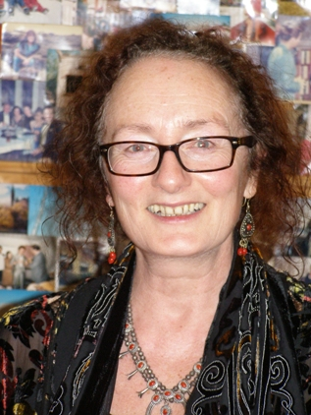
The transformative capacity of play and the arts for learning and student engagement: implications for pre-service teacher education.
Dr Janice K. Jones
Capacity Building Research Network
Faculty of Education, University of Southern Queensland.
University of Cambridge
PLACE Academic Group Seminar, 2012

Slide 2
Acknowledgement of Country
I acknowledge the traditional custodians of the lands where USQ teaching and research is conducted: the Gaibal, Jarowair, Ugarapul and Butchulla peoples of Queensland. I honour the wisdom of Elders past, present and future, seeking to walk together in the spirit of reconciliation.
Dinawan Dreaming by Donna Moodie
Notes:
I acknowledge the traditional custodians of the lands where USQ teaching and research is conducted: the Gaibal, Jarowair, Ugarapul and Butchulla peoples of Queensland. I honour the wisdom of Elders past, present and future, seeking to walk together in the spirit of reconciliation.

Slide 3
University of Southern Queensland
25,648 students
Students from 85 + countries
Top 3 international China, Malaysia & India
Student to academic rate: 21/1
Very high (2%) Indigenous students
80% Faculty of Education study fully online
7,382 postgraduate (very high) 94%

Slide 4
Changing Picture: Schools in Australia
Decreased from 9,600 in 2000 to 9,468 in 2010 (-132).
Government schools -223
Non-government schools +91 (+12 Catholic, +79 independent)
In 2010, 6,743 government schools (71%), 1,708 Catholic schools (18%), and 1,017 Independent schools (11%).
Australian Bureau of Statistics. (2010) 4221.0 - Schools, Australia, 2010

Slide 5
At-risk students
In 2006, 7% of 15-19 year olds who were no longer attending high school had not completed Year 10.
This proportion was considerably higher in remote (14%) and very remote areas (36%).
(51%) of Indigenous 15-19 year olds participating (up from 43% in 1996).

Slide 6
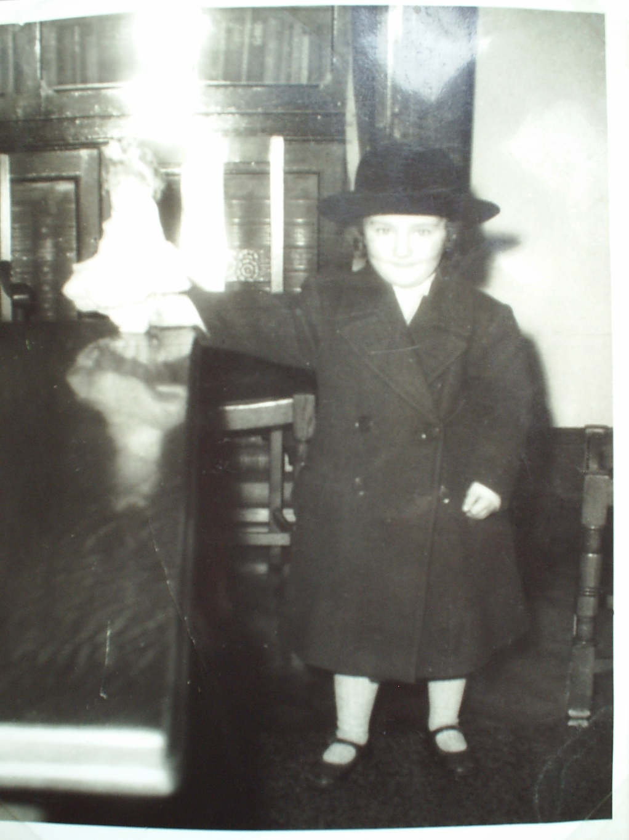
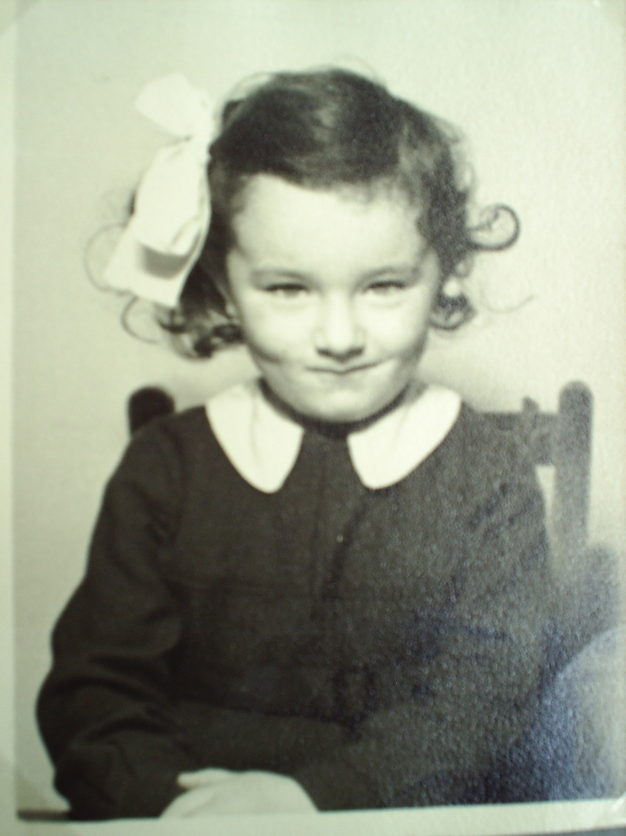
Positioning: Researcher-educator

Slide 7
Positioning – Pedagogies

Slide 8
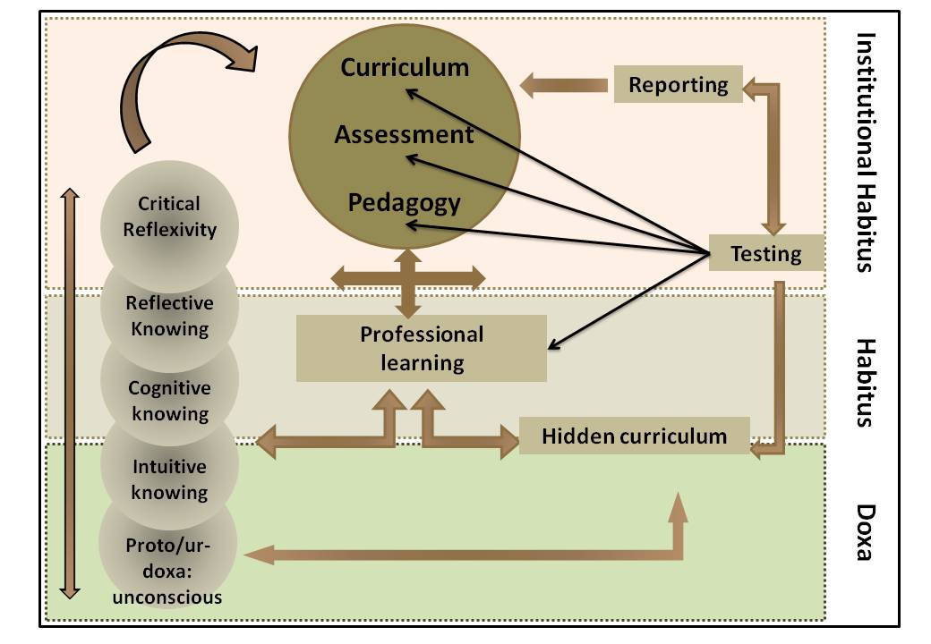
Professional Practice in Context

Slide 9
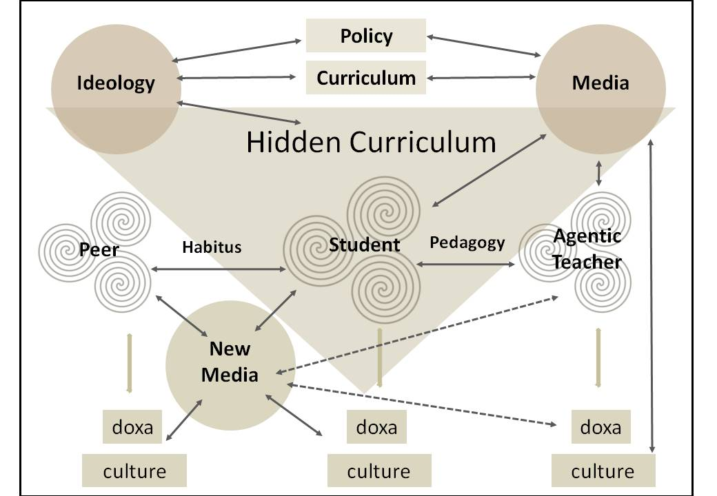
Child’s Context – Hidden Curriculum

Slide 10
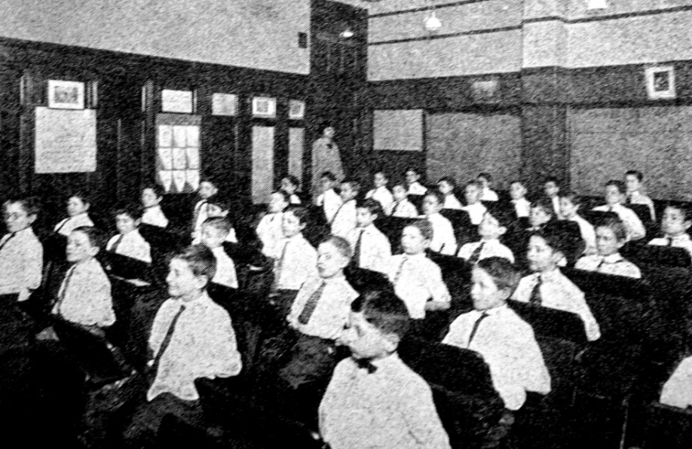
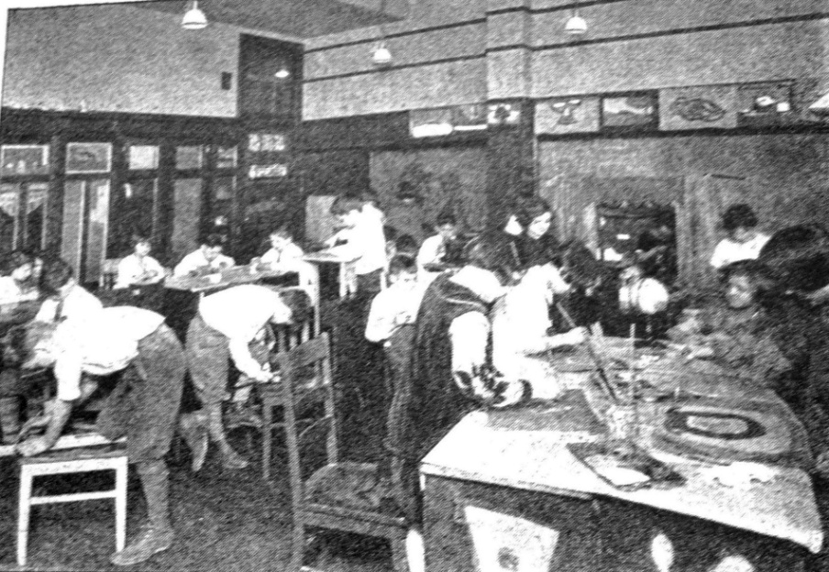
How much has changed?
Pre-1928
1928

Slide 11
Imagine...lifelong-life-wide learning

Slide 12
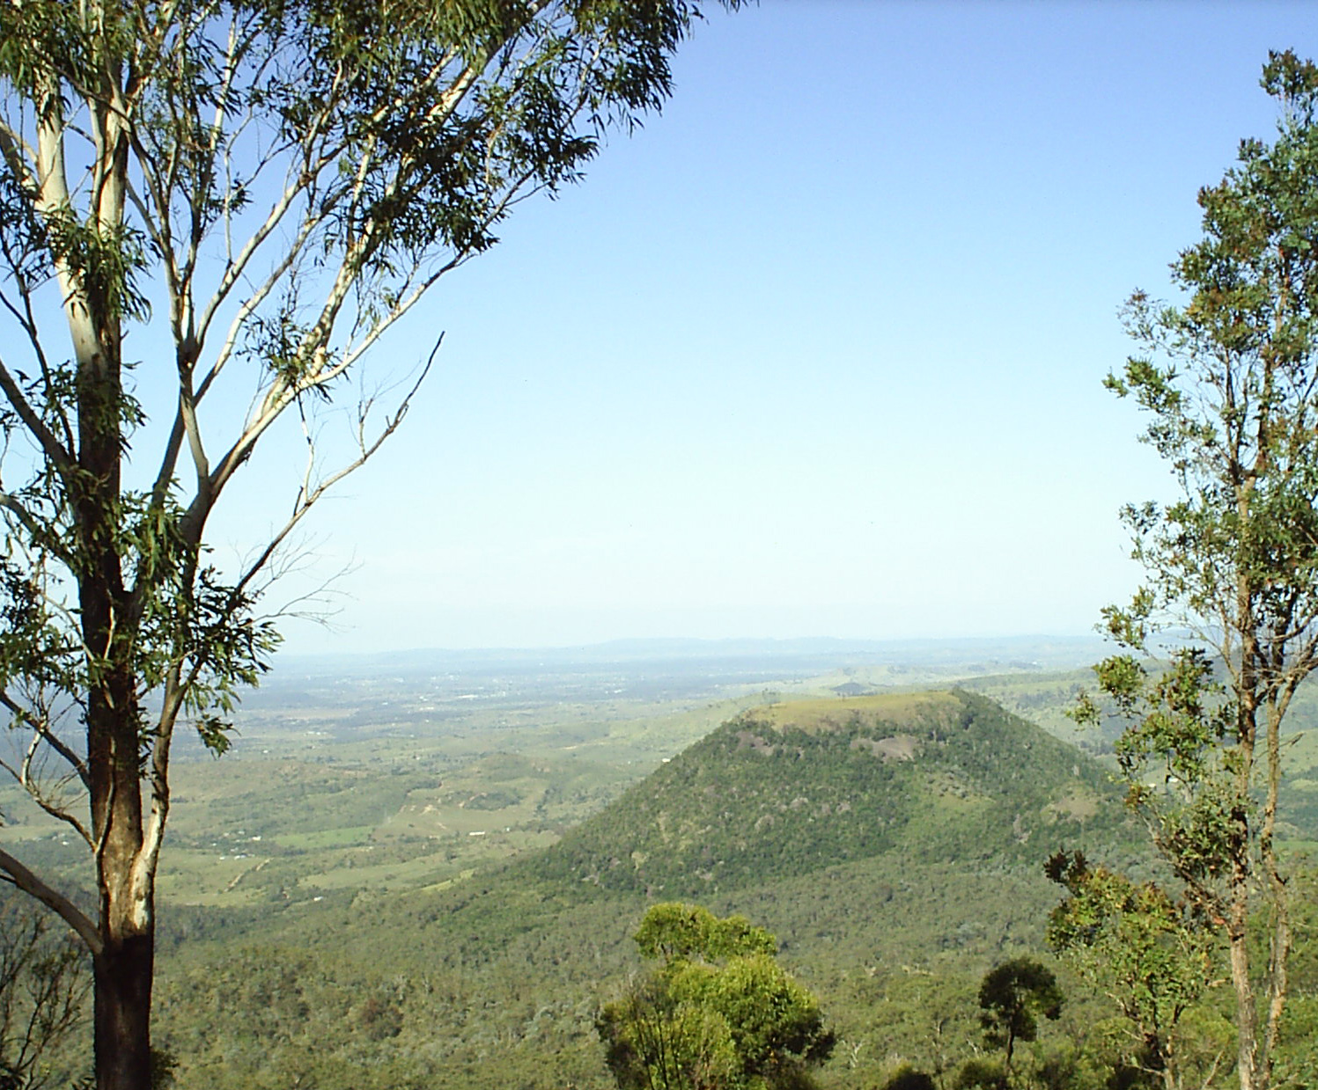
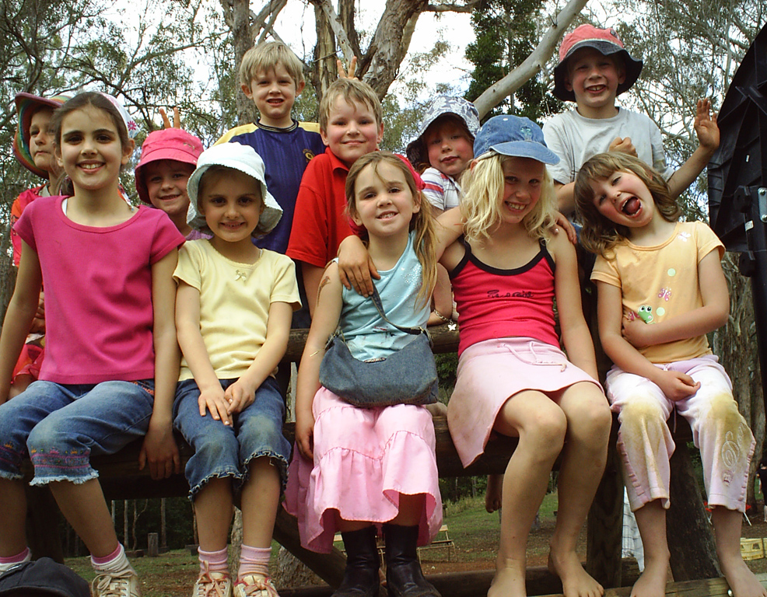
The pupils…
Notes:
Unlike a state school where relatively homogenous groups of children (by age and ability level) are engaged in teacher-facilitated activities, at the Magic Gardens School children move freely like small fish on a ‘coral reef of learning’, absorbed in their own projects (Gardner, 1991).
This community school is now in its third term, with around 30 enrolments and with two full-time facilitators (John and Meg) and parents, and community members who are able to and wish to be actively engaged in the children’s learning (Turner & Krechevsky, 2003).
The schoolchildren learn through exploration and play, moving freely across a seamless ‘indoors/outdoors’ space. One parent described it as ‘Free-range organic learning’.
There are no ‘lessons’ as such, no assembly, no set times for arrival and departure, no bells, none of the normal behaviours or environmental features that indicate any power imbalances between adult and child.
The school’s philosophy locates the child, parent, facilitator, older child, invited expert, and environment as teacher. Increasingly for me as researcher, this causes me to reflect back on my work in preparing pre-service teachers for ‘teaching’.

Slide 13
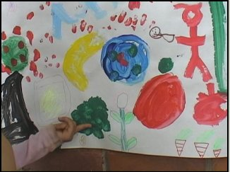
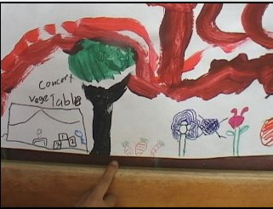
The Magic Gardens Project
Notes:
The Magic Gardens Community School is a non-traditional private school in rural Queensland. It opened in January 2006. The community shares a vision for the school which positions the child at the centre of all learning. Elements of Reggio Emilia, Montessori and Waldorf/Steiner philosophies inform the school’s holistic and child-originated curriculum.
The school recognizes the central importance of play as a tool for learning (Eisner, 2005). Children as young as 7 years old in QLD schools are allowed only a minimal amount of time for play in an increasingly ‘structured’ and nationally controlled educational system. In The Magic Gardens Community School children of up to 11 years are allowed to play all day.
The school’s motto is ‘Trust the Child’ – and all aspects of the school day are based around the individual child and his or her needs.
What happens when children are allowed to play rather than being ‘taught’?
What are the implications for teaching and teacher education?
These and other questions are jostling for a central place in my research.

Slide 14
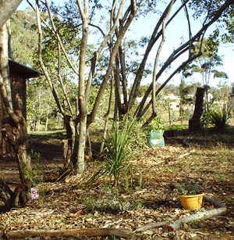
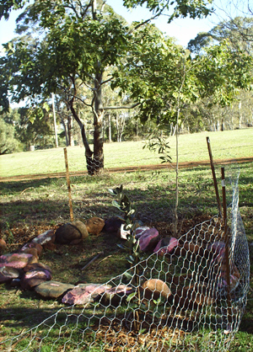
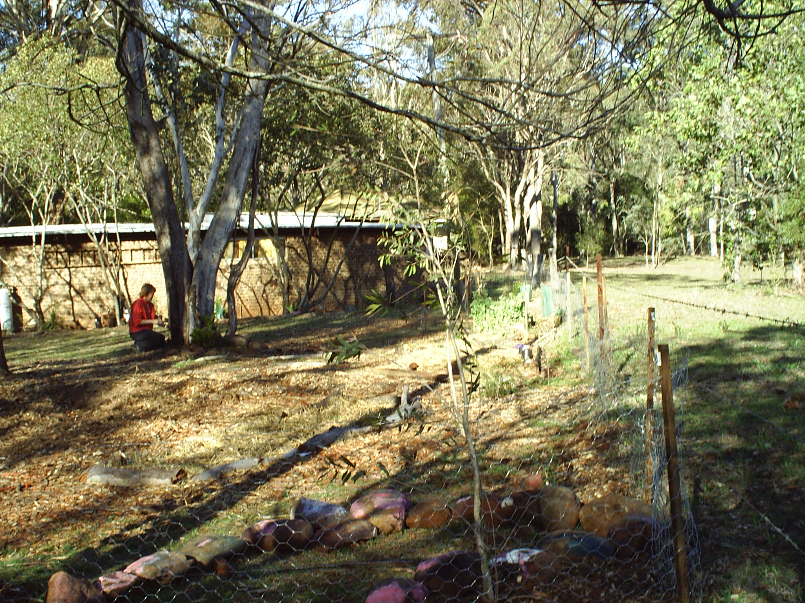
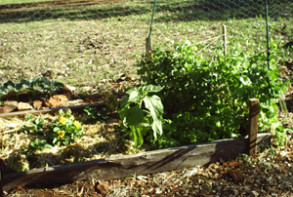
A challenge…a garden for the arts
Notes:
The film, digital and written records of each visit provide valuable records of behaviours, conversations, and student engagement which may otherwise go unremarked. They support John and Meg’s recording and documenting of individual children’s learning in line with Queensland Studies Authority (QSA) recommended practices (Queensland Studies Authority, 2002).
The children have seen a deserted space turned into an environment that meets their needs. In a years’ time they will have shelter from the sun. Painted stones surround their ‘meeting place’. Ponytail palms signal a gateway to their wonderful sandpit.
The garden and my research journey are synonymous. I have come to understand that the process of research is like gardening in a wasteland: one must simply begin planting. There are losses. There are surprising successes. Mostly, the process takes its own time and hidden from sight, that which feeds our understanding is a rich process of enquiry and reflexivity.

Slide 15
Learning through play
Knights in battle: research
into armour and warfare. Helmet and shield design, figure painting, filming and acting out. War games continue for 3 weeks.

Slide 16
Exploring percussion March 06
I’ll dance with my sista....emu dance

Slide 17
Drumming - instructional teaching
Children and adults learning together: music terminology and skills

Slide 18
Drumming - informal learning
Child-led and group-negotiated rules for drumming (16 June 2006)

Slide 19
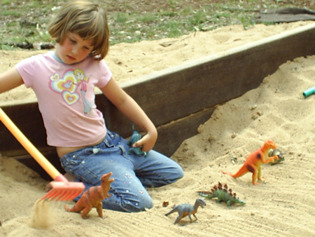
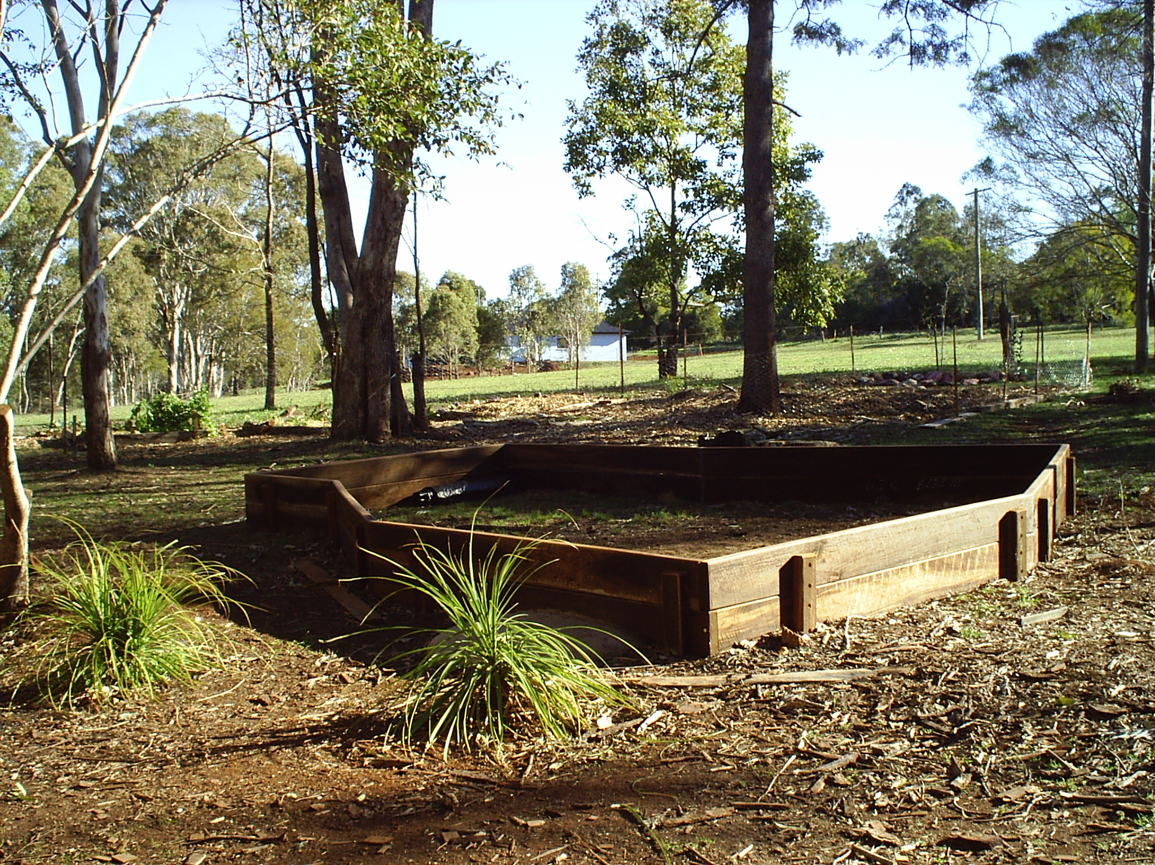
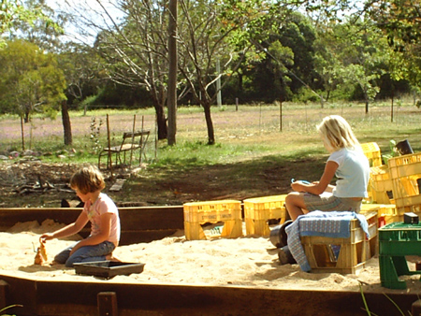
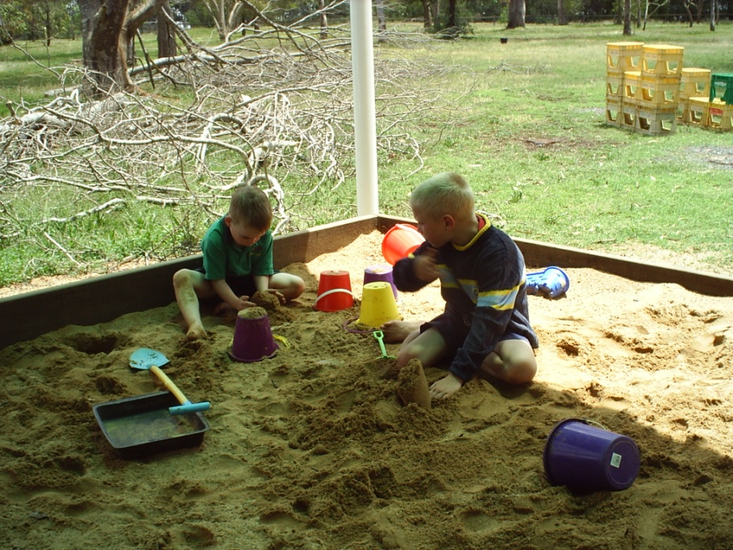
Notes:
In August a huge sandpit was added. The community of children, parents and facilitators decided it would not be square – it has since become a major focus for the children’s play. The milk crates are ‘an ice-cream factory’ used during a game that has lasted several weeks. The borders act as seating for children during solitary or group play.
Rakes allow the children to create Japanese-style ridge patterns around stones and toys.
The child left is playing with dinosaurs – she is lost in her story world. Arriving at the school having demonstrated behaviour problems in a traditional school, she has become more calm and plays co-operatively with others.

Slide 20
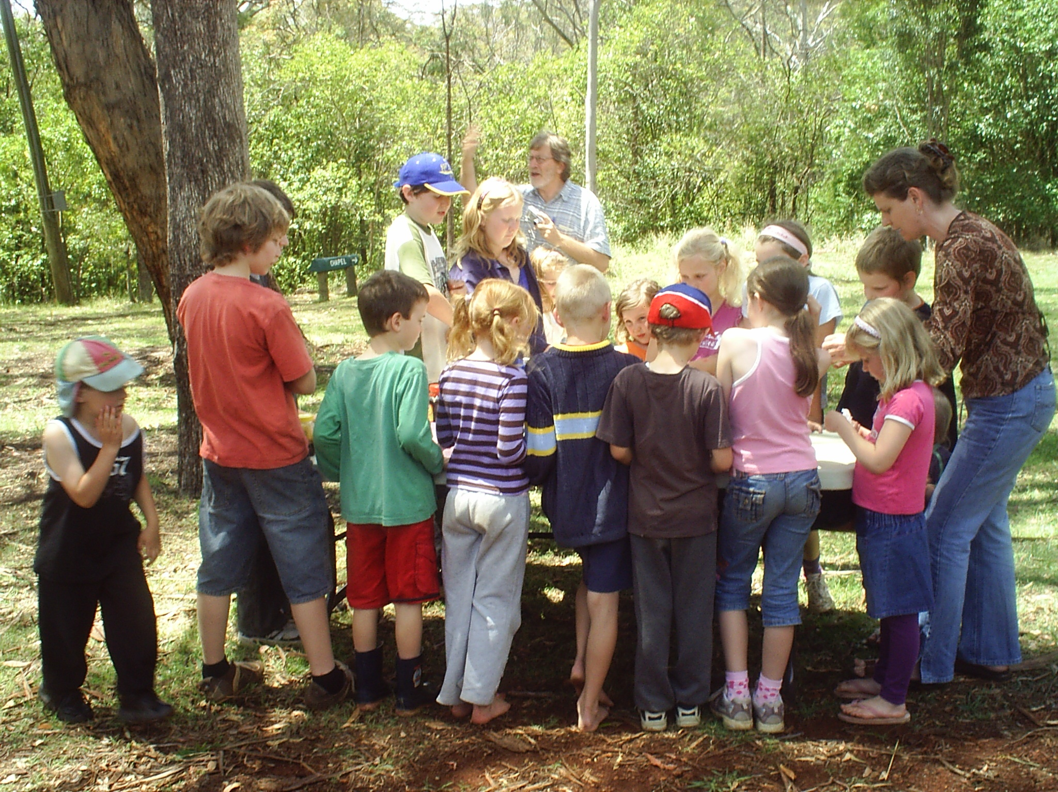

Slide 21
Celebrating the first rain for months
28 July 2006 – followed by science and sound experiments

Slide 22
Mapping and Assessment
Light and refraction
Environmental studies
All 5 senses
Wet-on-wet painting
Rain Play
Chemistry of water
Science of waves
Making
music
Maths
Displacement

Slide 23
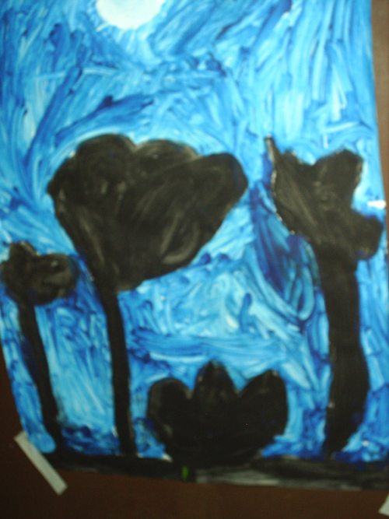
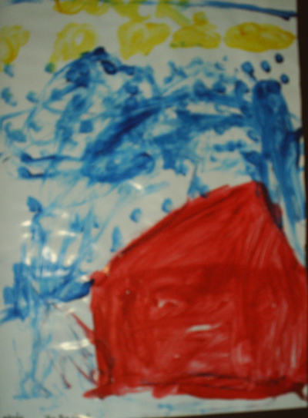
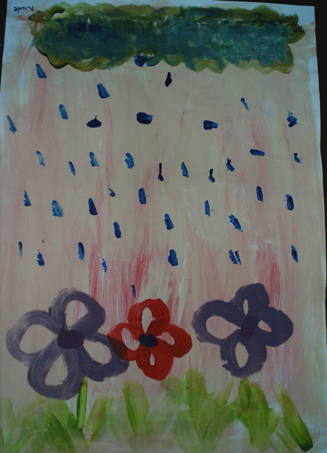
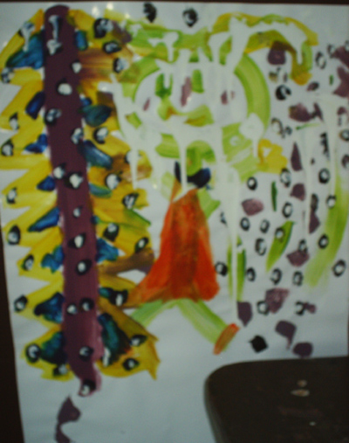
Children paint their world…
Notes:
This visits allowed the pre-service teachers to discuss the school and what they experienced there: some questioned the premise that children could learn without direct instruction and planning, others’ response was ‘Why aren’t more schools like this?’ and ‘The children were so calm and mature – they didn’t talk to us like children normally do’.
The stories and artwork created by the children is exceptionally beautiful and powerful, and as a facilitator for the arts this has led me to return to my own story writing and painting. Meg and John focus on literacy and mathematics, integrating these into each child’s learning in a supportive and holistic way.

Slide 24
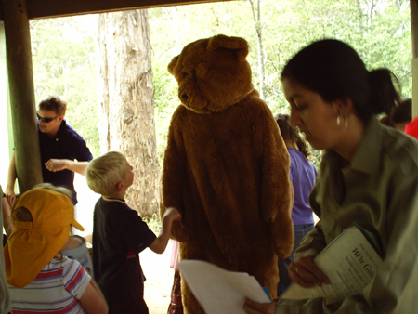
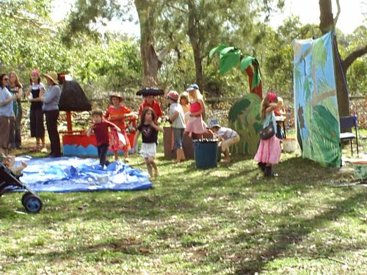
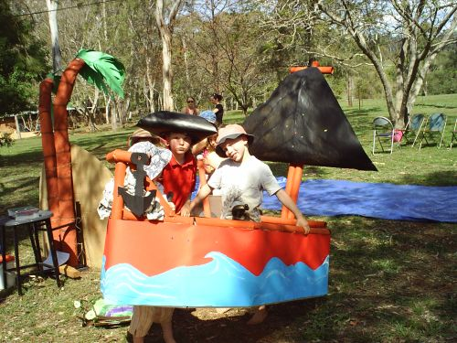
Pre-service teacher workshops

Slide 25
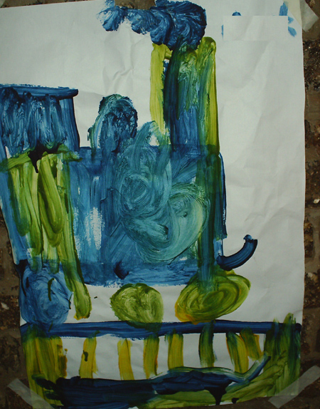
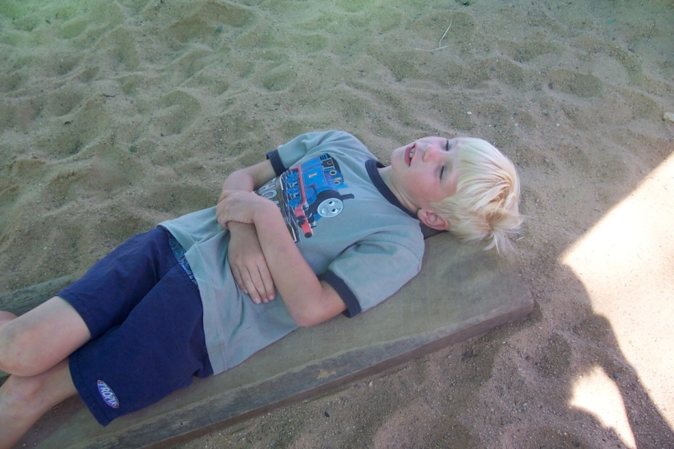
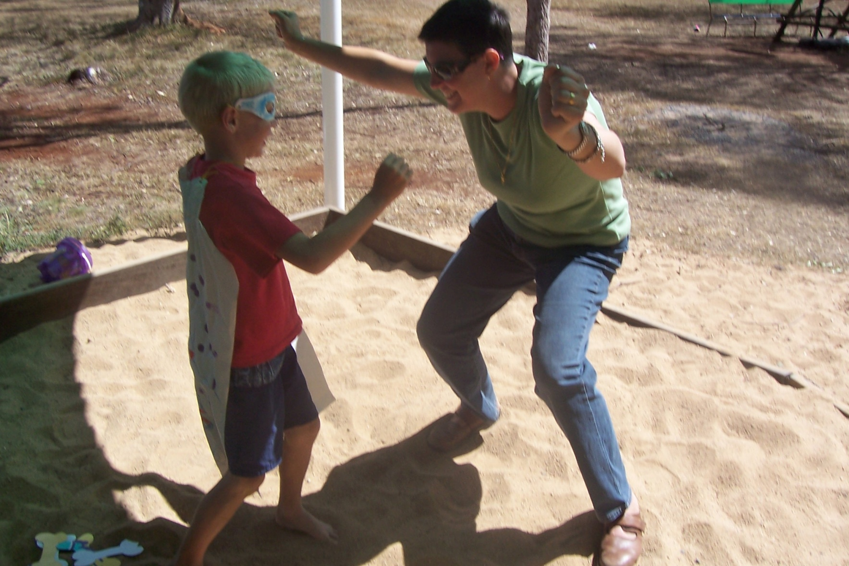
New confidence to create
Michael developed photo stories about himself as Superhero. Then, for weeks he and a younger child developed a game of trains: others joined in creating a shop, childminding service, taxis, ‘money’, bridges, carriages, tracks. Michael wrote his first words on his beautiful poster of a train. He began to create cartoon books...

Slide 26
Parents as Educators
In the next few slides – I run an animation workshop. However, I intervene in an argument between siblings, unaware that Shauna is the mother of all 3 children.
Her role in the school is important and I need to respect and acknowledge her ideas as equal to my own.

Slide 27
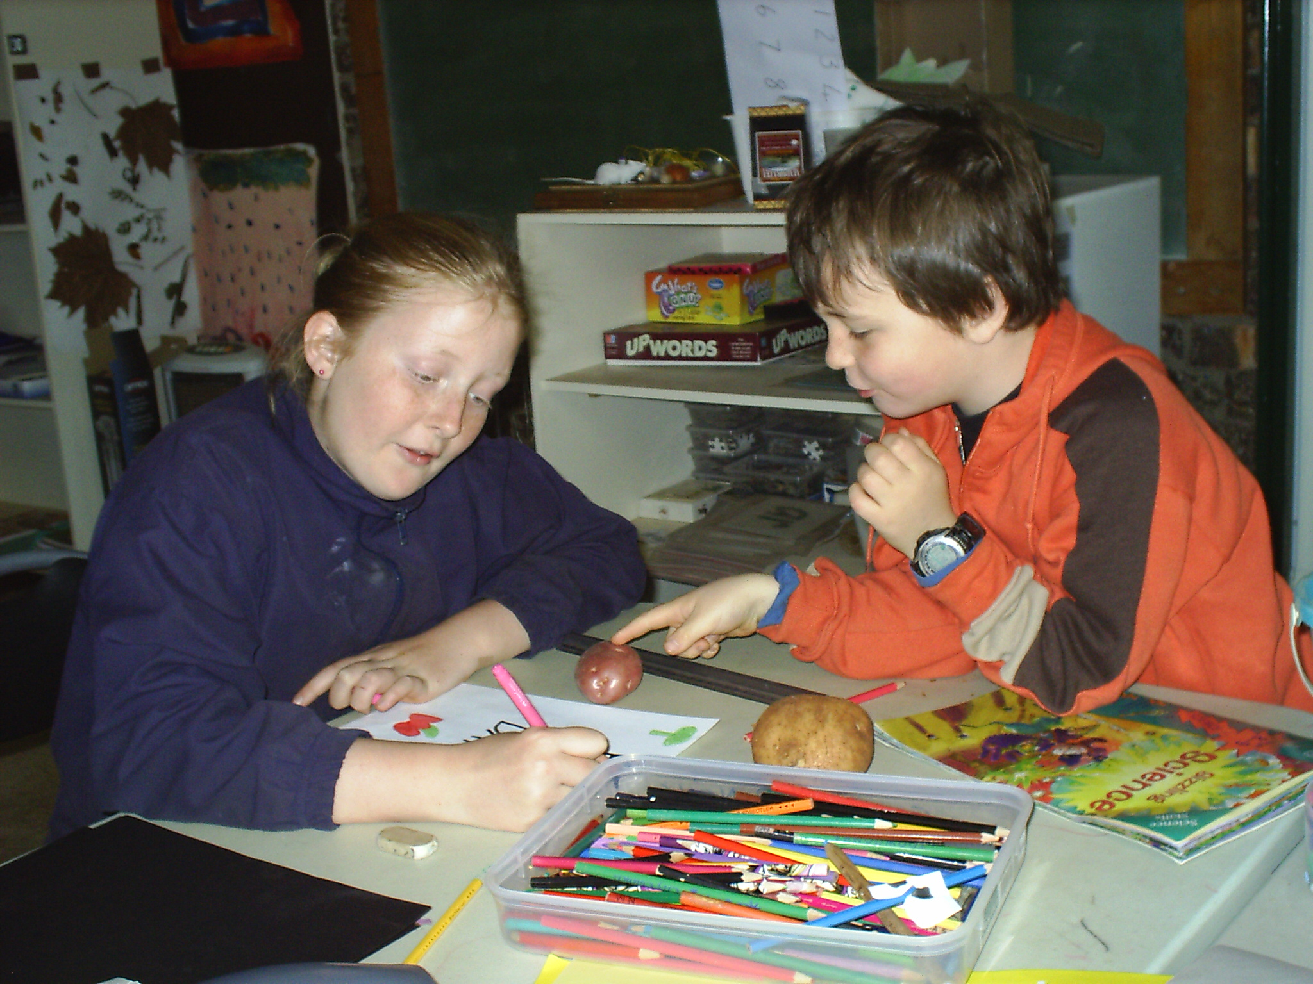

Slide 28
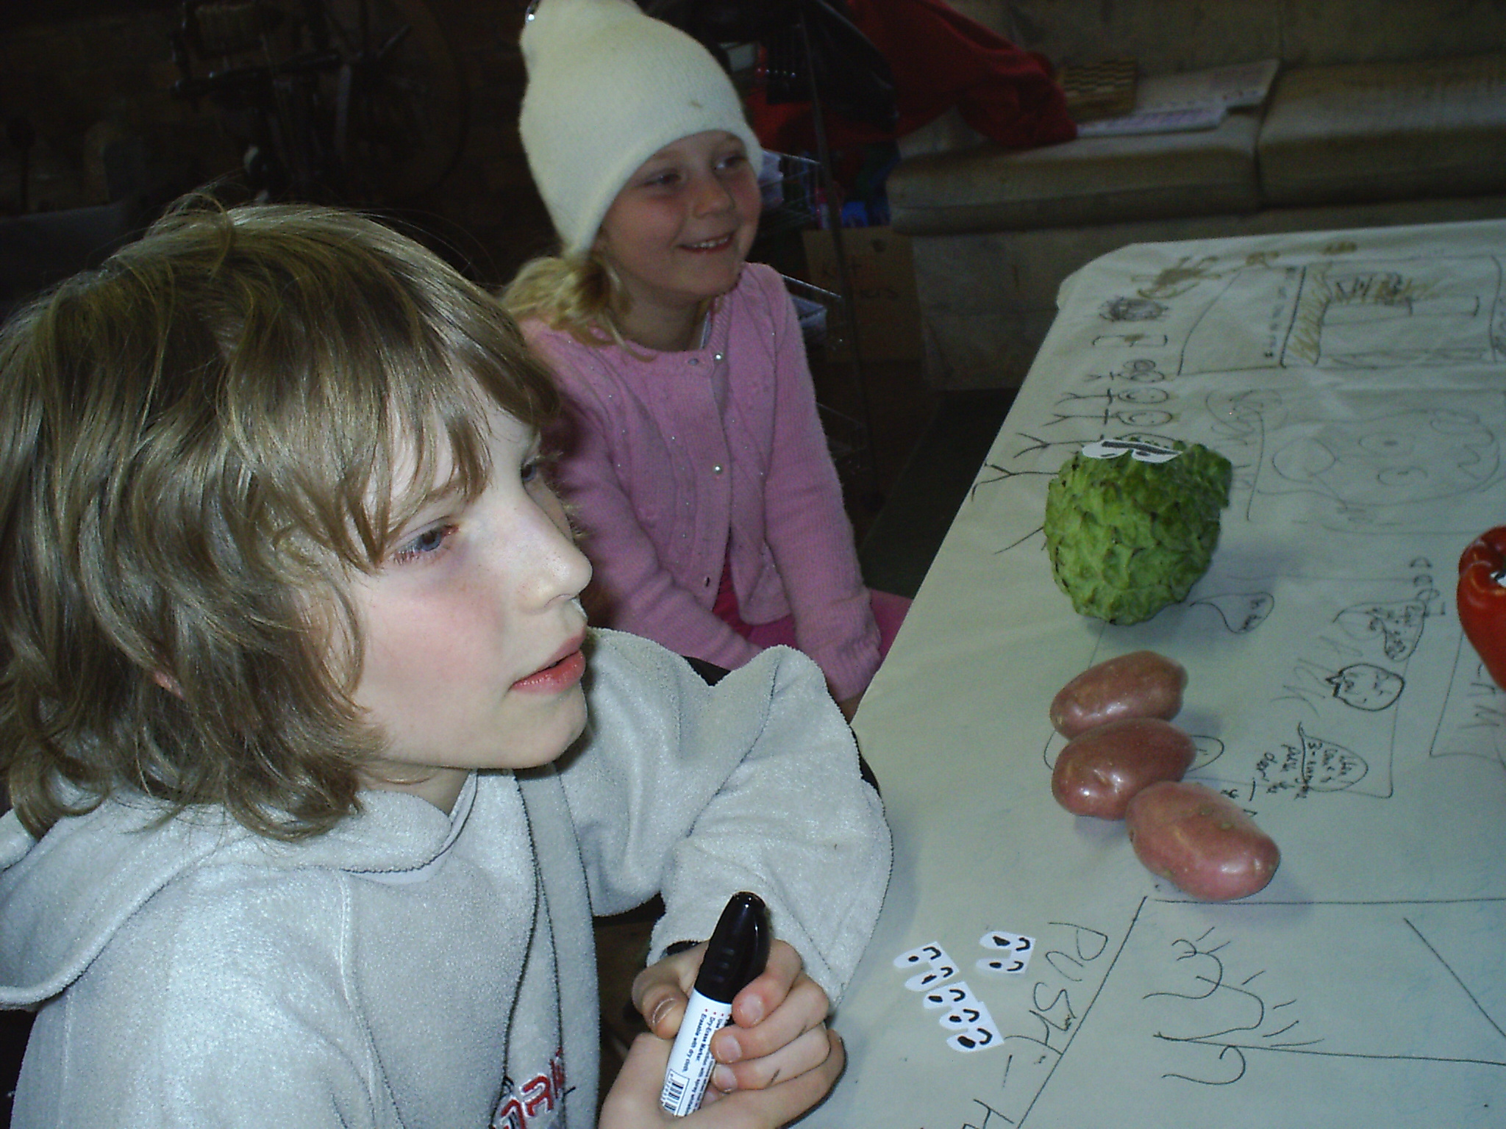

Slide 29
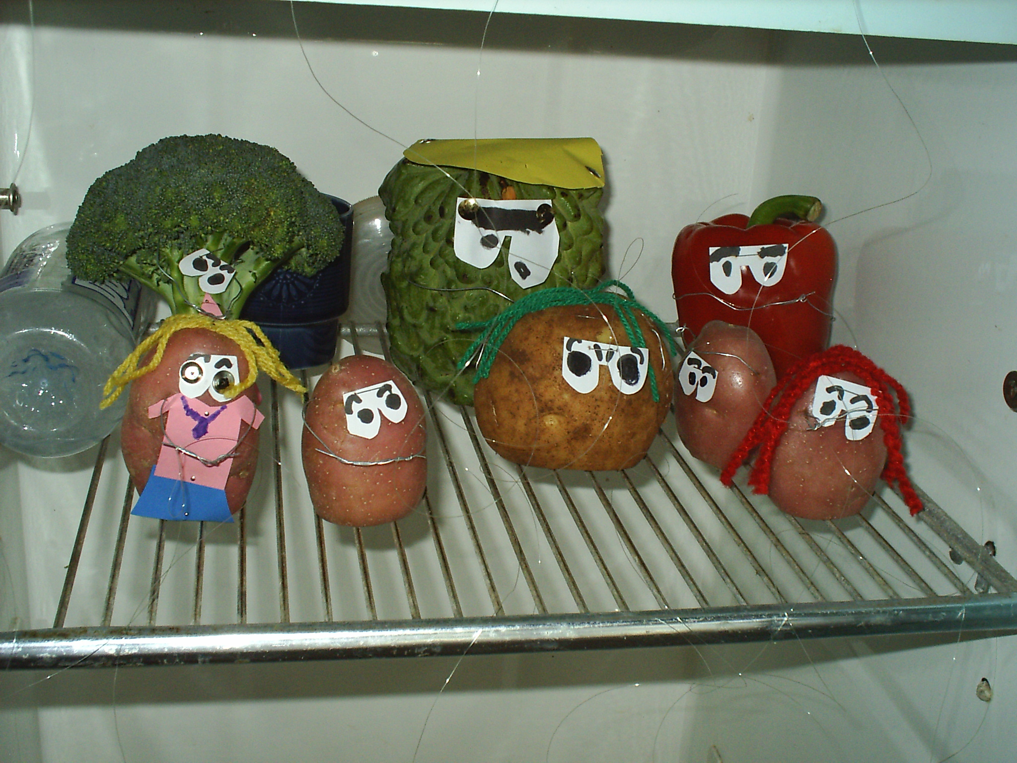

Slide 30
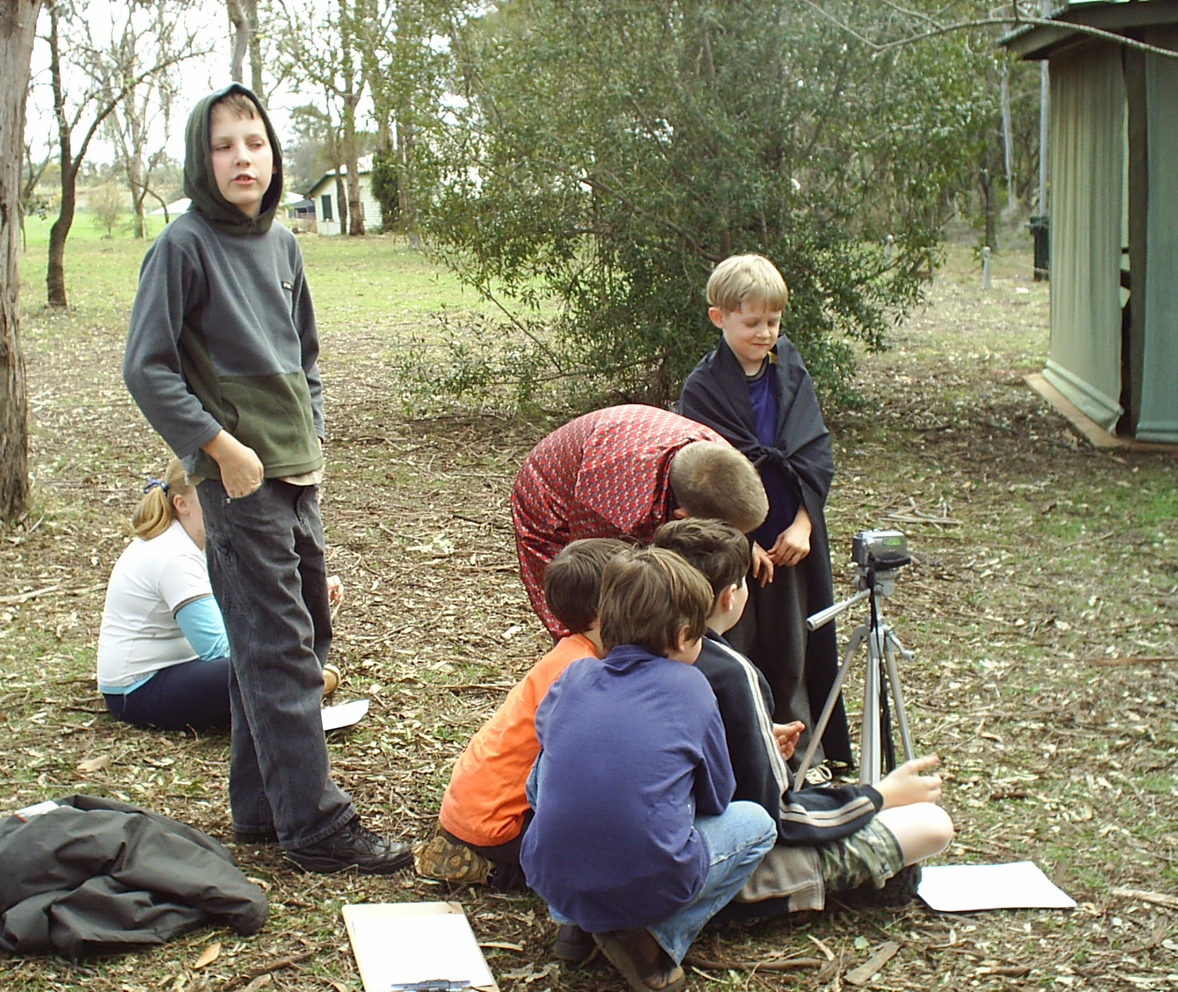
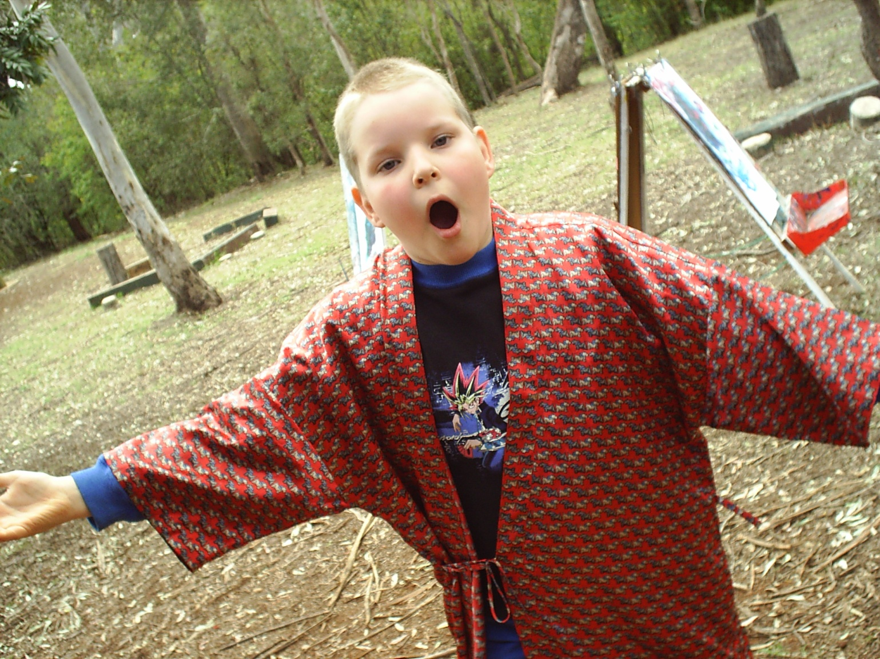
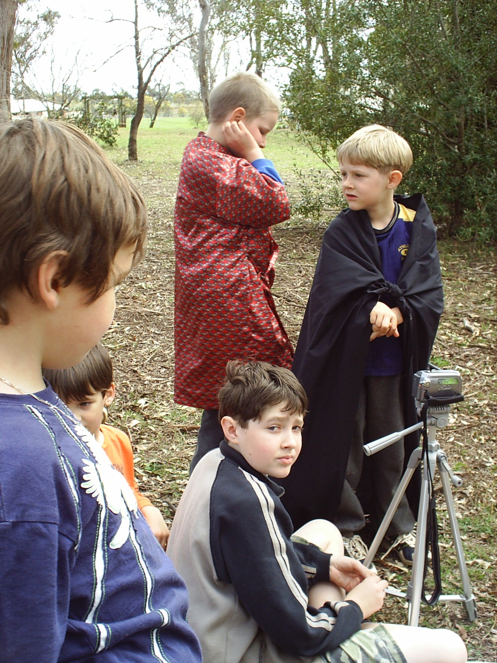

Slide 31
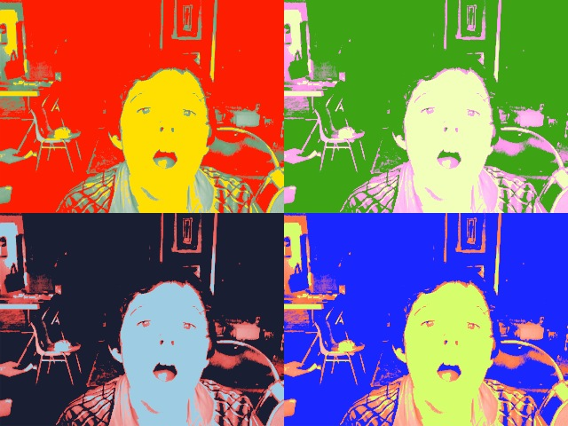
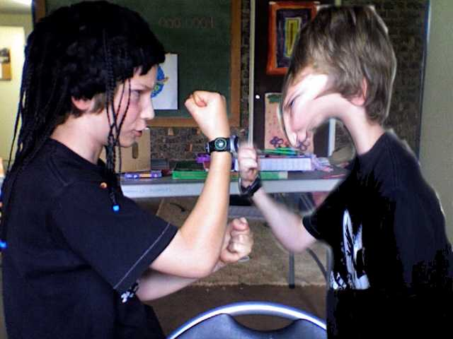
Creating Special Effects

Slide 32
Dance performance
Child choreographers, playwrights and actors. Christmas 2006

Slide 33
Australia – performance monitoring
In response to the Melbourne Declaration a National Assessment Program (NAP) focuses on:
Engagement in vocational education and training (VET)
Attendance, participation, completion and attainment in schools
National Report on Schooling in Australia (2010, p.6)

Slide 34
The Australian National Curriculum
Arts Syllabus to be endorsed by mid 2013: Focus on making and responding
Foundation to year 6 students engage in all 5 strands
From year 7 or 8 ‘one or more subject’
No set time allocation: schools decide hours and approach (integrated or discrete arts areas)

Slide 35
NAPLAN
National Assessment Program – Literacy and Numeracy (NAPLAN)
Annual assessment for students in Years 3, 5, 7 and 9
Literacy,numeracy, science, civics and citizenship, ICT
“...an everyday part of the school calendar and has been since 2008”

Slide 36
Attendance
Government schools
Catholic schools
Independent schools
National Report on Schooling in Australia (2010, pp.84-86)
Notes:
Collection period
Government sector
The collection period for government schools is Semester 1 of each school year, except in Tasmania, where Term 1 is used.
Non-government sectors
The collection period for non-government schools is specified as the last 20 school days in May of each school year. In practice, data are usually collected for 20 consecutive school days in May that form four complete school weeks. For 2010, this was the four-week period beginning Monday 3 May and ending Friday 28 May.
Collection methods
Government sector
Student attendance data for government schools were collected by government school authorities in each State and Territory and provided to ACARA. There were variations in the methodologies employed for collecting data and for calculating attendance rates. Explanatory notes on methodology, provided by each jurisdiction, are included below.
Non-government sectors
Data for the Catholic and independent school sectors were collected through the Australian Government’s online data collection system, known as the Student Attendance System and provided to ACARA by DEEWR. Individual non-government schools entered 2010 student attendance information directly into this system. The non-government sectors were also able to add data for all of their systemic schools. The collection system does not impose any limitations on the collection methodology used by the non-government school sectors. National Report on Schooling in Australia , 2010 p. 78

Slide 37
PISA Results 2009
34 OECD countries and 31 partner countries
14,000 students from 353 schools in Australia(randomly selected)
“While females continue to outperform males in reading literacy, the average scores of Australian males and females have declined significantly since reading literacy was first a major domain of assessment for PISA, by 17 and 13 points respectively” (Thomson, De Bortoli, et al., 2009)

Slide 38
114 first year pre-service teachers

Slide 48
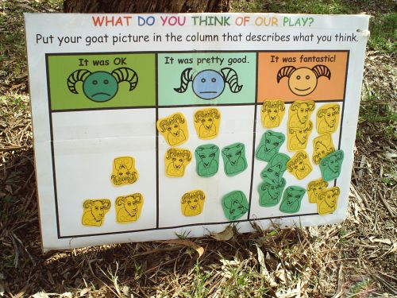
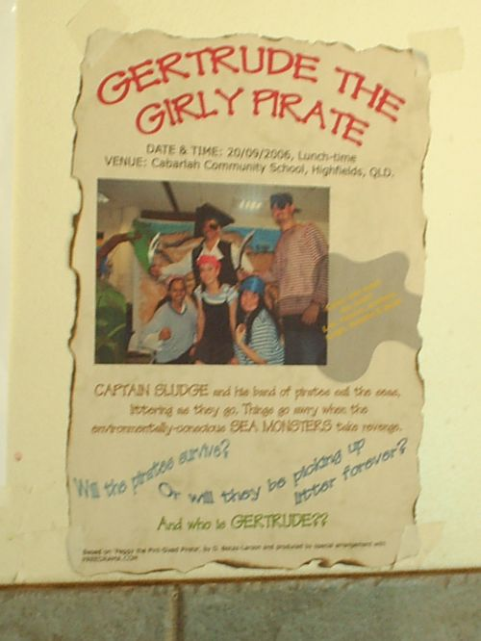
14 Groups Ran Workshops
Children and parents assessed the pre-service teachers’ workshops.
Facilitators also self and peer assessed.
One group of visiting pre-service teachers ordered children to ‘line up’ to give feedback....but the children dutifully complied.
This simple shift in agency – and adult concepts of order highlighted a key difference between ‘traditional’ and ‘child-centred’ education.

Slide 49
But....teachers can be so creative...
17.52 8 November 2006

Slide 50
References
Australian Bureau of Statistics. (2010). 4221.0 - Schools, Australia, 2010 Retrieved from http://www.abs.gov.au/4221.0
Australian Curriculum Assessment and Reporting Authority. (2010). National report on schooling in Australia 2010. Sydney: ACARA Retrieved from http://www.acara.edu.au/verve/_resources/National_Report_on_Schooling_in_Australia_2010_live.pdf.
Thomson, S., De Bortoli, L., Nicholas, M., Hillman, K., & Buckley, S. (2009). PISA in brief - highlights from the full Australian report: Challenges for Australian education: Results from PISA 2009. Paris, France: OECD Program for International Student Assessment (PISA), Retrieved from http://www.acer.edu.au/documents/PISA-2009-In-Brief.pdf.

Slide 51
Thank you - Questions Welcome
My contact email is:
jonesja@usq.edu.au

