Slide 1
Full Text Seeker
Using Microsoft Copilot to create a tool to assist with systematic reviews
Tracy Bruce
Senior Research Librarian

Slide 3
4 parts to today’s presentation
Background to development of the Full Text Seeker tool
What is does and how it supplements EndNote and Zotero tools
Share the experience of writing with AI as an “ordinary” person
Report on the tool’s effectiveness for me, but also to seek feedback from researchers and librarians for improvements

Slide 4
The problem…
Large systematic and scoping reviews
Can mean locating hundreds of full text articles
Automation helps … to an extent
Locating remainder is a manual process
Microsoft Bing: Image Creator (AI generated image)
Background | What it does | Writing with AI | Results

Slide 5
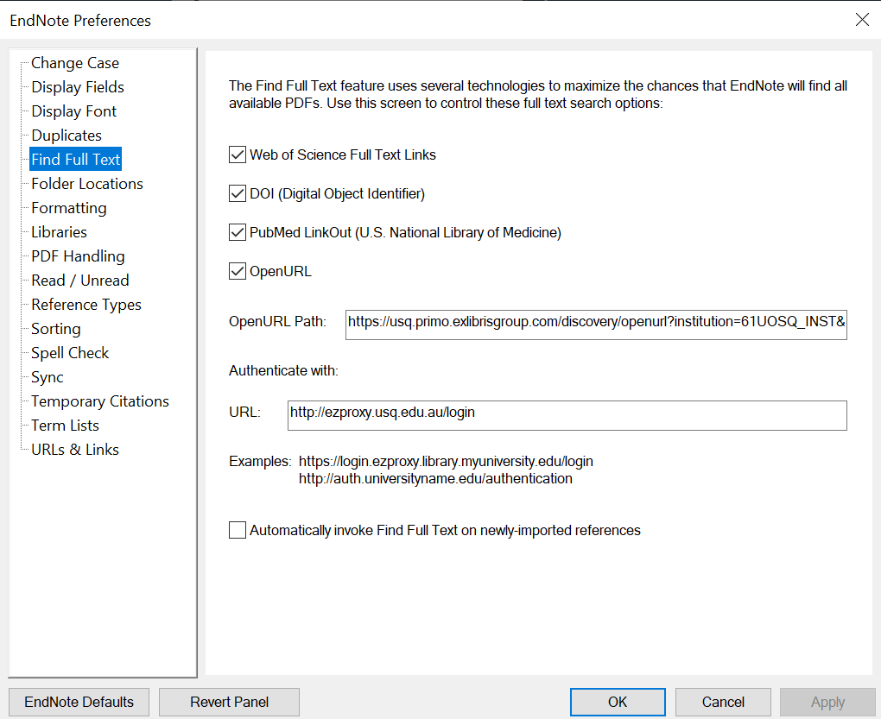
Automation - EndNote
Preference/Settings > Find Full Text
See your library for URLs
Select references, right-click, Find Full Text
Clarivate Analytics. EndNote 21 screenshot. Image used with permission.
Background | What it does | Writing with AI | Results
Notes:
Ideally you want automated tools to do most of the seeking and fetching for you.
EndNote has its Find Full Text function, and it’s a delight when it works effectively, sometimes retrieving about 70% of your articles
However it depends on whether articles have embedded DOIs, and experiences can differ depending on whether you are on campus or not, and other issues around ezproxies.
Speak to your librarian to get the Open URL and Authenticate URLs to put into Preferences > Find Full Text (Settings > FFT for Macs)

Slide 6
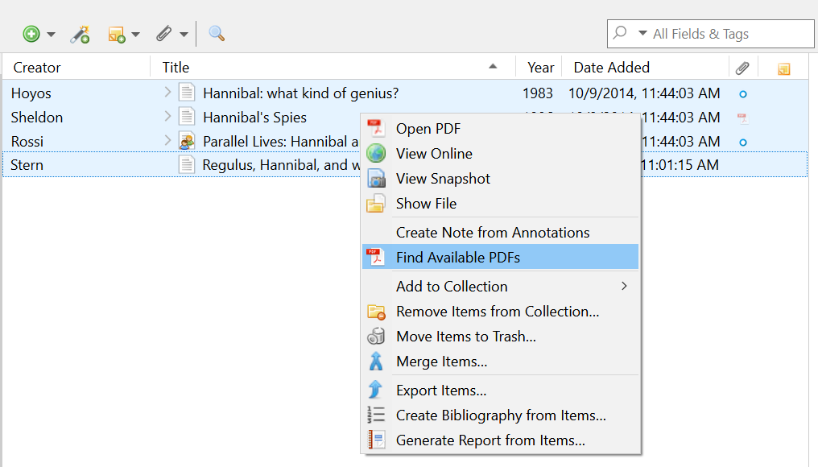
Automation - Zotero
Use the Desktop version
Select references
Right-click
Find Available PDFs
Zotero.Org. Zotero screenshot. Image used with permission.
Background | What it does | Writing with AI | Results
Notes:
Zotero has its own automatic function.
Use the desktop version, select your references, right-click and choose Find Available PDFs

Slide 7
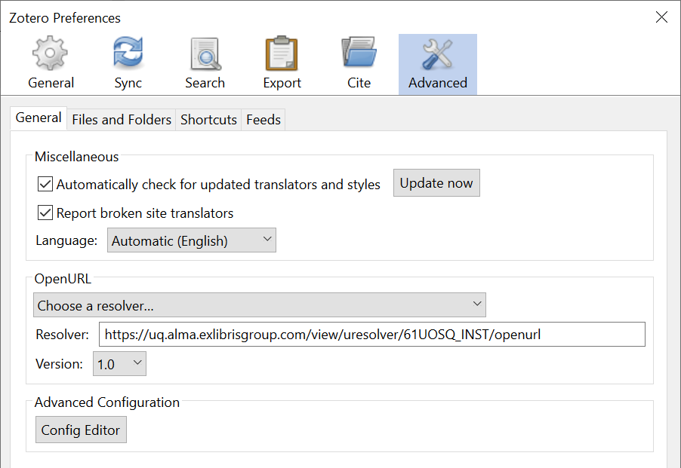
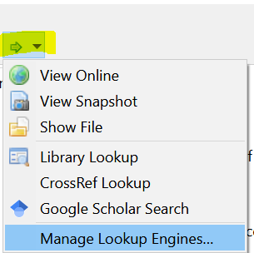
Additional tools - Zotero
Edit > Preferences
Choose OpenURL resolver or type it in
Use the Lookup Engines
Zotero.Org. Zotero screenshots. Images used with permission.
Background | What it does | Writing with AI | Results
Background | What it does | Writing with AI | Results
Notes:
The additional tools in Zotero are what inspired me to create the spreadsheet.
At the top right under a very subtle green arrow you’ll find the LookUp Engines.
These include Library Lookup, CrossRef Lookup, and Google Scholar search.
You can choose or enter your OpenURL resolver for your Library in Edit>Preferences
Clicking on any of the resolvers satisfyingly open a series of tabs searching by title
Then you can click to download the PDF and attach to your reference in your Zotero library, or into your EndNote Library.
So it is still a manual process of saving the actual PDFs, but you don’t have to paste the title into different search engines

Slide 8
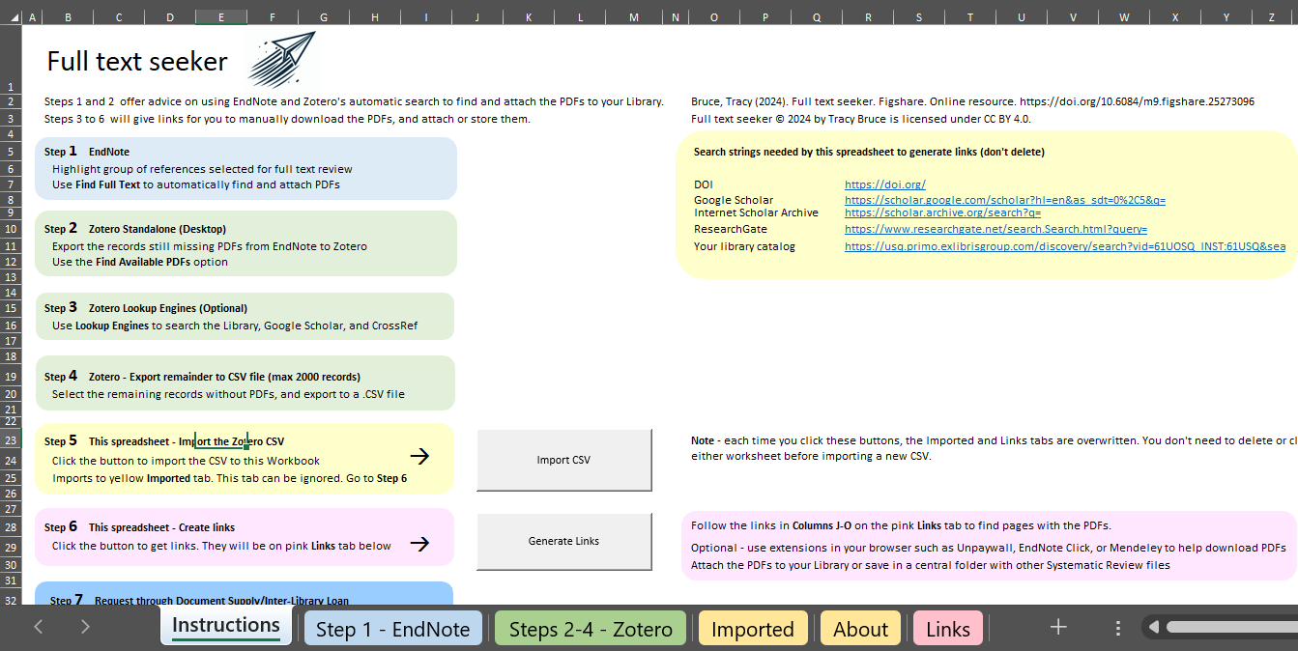
What Full Text Seeker does
Takes imported CSV (from Zotero)
Generates the Links worksheet
Produces clickable URLs
Full text seeker screenshot by author.
Background | What it does | Writing with AI | Results
Notes:
This screenshot shows the Instructions tab. The pre-filled prefixes are in the yellow box on the right.
Steps 1 to 4 explain how to use EndNote and Zotero functions, then to export the CSV from Zotero
Clicking the Import CSV activates the macro to import the file to the Imported tab (an in-between storage space)
Clicking Generate Links activates the macro to concatenate the URLs in the yellow box with the doi and title for each record, and pastes them in the Links worksheet

Slide 9
What Full Text Seeker does
Full text seeker screenshots by author
Background | What it does | Writing with AI | Results
Notes:
This is the resulting Links tab giving each reference’s details, and supplying clickable links for doi.org, Google Scholar, Internet Scholar Archive, ResearchGate, and an optional Library link.
The user still has to click the links to open up the search engines, but is saved the pasting of multiple titles into multiple search engines.
Linking GS to your institutional library can help, and using your own Library search string can either find the article in your collection, or enable the easier requesting of an inter-library loan (in Primo by expanding beyond your own collection)

Slide 10
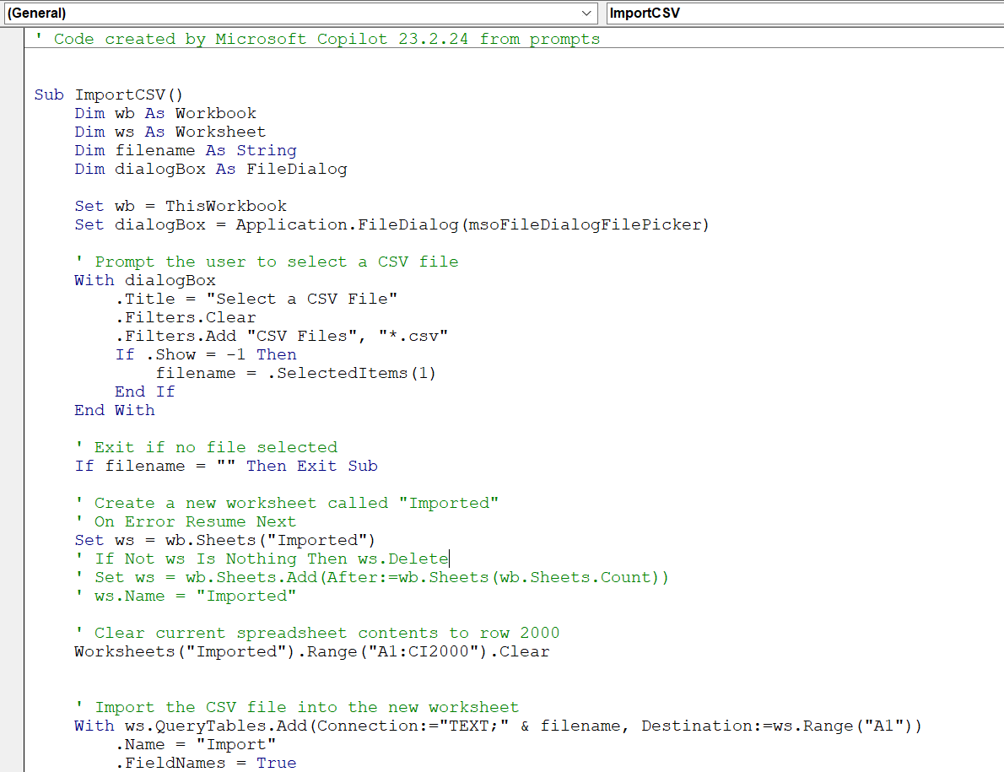
Copilot First Button: Import CSV
Gets the CSV and imports to temp worksheet Imported
Background | What it does | Writing with AI | Results
Notes:
There is macro code from Microsoft Copilot behind 2 buttons and some VBA code that applies to the Links sheet
This was in Feb 24 when it was re-branding at the time from Bing Chat.
Unfortunately I don’t have a record of the prompt I used. Between the switch of Bing Chat to Microsoft Copilot there seems to be a time where your query history isn’t saved.
There seems to be some ability to save now, depending on whether it is a personal or a corporate Microsoft account. I recommend copying and pasting if you want to keep particularly useful prompts/code.
Here’s the code for the first button which imports the CSV file to a new worksheet called Imported

Slide 11
Copilot. Second button – Generate Links
Concatenate title and DOI strings with search string prefixes
Create Links worksheet, paste value of concatenated string
Make links clickable
Background | What it does | Writing with AI | Results
Notes:
I did take a screenshot for prompt response for the second button.
The macro code for the second button
In CoPilot’s response here you can see my detailed prompt telling it what I wanted.
You essentially need to clearly describe the steps you want it to do, a type of pseudocode

Slide 12
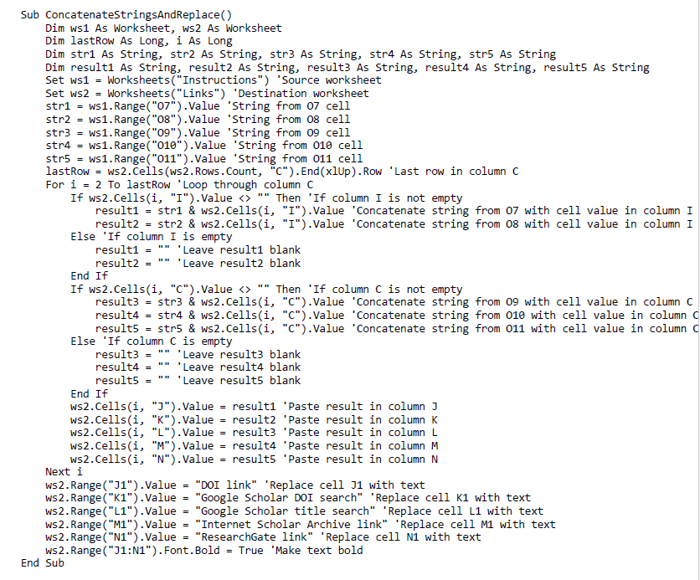
Copilot – Generate Links
Resulting code:
Background | What it does | Writing with AI | Results
Notes:
Because I was creating the macro in steps, the main changes I need to make was renaming or removing variable declarations as CoPilot didn’t know I had already defined some Workbooks.

Slide 13
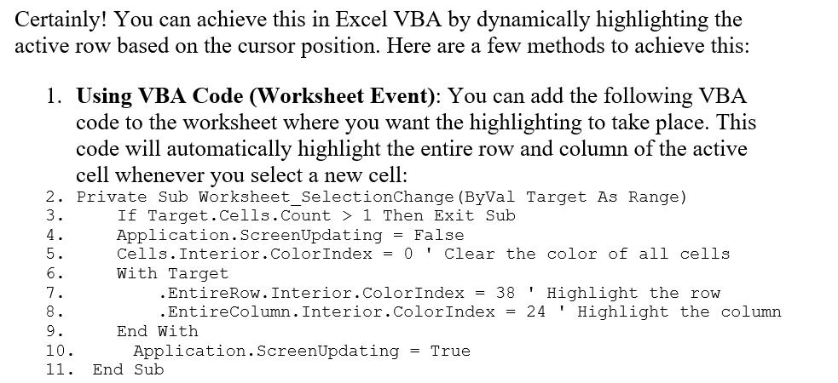
Copilot – additional edits
Prompt::
Response:
Background | What it does | Writing with AI | Results
Notes:
After I released the spreadsheet, I later made some updates. Currently up to version 7.
This one is VBA code that applies to the Links worksheet to automatically highlight the active row, so that a user can see where they are up to.
And last week I added the Library search string column, which brings me to my list of Issues/Challenges

Slide 14
Issues/Challenges
An imperfect understanding of the code / write better comments
Works on Windows only, not on Mac / considering Google Sheets instead
Needs permission for Macro to run / Google Sheets?
Still a manual process to download the found PDFs / harvesting issues
Background | What it does | Writing with AI | Results
Notes:
This was highlighted when I added the extra Library string. I wrote the spreadsheet in February and re-visiting in October meant I had re-comprehend what I’d done so that I could make those changes.
Strongly recommend writing good comments
Mac issue prompted me to start thinking about using Google Sheets. I’m trying Google Gemini.
It is still a manual process to download the PDFs, it would be nice to have some sort of automatic download, but you have to think about the systems that want to prevent bots automatically downloading. Even Google gets suspicious after you’ve clicked on 500 Google links from the spreadsheet.

Slide 15
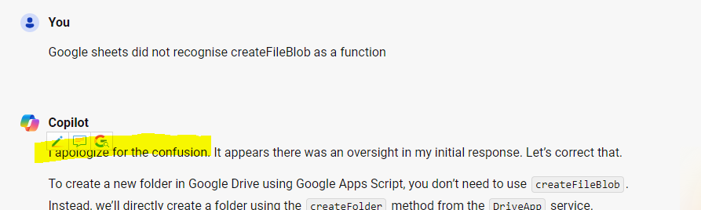
Background | What it does | Writing with AI | Results
Notes:
And an observation more than an issue, I find the human-imitating tone of AI to be irritating.

Slide 16
Results
I have used it for 3 systematic reviews as co-author or advisor
One required 569 articles
346 found using EndNote and Zotero
223 were exported to Full Text Seeker
211 retrieved using the links it generated
12 remained as inter-library loan requests
Background | What it does | Writing with AI | Results
Notes:
Using the tool for this review saved copying and pasting 223 titles up to 5 times each in various search engines.
I routinely use the tool when a researcher needs help finding bulk numbers.

Slide 17
Seeking feedback
Figshare:
https://figshare.com/articles/online_resource/Full_text_seeker/25273096
tracy.bruce@unisq.edu.au
Background | What it does | Writing with AI | Results
Notes:
If you could share with your colleagues who may be conducting reviews, or with your institution Librarians, I’d be grateful to hear of their experiences, and for any feedback to improve it.

Slide 18
Thank you

