Slide 1

Faculty Fellows
NASPA Doctoral Workshop
March 17, 2013
Key Biscayne Room, Orlando, FL
9:00 AM to 4 PM
Anna Ortiz
California State University – Long Beach
Fernando F. Padró
University of Southern Queensland -- Toowoomba

Slide 2
Acknowledgement
We want to thank the support of our colleagues in the Faculty Fellows for helping us out in the recruitment of panel members.
We also need to acknowledge Tim Ecklund who was the co-leader of this workshop the past two years and from whose PowerPoint presentation from last year we liberally borrowed.

Slide 3
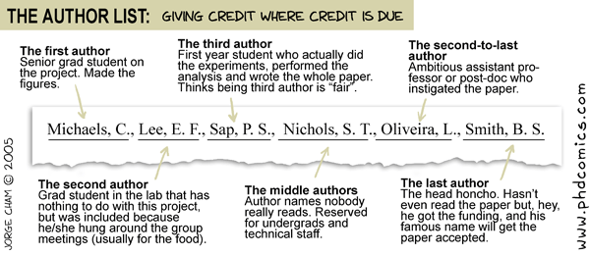

Slide 4
Day’s Agenda: Sunday, March 17th
9-9:30 Introductions and Overview
9:30-10:30 What Makes a Successful Doctoral Student
10:45-noon Overcoming Hurdles in the Journey
1-1:30 Sharing Strategies
1:30-2:30 What's Next? Various Career Directions
2:30- 3 Final Questions, Words of Wisdom, Evaluations

Slide 5
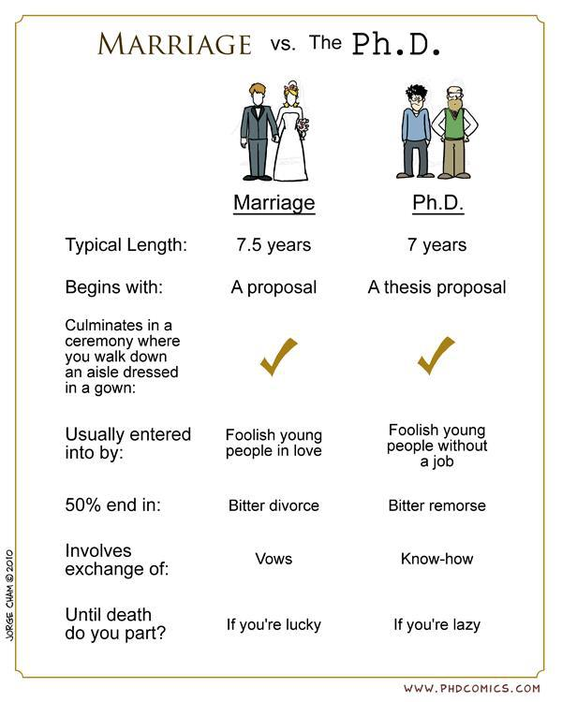

Slide 6
Part 1. Introduction
9:00 a.m. – 9:15 a.m. Introduction of participants - Fernando Padró
9:15 a.m. – 9:30 a.m. Overview of seminar goals and panel – Anna Ortiz

Slide 7
Who are you?
When looking at 28 applications, states represented (HEI location): 15
Arizona
Arkansas
California
Florida
Illinois
Indiana
Kansas
Louisiana
Maryland
Mississippi
New Jersey
Ohio
South Carolina
Texas

Slide 8
Who are you?
Again, out of 28 applications reviewed:
N full time students: 20
N part-time students: 6
N non matriculated: 1
No information: 1
N students taking courses: 22
N students completing comps soon: 5
N students at dissertation stage 4
No information: 2

Slide 9
Who are you?
Once more, out of 28 applications reviewed:
N respondents indicating a future as full-time administrator: 4
N respondents indicating a future as full-time faculty: 6
N respondents indicating a future as a combination: 14
N respondents indicating a different future: 2
No information: 2

Slide 10
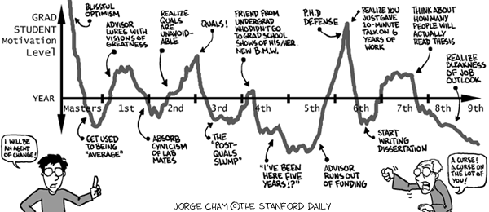

Slide 11
Why are you here?
a. Networking with other doctoral students
b. Getting to know some new faculty in the field
c. Getting ideas for dissertation topics
d. Learning tips on surviving doctoral programs
e. Having a perspective on professional options after graduation
f. A combination of these
g. Other

Slide 12
Part 2. 9:30 a.m. – 10:30 a.m. What Makes A Successful Doctoral Student
Panel: Elizabeth Allen, Logan Hazen, John Wesley Lowery, Robert Schwatrz
Facilitator: Fernando Padró
Break: 10:30-10:45

Slide 13
Perspectives from Experienced Faculty
What are some keys to success?
What gets our most successful students through it?
What other advice do we have?
What is our story?

Slide 14
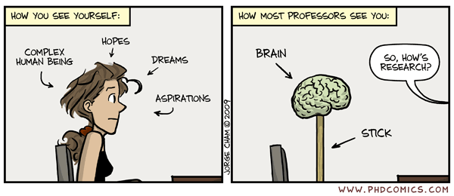

Slide 15
Suggested readings on what the doctoral journey is all about
For a quick dissertation rubric pamphlet:
Lovitts, B.E., & Wert, E.L. (2008). Developing quality dissertations in the social sciences: A graduate student’s guide to achieving excellence. Sterling, VA: Stylus Publishing, LLC.

Slide 16
Suggested readings on what the doctoral journey is all about
Berliner, D.C. (2002). Educational research: The hardest science of all. Educational Researcher, 31(8), 18-20.
Gardner, S.K., Hayes, M.T., & Neider, X.N. (2007). The disposition and skills of s PhD in Education: Perspectives of faculty and graduate students in one College of Education. Innovative Higher Education, 31(5), 287-299.
Gardner, S.K. (2008). “What’s too much and what’s too little?”: The process of becoming an independent researcher in doctoral education. The Journal of Higher Education, 79(3), 326-350.
Hawley, P. (2010). Being bright is not enough: The unwritten rules of doctoral study. (3rd ed.). Springfield, IL: Charles C. Thomas.
Kamler, B. (2008). Rethinking doctoral publication practices: Writing from and beyond the thesis. Studies in Higher Education, 33(3), 283-294.
Krathwohl, D.R. & Smith, N.L. (2005). How to prepare a dissertation proposal: Suggestions for students in
education & the social and behavioral sciences. Syracuse, NY: Syracuse University Press.
Labaree, D. (2003). The peculiar problems of preparing educational researchers. Educational Researcher, 32(4), 13-22.
Pilkington, R.M. (2009). Practitioner research in education: The critical perspectives of doctoral students. Studies in the Education of Adults, 41(2), 154-174.
Tierney, W.G., & Holley, K.A. (2008). Inside Pasteur’s Quadrant: knowledge production in a profession. Educational Studies, 34(4), 289-297.
Wright, L.L., Lange, E., & DaCosta, J. (2009). Facilitating adult learning and a researcher identity through a higher education pedagogical process. US-China Education Review, 6(11), 1-16.

Slide 17
Part 3. 10:45 a.m. – 11:45 p.m. How do I Succeed as a Doctoral Student?
Panel: Michael Preston, Cynthia Morales
Facilitator: Anna Ortiz

Slide 18
Perspectives from the Panel
What were some keys to our success?
What got us through it?
What other advice do we have?
What is our story?

Slide 19
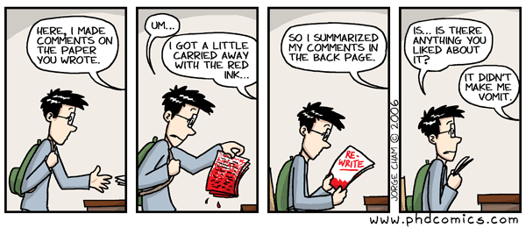

Slide 20
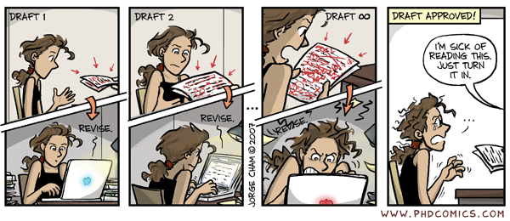

Slide 21
Part 4. 11:45 – 12:00 p.m.
Small group meeting by stage in doctoral program (Check your dot)
Task:
Get together into small groups based on the dot you have. Get together as a group and talk about :
What are your issues and challenges as a doctoral student/candidate?
What do you need from the group?
You’ll be reporting your results after lunch.

Slide 22
Focus/Small Group Perspectives
What about your story?
What got you in, through, and almost out of your doctoral studies?
What’s works from your experience?
What are some keys to your success?

Slide 23
12-1: Lunch – On your own, unfortunately
Go to the food court and get some lunch. If you’d like, please return to the room and continue your discussion as small groups related to the questions you will be reporting on.
This is also another opportunity to network with peers and panelists and Faculty Fellows who remain behind to share lunch with you.

Slide 24

Seminar faculty and NASPA Faculty Fellows
will join students for the
Annual NASPA Doctoral Seminar
“No Free Lunch!” Lunch
“After all, it’s your money!”
(Strange, 2010)

Slide 25


Slide 26
Welcome
Back! Glad you decided to come back
NASPA Doctoral Seminar: Part II

Slide 27
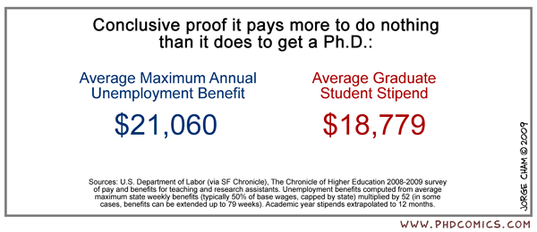
Thought of the day

Slide 28
Part 5. 1:00 p.m. – 1:30 p.m. Group reports
What are your issues and challenges?
2. What do you need from the group?

Slide 29
Part 6. 1:30 p.m. – 2:30 p.m. What’s Next? – Practitioner, Scholar, Practitioner/Scholar Panel
Panel Members: Logan Hazen, Lori Patton, Lea Jarnagin
Facilitator: Fernando Padró

Slide 30
Scholar to Practitioner Continuum
Pure Scholars: faculty who write articles, books, and scholarly pieces, predominantly based on original research.
Scholar/Practitioners : faculty or administrators who produce scholarship that is a hybrid of original research and application to practice.
Practitioner/Scholars: administrators who write and contribute to knowledge through reflection and research.
Practitioners: administrators who do not conduct research or scholarship but use theory and scholarship in their practice.
Non-consumers: administrators (and rarely faculty) who eschew scholarship, theory, and research as meaningless for their position. (Kinzie 2011)

Slide 31
Where do you fit?
Education Sector (profit/nonprofit; policy; member organizations)
Practitioner
Faculty
Researcher
Scholar
Application, Doing, Manage, Coordinate, Problem-solve, Lead
Consult, Research, Manage, Coordinate, Advocate, Application
Ask questions, Conduct analyses, Interpret results, Write reports, Communicate findings
Teach, Advise, Write, Research

Slide 32

What do you aspire to be?
a. Pure Scholar
b. Scholar/
Practitioners
c. Practitioner/
Scholars
d. Practitioner
e. Non-Consumer

Slide 33
Panel Discussion – Perspectives from those in the Field
What path did you think you would take after you completed your doctorate?
How did you decide to take the path
you are on now?
When did you know you made
a good choice?

Slide 34
Part 7. 2:30 p.m. – 3:00 p.m.
Final questions, comments, inspirations and evaluations
Facilitator: Fernando Padró

Slide 35
What did you think?
Closure and Evaluation
What did you learn today?
What commitments have you made?
What’s your next step?

Slide 36
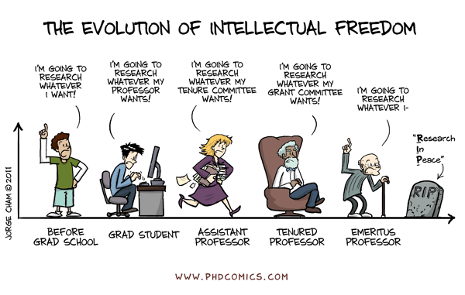

Slide 37
Right now I’m feeling:
a. Excited
b. Anxious
c. Overwhelmed
d. I need more coffee
e. In a place where I need to be
f. Ready to rock and roll

