Slide 1
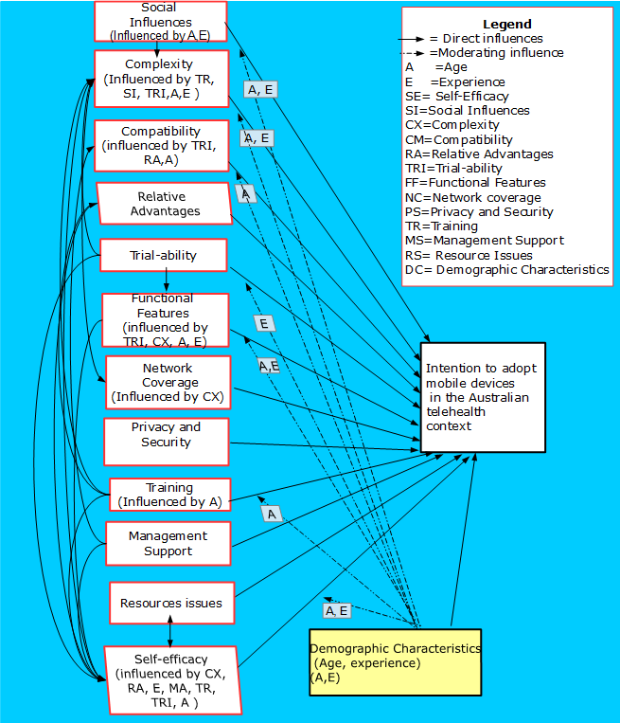
What factors determine healthcare professionals’ (HCPs) acceptance of mobile devices for telehealth: A qualitative study conducted in Queensland, Australia
Vasundhara, Rani, Sood, University of Southern Queensland, Australia, Vasundhara.Rani@usq.edu.au
Dr. Abdul Hafeez, Baig, University of Southern Queensland, Australia, Abdul.Hafeez-Baig@usq.edu.au
Prof. Raj, Gururajan, University of Southern Queensland, Australia, Raj.Gururajan@usq.edu.au
Objective
Even though mobile device based telehealth has the potential to monitor patients in the home bed side environment, yet the static model of telehealth is widely used. For a telehealth session patients have to arrive at the health facility for teleconsultation. The use of mobile device based telehealth services in many health activities such as telemedicine, patients’ records, treatment and monitoring is slow. Most of mobile device based telehealth services are used in text messaging and calling. Therefore, the aim of this research is to explore the perceptions and experiences of the healthcare professionals for the use of mobile devices in telehealth.
Proposed Model
The factors influencing adoption of mobile devices in the Australian telehealth environment are investigated using qualitative approach. Six focus group discussions, each group having 5-7 members and 2 interviews were used to collect qualitative data. The target population was healthcare professionals such as occupational therapists, physiotherapists, dietitians and oral health practioners involved with the provision of telehealth services.
Results
As shown in figure 1, in Queensland, health care professionals’ intention, self-efficacy, compatibility, relative advantages, education and training, management support, network coverage, privacy and security, resource issues, trialability, age and experience with technology use were found to be important factors for the use of mobile devices whereas social influences, functional features of mobile devices and complexity were found to be conflicting factors among various HCPs for the use of mobile devices in the Australian telehealth environment.
Contributions
Figure1: Factors influencing adoption of mobile devices in the Queensland telehealth environment
Factors obtained in this research can serve as a guide to the policy makers and mangers to implement mobile devices in telehealth which can further increase the use of mobile devices in telehealth. The increased use of mobile devices can reduce organisational costs, personalize illness management, enhance convenience and improve efficiency of the healthcare system.

