Slide 1
Synthesising socioecological frameworks, impacts of social determinants and strengths-based paradigms - imperatives for efficacy in health education and health promotion.
Susan Wilson-Gahan

Slide 2
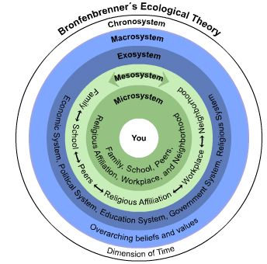
Synthesising - blending, combining, integrating
socioecological frameworks

Slide 3
Social determinants of health
The primary factors that shape the health of an individual are largely determined by their living conditions (Mikkonen & Raphael, 2010).
This includes the amount of income, housing, employment, resources to obtain food and social support
“A far greater determinant is the sometimes toxic relationship between how we live our lives and the economic, social and physical environments that surround us.
Some of the factors affecting our health we certainly can influence on our own; many of the factors, however, are outside our individual control” (Robert Wood Foundation, 2008, p. 1).

Slide 4
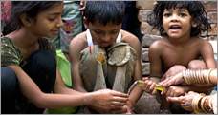
The World Health Organisation (WHO) (2009) refers to these factors as the ‘social determinants of health’ and identify that these factors are the most important indicators of health.
Health risk factors experienced by large numbers within populations are seen by The World Health Organisation as “a toxic combination of poor social policies and programs, unfair economic arrangements, and bad politics” (World Health Organisation, 2008, p. 1).

Slide 5
Social determinants of health are largely influenced by how income and wealth are distributed and the living and working conditions we experience. Remember the what did you do this morning before you came to Uni discussion? How many of these things do you control? Maybe not as many as you think…
Health is also shaped by the health services we are able to access and our ability to obtain the basic necessities such as clean drinking water, food, housing and education.
Many people believe that they are in control of these imperatives, however, to a large extent, these health-shaping factors are strongly determined by governments, communities and health agencies, social service agencies and a range of public policy domains.

Slide 6
Health Promotion
Health promotion is the process of enabling people to increase control over, and to improve, their health.
To reach a state of complete physical, mental and social well-being, an individual or group must be able to identify and to realize aspirations, to satisfy needs, and to change or cope with the environment.
Health is, therefore, seen as a resource for everyday life, not the objective of living.
Health is a positive concept emphasizing social and personal resources, as well as physical capacities.
Therefore, health promotion is not just the responsibility of the health sector, but goes beyond healthy life-styles to well-being.

Slide 7
Prerequisites For Health
The fundamental conditions and resources for health are:
peace,
shelter,
education,
food,
income,
a stable eco-system,
sustainable resources,
social justice, and equity.
Improvement in health requires a secure foundation in these basic prerequisites

Slide 8
Advocate
Good health is a major resource for social, economic and personal development and an important dimension of quality of life.
Political, economic, social, cultural, environmental, behavioural and biological factors can all favour health or be harmful to it.
Health promotion action aims at making these conditions favourable through advocacy for health.

Slide 9
Often the medical profession notice trends in illnesses or signs and symptoms of illnesses. They report to health authorities and governments and advocate for funding to find out more about the health concern and to act on it.
Sometimes it is community groups or emergency services that advocate for change in response to an issue: e.g. road trauma incidents caused by unsafe road; gay activists promoting safe sex to prevent the spread of HIV/AIDS; non-smokers advocating for smoke free zones
It can be individual stakeholders or small groups of stakeholders that initiate advocacy based on an experience or the experience of a loved one .
Research is initiated and reports are made. Directions for health promotion action are formulated.

Slide 10
Enable
Health promotion focuses on achieving equity in health.
Health promotion action aims at reducing differences in current health status and ensuring equal opportunities and resources to enable all people to achieve their fullest health potential.
This includes a secure foundation in a supportive environment, access to information, life skills and opportunities for making healthy choices.
People cannot achieve their fullest health potential unless they are able to take control of those things which determine their health. This must apply equally to women and men.

Slide 11
Mediate
The prerequisites and prospects for health cannot be ensured by the health sector alone.
More importantly, health promotion demands coordinated action by all concerned: by governments, by health and other social and economic sectors, by nongovernmental and voluntary organization, by local authorities, by industry and by the media.
People in all walks of life are involved as individuals, families and communities. Professional and social groups and health personnel have a major responsibility to mediate between differing interests in society for the pursuit of health.
Sometimes it is necessary to mediate between two or more opposing views in health issues. For example – in the issue of smoking, smokers v’s non-smokers; health authorities v’s tobacco industry, plain packaging advocates v’s shop owners, etc

Slide 12
Health promotion strategies and programs should be adapted to the local needs and possibilities of individual countries and regions to take into account differing social, cultural and economic systems
Health Promotion Action: there are five areas where action can be taken in varying degrees to ensure the health promotion action has the most likelihood of success.
Build Healthy Public Policy
Create Supportive Environments
Strengthen Community Actions
Develop Personal Skills
Reorient Health Services
Think about what actions were taken in Australia to address the increasing rates of smoking related diseases for both active and passive smokers in each action area below. Make a list – it will help.

Slide 13
Efficacy of health education and health promotion can be increased through assuming the principles of social justice - diversity, equity and supportive environments and adopting approaches cased in positivity and strengths-based paradigms
Leger and Nutbeam, 2000; ACARA, 2012.

Slide 14
Additionally, diverse cultural perspectives must be considered in the compilation and delivery of information and in the formulation of strategies
Ajzen and Fishbein, 1980.

Slide 15
Social justice principles
Social justice principles of Diversity, Equity, Supportive Environments are underpinning imperatives for achieving positive outcomes and intercultural understandings in health education and health promotion.

Slide 16
Health education and health promotion initiatives are more effective and more likely to result in adoption of beneficial health practices, attitudes and values if intercultural exchanges are an integral part of all propositions
(Glanz, Lewis and Rimer, 1997).

Slide 17
Evaluating the impact of these approaches on the knowledge, understandings and skills of population groups is challenging given that the uptake of health promoting behaviours is a long term proposition and health values are hard to quantify
Glanz, Lewis and Rimer, 1997; Ajzen and Fishbein, 1980.

Slide 18
WHO,1986; WHO, 1997; Nutbeam, 1996.
This research highlights the importance of whole of settings approaches and contends that interculturally inclusive and sensitive conversations are a prerequisite to the realisation to health education and health promotion initiatives
Look at sun safety, bullying, nutrition and physical activity... one context and one approach does not fit all
Consider that policies may be effective short term but do they establish behaviours for life – adolescents and sun safety. What happens to ‘no hat, no play’ when students turn 13?

Slide 19
Health literacy
Health literacy is a core component of the HPE curriculum at primary and secondary levels.
Its importance is underscored by ongoing concerns over issues such as diabetes, dental decay, unhealthy eating and young people's own concerns over drugs, body image, stress, depression and other health concerns.
Health advocates warn of insufficient resources to address these issues.
PE and sports advocates cite children's poor fitness and motor skills as priorities.
What is health education about and who is it for?
What should health education prioritise?
Notes:
Australian curriculum 0 rationale and aims.

Slide 20
Common misconceptions about health education and health promotion
Health is mainly concerned with the body…false
Health is multidimensional and the dimensions included in the school curriculum are mental, emotional, social, physical and spiritual
The main health concerns in term of morbidity and mortality for children are obesity and inactivity…false
The main health concerns for Australian children and adolescents in terms of morbidity and mortality are accidents and poisonings followed by cancers and mental health
Focus in health education and health promotion should be on these main health concerns…false
Teachers are not qualified to ‘solve’ these concerns and the cancers referred to on the statistics are unsolvable through education
Teachers can teach the information as required by the curriculum – the rest is for professionals and experts and starts earlier in life

Slide 21
Impact of socioecological systems on develop of health and health behaviours

Slide 22
The foundations of lifelong health are built in early childhood
Foundations of Healthy Development
Creating a Stable and Responsive Environment of Relationships
Safe and Supportive Chemical, Physical, and Built Environments
Sound and Appropriate Nutrition
Health in the earliest years—actually beginning with the future mother’s health before she becomes pregnant—lays the groundwork for a lifetime of well-being … health education and promotion are adjuncts, with the most ‘at risk ‘ being the least enabled to act on health education and promotion information.

Slide 23
The foundations of lifelong health are built in early childhood.
Poor health early in life also imposes significant societal costs that are borne by those who remain healthy. For example, when large numbers of children become ill because they did not receive their immunisations, the entire population becomes vulnerable to epidemics of infectious diseases.
The consequences of adversity and poor health in childhood can lead to higher rates of chronic diseases in adults, such as diabetes, hypertension, cardiovascular disease, and various forms of cancer, as well as depression, anxiety disorders, addictions, and other mental health impairments.

Slide 24
These conditions affect all of society by reducing the productivity of the workforce and increasing the incidence of disability, the demand on medical facilities, and the costs of medical care.
A focus on health promotion in the early childhood period—where an extensive body of evidence supports the promise of effective prevention programs that can change the trajectory of children’s lives—can help reduce the social and economic burdens of illness, not only in childhood but also throughout the adult years.

Slide 25
Nations with the most positive indicators of population health, such as longer life expectancy and lower infant mortality, typically have higher levels of wealth and lower levels of income inequality
Children’s health is a nation’s wealth, as a sound body and mind enhance the capacity of children to develop a wide range of competencies that are necessary to become contributing members of a successful society.
Adverse events or experiences that occur early in childhood can have lifelong consequences for both physical and mental well-being.
Developmental and biological disruptions during the prenatal period and earliest years of life may result in weakened physiological responses (e.g., in the immune system), vulnerabilities to later impairments in health (e.g., elevated blood pressure), and altered brain architecture (e.g., impaired neural circuits).
Does this mean health education and promotion are a waste of time?

Slide 26
The connection between early life experiences and the health of a nation underscores the importance of strategic investments in the care and protection of pregnant women, infants, and young children. It suggests that most current attempts to prevent adult disease and create a healthier workforce may be starting too late.

Slide 27
Let’s consider what this means…
By the time children reach school age and are exposed to health education and promotion, their life health outcomes have been set in motion and for some, intervention is needed
The importance of Early Childhood settings becomes obvious
‘The National Early Years Learning Framework’ supports the importance of health education and health promotion
A child’s environment of relationships can affect lifelong outcomes in emotional health, regulation of stress response systems, immune system competence, and the early establishment of health-related behaviours.

Slide 28
School-based health education (SBHE), while 'littered with well-intentioned and thoroughly researched programs', has failed to gain sustained purchase within the core business of Australian classrooms
The approach does not resonate with students or staff.
There has been limited support and training to ensure the uptake of SBHE principles and pedagogical approaches.
As a result, schools have tended to rely on externally based health promotion professionals and agencies, sometimes via one-off presentations, to deliver health messages.
By contrast, the 'health literacy' approach offers a chance to improve health education in schools – it is inquiry based rather than knowledge based. Let’s use alcohol as an example…
Health literacy replaces a 'downstream', pathogenic, illness-solving approach to health with a 'salutogenic' model that emphasises an individual's access to and use of resources to create and maintain healthy living conditions.
It includes critical elements that help individuals address barriers to good health and involves awareness of the multimodal forms in which health messages are delivered.

Slide 29
Personal habits of children and adolescents related to health are influenced by various determinants in the micro and macroenvironment. These include attitudes and behaviours about eating; exercise and physical appearance modelled by parents, teachers, and peers; as well as opportunities to learn new habits and social praise for healthy choices. The coordinated school health program is compatible with an ecological approach to developing new health behaviours. Evans RR, Roy J, Geiger BF, Werner KA, Burnett D. Ecological Strategies To Promote Healthy Body Image Among Children. J Sch Health. 2008; 78: 359-367.

Slide 30
One element of health literacy is 'Code-breaking', which includes the ability to interpret nutritional information and prescriptions and labels, learn relevant terminology and seek further information. Another element is meaning-making, as the individual relates the information they receive to prior knowledge about their own situation, including their cultural context, as a basis to decide what they could afford or manage in terms of health care, to balance costs and benefits, and to reflect on past experiences. A third element of health literacy is the pragmatic application of skills and knowledge to the way that they cook, exercise and live. The final element is critical analysis of who provides health advice and why, how others are affected by one's health choices, the sustainability of these choices, and possible alternatives.

Slide 31
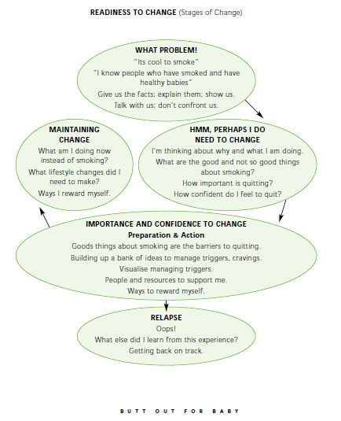
Department of Human Services (DHS), Tobacco Control Unit. South Australia (SA).

Slide 32
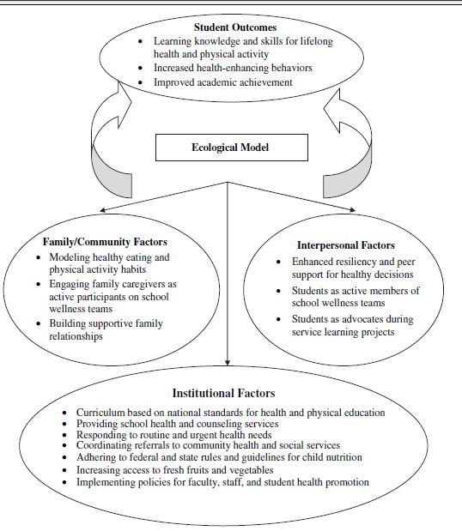
Application of the ecological model to a comprehensive school health program Journal Of School Health D July 2008, Vol. 78, No. 7 D ª 2008, American School Health Association

Slide 33
What do kids care about?
Body image
Relationships
Being safe and secure and loved – belonging
Drugs of all types including alcohol
Sex – including sexuality

Slide 34
How should this ‘fit’ with health education and health promotion initiatives?
Diversity – a health literacies approach and strengths-based paradigms afford flexibility for students to personalise health learning through inquiry.
Equity – an understanding about the impacts of social determinants of health enables schools to make informed decisions about policies and programs – such as ‘no hat, no play’, nutrition education and bullying policies
Understanding of the impacts of diversity and inequity on students’ health behaviours enables the school to advocate for health outcomes and to create environments that support the health and wellbeing of their specific student demographic.

Slide 35
Educators may effectively use a coordinated approach to guide multiple intervention activities aimed at increasing positive health behaviours among children, adolescents and their families.
The strength of comprehensive school health programs is the collaborative nature, with active participation by students, faculty members, family and caregivers, agency professionals, community residents, and health care providers.

