Slide 1
“You can be good enough… you can be great!”
Defining the needs of CALD students in an Accelerated Entry Pathway Program
Tatra Palfery, Heejin Chang, & Daniel Crane

Slide 2
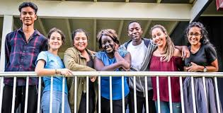

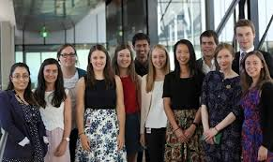
Culturally and linguistically diverse (CALD) students

Slide 3
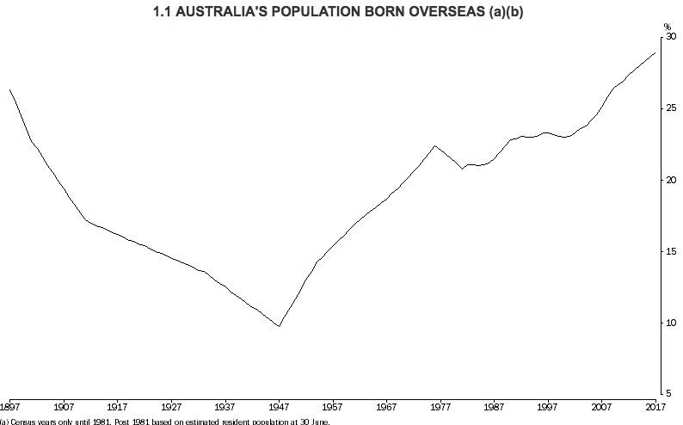
What do we already know about this topic?
Australia is one of the most ethnically diverse societies in the world (Australian Bureau of statistics (ABS, 2018)

Slide 4
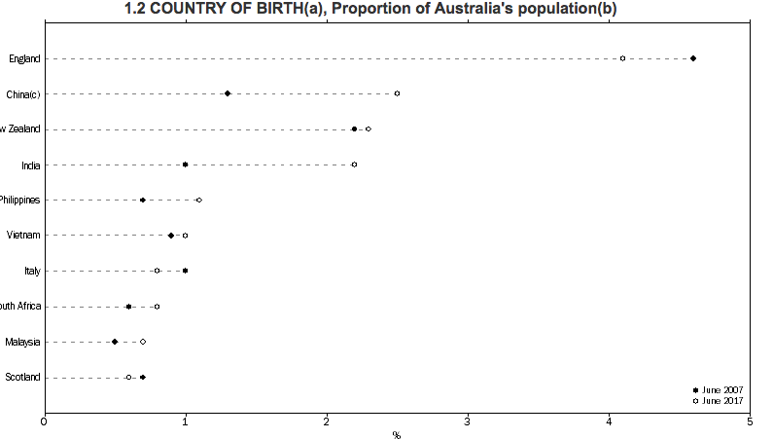
What do we already know
about this topic?
2017 2007
2007 2017
England decreased from 4.6 % to 4.1% in 2017
China increased from 1.3% to 2.5%, New Zealand 2.2% to 2.3% and India from 1.0% to 2.2%

Slide 5
Definition
Describes first- and second-generation individuals, whereby the former are those born overseas and the latter have parents born overseas (National Medical Health and Medical Research Council, 2005).
Do not speak English as their primary language.
Identified on the basis of language, religion, or culture of origin (Khoo & Lucas, 2001)

Slide 6
Definition
Generally, two categories of people who are described as being of CALD background: migrants and refugees.
  migrants: move voluntarily from one place to another to find better educational and employment opportunities and living conditions (Ward, Bochner, & Furnham, 2001)
  refugees: move involuntarily to flee from life-threatening situations and persecution to find a safe place with better life conditions and opportunities (UNHCR, 2007)

Slide 7
A better life
Even though these two groups may vary on:
  the original cause of relocating to a new country,
  migration process, and
  demographics
Experience similar types of adjustment-related stressors and share a common purpose of adapting to a new country to secure a better life.
Most demonstrate resilience, positive adaptation and acculturation (Khawaja, Moisuc, & Ramirez, 2014)

Slide 8
Research question
Does the cultural and linguistic background of a student affect their learning approaches/processes/ outcomes?

Slide 9
Accelerated Entry Pathway Program (AEPP)
AEPP is a university pathway program especially designed for Year 12 leavers to help smooth the transition from school to university.
Entry criteria:
    Current Year 12 student.
    Taking a non-OP pathway or OP pathway
    Planning on taking tertiary studies
    Want to find out what university study is like
    Want to learn how to manage university study and university life
    Need to meet university English pre-requisite

Slide 10
Funding for AEPP
  Higher Education Pathway Program (HEPP) Funding (2012 [N=20]→present [N=~200])
  Federal government funding
  Targets: first in family, low SES, under-represented youth, CALD background…
  Covers the entire cost of teaching, materials, food, and residential housing for students who attend in Toowoomba from rural and regional areas

Slide 11

Youth statistics
CALD/NESB Students in AEPP
CALD Youth in Australia
2018
28% from CALD (27% NESB) background
2017 (NESB)
30%
2016
25% (NESB)
2014
27% from CALD background

Slide 12
AEPP Results 2017-2018
Describe first- and second-generation individuals,
here by the former are those born overseas and the latter have parents born born overseas (National Medical Health and Medical Research Council, 2005).
Do not speak English as their primary language.
Identified on the basis of language, religion, or culture of origin (Khoo & Lucas, 2001)
Blue=TransitionNESB; Orange=Literacies NESB; Gray=Transition nonNESB; Yellow: Literacies nonNESB

Slide 13
Qualitative Survey Data
Students are primarily interested in entering: nursing, education, international law, civil engineering and medicine
“Because of the language I had only come to Australia and English a bit difficult”.
“I am very hard working, and I come from a culture background where girls do everything in the house, so it will be challenging”.
“I couldn't really understand the teacher as he had a strong accent”.
“English is not my strongest subject”

Slide 15
AEPP to U/G Results Nov 2018
Describe first- and second-generation individuals,
here by the former are those born overseas and the latter have parents born born overseas (National Medical Health and Medical Research Council, 2005).
Do not speak English as their primary language.
Identified on the basis of language, religion, or culture of origin (Khoo & Lucas, 2001)
Blue=TransitionNESB; Orange=Literacies NESB; Gray=Transition nonNESB; Yellow: Literacies nonNESB

Slide 16
AEPP to U/G Results Nov 2018
GRADE HD A B C F OTHER
AEP1111 NESB 2 10 10 3 1 3
AEP1112 NESB 0 3 7 9 5 5
AEP1111nonNESB 8 29 19 10 12 14
AEP1112nonNESB 5 9 27 14 20 23

Slide 17
Explaining the disparity in outcomes between NESB and non-NESB students
Many more NESB students are working > than 15 h/week during the program
Language
Family/other responsibilities-domestic, family business
…

Slide 18
AEPP Demographic Data 2018-19 Cohort (as of November 26/18)
Total applications: 196
Identify as NESB: 49 (27%)
52 (28%) born outside Australia
25 Other Country of Birth
Notes:
Many from Africa including Congo, Sudan, Tanzania, Kenya, Uganda, Rwanda, Sierra Leone; then NZ/Pacifica students

Slide 19
Proposed strategies/interventions to improve CALD student outcomes
Administer ALL test at start of program, and strongly recommend attendance at optional sessions to students who perform poorly
Availability of additional language support in labs
Distribute CALD students between the different classes/ study groups

Slide 20

“You can be good enough… you can be great!”

