Slide 1

Pass
Original Artwork
Artist: Rhiannan Johnson
[Original Work Submission Year: 2024]

Slide 2
Pass is an acrylic painting on board which interrogates facets of the Australian landscape. This work focuses on regionality, everyday environments, and the intersection between natural and built environments.
Original Artwork – Visual Arts
Rhi Johnson (UniSQ)
[Original Artwork Submission – 2024]

Slide 3
RESEARCH STATEMENT – Pass [Original Artwork]
Background: There is much to be explored about artworks that focus on the intersection between natural and built environments. Contemporary scholars such as Mednick (2018) argue that these intersections exemplify notions of landscape painting as a form of 'cultural construction' rather than simply a mechanism for visual reproduction, and subsequently, it deploys painting as both a representation of self and inhabited environments (Cosgrove, 1984).
Contribution: 'Pass' is an original acrylic painting on board which interrogates facets of the Australian landscape. 'Pass' engages with the contemporary dialogue surrounding landscape painting practices and contributes new insight about the convergence of nature and built environments and beauty and utility in regional Australian contexts.
Significance: ‘Pass’ was selected as a finalist in the Corner Store Gallery’s 2024 Regional Landscape Prize, a biannual, juried exhibition and award for established and emerging artists living in regional, rural and outback Australia. Curated by Madeline Young (Gallery Director, The Corner Store Gallery) and Sarah Thomas (Director, Gallery Alchemy), the exhibition showcased ‘Pass’ alongside 52 other outstanding works at The Corner Store Gallery in Orange, NSW, and was documented in a full-colour catalogue.

Slide 4
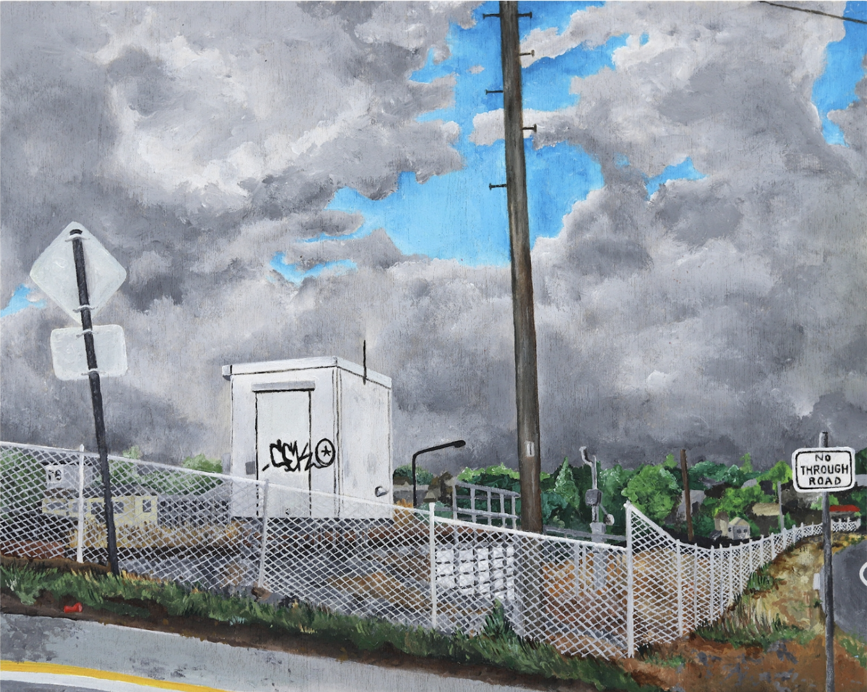
Pass 2024
Rhiannan Johnson
Acrylic paint
on board

