Slide 1
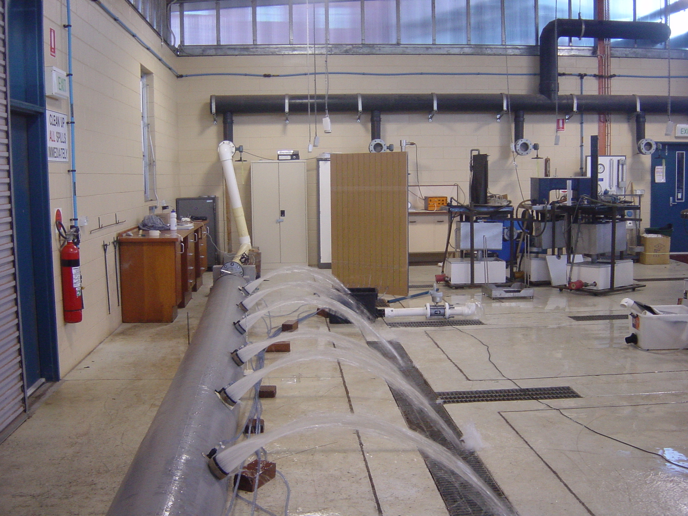
Hydraulic characteristics of large diameter gated flexible fluming
Richard Koech, Rod Smith and Malcolm Gillies
CRC Cotton Catchment Communities and National Centre of Engineering in Agriculture (NCEA)
University of Southern Queensland (USQ), Toowoomba
Introduction
Furrow irrigation, and particularly the use of overbank siphons, is the dominant method used for the irrigation of cotton in Australia. However, this system is labour-intensive and often inefficient. Gated flexible fluming (or layflat) is a possible alternative to siphons, particularly for automated furrow systems. Layflat is relatively low-cost, easily transportable and requires minimal storage space. Layflat is widely used in the sugar industry, but has so far not been successfully applied in the cotton industry because of the high flow rates required.
Objectives of study
Results and discussion
This study was undertaken at USQ to establish the flow characteristics of large diameter gated layflat under low heads and high flow rates. The specific objectives of the trials were to:
assess the ability of fluming to deliver high flows;
assess the uniformity of outlet discharges at these high flow rates; and
to develop head-discharge equations for the plastic outlets supplied with the fluming.
The maximum average outlet discharge with the valves removed was 6 l/s at a pressure in the layflat of 600 mm. A much lower outlet flow rate of 2.5 l/s at a pressure head of 1100 mm was measured for valves in the fully open position.
Hence this type of gate with the valves fully open is unsuitable for the high flow rates required at the low heads available in the cotton industry. Removal of the valves gives higher flows but significant erosion in the furrow is likely to occur.
Use of socks on the outlets to mitigate this erosion and new outlet configurations without valve inserts require further study.
The outlet flow DU ranged from 92.7 to 99.7%.
Two-parameter non-linear regression analyses (Fig. 2) gave outlet characteristic equations for outlets with the valves removed (Eqn. 1) and outlets with valves in the fully open position (Eqn. 2).
Q = 7.52H^{0.443} (Eqn. 1) Q = 2.32H^{0.558} (Eqn. 2)
where Q is the outlet discharge (l/s) and H is the pressure head (m) at the outlet.
These equations were incorporated into hydraulic simulation program GPIPE and the predicted and measured discharges were found to correlate well.
Materials and methods
Trials were conducted on a 12 m long 425 mm diameter layflat (Fig. 1).
Ten 50 mm outlets complete with valve inserts were installed in the layflat at 1 m spacings.
Water was drawn from an elevated header tank maintained at constant head.
Seven trials were conducted at various pressures and flow rates (four with the valves fully open and three with the valves removed).
Outlet characteristics measured were: discharge, height of outlet above the ground, pressure head, total inflow and the layflat dimensions.
Fig. 1: Layflat hydraulic trial at USQ
Fig. 2: Discharge-pressure relationship
Conclusion
Large diameter gated layflat fluming with the valves removed from the outlets can supply high flow rates with relatively low heads and is a suitable replacement for the siphons which are traditionally used in furrow irrigation.

