Slide 1
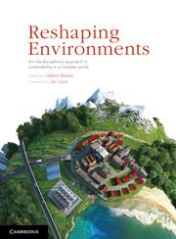
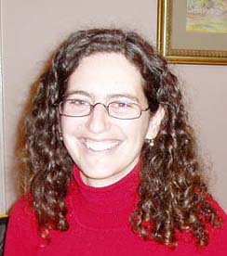
Sustainability, emergence and the graduate attribute of global citizenship
Kate Judith, USQ
Dr Helena Bender, U of Melbourne
Notes:
Set out to determine if we are changing students attitudes;
Add photos of us

Slide 2
Systems and Emergence
Interactions
Direct or indirect
Simple rule(s)
Actions at micro → patterns at macro
Un-orchestrated
Observer
Active
Location
Blindness
http://bambergerranch.org/news/bats-bats-and-more-bats/

Slide 3
Sustainability as an emergent property
“The emergent quality of a system that results from the responsive interplay between the nourishing actions of individuals (bottom-up) and feedback about the persistence and nourishment of the interrelationships between elements of the supporting environment and ultimately the global system (top-down)”
Fred Williams Euchuca Landscape 1961

Slide 4
Sustainability as an emergent property
http://relationalspirit.com/relational_inquiry
Macro
pattern recognition
and response
Feedback between the two
simple rules
Micro
Notes:
interactions in a system between local actors are happening at the ‘micro scale’. These may be direct or indirect actions. These actions and interactions may result in patterns (Johnson, 2001) that can only be detected by observing from a scale of greater generalisation. We consider this to be the ‘macro scale’ throughout this paper.
from complex systems new properties emerge (Meadows, 1999). Emergence implies at least two scales; one at which action occurs, and another from which the pattern(s) resulting from that action may be observed.

Slide 5
Universities role in shaping the future
https://charlevilleshs.eq.edu.au/Calendarandnews/News/Pages/Visual-Identity-Guidelines-for-the-University-of-Southern-Queensland.aspx
http://www.rmit.edu.au/socialhumanities
http://sustainablecampus.unimelb.edu.au/campus_sustainability/bicycles.html
Notes:
. Higher order attributes are important because they set aspirations, responsibilities and an agenda for both Universities and the students who graduate from them.
In framing high-level graduate attributes, universities are recognising their important role in setting the agenda for the future and attempting to demonstrate accountability regarding this responsibility.
By choosing to have higher level graduate attributes like leadership and global citizenship, universities are taking a risk in selecting and advocating for the attributes they think our future thinkers and leaders should have.

Slide 6
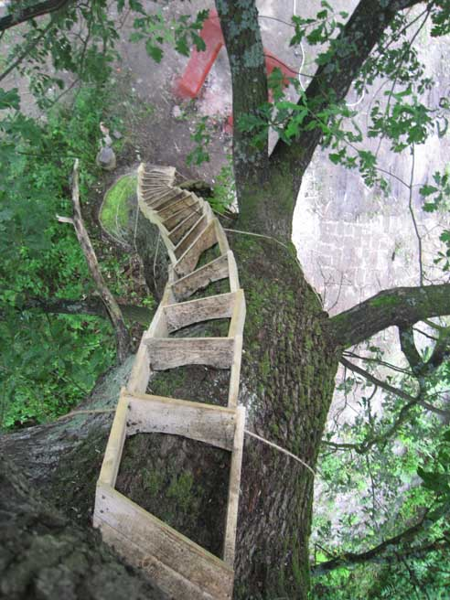
Role of the University’s graduate attributes
Four purposes
job readiness
lifelong learning
preparation for uncertain future
common good
Methodological lever to shape values of future
http://www.wesleymulvin.com/cesta.html

Slide 7
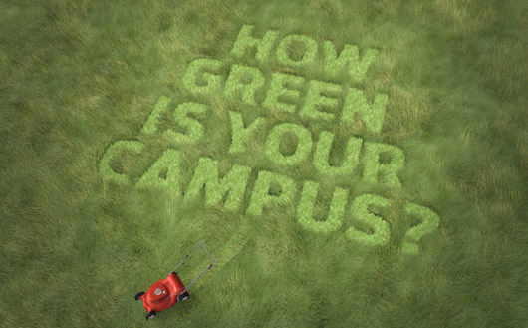
Global Citizenship Graduate Attribute (U of Melbourne)
Active global citizens:
accept social and civic responsibilities
be advocates for improving the sustainability of the environment
have a broad global understanding, with a high regard for human rights, equity and ethics
http://world.edu/building-green-campus/

Slide 8
How ‘Reshaping Environments’ develops global citizenship
Relationship between humans and their environments:
Human-nature binary
Sustainability
Role of humans in shaping the future
Needs and norms
How needs and norms shape human behaviour
Environmental ethics
History of whether ethical values about the environment stem from in Western world

Slide 9
Methodology used in pilot study
Undergrad core subject of 400 students
Pre/post Questionnaire
Self-reported meaning of ‘global citizenship’ and the characteristics associated
Excluded questionnaires that did not have a match (missing either pre or post)
Reviewed to determine range of views
Identified themes
Categorised
+/- change, neutral

Slide 10
Change towards global citizenship made by students by end of semester
Themes identified | Frequency (Q1 – description of global citizen) | Frequency (Q6 – Characteristics of global citizen)
A change in scale | 16 | 8
Increased ethical focus | 9 | 11
Added an action focus | 13 | 4
Added sense of responsibility | 8 | 1
More conscious of one’s impact | 4
Added understanding of greater complexity | 2
Other |  | 5
TOTAL | 52/81 | 29/50
n=81

Slide 11
Conclusions
Further work to develop a methodological framework for determining if students are becoming global citizens
surveys useful to identify perceptions
other methodologies that can cross disciplinary teaching areas with ease
Can a longer term study that follows students into their careers and home practice reveal whether perceptions are converted to action?
Is there a method that would help to determine this?
In what contexts might this emergence based approach to sustainability be useful to you? Would you use it?
Notes:
This project will drive sector-wide change by providing a methodological model that can enable universities to demonstrate this responsibility more credibly with evidence. It will drive curriculum renewal as it begins to provide evidence of areas of curriculum where there may be misalignments with the graduate attributes.
A mixed method approach is being used to evaluate different methods for assessing for the global citizenship graduate attribute. Paper surveys (with some online delivery) in combination with, focus groups, interviews, and document analysis, will provide both quantitative and qualitative data. Interviews will be conducted with students and staff, document analysis will be of both subject description documents as well as student work, and focus groups will be with local and international students. Some methods will not be applicable at all three universities due to differences in program delivery and assessment strategies. A combination of basic statistical analysis and discourse analysis will be used to ascertain to what extent students have attained the global citizenship attribute. The results from the different sources will be analysed to triangulate whether students have attained, are developing, or have not yet attained the global citizen attribute. An assessment of which methods were more effective in revealing the attainment or partial development of the graduate attribute will be conducted. Key questions will be identified, the ease with which these methods can be incorporated into assessment for future curriculum use, and the effectiveness and efficiency of the different methods will be evaluated. This analysis will provide the basis for the design of a methodology specifically adapted to the effective and efficient evaluation of the global citizenship graduate attribute.

Slide 12
Acknowledgements
Support from University of Melbourne, Department of Resource Management and Geography
Support from University of Southern Queensland, Open Access College
Feedback from colleagues

