Slide 1
Innovative mental health solutions for regional well-being and resilience
Dr Sonja March
Michael Ireland, Charlotte Brownlow, Amy Antonio, Hong Eng Goh, Gerry Tehan, Mike Keppel

Slide 2
Acknowledgements
Strategic funding by USQ
USQ Innovative Mental Health Solutions (IMHS) Team Members
Dr Michael Ireland | Dr Charlotte Brownlow
Dr Amy Antonio | Dr Hong Eng Goh
Prof Gerry Tehan | Prof Mike Keppell
Benjamin Mackie

Slide 3
What is IMHS?
A research program targeting a strategic direction of USQ
Contributes to the ‘Health and Well-being’ component of Institute for Resilient Regions (IRR)
Multidisciplinary team of USQ and external members
“A team dedicated to examining innovative mental health solutions for improving the well-being and resilience of people living in regional areas.”

Slide 4
Regional resilience and well-being
Health disadvantage
Higher illness risk and prevalence
Higher rates of chronic disease
Older populations
Higher disease burden (26.5% greater than major cities)
Mental health disadvantage
Among leading causes of disease burden
8% more likely to have mental health problem at some point
Higher substance use rates
Higher suicide rates for men (51.7 per 100,000 compared to 31.8 per 100,000)
Help seeking by males less than half the rate of males in metropolitan areas
National Rural Health Alliance, 2013

Slide 5
Infrastructure, service and usage
Limited access to quality and specialised health and mental health care
Annual shortfall in health services > 25 million services
Rate of usage of mental health services
Regional: 40-90% of rate of major cities
Remote: 10-30% of rate of major cities
91% psychiatrists main practice in metropolitan areas
National Rural Health Alliance
Australian Institute of Health and Welfare

Slide 6
Other challenges
Professionals in regional areas overworked, limited access to evidence-based services
Other problems affecting social, economic and environmental sustainability that further intensify health and mental health challenges
Metropolitan service delivery models do not translate well to regional areas

Slide 7
COAG standing council on Health (2012)
Identified pressing need to “design, deliver and support regional health services, using flexible, innovative and locally appropriate solutions, without compromising the quality and safety of care”
Improved access to appropriate and comprehensive health care
Effective, appropriate and sustainable health care service delivery
Appropriate, skilled and well-supported health workforces
Notes:
Council of Australian governments

Slide 8
The need for ‘innovative approaches’
Clinical health service delivery need NOT be constrained by:
Geographical location
Long waiting lists
Lack of trained professionals
The potential of innovative delivery of quality health care has been demonstrated

Slide 9
What does ‘Innovative’ encompass?
e-Health or e-Mental health interventions direct to individuals
Telehealth
Virtual reality
Apps
Digital information and referral systems
Digital support communities
Digital training/professional development programs
Mobile professionals, workshops and training
Notes:
Ehealth/e-mental health
Digital technologies to deliver or aid delivery of specialised health or mental health assessments & interventions
Online, CD-ROM, Videoconferencing, telehealth, App-based
Enhancing effectiveness of eHealth or eMental health
Improving digital skills and digital information literacy
Improving e-mental health literacy
Examining groups not native to digital environments
Digital information, referral and support communities
E.g. digital support communities
Evidence-based information to aid detection and referral
Digital Training/Professional Development Programs to professionals working in regional communities
Specialised modules unavailable
Region-specific

Slide 10
The need for regional-specific approaches
Applicability to regional areas unknown
Ability to improve access and uptake of quality services in rural areas unknown
Overall, many gaps in understanding the impact and limitations of innovative approaches for various non-metropolitan communities

Slide 11
What are the gaps?
Comprehensive examination of unique needs of various regional communities
Peri-urban, regional, rural, remote
Needs of the ‘individual’ and ‘health professional’
Systematic evaluations of:
Efficacy (Does it work?); and
Cost-effectiveness (Is it worth it? Is it more cost-effective than other approaches?)
Dissemination efforts (When it works, can we reach everyone who needs it?)

Slide 12
USQ IMHS: Broad Aims
Identify the nature of unique health and mental health challenges evident for various Queensland regional communities
Develop, evaluate and disseminate locally appropriate, multi-level assessments, interventions and resources

Slide 13
Who are we?
Health conditions
Adult mental health
Clinical Psychology
Educational technology, learning design
Community Psychology
Natural disaster / traumatic events
Military and Veterans
Isolated families
Research methods and statistics
Child and family mental health
Nursing
Stress management and resilience
E-approaches
Cognitive screening and rehabilitation
Non-native digital environments
Social Media
Development of evidence-based interventions
Development of assessments
Train the trainer/ professional
Digital information literacy
Mental Health literacy

Slide 14
IMHS Specific Objectives
OBJECTIVE 1: RESILIENT PROVIDERS
Build capacity of regional health and service professionals and employers to service and improve health and wellbeing of regional communities
Resourcing, improving knowledge, specialist skills, resilience and productivity for health professionals, informing ‘mental health safety’ policies
OBJECTIVE 2: RESILIENT INDIVIDUALS
Enhance accessibility to specialised, remote and online mental health assessment and intervention services for individuals

Slide 15
IMHS projects
Extending into Regional areas
Existing
Identified need
Community/Organisation requested
In response to events
Notes:
Extension of current and previous work
New projects
Regional vs rural, chronic illness, farmers, health professionals, miners, unemployed, ageing populations, indigenous populations, populations from CALD backgrounds

Slide 16
Existing Projects (March)

Slide 17
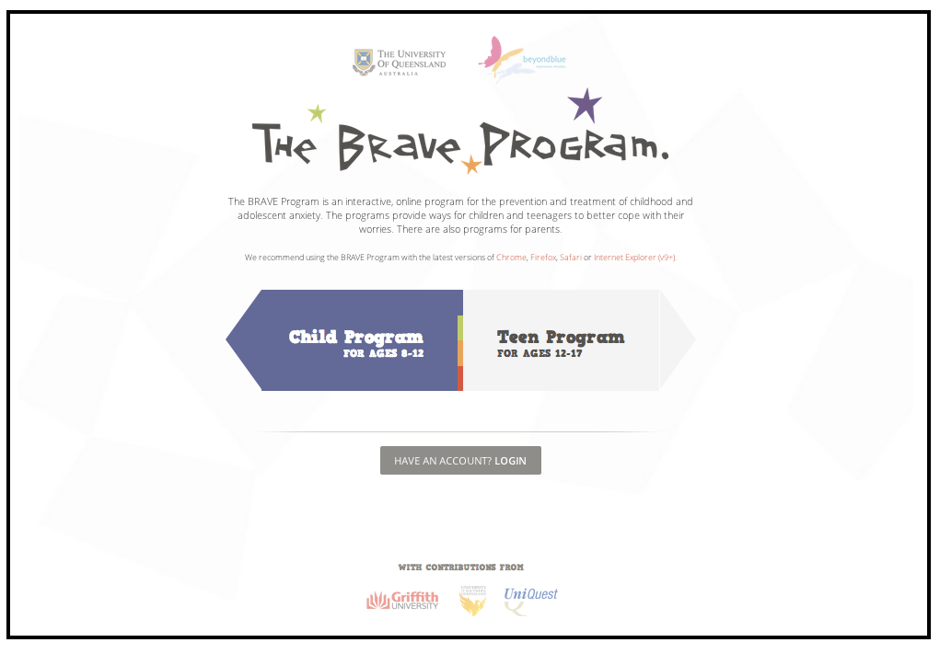
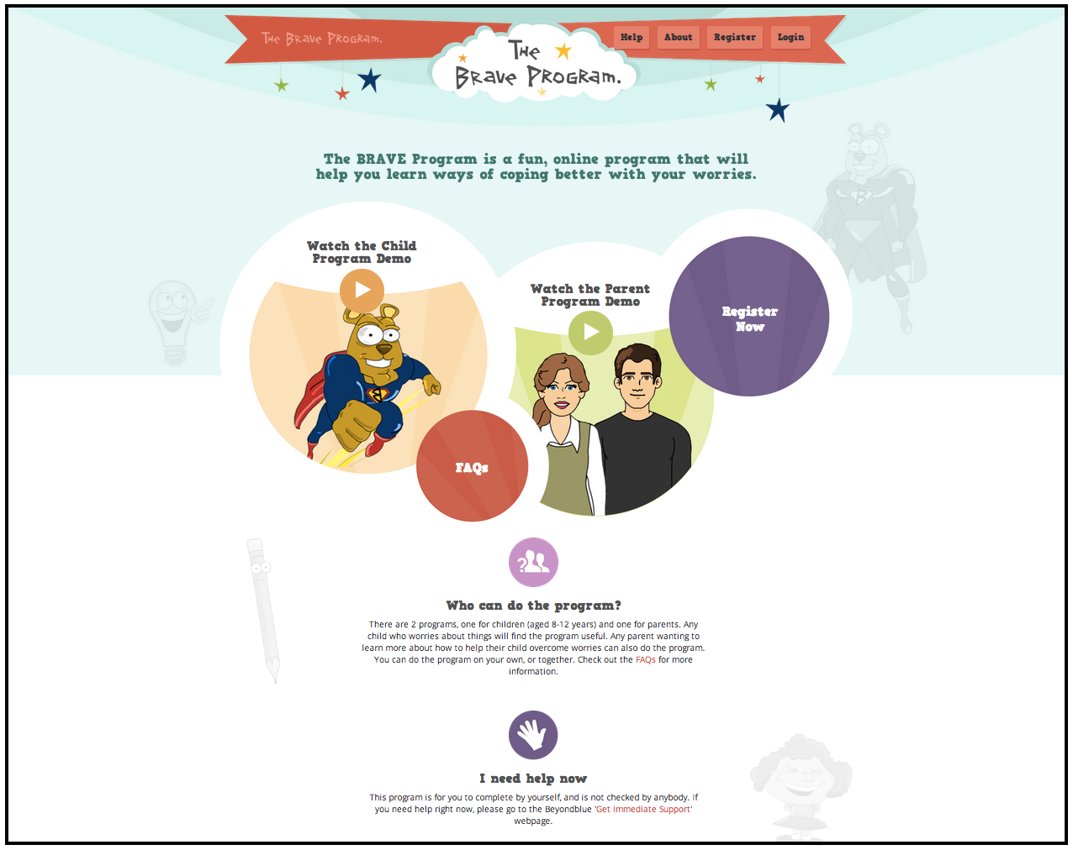

Slide 18
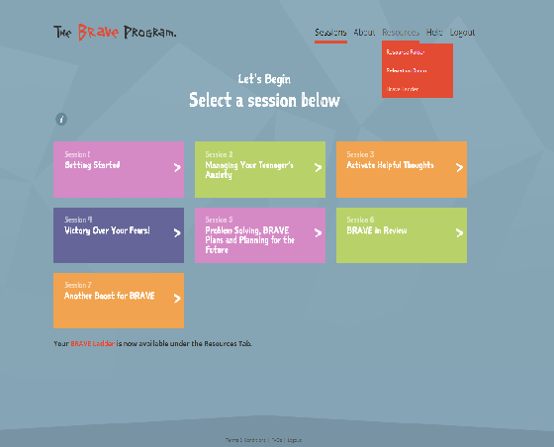
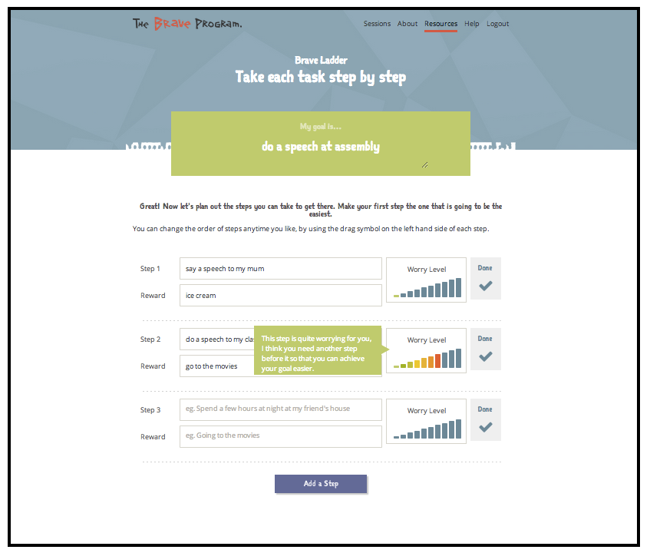
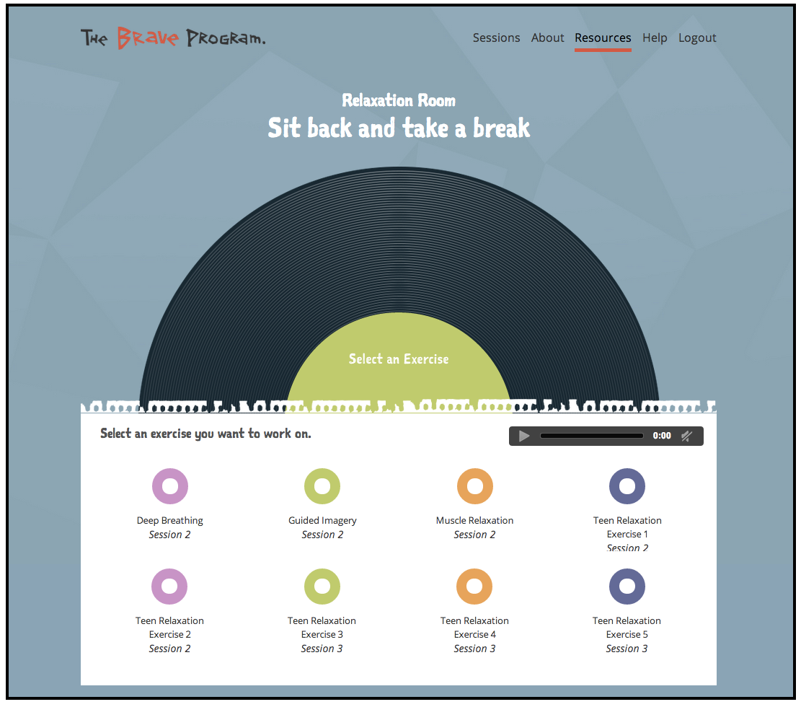
Pages from the site

Slide 19
Since BRAVE Self-Help has launched…
> 1.5 million ‘hits’
> 17,000 ‘visits’ to the site
Of those visits, 8% were from people living outside of a capital city
> 1600 people have registered for the program
76% are Female
33% are Children aged 7-12 years; 27% Teenagers aged 12-17 years
52% are accessing the program via desktop/laptop; 27% on their mobile, 21% on their iPad/tablet

Slide 20
Teacher training: Natural disasters (March)
Delivered QLD wide following 2011 natural disasters
Follow-on work attempting to integrate into education training and applicability to other ‘traumatic events’

Slide 21
Teacher mental health and burnout (Ireland)
Aim: Explore differences in mental health, work perceptions, and burnout among teachers in rural versus metropolitan regions
Method: Large scale- ross-sectional survey of teachers across QLD using Education QLD contact lists
Results: Data is being analysed

Slide 22
Resilience in Medical Practitioners (Ireland)
Aim: Promote resilience, and reduce stress and burnout among intern doctors working in an emergency department
Method: A randomised controlled trial was conducted examining a 10 week Mindfulness intervention for 50 medical interns
Results: The data is being analysed currently

Slide 23
Enhancing outcomes for people with disability (Brownlow)
Inclusive educational and workplace settings for people with ASD
Experiences of students who identify with a disability at regional universities
Issues of identity construction in ASD populations; The buffering effect of sense of belonging on the detrimental outcomes of negative life events on well-being of Aboriginal Australians
Transitions of young people with ASD post-school; experiences of sensory perception and empathy in people with ASD

Slide 24
Projects targeting identified need
Utilising outcomes of recent surveys
CheckUp Census
Men’s Health Roadshows
State of Children report
Other local reports
Conduct of follow-up surveys/interviews in conjunction with community partners (e.g. medicare local) to identify need

Slide 25
Community/Organisation requested
Forming community partnerships and collaborations to develop locally appropriate services to address a need
Forming business/enterprise collaborations to develop appropriate tools

Slide 26
IMHS new target areas
Regional vs Rural
Chronic Illness, Mental health, employment
Farmers
Health Professionals
Indigenous populations
CALD populations
Unemployed
FIFO/DIDO
Disability
Young people
Mental health literacy
Digital literacy
Disaster/trauma responses
Mental health in physical health conditions
Cognitive screening and rehabilitation
Carers

Slide 27
The next phase
2014-2017
Working with individuals, communities and organisations to implement program objectives
Working towards making a meaningful difference for the mental health of people living in regional areas

Slide 28
Thank you imhs@usq.edu.au Sonja.March@usq.edu.au

