Slide 1
Slow scholarship and wellbeing: Humanising the academic machine
Emergent Culture 6th midterm Conference
of the European Sociological Association’s Research Network Sociology of Culture (RN7)
16-18 November 2016, Exeter, UK
Dr Janice K. Jones, University of Southern Queensland
Dr Gail Crimmins, University of the Sunshine Coast
Dr Ali Black, University of the Sunshine Coast
Julianne Impiccini, CQUniversity

Slide 2
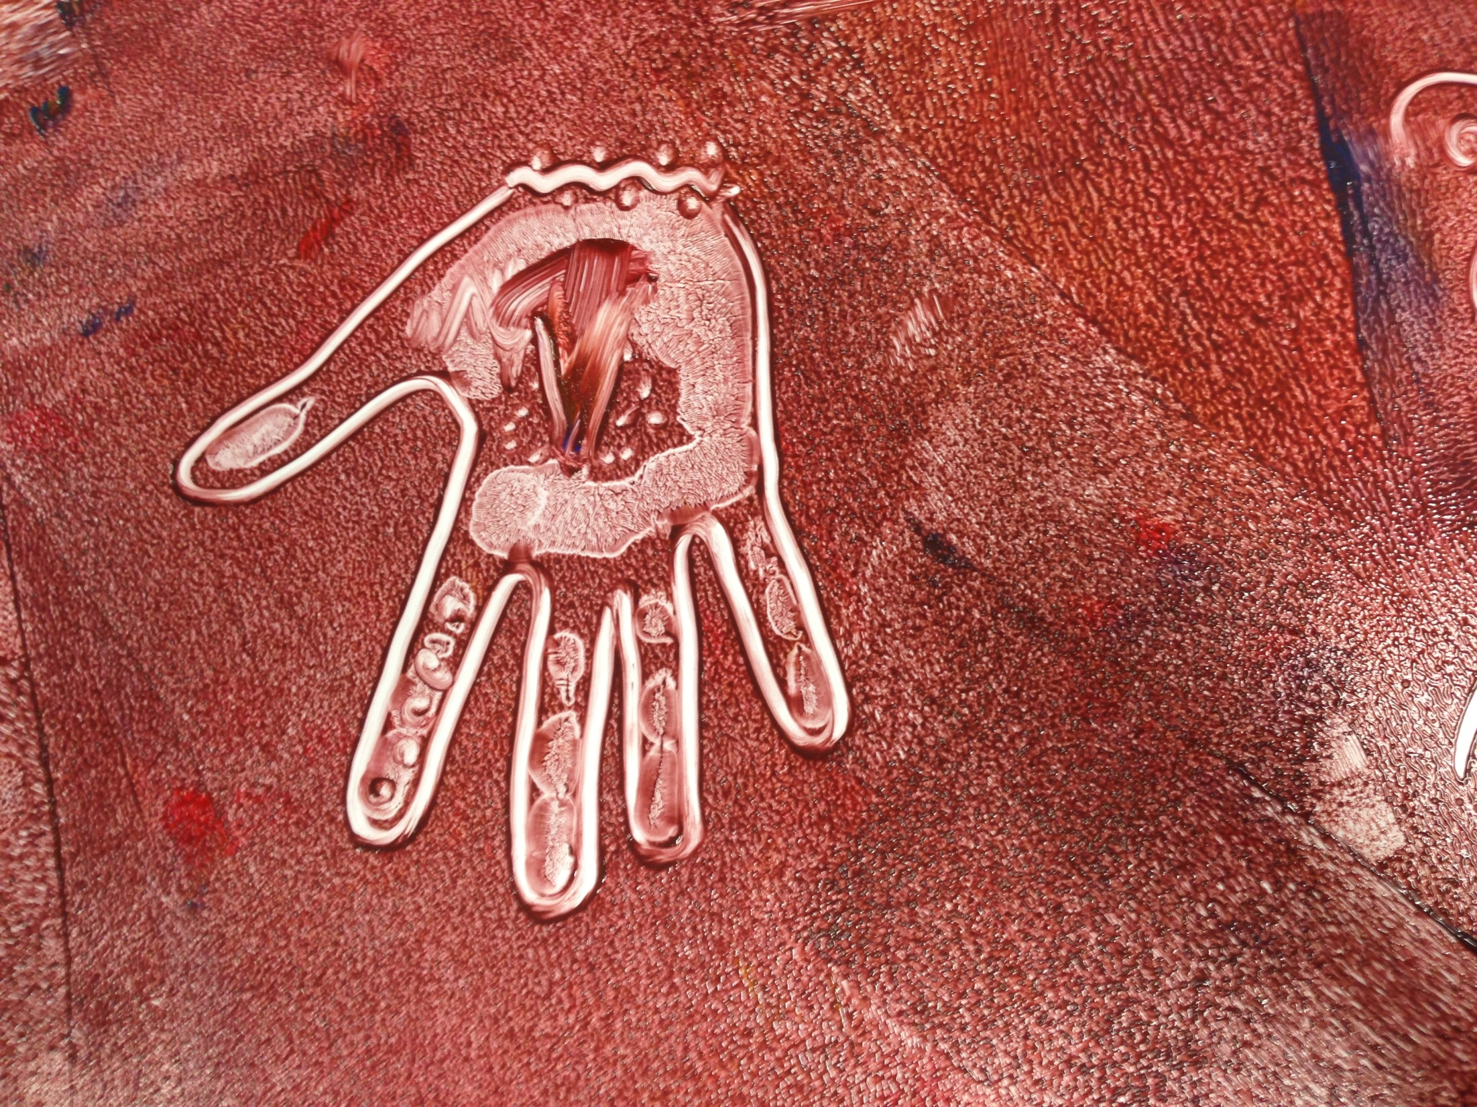
Acknowledgement of Country
We acknowledge the traditional custodians of the lands where our stories take shape. With the First Peoples of Australia we honour the wisdom of Elders past, present and future, walking together in the spirit of reconciliation.
Notes:
I acknowledge the traditional custodians of the lands where USQ teaching and research is conducted: the Gaibal, Jarowair, Ugarapul and Butchulla peoples of Queensland. I honour the wisdom of Elders past, present and future, seeking to walk together in the spirit of reconciliation.

Slide 3
Pattern making beings – Lines, Borders, Boundaries
Notes:
Our instinct to make patterns and to make the abstract concrete has informed some of the world’s most beautiful structures, inventions and philosophies. However, that same quality informs linear thinking, process thinking, and the creation of rules, boundaries, borders, limits – which are manifest in industrial and post industrial societies as patterns that represent power, control and separation. Universities are inherently hierarchical structures, and the growth of formal schooling and post-industrial (global) competition has informed

Slide 4
Into the Factory
Drivers for Australian Education
PISA, NAPLAN
Globalisation Neoliberalism: Learners “atomistic” units of economic exchange in competition (Brohman 1995, p. 297)
Driving Focus on science, maths, literacies, testing, reporting, benchmarking
VISION for education ACARA (2010); MCEETYA (2008)
Creativity, adaptability
Sustainability
Diversity, equity and social justice, includes First Peoples’ ways of knowing/being/doing
Holistic - wellbeing affective/relational/cultural/spiritual

Slide 5
The Education Factory
Units of Production
Targets
Planning
Standards
What counts…
Global Market
Benchmarking
Quality
PISA
Publish or Perish
Self as product
Corporate Structure

Slide 6
In Europe, only 18% of full professors are women (Vernos 2013). In Britain in 2012 across HE, only 14.2% of Vice Chancellors were women (Counting Women in 2012). In 2012, the UK Higher Education Statistics Agency reported that out of 18,465 professors only 20.5% (3790) were women.
The Equality Challenge Unit (2010) reported that across British academia while 56.6% of academic staff were men, 81% of professors are male (85.5% in STEM subjects) and only 10 female professors were from black and minority ethnic groups.
At this rate of increase (0.75% per year), it will take 119 years for women to achieve equal numbers in the professoriate (and that is assuming the total number of professors stays the same!) (Savigny, 2014)

Slide 7
Although the number of women in higher education has increased over the last 40 years, these increases have predominantly furnished lower academic staffing positions (Carchalo & White, 2008).
For instance, 75% of the fractional full-time and the majority of academics at Level A (associate lecturer/tutor) are women, while the senior ranks of Professor (Level E) and Associate Professor (Level D) remain male dominated (May et al., 2011).
In addition, women academics are also more likely to be employed on casual or short-term contracts than their male counterparts and Carvalho and Machado (2010) reveal that at the end of a PhD women earn less, and are more likely to be engaged in casual work, than men.

Slide 8
Machines Machinic Everywhere it is machines A writing machine driving other machines Couplings and connections, disjunctions and flows Cogs, wheels, pulleys, and levers, Wounds, scars, ruptures and breaks Lines of connections Intensities Singularities Virtual possibilities Corporeal markings Between present and past Between places and spaces Territorialized and re-territorialized And lines of flight This is the academicwritingmachine
Henderson, L., Honan, E., Loch, S., (2016)

Slide 9
Fuel for the machine
We count. We are counted. We must count. We must learn to count. The quantified academic is what counts. To be counted you have to plug into this quantified machine. Learn its numbers, its functions, its mechanics. We do so to be successful, to be counted. To fail is to be uncountable, unpublishable.
(Henderson, L., Honan, E., Loch, S., 2016, p.12)

Slide 11
What counts…
…the hyper-quantified machine of the neoliberal university. We connect to this machine, desiring to be counted and recognized as an academic within the hyper-individualized neoliberal university (Henderson, L., Honan, E., Loch, S., 2016, p.5
I have been thinking for instance about:
The apparent need/longing so many of us have for safe spaces to write and connect (judgement free, measurement free)
The important blurring of personal/professional in our work and how we must allow the personal to come forth if our work in education/the arts is to touch and reach and change
Valuing aesthetic ways of knowing (Ali Black – personal communication 2015)

Slide 12
Meeting the Wall: Cai Guo-Quiang “Head On”

Slide 13
“Falling Back to Earth” Invisible boundaries
Ambushed
Pushed
Steamrolled
Silenced
Choked

Slide 14
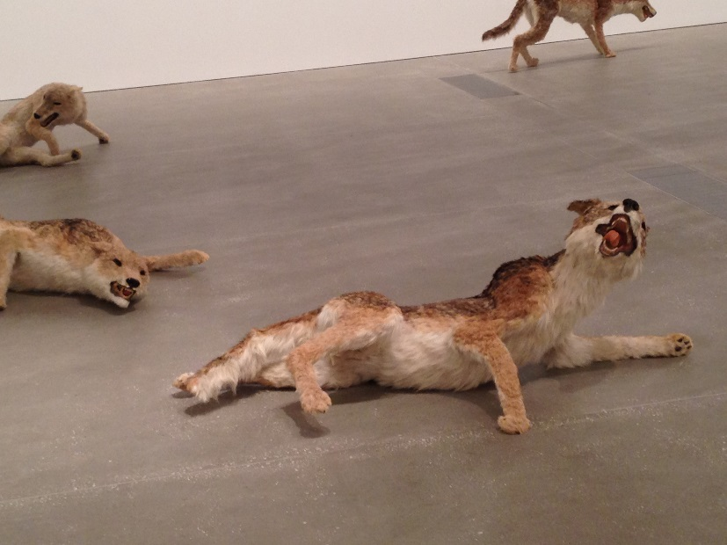
Courage and determination - Damage

Slide 15
Slow scholarship - Breaking the machine
“scholars have described the need for a slower pace of production across academia, particularly within social science research. Such descriptions have been framed as slow research (Banks, 2014; Kuus, 2015), slow scholarship (Hartman & Darab, 2012), and even slow science (Owens, 2013)” (Ulmer, 2016, p.5)
“… we attempt to explore disjunctures, to unpack the machine, but not to explore how it is made, but how it can be broken. Taking a Luddite hammer to the Goldberg contraption, smashing the levers and uncoupling the connections, we provide here a series of machinic arrangements, not in a linear temporal sequence, but a series of ideas, bits of writing, that connect/disconnect. The writing is about writing an academic paper, of our desire to become academicwritingmachine, we make visible our desire to be this machine. (Henderson, Honan, Loch, 2016, p.5)

Slide 16
A Story of disruptive collaboration

Slide 17
Collaboration: Ali speaks
I like how this process of thinking and sharing offers awakenings and awareness, and points for contemplation and consideration, and that we can sit with the complexities and the dissonance and the silence and the connection and the uncertainty and the certainty and the knowing and the not knowing and the learning and the unlearning and the talking and the listening and the awkwardness.
Collaboration doesn’t equal ease and joy and light and harmony. It can have those things, but it can also be hard, unsettling, frightening, and we can feel empowered, inadequate, challenged, heard, misunderstood, understood.
I realise that collaboration is complex and the conditions required are complex and human beings are complex. I needed to be reminded that silence is ok, and not knowing is ok.

Slide 18
Why story?
We make sense of experience by storying it.
Theodore Sarbin describes us living in a ‘story-shaped world’.
Our narratives are ‘culturally bound’.
Nira Yuval-Davis offers insights about belonging and the politics of belonging and how our ways of knowing and seeing are situated. She reminds us that our identities are fluid and dynamic stories that we tell ourselves and others about ‘who we are’ and ‘who we are not’, stories about our ‘being and becoming’ and our ‘belonging and longing to belong’
In telling our stories we are making sense of experiences and what they mean to us. We are using our narratives to ‘make connections’ and ‘meaning’.
We are recognising the narratives in which we are positioned. And, we are using them to engage in acts of self-positioning.

Slide 19
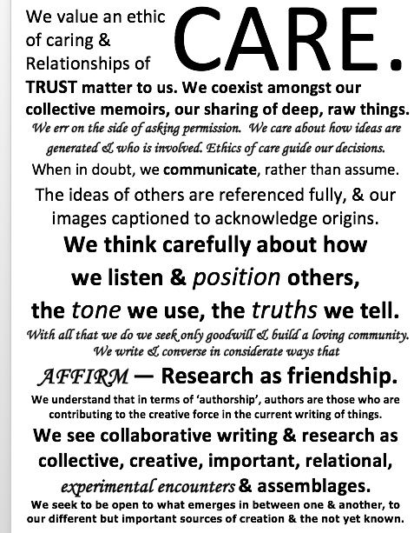

Slide 20
Disrupting the machine -

Slide 21
The power of telling stories
An opportunity to write, to tell, to share, to relive, to experience the whole of it by reliving parts of it. The journey starts always at that moment when everyone is content and involved in their own moments. I move and sit and look at the screen, the keyboard, pause for a moment and then it begins, it flows, sometimes caught like water in a dam, lapping, and then trickling through and then flowing freely, spilling over the top. Likeminded souls residing in the same eras, moved by the same social frames, come together via awkward technologies and share their journeys, their days, their most memorable, heart wrenching, soul giving seconds, hours, and days. In these sittings, someone else's story moves our being, confirms the challenges that must be faced by us humans. This is life, our lives committed to words, images, metaphors, emotions.
Julianne Impiccini (Personal Communication, 2016)

Slide 22
The word 'yarning' keeps surfacing and I am constantly reflecting on the yarning that is a part of the whole process we have followed in 2015. Yarning is important, it is a gathering of like minded souls, it is a time to gather and share stories. Even though we have written our own separate chapters, I believe the 'yarning' has been a part of the storytelling, the journey, the healing.
(Janice Jones – personal commuication 2016)
We do what we can, if it fits in to and contributes to our life. There will be times when it does, and times when it doesn't….Sometimes one will lead, sometimes another, sometimes one presents, sometimes three others. I think an important focus of women working collectively is that it is based on the ethic of care and connectivity (Gilligan, Balenky et al). We can consciously identify and reject masculine processes of sole-ownership, competition, targets, measurement.
Gail Crimmins – personal communication 2016

Slide 23
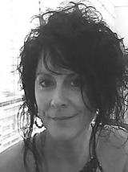
Ali
Mid-life.
This year I turned 47…48…
It is startling to look in the mirror and see the middle-aged woman looking back.
Tears are always close to the surface. Pain swirls in body and spirit. Is this grief? Depression? Some kind of reaction to transition? A mid-life crisis? A type of life exhaustion?

Slide 24
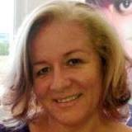
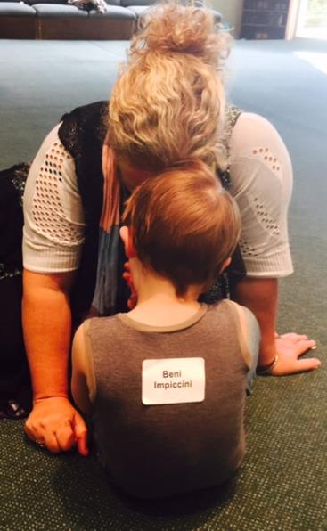
Julianne
I wrote to ease my soul, to make sense of my world. I wrote to make sense of the diagnosis that I feared, of which I knew nothing about. It is a most daunting prospect when you first discover that the child you have just given birth to has Trisomy 21.

Slide 25
Gail
Quite simple and plain, though astonishingly important, my mum believed in equality. Her mantra was there is no one greater and there is no-one lesser.

Slide 26
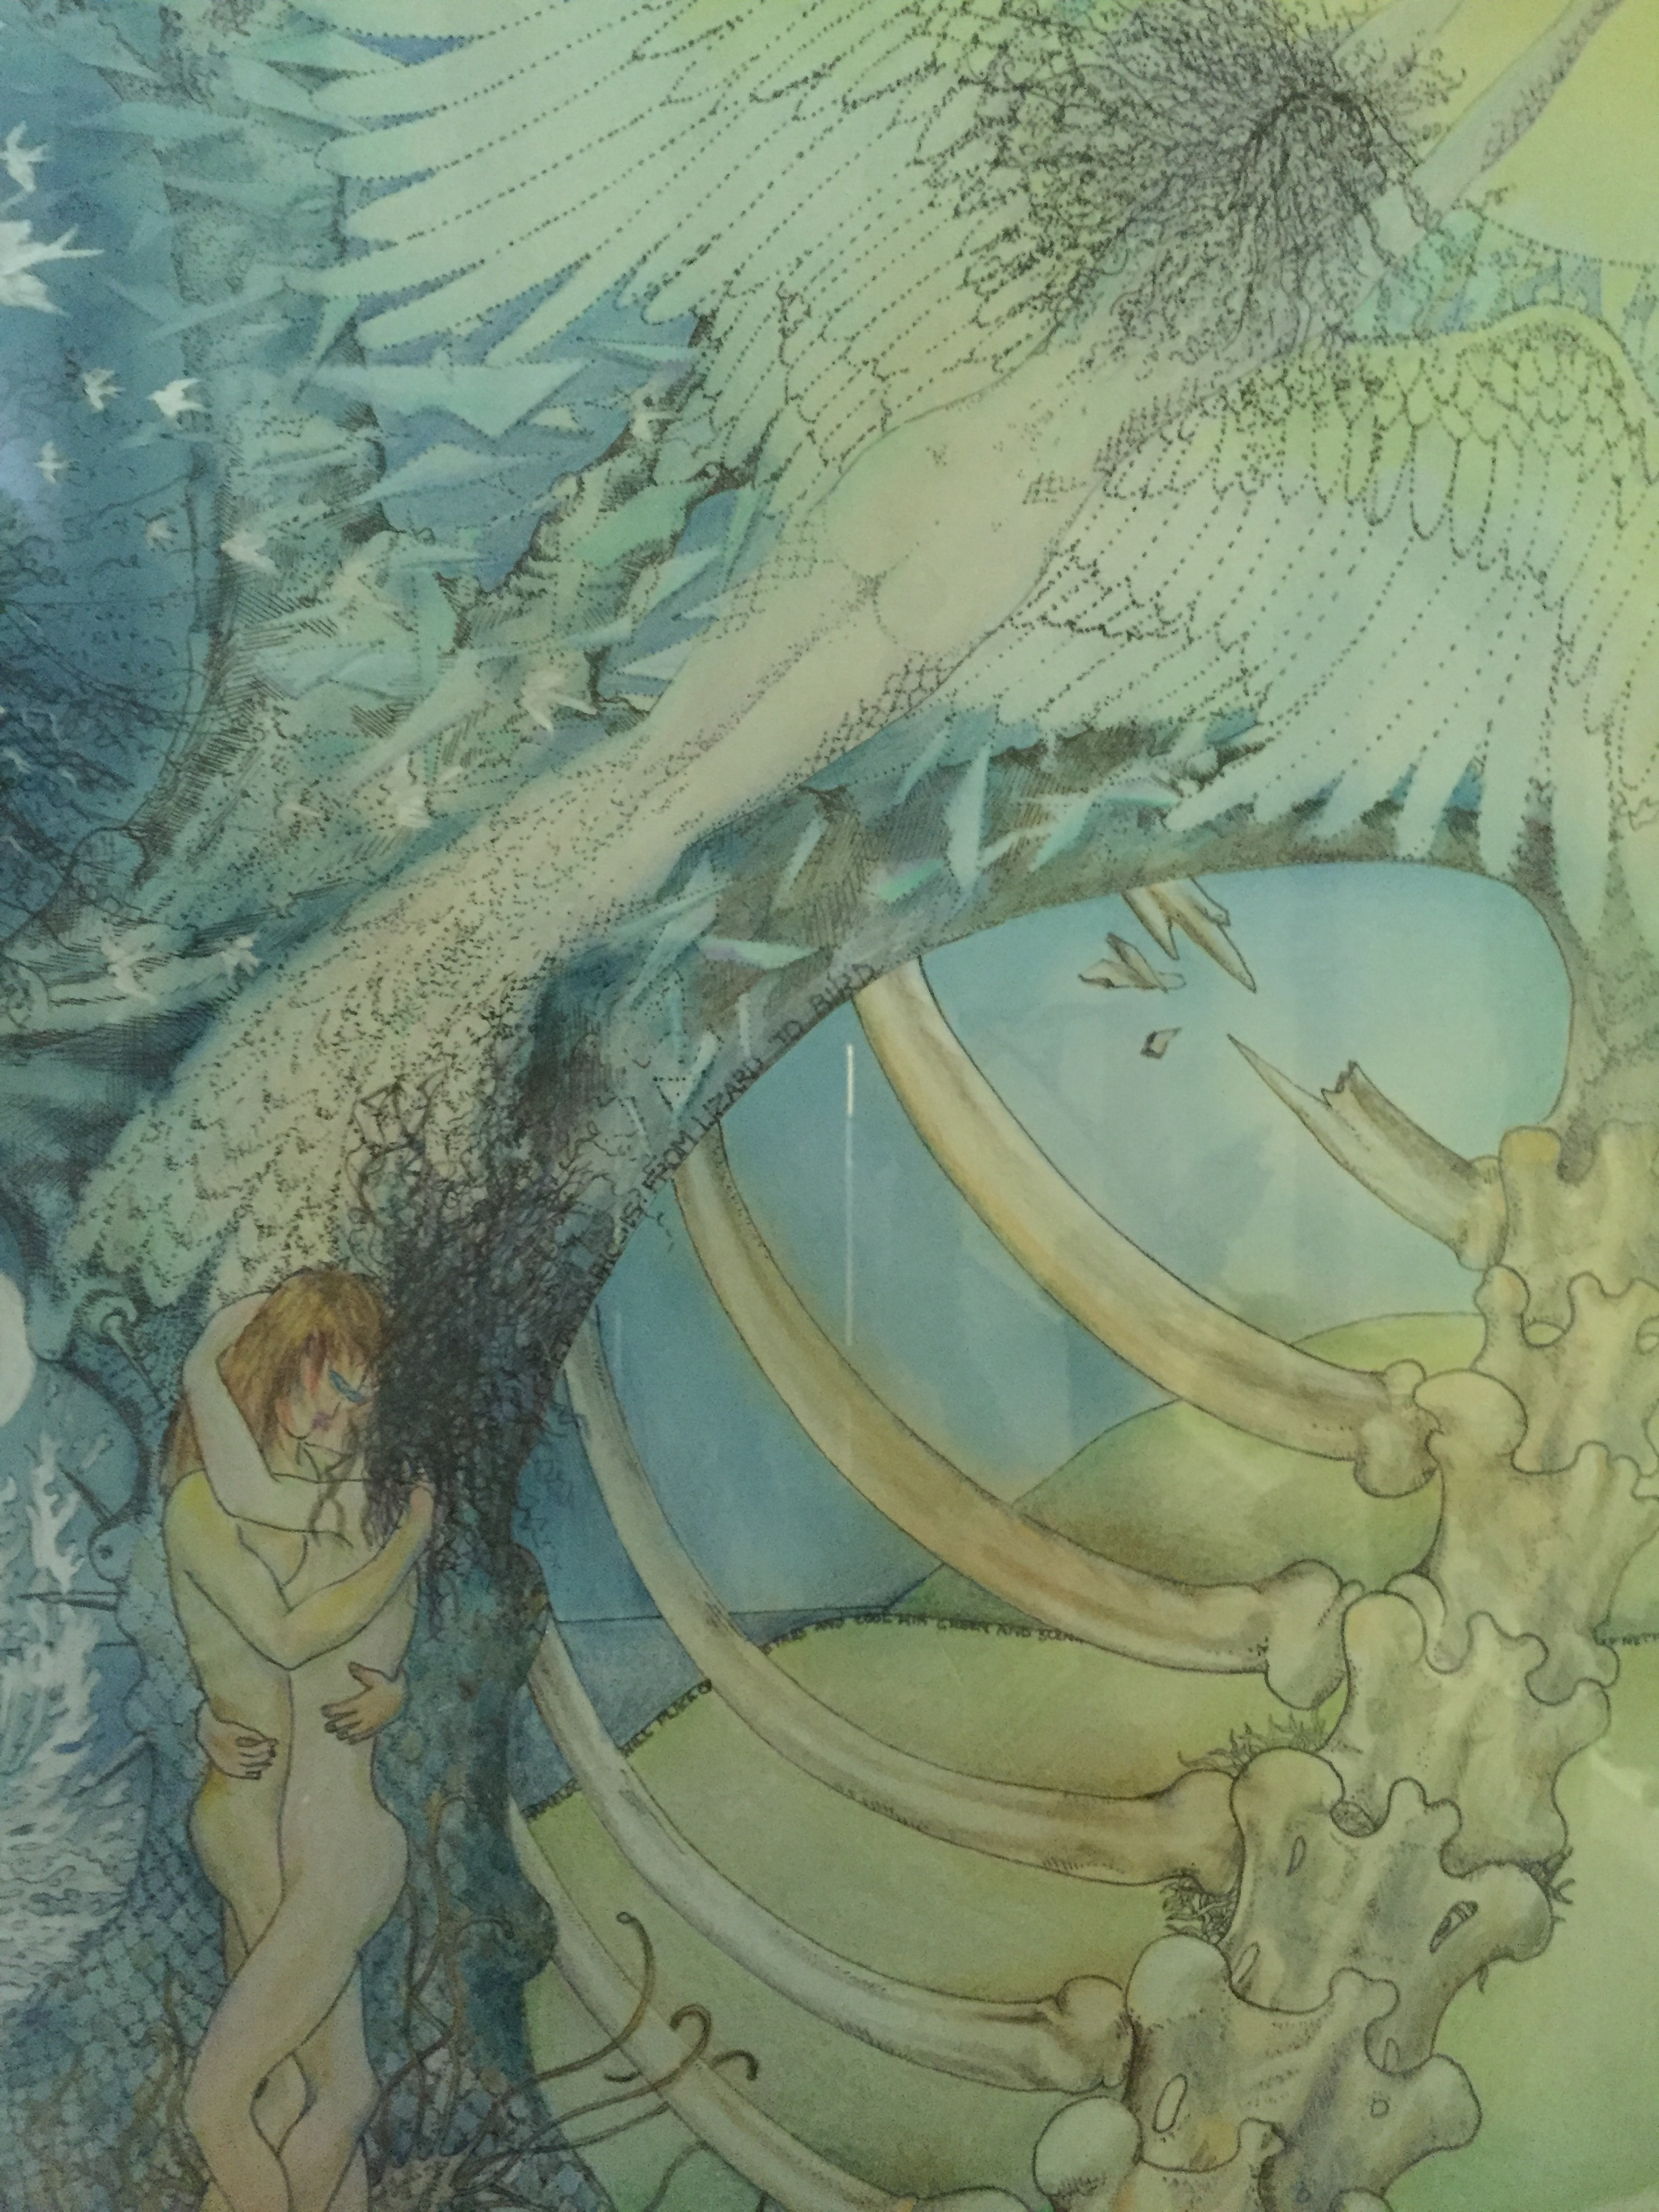
Janice
34 years of love, fun, adventure.
My soul mate, gone.
Morgan, your passing has stolen the sun from my day and the stars from my night. I struggle to breathe without you by my side.

Slide 27
Weaving ideas – Negotiating Space

Slide 28
Embracing difference

Slide 29
The V Formation of Collaborative Writing

Slide 30
Defiance

Slide 31
Honouring our voices, and wellbeing

Slide 33
References
Black, A. L, Impiccini, J., Crimmins, G., &Jones, J.K. (2016). Finding connectedness, finding belonging, finding our voice: Contemplating creative and connected futures through storytelling and narrative. Regional Universites Network (RUN) Conference, University of Southern Queensland, Australia.
Crimmins, G., Black, A.L.., Loch, S., Jones, J.K., Impiccini, J., Albion, L., & Berryman, A. (2016) Risky discourses: Promiscuously storying women's lives. AWGSA International Biennial Conference 2016: De/story the joint, Brisbane, Australia 29 June - 1 July 2016
Crimmins, G., Jones, J.K., Loch, S., Black, A.L., Albion, L. (2016, 8 February). Telling lives: Women, stories and healing. Conference Program of the 1st Narrative, Health and Wellbeing Research Conference: Enlightened: Narratives and Narrative Strategies to Awaken Applied and Creative Humanism (pp. 7-8). University of Southern Queensland
Crimmins, G., Jones, J.K., Loch, S., Black, A.L., Albion, L. (2016, 8 February). Telling lives: Women, stories and healing. Conference Program of the 1st Narrative, Health and Wellbeing Research Conference: Enlightened: Narratives and Narrative Strategies to Awaken Applied and Creative Humanism (pp. 7-8). University of Southern Queensland
Henderson, L., Honan, E., Loch, S., (2016) The production of the academicwritingmachine. Reconceptualizing Educational Research Methodology 7(2)
Savigny, H. (2014) Women, know your limits: cultural sexism in academia, Gender and Education, 26:7, 794-809, DOI: 10.1080/09540253.2014.970977
Ulmer, J.,(2016) Slow ontology. Qualitative inquiry
Zajda, Joseph (Ed.). (2010). Globalisation, Ideology and Education Policy Reforms New York: Springer Netherlands.

