Slide 1
Disrupting the label: a 4D research method for re-constituting ‘the other' and ‘othered' through theory, narrative, metaphor and constructive conversation
…
(Findlay, Y.S., & Jones, J. K. (in press). Uisge Beatha: The ebb and flow of four tides. In J.K. Jones (Ed.), Weaving Words: Personal and professional transformation through writing as research. Cambridge Scholars, Newcastle Upon Tyne, UK.)

Slide 2
In conversation with….
Anne & Margaret: “Agents provocateur”
Creating myself as researcher
Exploring narrative inquiry

Slide 3
Slow beginnings
Phenomenology through narrative inquiry.
A phenomenological approach leads to “a deeper understanding of the nature or meaning of our everyday experiences” (Van Manen , 1990, p.)

Slide 4
In conversation with….
Myself: “I am NOT an auto-ethnographer! It’s too scary!”
Autobiography
Exploring self

Slide 5
Who am I???
Teacher
Doctoral student
Expert?? YES – in my own lived experience.

Slide 7
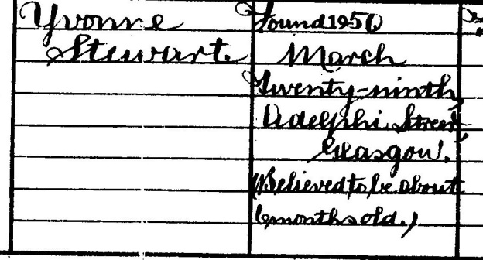
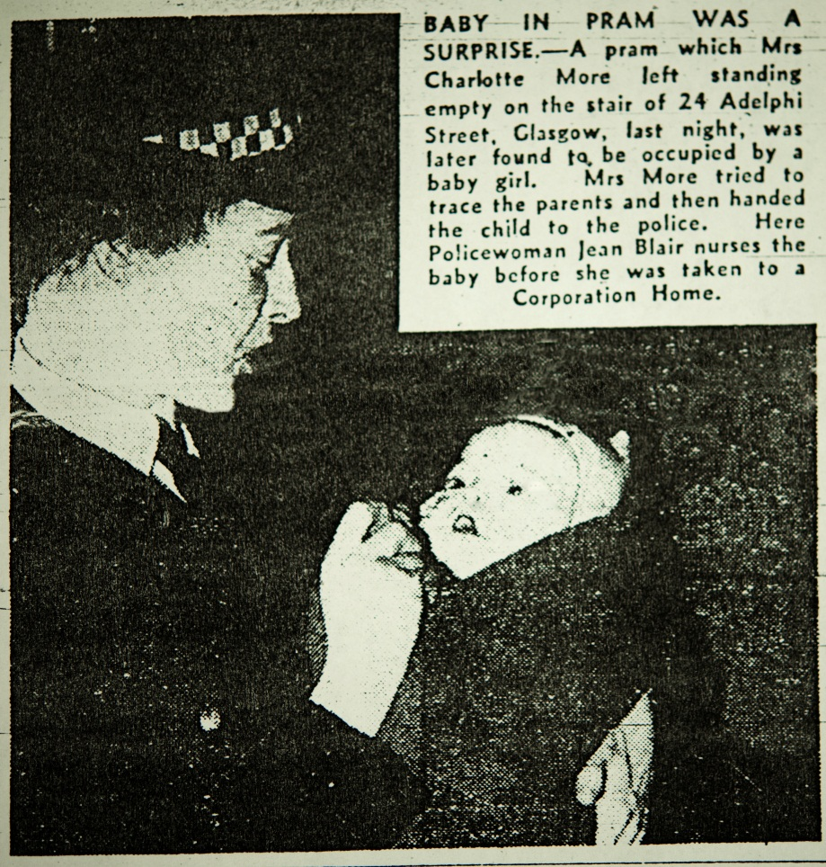
Stimulus

Slide 8
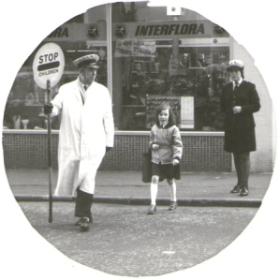

Slide 9
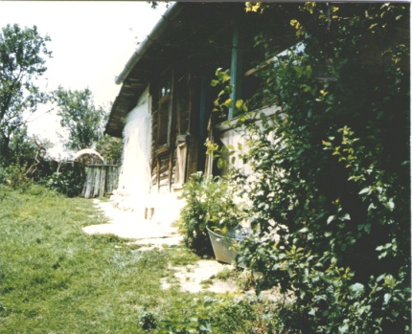
Romania

Slide 10
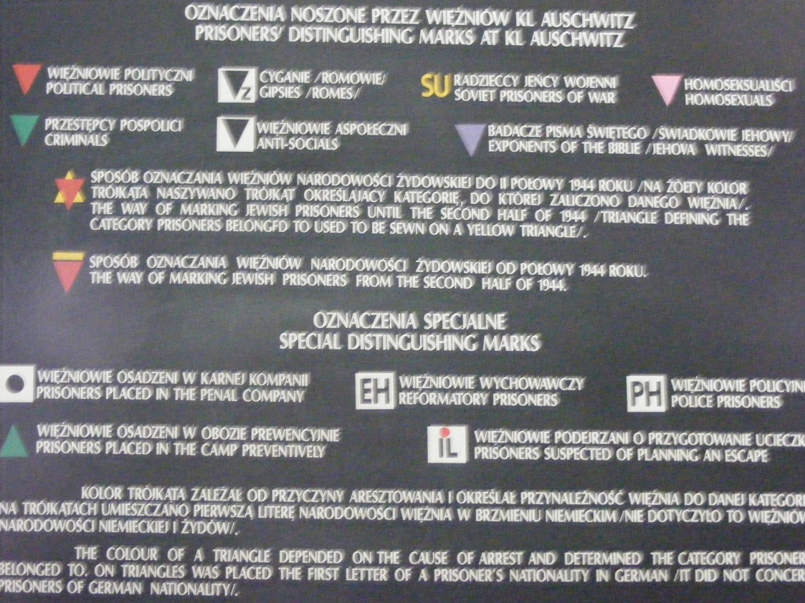
Auschwitz

Slide 11
Revelations
Labelling and what it leads to
Dehumanising
Administrative convenience
Taking control
Not all labels are negative

Slide 12
In conversation with….
Janice: “Developing a relational dialogue”
Subordinate – perception of my role
Novice writer
Unpacking the story
Affirmation and confirmation
Self-labelling as taking power over identity

Slide 13
Janice’s learning…
Thinking
Writing as Thinking
Reflecting
Writing as Reflection
Critical Reading
Writing the World
Focussed Conversation
Writing as Research
New Understanding
Writing of Research
Reflecting

Slide 14
Conclusions
Liquidity of identity and voice
Metaphor is a powerful tool for researchers
Life-writing is an organic and relational process

Slide 15
Gene Pool…

Slide 16
to Birth Process
Yvonne:
Re-focus of dissertation
Shift in perspective of narrative inquiry
Janice:
Discovery of power of mentoring
Using visual arts as narrative (life-stories from suitcases)

Slide 17
