Slide 1
post – STRUCTURE Group Exhibition Curatorial Work Group Exhibition (visual art) 2023 curated by: Kyle Jenkins (UniSQ) (Curatorial Work and artwork submission Year: 2018 – 2023)

Slide 2
Curated group exhibition bringing together a selection of 15 international contemporary artists from Australia, USA, New Zealand, Denmark, Netherlands, Germany and Italy who prospect the technical issues, limitations and associations embedded within painting and sculpture today and through individual parameters, these are explored, defined and embody their individual relationship with the world. Curated by: Kyle Jenkins (UniSQ) Artists: Justin Andrews (AUS) Melinda Harper (AUS) Karin Lind (DK) Sean Lowry (AUS), Peter Holm (DK), Kyle Jenkins (AUS - UniSQ) Jordan Mitchell-Fletcher (AUS) Simon Morris (NZ), Victoria Munro (US/NZ) Jan van der Ploeg (NL) Jacqueline Stojanovic (AUS) David Thomas (AUS) TILMAN (DK/Italy) Gwen Walker (AUS) Michael Zahn (US)

Slide 3
Background: The exhibition ‘Post-STUCTURE’ was about bringing together a selection of 17 contemporary artists from Australia, USA, New Zealand, Denmark, Netherlands, Germany and Italy who prospect the technical issues embedded within painting and sculpture today and through individual parameters these are explored and defined through permutations that can be read within western art history but are not bound by it. Contribution: I both curated the exhibition and had a piece of artwork included in the exhibition. The artwork I contributed entitled: Painting (Celare) #51, are about the history of monochromatic paintings engaging with the tradition that the reading of a painting is all about its surface. This specific exhibition is intertwined with the aesthetic investigations into structure/s and what that means within socio-cultural, political, organic, art historical and constructed spaces. These structures are defined through conceptual based geometric and abstract practices as a vehicle to understand and investigate the transformative nature of colour, surface, mark, composition, and construction as a conceptual investigative tool that focuses on how simplification does not reduce the conditions and complexities of perception but to enhance the visual possibilities that come from such working conditions. Significance: The title 'Post-STRUCTURE' reviews the limitations but openness we are now faced in the early 21st century within painting and sculpture. This exhibition is engaged within a lens of post-structural thought, where the slippages that occur through the personalised reading of a history ‘as’ a form of abstraction, become a positive moment of reflection for an artist, that is manifested in their studio where the work and themselves are positioned alongside each other through shared contemplation. As such, to demonstrate this, the exhibition is about presenting a survey of outcomes that can be seen as painting 'as' object and/or object 'as' painting, and what sits in between these passing moments of intervention become luminal spaces for further outcome/s. The artists involved, and their outcomes are just examples of individual methods of application and contemplation, that are not rigid and placed within systems or categorisation of intimated universal truths. Instead, the artists in this exhibition are building upon established signs of personalised art making (either painting and/or sculpture) by mediating these through a reality of individual studio interrelationships that cross over, blend and sometimes abandon historical and personal truths. The ‘painting as an object’ and ‘object as painting’ is a contemporised debate that has been discussed at length. What this exhibition is about are the distinctions between representation and abstraction and the space that sits in between these distinctive concepts. The artists in the exhibition are making works that embody their individual relationship with the world, however what that world is gives each work a unique reading. It is not a refusal ‘of’ a painting or sculpture, but rather a refusal that of an artwork dealing with the limitations of these distinct associative outcomes that have traditionally been used. The layout of the installation is broken into distinct parts that each address the form strategies of the artists included in the exhibition: object, rectangle, square, documentation, pattern and matter.

Slide 4
Gwen Walker (AUS) (l) Karin Lind (DK) (r) Exhibition Installation

Slide 5
Jordan Mitchell-Fletcher (AUS) (l) Michael Zahn (US) (m) David Thomas (AUS) (r) Exhibition Installation

Slide 6
Jan van der Ploeg (NL) (l) Sean Lowry (AUS) (m) Jacqueline Stojanovic (AUS) (r) Exhibition Installation

Slide 7
Simon Morris (NZ) (l) Melinda Harper (AUS) (m) Kyle Jenkins (AUS – UniSQ) (r) Exhibition Installation

Slide 8
Victoria Munro (US/NZ) (l) Michale Zahn (US) (m) Justin Andrews (AUS) (r) Exhibition Installation

Slide 9
Gwen Walker (AUS) Blanket Made by Walking (Reykjavik) 2023 Icelandic Wool (Crochet), 193 x 74cm Courtesy the artist

Slide 10
Jacqueline Stojanovic (AUS) Diptych VI 2023 Wool, cotton, and linen, 61 x 61cm Courtesy Haydens, Melbourne

Slide 11
Jan van der Ploeg (NL) Untitled 2017 Acrylic on canvas, wood, 43 x 33cm Courtesy the artist

Slide 12
Justin Andrews (AUS) Cosmic Painting 2023 Acrylic on calico-lined, Masonite panel, timber shelf (# ‘6’ verso), 73.5 x 48.5 x 4.5cm, Courtesy of the artist and Charles Nodrum Gallery, Melbourne

Slide 13
Karin Lind (DK) Leaning Tree 2022 Photo work of a temporary, installation, chestnut tree, chestnut fence, digital print, 50 x 40cm, Courtesy the artist

Slide 14
Kyle Jenkins (AUS – UniSQ) Painting (Celare) #16 2018 Oil on canvas, wooden frame, 31 x 6 x 30cm, Courtesy the artist, and BLOCK Projects Melbourne

Slide 15
Melinda Harper (AUS) Untitled 2023 Thread on mesh with oil paint and Wooden circles, 31 x 31cm Courtesy the artist

Slide 16
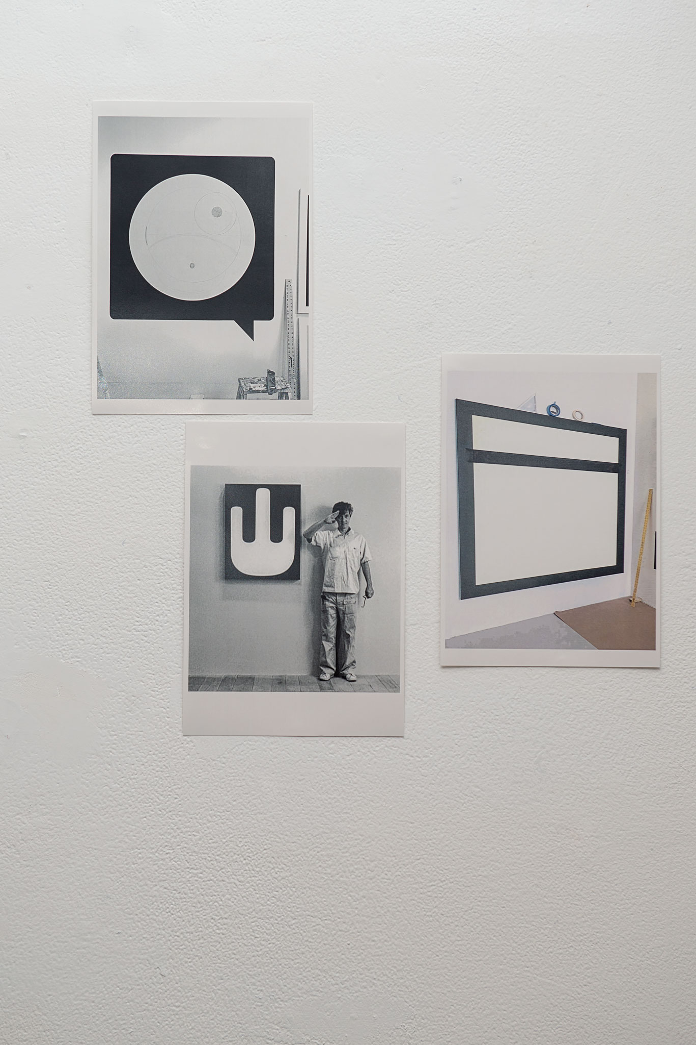
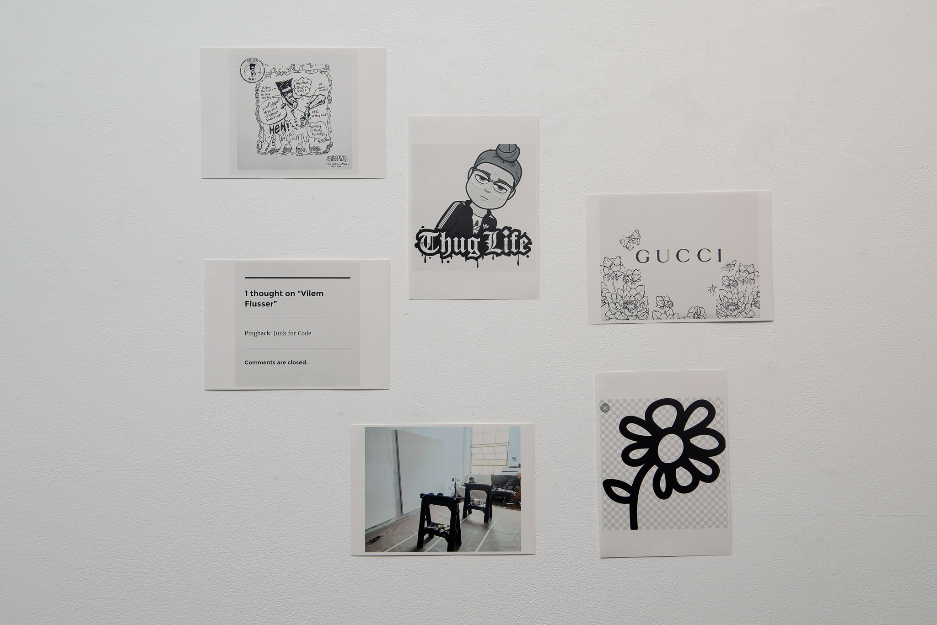
Michael Zahn (US) KOLLECTIF.19 2015-2023 Digital print on paper, Each: 21 x 14.8cm Courtesy the artist

Slide 17
Peter Holm (DK) Black space -White space 2023 Acrylic on wood, acrylic wall painting, each panel: 38 x 34.5 x 4cm, Acrylic wall painting, 70 x 70cm, Courtesy the artist

Slide 18
Sean Lowry (AUS) Jimee BS Balking 2016 Artist book, edition 3 of 3 + AP, 21.5 x 16cm Courtesy the artist

Slide 19
Simon Morris (NZ) Colour Light (Brown) 2020 Acrylic, linen on wood, 45 x 45cm Courtesy of the artist

Slide 20
TILMAN (DK/Italy) Movements (Desire) 2018 Enamel on aluminum, 33 x 25 x 4cm Courtesy the artist

Slide 21
Victoria Munro (NZ/US) When I Think of You 2016 Fabric on wooden stretcher, 22 x 22cm x 11cm Courtesy the artist

Slide 22
David Thomas (AUS) Reflecting on Passing Time 2007-2023 Enamel on photography, 27.5 x 36.5cm, Courtesy the artist, BLOCK Projects Melbourne

Slide 23
Jordan Mitchell- Fletcher (AUS) Tile Collection 2022-2023 Glazed stoneware, Dimensions variable Courtesy of Reading Room, Melbourne

