Slide 1
Benchmarking and ACODE Benchmarking: A methodological perspective
Associate Professor Fernando F. Padró, PhD
Open Access College

Slide 2
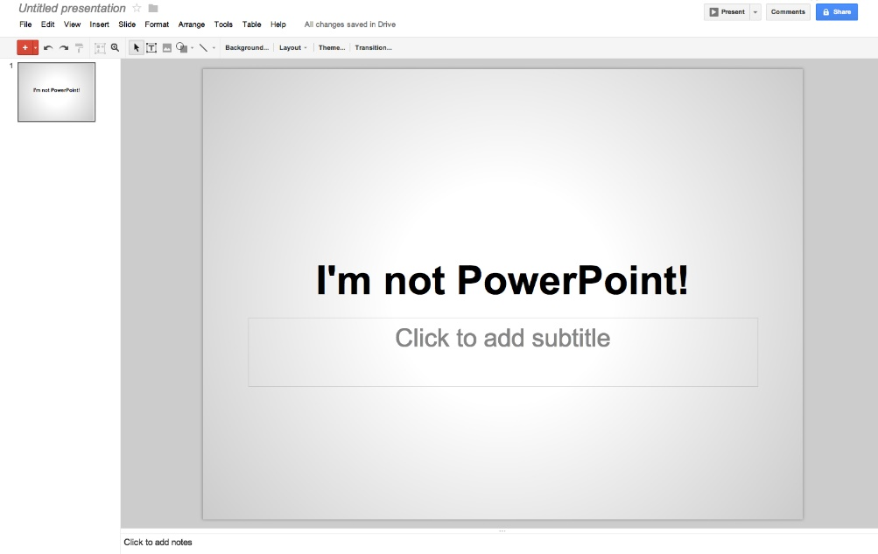
This is a quick discussion of the methodological issues surrounding benchmarking that influenced and continues to influence the ACODE Benchmarking Summit
  A quick primer on benchmarking in general – pros and cons
  ACODE Benchmarking Rounds basic benchmarking approach
  Future considerations

Slide 3


Benchmarking as a QMS (TQM) instrument
Almost all … quality management [activities] emphasise evaluation, and broadly this can only be undertaken in four main ways: against defined objectives or standards (whether set internally or by external funding bodies); against measures of customer satisfaction; against expert and professional judgement; and against comparator organisations; with analysis in all four approaches being undertaken over a defined time scale. Thus benchmarking as it has come to be defined, was an inevitable outcome of the growth of the quality movement, was an inevitable outcome of the growth of the quality movement, and indeed a recent major review of benchmarking methodologies has identified a close conceptual and philosophical link between it and TQM (Schofield, 1998, p. 6).

Slide 4

What is benchmarking?
It is a quality-based technique that provides a roadmap that links and aligns organisational action and planning to mission, vision and values (Bridgland & Goodacre, 2005).
  a means by which an entity can: demonstrate accountability to stakeholders; improve networking and collaborative relationships; generate management information; develop an increased understanding of practice, process or performance; and garner insights into how improvements might be made (TEQSA, n.d.)
  Unpacked, TEQSA’s perspective aligns with benchmarking for:
    Continuous improvement (CI)
    Determining areas for development or growth (gap or opportunity identification)
    Developing strategy
    Enhancing organisational learning and improving organisational sense-making
    Increasing productivity or improving the design of a product or service
    Performance assessment
    Performance improvement through recalibration or setting of goal (Elmuti and Kathawala (1997)

Slide 5
What is benchmarking?
Either a formal or informal knowledge sharing process based on the comparative analysis of practices for improvement purposes beyond that of evaluation (Ronco, 2012; Tomlinson & Lundvall, 2001).
It is process-driven (attainment of improvement) and variance-driven (need for improvement – Moriarty, 2011).
More of a guide than a tool for statistical precision directed by what is deemed meaningful evidence (Braadbaart & Yusnandarshah, 2008; Bhutta & Huq, 1999).
On the other, it is more than simple comparison of performance and the ultimate pay-off to organisations doing it is based on the extent of useful organisational learning that can be translated into improvement action plans (Mann, 2012).
In a university situation, benchmarking as a means of “connecting up relevant stakeholders both within and outside the institution in such a way that leads to knowledge exchange about why, what, where and how improvement might occur” (Garlick & Pryor, 2004 as cited in Meek & van der Lee, 2005).

Slide 6
Potential downsides to benchmarking – and why it should not be done casually
Benchmarking can be used for political and organisational control (Northcott & Llewelyn, 2005).
Benchmarking can either become an exercise of collaboration or the creation of rivalries (Braadbaart & Yusnandarshah, 2008).
Capturing performance metrics alone does not necessarily lead to understanding how the underlying processes enable results as it can lead to benchmarking being used incorrectly (Alstete, 1995; Boxwell, 1994).
Limiting benchmarking to only performance indicators (PIs) ignores the premise that determining improvement requires the identification of the processes that generate the results found (Levy & Ronco, 2012). Benchmarking and PIs are two distinct processes that should operate in parallel (Meek & van der Lee, 2005).

Slide 7

Potential downsides to benchmarking -- continued
Using findings from a benchmarking exercise merely to imitate what others are doing does not mean improvement as the organisational response may not factor in context specific issues that impact on success (Moriarty, 2011; Pfeffer & Sutton, 2006). For when the distinction is important, pursuing a copy-and-paste approach encourages the identification of “good” practices instead of “best” practices (Navarro et al., 2014).
Positive outcomes from benchmarking will be extoled while setbacks will most probably be ignored and the benchmarking process downplayed or deemed flawed (especially when there may be regulatory compliance implications – cf., Feller, 2002).

Slide 8
Types of benchmarking (Bhutta & Huq, 1999, p. 257)
Performance benchmarking
  the comparison of performance measures to determine how an organization compares to others
Process benchmarking
  methods and processes comparing methods and processes in an effort to improve an organization’s own processes
Strategic benchmarking
  when changing an organization’s strategic direction and the comparison with the competition is pursued in terms of strategy
Internal benchmarking
  comparisons made between an organization’s own departments/divisions
Competitive benchmarking
  performed against ``best'' competition to compare performance and results
Functional benchmarking
  compare the technology/process in one's own industry or technological area to become the best in that technology/process
Generic benchmarking
  comparison of processes against best process operators regardless of industry

Slide 9
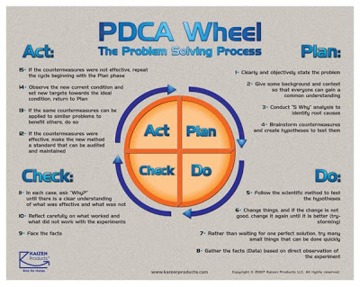
How to do benchmarking
More than 40 to 60 benchmarking frameworks have been created since WWII. Most based on the Deming-Shewhart PDCA cycle (Padró & Sankey, in press). These frameworks can be placed within three broad-based categories:
  academic/research-based (looking at theoretical and conceptual aspects based on academic’s or researcher’s own work),
  consultant/expert-based (judgment developed from personal practical experience at client’s organisation), and
  organisation-based (proposed by organisations based on own experience and knowledge – Anand & Kodali, 2008)
These frameworks have as few as 4 to as many as 33 steps within them predicated on where these sit within the PDCA cycle

Slide 10

TEQSA is requiring evidence of active benchmarking activity implementation and formalised benchmarking relationships (Freeman, 2014).
The ACODE Benchmarking approach echoes Garlick and Langworthy’s (2008) view on benchmarking:
… uses normative terms like “collaboration”, “organisation learning”, “inclusiveness”, “reflection”, “review”, “leadership” and “improvement”. This way is about connecting up relevant stakeholders both within and outside the institution in such a way that leads to knowledge exchange about why, what, where and how improvement might occur (p. 6).

Slide 11
ACODE Round 1 process in relation to the Camp and De Toro’s benchmarking process (Sankey & Padró, 2016). This was followed in Round 2.
Benchmarking phase | Benchmarking steps | ACODE Benchmarking study
Phase 1: Planning | Deciding what to benchmark Identify whom to benchmark 3a. Plan the investigation and 3b. Conduct it | Validation of the benchmarks themselves: identification of use of Benchmarks by HEIs and their impact HEIs using ACODE – internal, competitive and partnering benchmarking exercises (Camp & De Toro, 1999) 3a. Participants had to perform an assessment of at least 2 of the benchmarks. 3b. [i] Summit where all participants shared information and worked on filling the survey [ii] Follow-up survey
Phase 2: Analysis | 4. Have a full understanding of internal business processes before comparing them to external organisations; examine the best practices of other organisations; measure the gap 5. Project future performance levels | 4. To participate, HEIs first had to undertake a rigorous self-assessment of their capacity in TEL against the embedded performance indicators (PIs) that are part of (used to validate) the Benchmarks. 5. Completion of findings, generation of ratings and reporting on strengths and weaknesses that suggest further performance focus (at the Summit and through communication within individual HEI)

Slide 12
ACODE Round 1 process – continued
Benchmarking phase | Benchmarking steps | ACODE Benchmarking study
Phase 3: Integration | 6. Communicate findings and achieve acceptance of findings; refine goals and incorporate into planning process 7. Establish functional goals reflecting projected improvement , integrating targets and strategies into business plans and operational reviews | 6. Overall and individual HEI reports of results provided by all participants and ACODE members 7. Completion of the ACODE Benchmarks process leads to the identification of improvements and strategies that individual HEIs can pursue: for ACODE itself, recommendations have been identified from collective feedback of participants to establish targets and strategies on future plans
Phase 4: Action | 8. Develop and implement action plans 9. Monitor progress 10. Recalibrate benchmarks | 8. Predicated on internal HEI interest, QA and decisionmaking process; for ACODE action plans generated by leadership team in consultation with the membership 9. ACODE will perform follow-up activities as part of the overall benchmarking exercise to monitor HEI impact and continue validation of the Benchmarks 10. ACODE intention is fitness for purpose to determine appropriateness of Benchmarks and their use

Slide 13
ACODE Rounds 1 & 2 process – continued
Benchmarking phase | Benchmarking steps | ACODE Benchmarking study
Phase 5: Maturity | Determining when a leadership position is attained; incorporating best practices in all business processes; benchmarking is a standard part of guiding work as an ongoing process | Determination of ACODE’s ability to demonstrate how, what Luhmann (1995) called double contingency, generates a shared perspective and mutual capacity [to influence HEIs and the sector]
Source: Adapted from Camp & De Toro, 1999, pp. 12.3-12.4
Re maturity:
  ACODE is looking for sector leadership recognition and maturity and is currently not focused on individual HEI maturity (that is indirectly measurable through the action plans derived from the internal HEI assessments, follow-up communications and changes in planning, action plan development capacity, etc.).
  An ACODE Benchmarking exercise was performed in the UK in 2017 by 15 HEIs.
  This is the third round, this time with 25 HEI participants. This in itself was an important step as participation is a demonstration of sustained interest based on perceived benefits accrued to participants from ACODE’s activities and Benchmarks (cf., Adebanjo & Mann, 2008).

Slide 14
Complementary or competing TEL guiding principles informing HEIs

Slide 15
Changes between Rounds 1 & 2
Round 2 began to see a more evaluation elements than Round 1, which was exploratory in nature in order to determine some baselines for later comparisons.
For Round 2, evaluation frameworks within benchmarking were embedded rather than the more typical reverse practice of using benchmarking as an element of an evaluation (cf., Feinstein, 2012; Lucertini, Nicolo, & Telmon, 1995; Newcomer & Brass, 2016; Scriven, 2016).
Similar to what some have previously termed intelligent benchmarking, the rationale for this approach was to:
  deemphasize metrics,
  focus on collaboration rather than competition,
  concentrate on “good” practice to identify “best” practice and determine the extent and type of influence HEI context has on the distinction, and
  being systemic to provide a broad perspective on CI from using of a variety of analytical tools and methodologies (cf., Tomlinson & Lundvall, 2001).

Slide 16
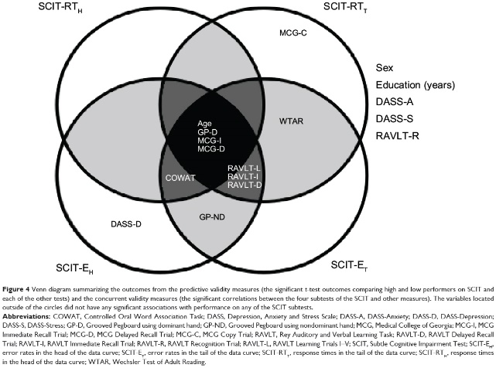
Round 3 and future plans (resources permitting)
ACODE Benchmarking’s final frontier: item validation (Marshall & Sankey, 2017).
There are three basic types of validity: criterion, content and construct (Cronbach & Meehl, 1955). Ideally, per Messick (1995), these three should be performed and connected to better determine the meaning of the results because “it matters whether the contextual clues that people respond to are construct-relevant or represent construct-irrelevant difficulty or easiness” (p. 743).
Validation is important as the evaluation component has now become an important part of the ACODE Benchmarking activity. Benchmarking and evaluation have an uneasy relationship methodologically as they represent slightly different things (Padró & Sankey, in press); however, Castonguay (2009), notes where the nexus exists and where approaches such as ours need to consider.

Slide 17
Complementarities between benchmarking and evaluation frameworks (Nielsen & Hunter, 2013, p. 120)
Methodological concerns may sound trivial, but they do present challenges when designing activities such as this that are multi-purpose in scope. This was our experience as we designed items and approaches to collect data after Round 1.
Complementarities:
  Sequential complementarity – where monitoring information generate questions requiring evaluation studies or these studies generate knowledge requiring continuous performance monitoring.
  Information complementarity – when both monitoring and evaluation draw from the same data sources and recycle information for different uses and analyses.
  Organizational complementarity – the coupling and sharing of monitoring and evaluation information through the same administrative unit rather than two or more discrete units.
  Methodical complementarity – the sharing of similar processes and tools for structuring and planning, obtaining data, analysing and inferring judgment, and converting data into actionable information.
  Hierarchical complementarity – information gathered as part of performance management at the national or policy level that can be utilised as comparative or benchmark data for evaluation purposes.

Slide 18

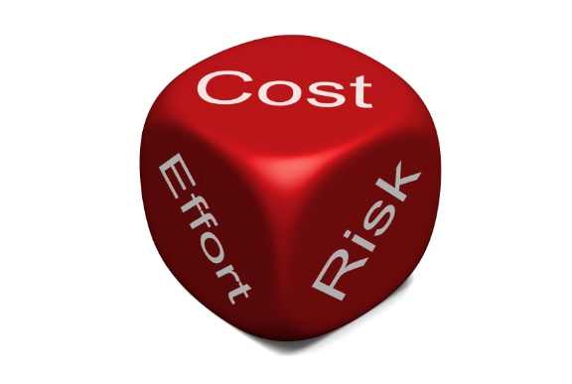
Final thoughts about future actions
Going through this process now for the third time, two items stand out that are being considered:
  There is a need for a standard specific to student engagement. Being a course examiner for a course with over 1,000 students most of whom are online, this is a point that comes through all the time to me.
  As someone who has and does a fair bit of research on risk in higher education settings, there is a need to either embed a risk component to appropriate elements of existing ACODE Benchmarks or add another one.

Slide 19
References
Adebanjo, D., & Mann, R. (2008). Sustainability of benchmarking networks: A case-based analysis. Total Quality Management & Business Excellence, 19(1-2), 107-122.
Alstete, J. W. (1995). Benchmarking in higher education: Adapting best practices to improve quality. ASHE-ERIC Higher Education Report, #5. Washington, DC: George Washington University.
Anand, G., & Kobali, R. (2008). Benchmarking the benchmarking models. Benchmarking: An International Journal, 15(3), 257 – 291.
Boxwell, R.J., Jr. (1994). Benchmarking for competitive advantage. New York: McGraw-Hill.
Bhutta, K.S., & Huq, F. (1999). Benchmarking best practices: an integrated approach. Benchmarking: An International Journal, 6(3), 254-68.
Braadbaart, O., & Yusnandarshah, B. (2008). Public sector benchmarking: a survey of scientific articles, 1990–2005. International Review of Administrative Sciences, 74(3), 4 21–433.
Bridgland, A., & Goodacre, C. (2005). Benchmarking in higher education: a framework for benchmarking quality improvement purposes. In Proceedings, Educause Australasia, 5-8 April, Auckland, New Zealand.
Castonguay, J. (2009). Benchmarking carrots and sticks: Developing a model for the evaluation of work-based employment programs. Amsterdam: Amsterdam University Press.
Cronbach, L.J., & Meehl, P.E. (1955). Construct validity in psychological tests. Psychological Bulletin, 52(4), 281-302.
Elmuti, D., & Kathawala, Y. (1997). An overview of benchmarking process: a tool for continuous improvement and competitive advantage. Benchmarking for Quality Management & Technology, 4(4), 229-243.
Feller, I. (2002). Performance measurement redux. American Journal of Evaluation, 23(4), 435–452.
Feinstein, O. N. (2012). Evaluation as a learning tool. In S. Kushner & E. Rotondo (Eds.), Evaluation voices from Latin America. New Directions for Evaluation, 134, 103–112.
Freeman, B. (2014). Benchmarking Australian and New Zealand university meta-policy in an increasingly regulated tertiary environment. Journal of Higher Education Policy and Management, 36(1), 74-87.
Garlick, S., & Pryor, G. 2004, Benchmarking the university: Learning about improvement. Canberra: Department of Education Science and Training.
Garlick, S., & Langworthy, A. (2008). Benchmarking university community engagement: Developing a national approach in Australia. In OECD Higher Education Management and Policy, Volume 20 Issue 2: Higher Education and Regional Development. (12 pp.). Paris: OECD Publishing.
Levy, G.D., & Ronco, S.L. (2012). How benchmarking and higher education came together. In G. D. Levy & N. A. Valcik (Eds.), Benchmarking in Institutional Research, New Directions for Institutional Research no. 156, 5-13.
Lucertini, M., Nicolo, F., & Telmon, D. (1995). Integration of benchmarking and benchmarking of integration. International Journal of Production Economics, 38, 59-71.
Luhmann, N. (1994/1984). (Trans. By J. Bednarz, Jr. & D. Beacker). Social systems. Stanford, CA: Stanford University Press.
Mann, R. (2012). Everything You Need to Know About Benchmarking. Retrieved from http://www.financepractitioner.com/performance-management-best-practice/everything-you-need-to-know-about-benchmarking?page=1
Marshall, S. & Sankey, M. (2017). The ACODE Benchmarks for Technology Enhanced Learning. Proceedings of the THETA 2017 Conference, Connecting Minds. Creating The Future. (pp. 1-13). Auckland, New Zealand. 7-10 May. Retrieved from: https://www.researchgate.net/publication/320216099_The_ACODE_Benchmarks_for_Technology_Enhanced_Learning
Meek, V.L., & van der Lee, J.J. (2005). Performance indicators for assessing and benchmarking research capacities in universities. In APEID, UNESCO Bangkok Occasional Paper Series Paper no. 2: United Nations Educational, Scientific and Cultural Organisation (UNESCO).Retrieved from http://unesdoc.unesco.org/images/0015/001529/152960e.pdf
Messick, S. (1995). Validity of psychological assessment: Validation of inferences from persons’ responses and performances as scientific inquiry into score meaning. American Psychologist, 50, 741–749.
Moriarty, J.P. (2011). A theory of benchmarking. Benchmarking: An International Journal, 18(4), 588 – 611.
Navarro, M., Gibaja, J.J., Franco, S., Murciego, A., Gianelle, C., Hegyi, F.B., & Kleibrink, A. (2014). Regional benchmarking in the smart specialisation process: Identification of reference regions based on structural similarity. S3 Working Paper Series No. 03/2014. Seville, Spain: European Commission Joint Research Centre.
Newcomer, K., & Brass, C.T. (2016). Forging a strategic and comprehensive approach to evaluation within public and non-profit organizations: Integrating measurement and analytics within evaluation. American Journal of Evaluation, 37(1), 80-99.
Nielsen, S. B., & Hunter, D. E. K. (2013). Challenges to and forms of complementarity between performance management and evaluation. In S. B. Nielsen & D. E. K. Hunter (Eds.), Performance management and evaluation. New Directions for Evaluation, 137, 115–123.
Northcott, D., & Llewellyn, S. (2005). Benchmarking in UK health: a gap between policy and practice? Benchmarking: An International Journal, 12(5), 419 – 435.
Padró, F.F., & Sankey, M. (in press). Benchmarking as an instrument for continuous improvement in a regulated higher education quality assurance environment. In A. Krishnan (Ed.), Cases on quality initiatives for organizational longevity. New Dehli: IGI Global.
Pfeffer, J., & Sutton, R.I. (2006). Evidence-based management. Harvard Business Review, 84(1), 62-74, 133.
Ronco, S.L. (2012). Internal benchmarking for institutional effectiveness. In G. D. Levy & N. A. Valcik (Eds.), Benchmarking in Institutional Research, New Directions for Institutional Research no. 156, 15-23.
Sankey, M., & Padró, FF. (2016). ACODE Benchmarks for Technology Enhanced Learning (TEL): Findings from a 24 university benchmarking exercise regarding the benchmarks’ fitness for purpose. International Journal of Quality and Service Sciences, 8(3), 263-278.
Schofield, A. (1998). Benchmarking: An Introduction to Benchmarking in Higher Education. In A. Schofield (ed.), Benchmarking in Higher Education: An international review. (pp. 8-20). London: Commonwealth Higher Education Management Service.
Scriven, M. (2016). Roadblocks to recognition and revolution. American Journal of Evaluation 2016, 37(1), 27-44.
Tertiary Education Quality & Standards Agency [TEQSA]. (n.d.a). TEQSA glossary of terms. Retrieved from http://www.teqsa.gov.au/media-publications/glossary
Tomlinson, M. & Lundvall, B-A. (2001). Policy learning through benchmarking national systems of competence building and innovation - learning by comparing: Report for the ‘Advanced Benchmarking Concepts’ (ABC) Project. Strasbourg: European Council.

Slide 20
Thank you for listening. Feel free to ask question of our methodology and its application within HEIs.
+61-46312236
fernando.padro@usq.edu.au

