Slide 1
Communication Techniques for Blended Learning
Barack Obama and Julia Gillard, 2010-2013©
Dr Caryn Coatney,
University of Southern Queensland
Presented for the 12th Annual Online Learning Consortium Blended Learning Conference and Workshop 2015

Slide 2
Generating trustworthy messages
Blended learning teachers and political leaders share aims to:
create a sense of community; and,
develop relations with their audiences based on trust and belonging.

Slide 3
Engaging audiences
During their alliance, President Obama and Australian Prime Minister Gillard:
persuaded journalists to convey a sense of citizen participation in their leaderships;
developed more inclusive rhetoric; and,
created media impressions of involving audiences as close allies.
Educators in blended learning can adapt these techniques to encourage active learning and reflective thinking skills.

Slide 4
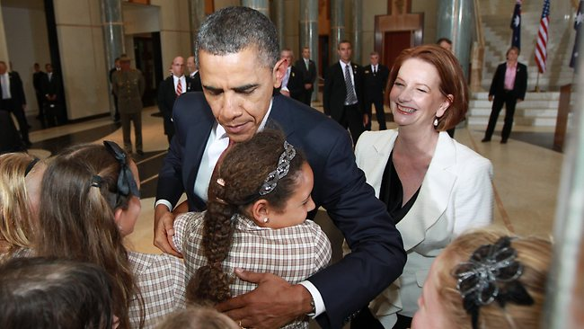
President Obama’s Australian visit, 2011
Obama and Gillard outside Parliament House, Canberra.
Picture: Gary Ramage, The Australian, 2011.

Slide 5
The President’s Australian campaign
This increased public enthusiasm for the alliance.
Both leaders worked closely with journalists to perform seemingly spontaneous public interactions.
Polls indicated more public understanding of the alliance.
Instructors can adapt these multimedia techniques to expand the language of inclusivity in blended learning.

Slide 6
Performing visual rhetoric
Journalists cooperated with Obama and Gillard to represent their 2011 speech to US marines and Australian soldiers as:
generating easy-going public interactions; and,
developing a sense of connectedness with media audiences through open gestures.
The media representations provide insights for educators in using informal language, visual signs and inclusive gestures to create a sense of civic engagement in blended learning goals.

Slide 7
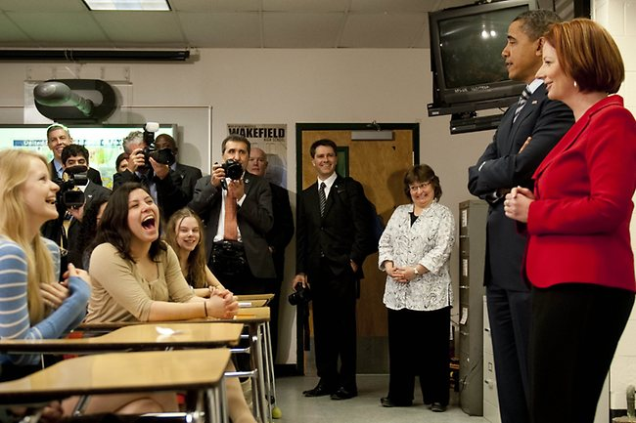
Gillard’s alliance campaign
in America
Journalists cooperated to portray this stage-managed performance as an impromptu exchange, when Obama and Gillard visited Wakefield High School in Arlington, Virginia on March 8, 2011.
Picture: Jim Watson, AFP Photo. Source: The Australian, 2011.

Slide 8
Anecdotes of shared ideals
Gillard’s alliance speech was nuanced by rhetorical performances to evoke shared cultural values.
She won journalists’ support for her speech to the US Congress on March 9, 2011 by:
developing more inclusive, personal and informal rhetoric than her Australian prime ministerial predecessors’ oratory.
using anecdotes and visual symbolism to appeal to shared democratic values.
These techniques provide some useful ideas for instructors to generate a sense of community in the blended learning group to motivate the participants to be successful.

Slide 9
Signifying compassion
Blended learning teachers and political leaders face similar challenges when communicating seemingly intimate messages in online environments.
Obama and Gillard expanded the use of online media to develop compassionate language indicating a lack of separation between them and public audiences.
They persuaded journalists to show them as reassuring, focusing on close-up images of their faces.
Also they retained journalists’ endorsement for delivering informative messages linked to a meaningful purpose.
These communication tactics can be effective for a supportive blended learning environment.

Slide 10
Inspiring hope
for the future
Obama and Gillard won public support for their alliance by:
clearly communicating a time frame and practical objectives;
emphasizing keywords such as a shared future and prosperity;
targeting messages to local audiences; and,
appearing responsive to public opinion.
The success of Obama’s Australian campaign indicates the benefits for blended learning instructors to deliver meaningful content, linked to a clear purpose and achievable goals.

Slide 11
Interacting with communities of learners
The two leaders’ communication tactics indicate the possibilities for blended learning educators to expand the language of inclusivity to involve more learners.
These tactics include:
telling stories to develop a web of connectedness and a unified sense of identity based on shared values;
delivering clear messages linked to a meaningful purpose and achievable goals to enhance audiences’ understanding.
representing interactions with audiences as spontaneous, informal and personalised.
identifying with vulnerabilities as well as strengths to elicit a capacity for new ideas and hope for creative possibilities.

Slide 12
Discussion questions
How can educators generate trust in their leaderships?
What are some ways that instructors can create a sense of community for blended learners?

Slide 13
Discussion questions
From the following list, what are priorities for communicating in blended learning environments?
Initiating inclusive conversations;
Being responsive to new ideas;
Showing compassion;
Being spontaneous; and/or
Clearly expressing complex ideas.

Slide 14
Acknowledgements
Ramage, G. (2011). Pomp aside, President Obama in the zone [Digital photograph]. Retrieved from www.theaustralian.com.au/.../story-fn59niix-1226197312340
Watson, J. (2011). Galleries: When Barack met Julia, Picture: Jim Watson [Digital photograph]. Retrieved from http://www.theaustralian.com.au/national-affairs/photos-fn59niix-1226017522987?page=6
The transcription of this presentation has been uploaded to the Online Learning Consortium website.

