Slide 1
Auditing the TPACK Capabilities of Final Year Teacher Education Students: Are they ready for the 21st century?
Romina Jamieson-Proctor - USQ
Glenn Finger - GU
Peter Albion - USQ

Slide 2
Australian Government commitment to ICT in education
Students should graduate with relevant knowledge and skills for the information economy
ICT should be integrated to improve learning
(Toomey, 2001)

Slide 3
Digital Education Revolution (DER)
“
Australia will have technology enriched learning environments that enable students to achieve high quality learning outcomes
”
(DEEWR, 2008)

Slide 4
Teacher quality
The most important factor in quality learning outcomes is…
the quality of an education system cannot exceed the quality of its teachers
“
”
(Barber & Mourshed, 2007, p.7)

Slide 5
#2 of 6 DER principles
“
teachers and educators require the pedagogical knowledge, confidence, skills, resources and support to creatively and effectively use online tools and systems to engage students
”
(AICTEC, 2009)

Slide 6
DER roadmap

Slide 7
But, major questions remain:
What professional development?
What standards?
How will progress towards the teacher “standards utopia” be measured?
Are positive attitudes + IT skills enough?
How well are teacher education programs preparing graduates to meet the demands of teaching in the 21st century?

Slide 8
Aims of this study
This paper presents a summary of an audit of the Technology Knowledge (TK) and TPACK capabilities of final year preservice teacher education students in two Queensland Universities

Slide 9
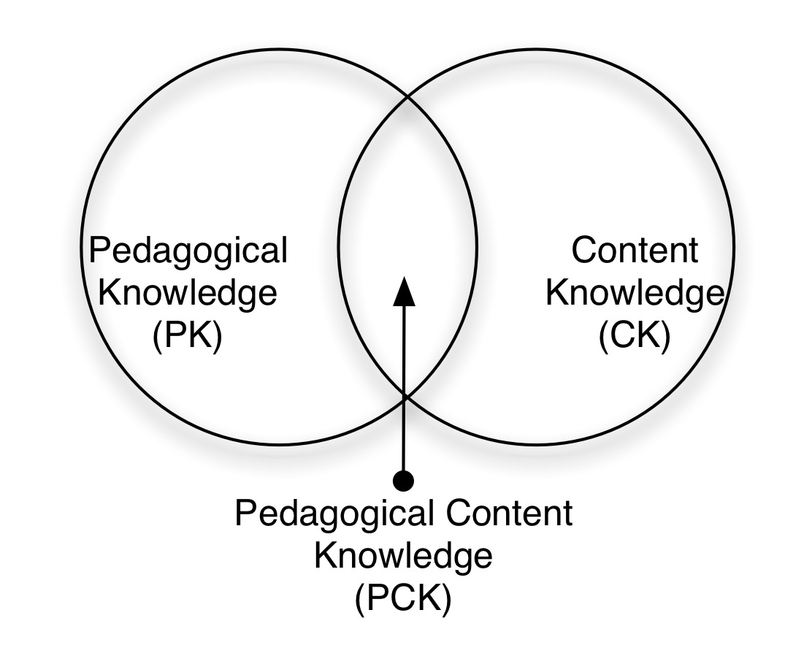
Pedagogical Content Knowledge
(Shulman, 1987)

Slide 10
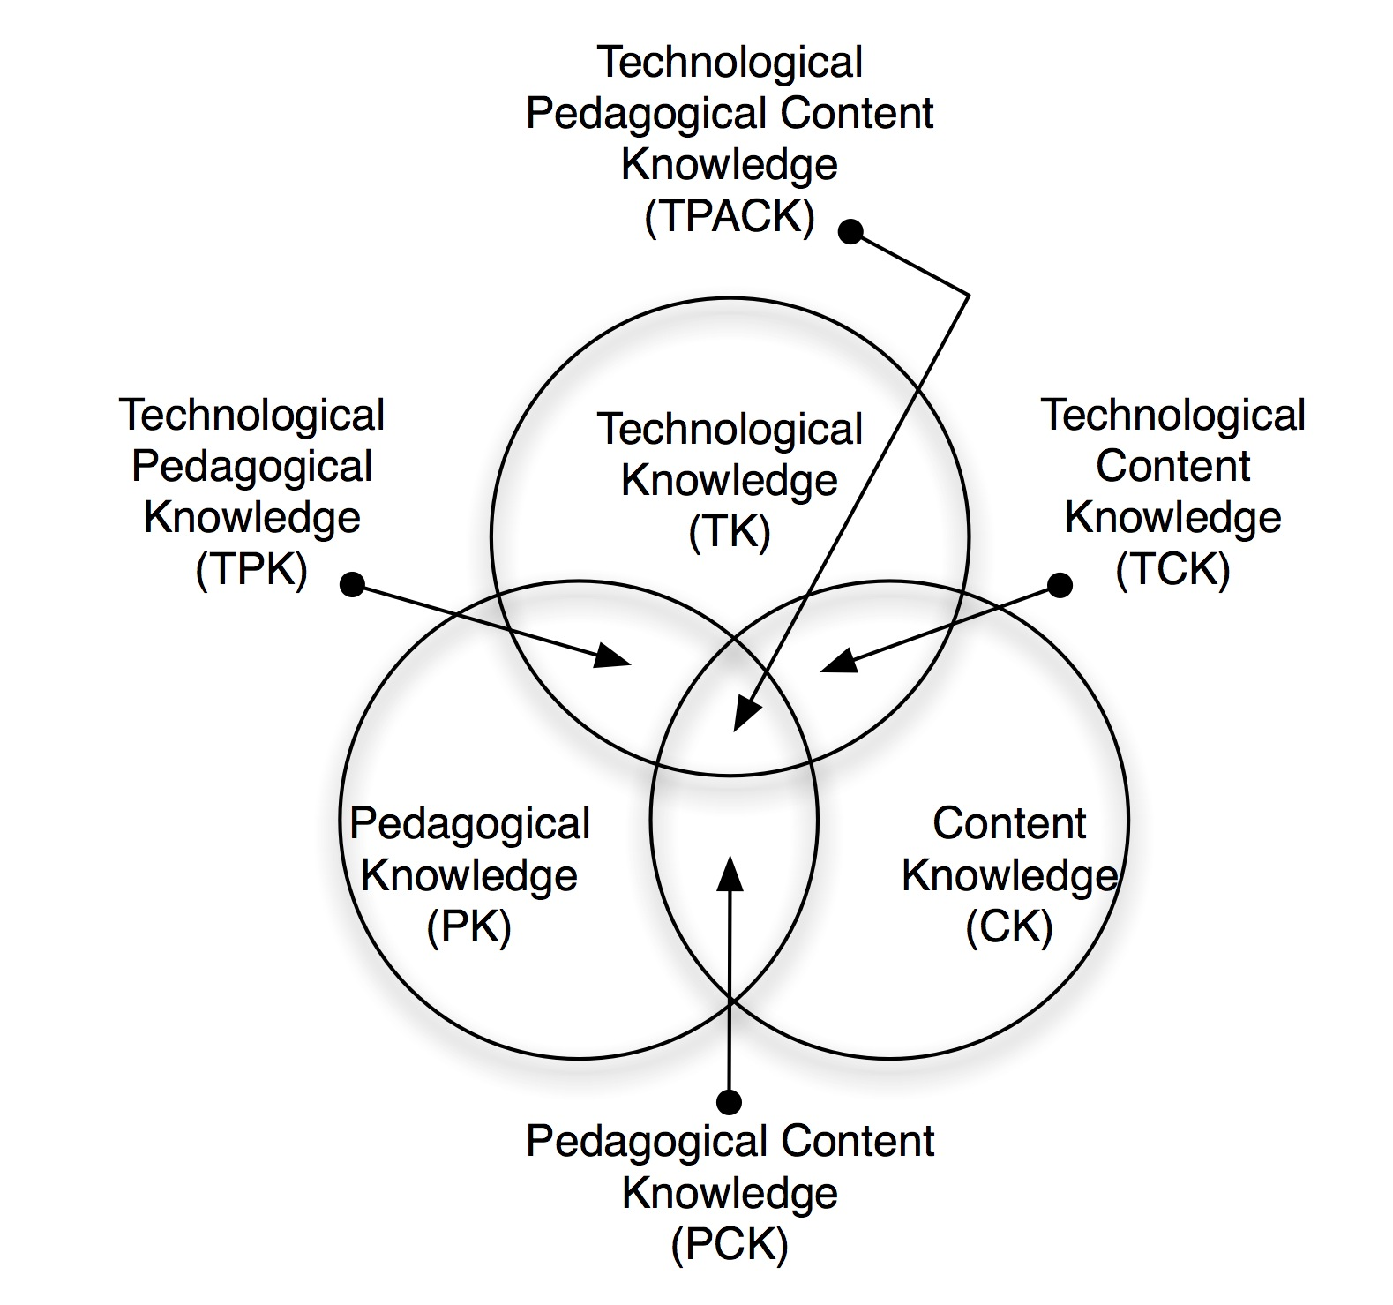
Technological Pedagogical Content Knowledge (TPCK or TPACK) – the total package for 21st century teachers
(Koehler & Mishra, 2008)

Slide 11
TPACK in Australia
To date, no studies in Australia have explicitly used the TPACK conceptualisation to guide evaluative studies, and this study represents an early exploration of TPACK capabilities of pre-service teachers

Slide 12
Measuring TPACK
TPACK is the “knowledge” required of teachers – the intersection of content, pedagogical and technological knowledge sets
How do we / can we measure TPACK?
The ideal instrument would be:
Valid & reliable for use in small and large scale studies
Conveniently administered & scored
Be based on student outcomes from TPACK rather than input measures e.g. $s spent on PD

Slide 13
Current approaches to measuring TPACK
Various approaches now appearing in the international literature (Angeli & Valanides, 2009; Archambault & Crippen, 2009; Graham et al., 2009; Koehler & Mishra, 2005; Lee & Tsai, 2010; Schmidt et al., 2009)
No widely accepted & generally applicable instrument

Slide 14
This Study: TCS
TPACK Confidence Survey – named after this paper was written – formally Teacher ICT Audit Survey ☺
Based on 7 years prior work
Learning with ICT: Measuring ICT Use in the Curriculum (Jamieson-Proctor et al., 2005, 2007)
“In my class students use ICTs to …”
4 point scale, never … very often
20 items, 2 factor solution
Enhancement of learning with ICT, Alpha = 0.94
Transformation of learning with ICT, Alpha = 0.86

Slide 15
The TCS link to TPACK
Measures frequency of ICT use by students for learning
Indirect measure of teachers’ TK
Essential to facilitate ICT use
Indirect measure of teachers’ PK
Needed to plan and facilitate ICT use in subject context
Indirect measure of teachers’ CK
Needed to enhance or transform curriculum
Instrument therefore implies measure of TPACK

Slide 16
TPACK confidence
Preservice teachers have limited experience
4-point Likert scale – No confidence … Very confident
Added TK scale based on competence with applications and digital technologies
Added self-efficacy scale based on Qld DET ICT Certificate indicators
Confidence based on
Self-assessed knowledge
Practicum experience
Used since 2005 with inservice teachers
Confidence based on experience

Slide 17
Subjects
345 final year pre-service teacher education students
from 2 Qld universities with multiple campuses
58% from metropolitan university and 42% from regional university
represents 27% of 1270 final year students at the 2 unis
79% female
48% with ages in excess of 30 years
5% secondary & 20% primary from each uni approx
63% “confident” or “very confident” to use ICT with students for teaching and learning
Demographics confirmed representative sample

Slide 18
Data Analysis and Results
TK and TPACK related to demographic characteristics, confidence and beliefs about using ICT with students
Data were analysed using SPSS 17
Chi-square (χ²) tests were used to investigate relationships between university attended, gender, age, program of study and confidence to use ICT for both personal and professional (teaching and learning) purposes

Slide 19
Availability of and interest in using ICT resources
Availability:
99.4% owned a computer
96.5% had regular access to broadband Internet (93% regional & 99% metro)
41.2% had access to mobile computing devices – affordances of mobile technologies still to be realised?

Slide 20
Interest, Use, Beliefs:
4-point Likert scale (1=Not at all; 2=Some extent; 3=Great extent; and 4=Very great extent) used
Overall subjects expressed a strong interest in using ICT for personal purposes (M=3.06) and T&L purposes (M=3.25); extensive use of ICT for personal purposes (M=3.01) and moderate use for T&L purposes (M=2.68); and a strong belief that ICT can improve student learning outcomes (M=3.19)
Thus subjects have strong belief that ICT can improve learning outcomes but expressed only a moderate level of use of ICT for T&L – Possible reasons????

Slide 21
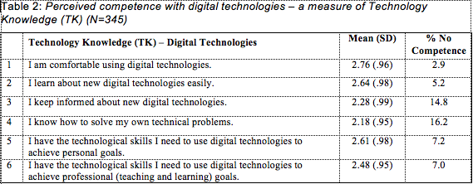
Competence with digital technologies - TK
4-point Likert scale (1=No competence; 2=Some competence; 3=Competent; and 4=Very competent)
No means >3 (“competent” perception); >10% No competence for #3 & #4

Slide 22
Competence with ICT software applications - TK
19 applications tested – 5 additional to 2003 audit
Little change between 2003 and 2009 audits
High levels of competence expressed (M>3) for WP, presentation SW, email, web browsers & searching in 2003 & 2009
Very low levels (M<2) for multimedia development & authoring, visual thinking SW, digital video editing, and web page development in 2003 & 2009
Low to very low levels of competence expressed for web 2.0, online learning, online publishing, accessing & creating reusable learning objects (M<3) – of particular concern due to $s poured into creating LOs by state and national govs

Slide 23
Relationship between uni attended, gender, age, program and confidence to use ICT with students
No difference between unis for confidence or confidence by age
Significant difference between male & female pre-service teachers’ confidence – males more confident
This result mirrors that of previous studies involving 2652 in-service state and Catholic teachers since 2004 (Jamieson-Proctor & Finger, 2008)
Males & females differ in their confidence to use ICT with students & this difference is maintained during their teaching career, irrespective of years of experience, age & PD initiatives – 6 years of research to support this statement in Qld!
Major challenge for education systems as 1/3 of future female teachers perceive themselves to be unconfident & females make up 72% of the teaching workforce across Australia

Slide 24
Confidence with ICT integration by university -TPACK
Mean (SD) | Metropolitan (N = 199) | Regional (N = 146)
1 Enhancing learning | 2.59 (0.06) | 2.62 (0.08)
2 Transforming learning | 2.55 (0.06) | 2.58 (0.07)
Preservice general confidence, 2.79
Inservice general confidence, 2.62 (Jamieson-Proctor et al., 2007)
Preservice enhancing, 2.60
Preservice transforming, 2.56
No confidence
Some confidence
Confident
Very confident

Slide 25
TPACK cont.
In my class, I could support students’ use of ICT to…
No significant difference between unis
>30% of pre-service teachers expressed No or Limited confidence with 10/20 (half) of the items (Table 6)
No significant difference between male and female subjects in their confidence to support student use of ICT for either dimension – a significant result when compared with previous studies that found a gender based difference – is the gender difference decreasing? Watch this space…

Slide 26
Conclusion (or So What?)
Male pre-service teachers still report higher levels of general confidence to use ICT with students than females
At metropolitan uni only, primary graduates were more confident than other students – same result as in 2003 – this result may be due to limited opportunities for students to engage with ICT during their degree that would build their TK and TPACK – need to closely examine the differences in program structures within and between each university

Slide 27
Conclusion cont.
Subjects asked to indicate how confident they were to support students to use ICT to enhance and transform the curriculum – means indicated no difference between male and female subjects – contrary to all previous studies. Possible reasons?
Finding 1: It’s imperative that the ICT knowledge bases (TK and TPACK) of pre-service (and in-service) teachers are regularly audited in light of the rapidity with which these knowledge bases change in relation to digital technologies

Slide 28
Conclusion cont.
Finding 2: Comparison of 2003 and 2009 audit results indicate less than optimal acceptance of ICT curriculum integration by graduating pre-service teachers in past decade.
Teacher education programs still use PCK (Shulman, 1987) as a core philosophy – TPACK capabilities (Koehler & Mishra, 2008) are essential for teachers in the 21st century.

Slide 29
Questions
Romina.Jamieson-Proctor@usq.edu.au
Where to from here?

