Slide 1
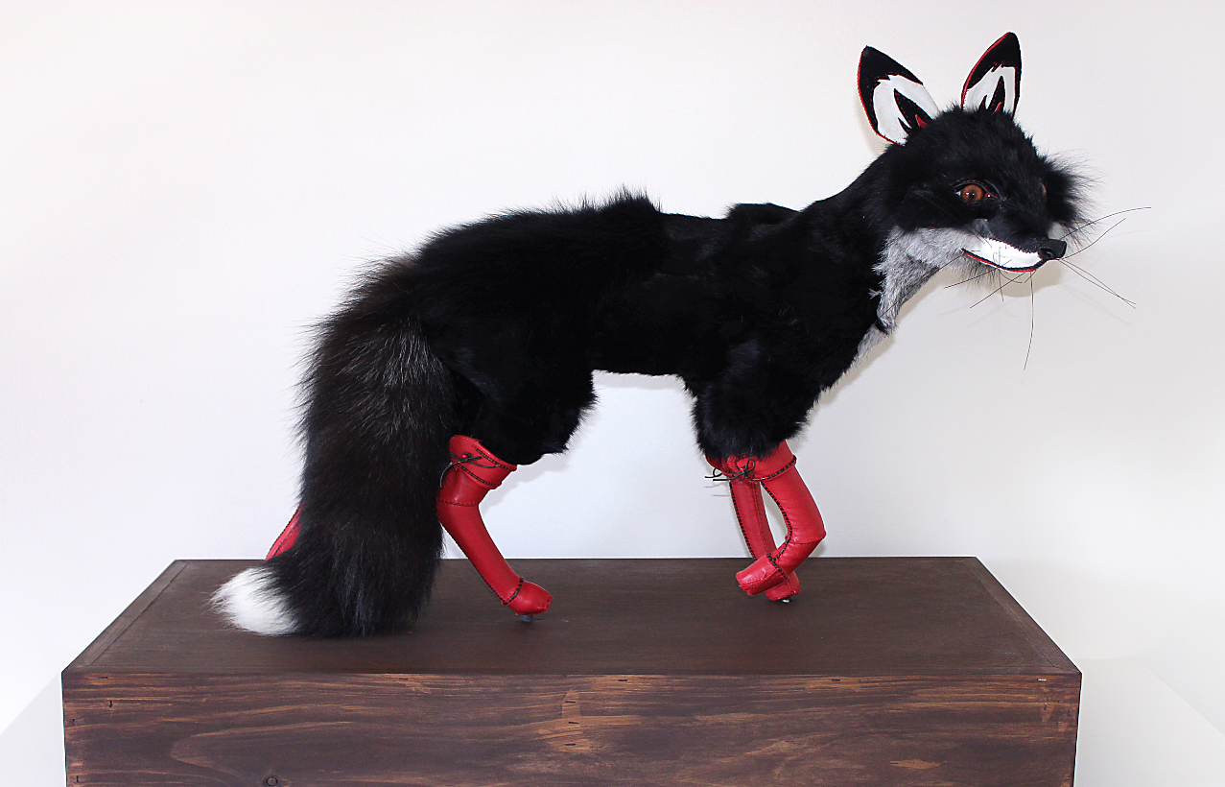
Queensland University Educators Showcasing
[Progressing teaching practice, showcasing higher education research projects]
Teachers as Tricksters:
The Magical Rituals of Women Artists in Academia
Dr Beata Batorowicz, Senior Lecturer in Sculpture, Creative Arts Coordinator
School of Arts and Communication, Faculty of Business, Education, Law and Arts, USQ
E: Beata.batorowicz@usq.edu.au

Slide 2
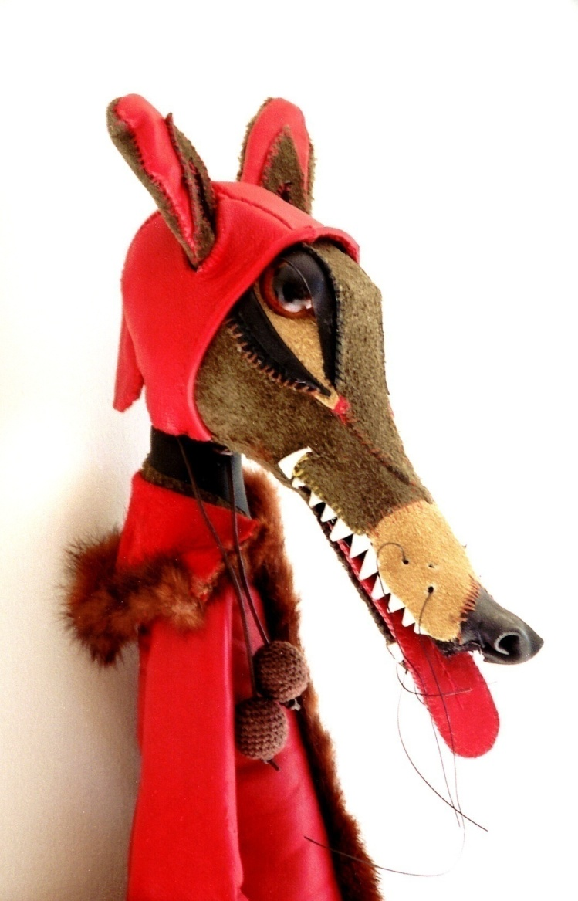
Preface
As a Polish born Australian artist and educator, I draw on symbolically charged narratives, such as fairy tales and folklore, to highlight the power of sub textual stories in subverting grand narratives of art history and its role in education.
My artworks apply personal stories to create slippages and other spaces, which offer a rich complexity of cultural tales that can be retold and experienced.
My use of personal mythologies in critiquing established art narrative tropes have been further honed and ritualised through exploring the Trickster archetype through my role as an educator.

Slide 3
The Trickster
Tricksters are creators of culture that shape the world by alerting us to the human condition and the knowledge amidst it (Hyde 2017, p.8).
The trickster is a boundary crosser but also one that extends boundaries (Hyde 2017, p.6).
The trickster archetype as a metaphor in learning and teaching in the arts that is content and model-based.
Content: It is a critical and creative thinking device in extending the boundaries of knowledge through practice-led learning in Visual Arts and broader university graduate attributes.
2. Art Teaching Model: The trickster also alerts us to the possibilities of extending boundaries towards innovative artistic and educational outcomes through blurring art and life, fact and fiction as magical learning and teaching rituals that encompass lived experiences.

Slide 4
Trickster as Metaphor
As tricksters are boundary crossers, they operate as artist-teachers do. Creative fluidity and play underpin their practice-centred enquiry as a method of overturning rigid ideas (Graham & Zwirn 2015).
There is a criticality in the way the artist-tricksters alerts us through their subversive, social constructivist teachings involving collaboration, active learning and self-reflection (Vygotsky 1978; Matthews 2017).
The trickster is a wise fool. The teaching artist, therefore, creates engaged, critical art and learning art experiences. Students learn to create the kind of art that looks back at you!
This strategy engages students in artmaking that re-establishes a focus on their artworks as ‘an identity-defining response to social and cultural conditions’ (Castro & Batorowicz 2017)

Slide 5
Contextual Challenges in Visual Arts
As an artist-academic, I came to identify synergies between my use of personal art tales and working in a regional university, in that they both operate from the periphery. They are both side-lined from global art debates.
Industry Context: As regional Australian artists have less access and to professional opportunities than colleagues based in metropolitan areas, regional artists have increasingly negative perceptions about the impact of their location on their practice.
Within the Visual Arts in Australia, women artists continue to be underrepresented in comparison with their counterparts (Countess Report, 2016).
Highly competitive industry, with regional artists earning almost a third less than their city counterparts for creative work (Australia Council, The Arts in Regional Australia: A Research Summary, 2017).
Only 17% of Australian professional artists are working full-time on their practice.; Artists living in capital cities earn 22% more than those in regional cities; 65% of Australian professional artists hold a tertiary qualification, compared to 25% in the workforce at large; 42% of Visual Artists hold a postgraduate degree. (Australia Council, The Arts in Regional Australia: A Research Summary, 2017).

Slide 6
Contextual Challenges in Visual Arts
Academia: An imbalance is experienced through the hierarchal traditions of art academies, whereby public (art institution) and private (domestic) spaces continue to be a gendered domain (Battersby 1989, Horne and Perry, 2017).
Devaluing of Creativity e.g. STEM vs STEAM within the Educational Sector
Students don’t see themselves as artists.
Career vs Employability: While Creative Arts being integral to national cultural growth, ‘creative graduates often find it difficult to become established professionally’ (Bridgstock 2011:2). This is further reflected by Creative Arts graduates having the lowest rates of employment among 21 disciplines (The Higher Education Reform Package, 2017).
Challenges specific to USQ Creative Arts students include:
1) Low socio-economic status, with 82% of USQ students being classified as low to middle SES. Attrition is inversely proportional to SES. Thus, the rates of attrition at USQ are high.
2) Majority of USQ students are online (70%) with few students exposed to Creative Arts hubs in their communities (The Higher Education Reform Package, 2017).

Slide 7
The Trickster as Extending Teaching Practices
The trickster assist us in understanding and enabling art students’ process of charting the often challenging terrain between university and industry practice-led (studio) learning.
The trickster, is a non-authoritative, empowering device as a way of allowing students in seeing themselves as professional artists as they study through authentic art industry experiences.
The trickster works from the periphery and is useful in offering strategies in addressing regionalism, gender and other forms of marginalisation.
The trickster blurs personal, imaginative and intuitive-based processes with broader socio-cultural reasoning.

Slide 8
Trickster’s Ritual: Seeing Around Corners
On the other hand, personal tales and regional spaces can work the periphery well. They hold their own agency that asserts a ‘peripheral power’ in which dominant narratives are unable to exercise (Palmer & Batorowicz Under Review; Weaver and Mora 2015, p.479).
The ability to work well from the periphery as a regional artist-teacher lies in what I describe as a Trickster ritual of ‘seeing around corners.’
This ritual involves perceiving limitations, whether it be artistic or institutional constraints, not as dead-end routes, but as reminders to look slantwise; to be attuned to uncovering potential pathways that lie in our peripheral vision.

Slide 9
Realising the Vision
Turning corners in academia has become my ritual in forging practice-led projects that develop cross-university and industry collaborations in curricula, to enhance 3D art culture and professional access to industry opportunities and outcomes in regional Australia and internationally for student-artists.
I innovate practice-led learning through authentic student engagement in art projects across university and industry sectors. As a central method, I expand upon Barrett and Bolt’s (2007) idea of practice-led learning as a transformative and authentic artist experience by initiating professional industry opportunities (exhibitions, cultural events) in curricula.
By engaging students in external projects, they employ their own process of discovery beyond the classroom. Students develop regional resiliency through developing industry skills that advance their art careers. This learning and teaching practice prepares students for their life-long learning as professional artists and entrepreneurs.
As Creative Arts Coordinator at USQ, I have developed a practice-led curriculum pathway across Creative Arts undergraduate and postgraduate programs and lead the implementation of the New Doctor of Creative Arts Program at USQ in 2016. In expanding regional university programs and research partnerships, exemplifies creative resiliency in its local and international reach.

Slide 10
Case Study: Dark Rituals, Magical Relics: From the little Art Spell Book
In collaboration with Megan Williams, University of Sunshine Coast Art Gallery, University of Saskatchewan, Canada, University of Tasmania, Launceston and USQ.
Artists: Lisa Reihana (New Zealand), Amalie Atkins (Canada), Susan Shantz (Canada), Margaret Baguley (USQ), Linda Clark, Ellie Coleman (USQ DCA students).
The project is supported by Australia Council for the Arts (2018) and offers a model in connecting regional artists internationally.
Internationally touring exhibition with 100 page artist book publication. (Includes Arts Writer Louise-Martin Chew)
Extends industry and teaching conventions:
Students collaboration with their teachers
Proposal consisted with artists and educational connections in mind.

Slide 11
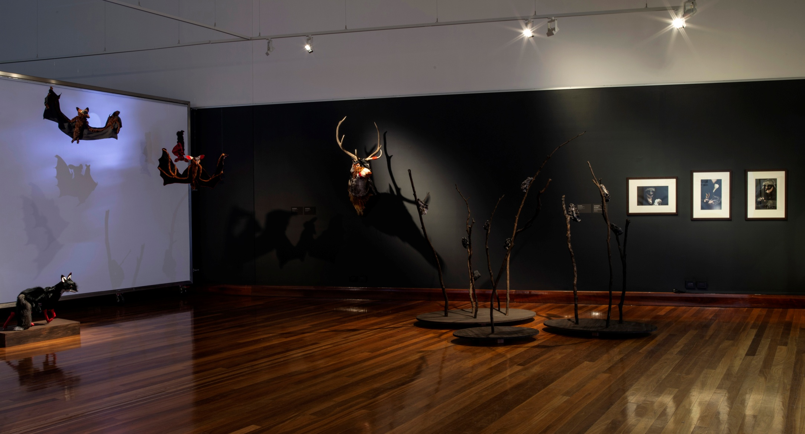
Dark Rituals Install View Photo Credit: Carl Warner

Slide 12
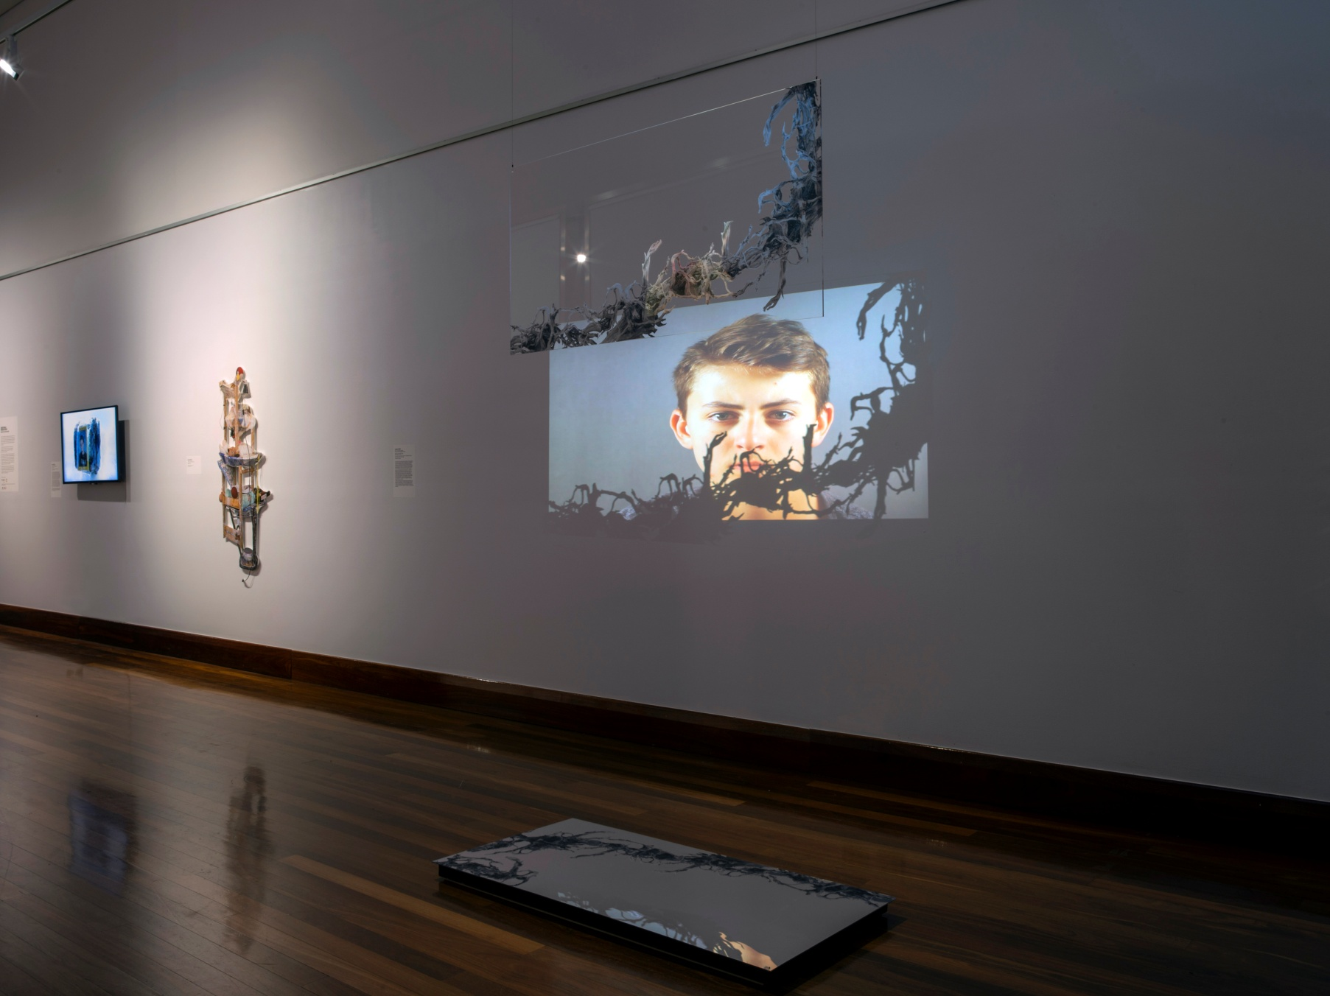
Linda Clark
USQ student
New work created
as part of her DCA
Exploring mother-artist model in creative regional communities
Dark Rituals Install View Photo Credit: Carl Warner

Slide 13
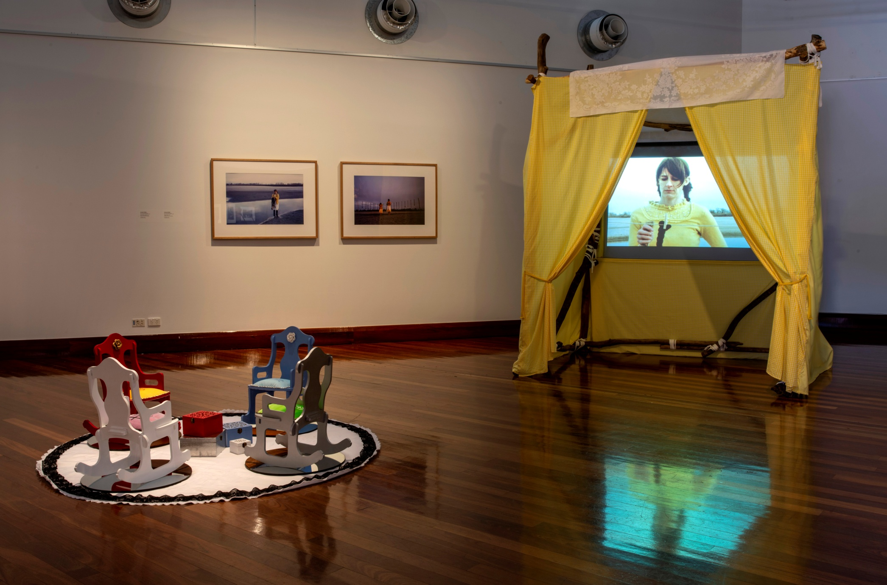
For the Australian artists, the involvement of international artists in the project means their work is positioned within global art conversations.
Thematically, the project examines personal and cultural mythologies as rites of passage inherit in the practices of contemporary women artists in academia. Blurring art and life, fact and fiction, women artists often ritualise their practice as a means of reclaiming the culturally gendered spaces in art and education (Battersby 1989; Horne & Perry 2017).
Dark Rituals Install View Photo Credit: Carl Warner

Slide 14
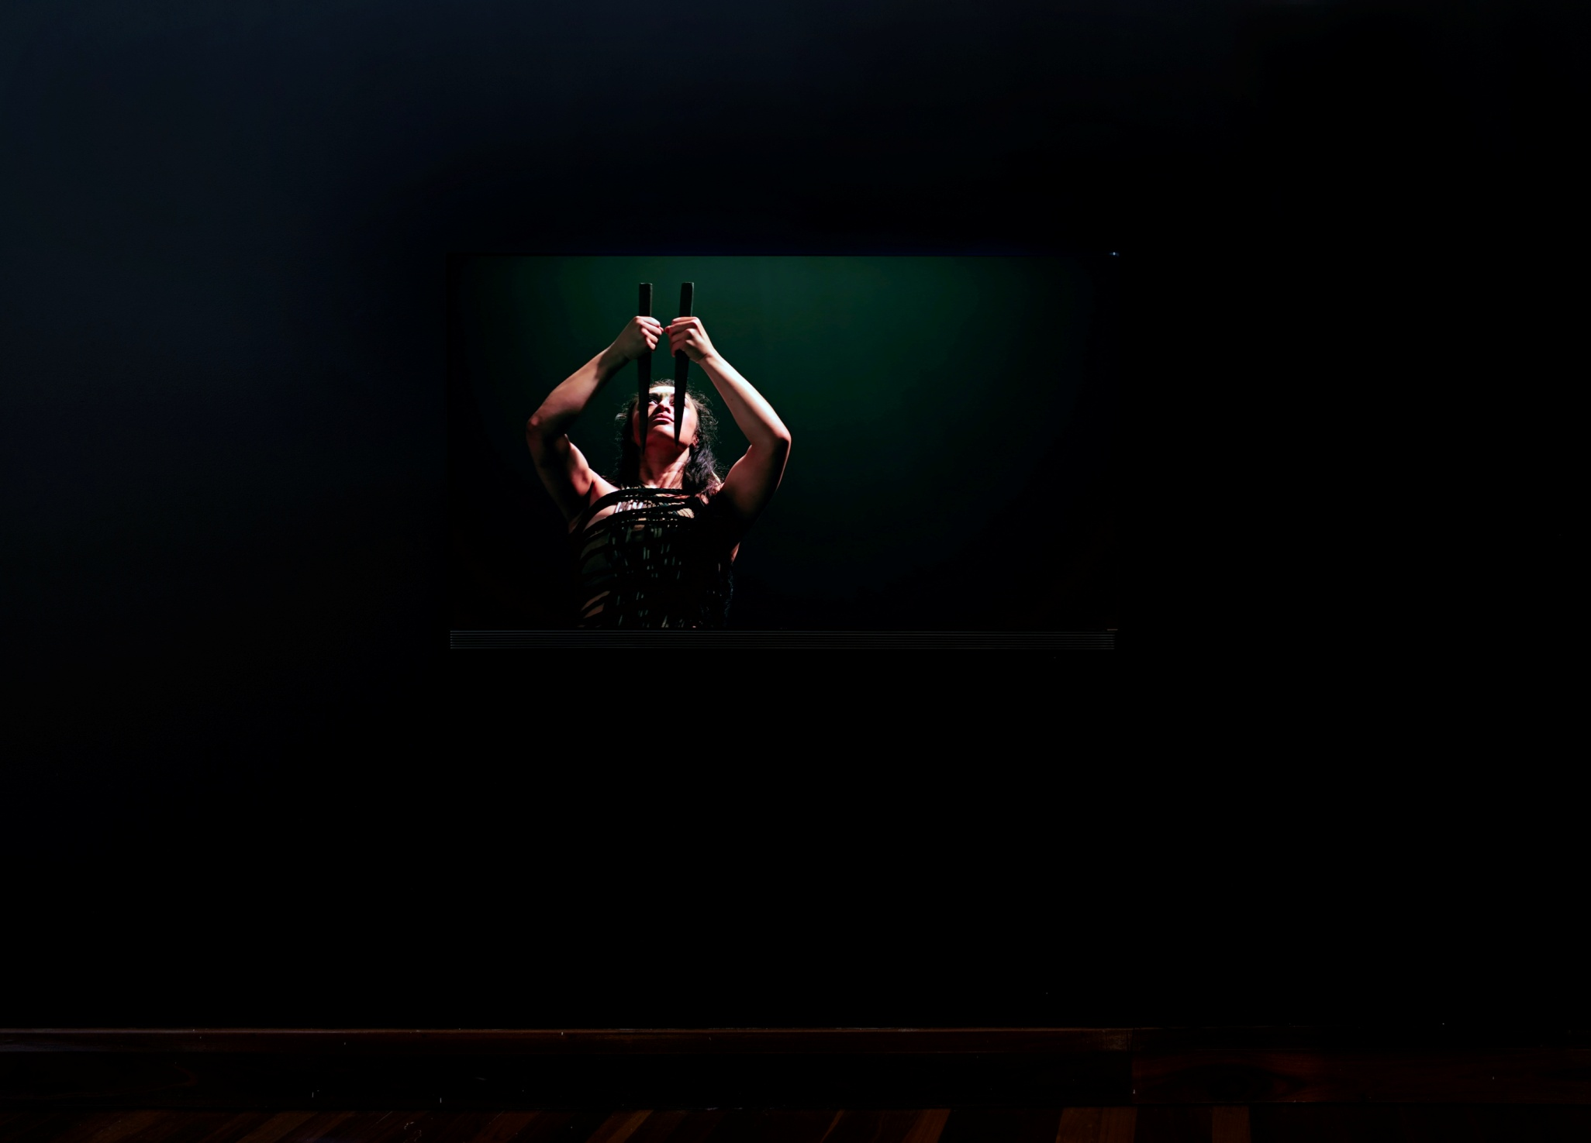
Showcasing with Peak industry artists:
Lisa Reihana
Dark Rituals Install View Photo Credit: Carl Warner

Slide 15
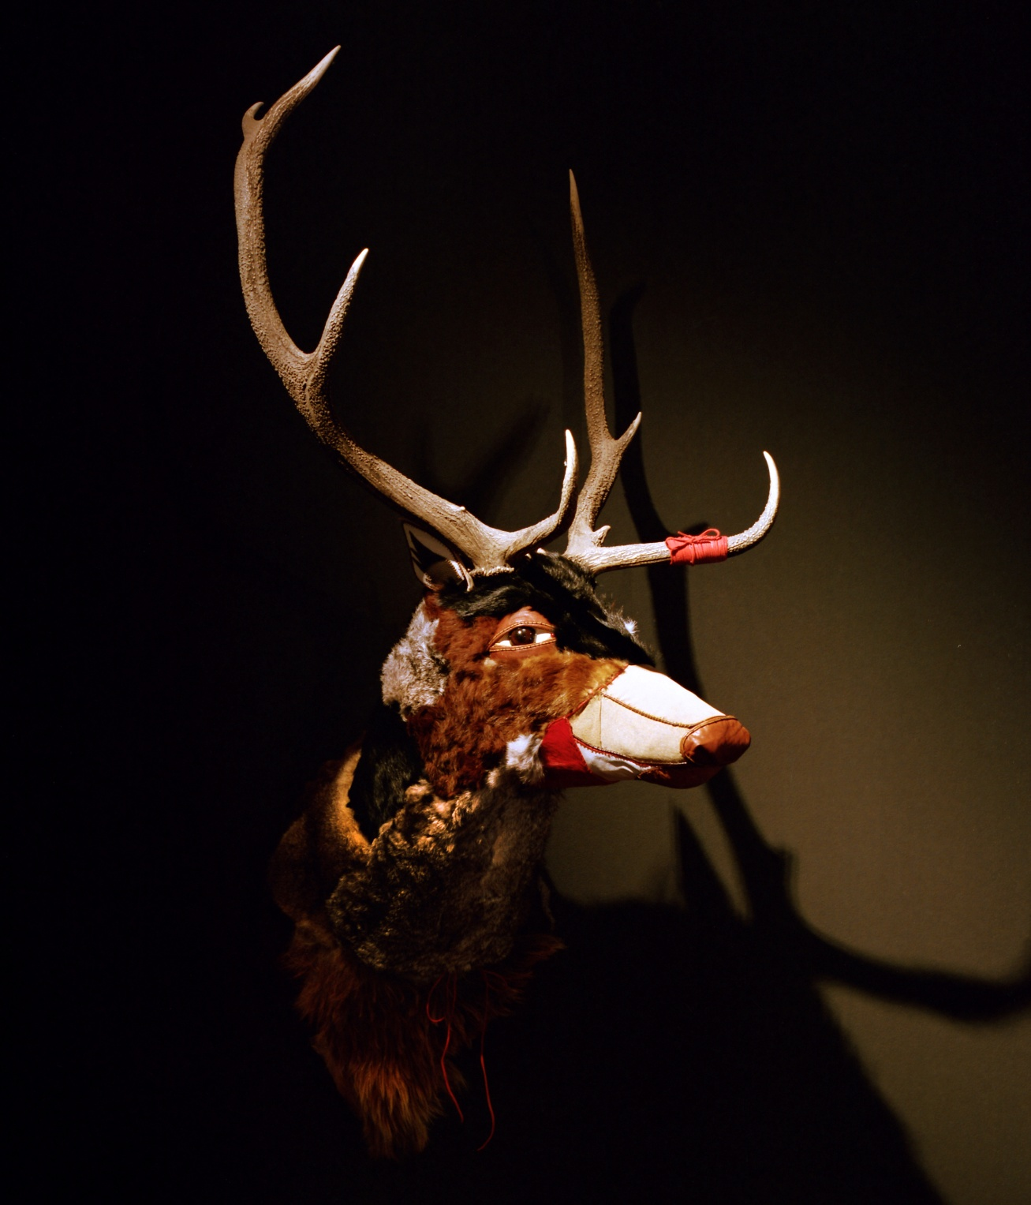
Dark Rituals Install View
Photo Credit: Carl Warner

Slide 16
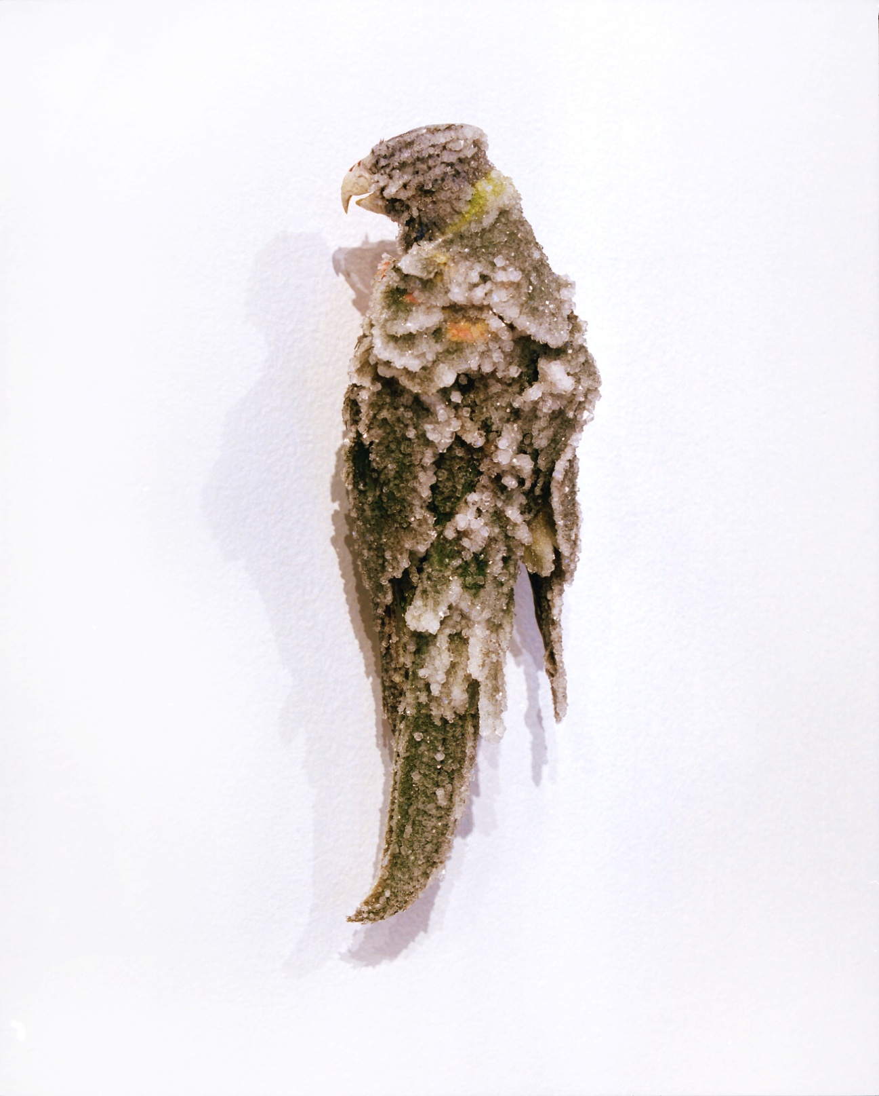
Ellie Coleman
USQ, DCA student
Dark Rituals Install Detail
Photo credit: Carl Warner

Slide 17
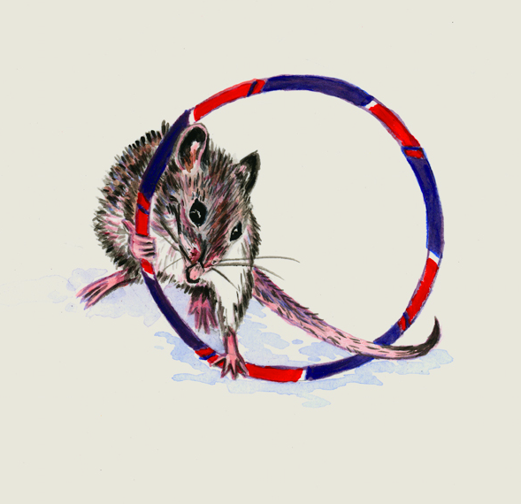
Closing The Loop
Students with grants, peak body opportunities, industry expertise and long term networks
Program growth with student mentorship
Publications on program development and high profile projects
Students as ambassadorial leaders for the university and its programs.
Industry and cross-university acknowledgment and esteem factors (reviews, interviews etc).

Slide 18
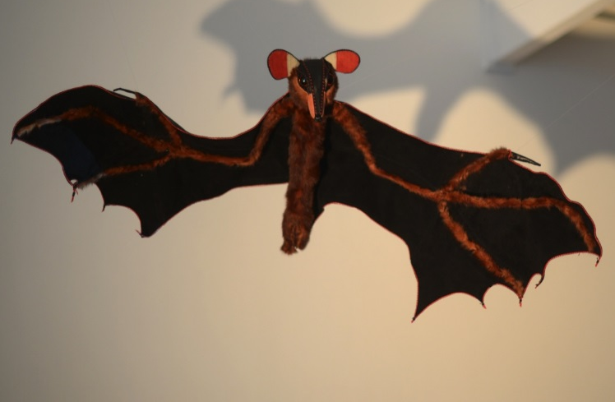
References
Australia Council for the Arts (2017) The Arts in Regional Australia: A Research Summary, Sydney. Retrieved From: http://www.australiacouncil.gov.au/research/regional-arts-summary/
Barrett, E & B. Bolt (2017) Practice as Research, Approaches to Creative Arts Enquiry, I.B. Tauris, London.
Battersby, C. (1989) Gender and Genius: Towards a Feminist Aesthetics, Bloomington and Indianapolis.
Graham, M. A & Zwirn S.G (2015) ‘How Being a Teaching Artist Can Influence K-12 Art Education’ Studies in Art Education Vol.51, Issue 3 p.219
Horne, V. & Perry, L. (eds) (2017) Feminism and Art History Now, Radical Critiques of Theory and Practice, I.B. Tauris, London.
Matthews, K. (2017) Student as Partners. Australian Learning & Teaching Fellowship. Retrieved from: http://itali.uq.edu.au/Matthews-studentsaspartners.
Palmer, J. & Batorowicz, B. (2018) ‘Peripheral Power: Little Stories to Unsettle the Present,’ Text & Performance Quarterly (Under Review).
Richardson, E. (2016) The Countess Report. Retrieved from: http://thecountessreport.com.au
Vygotsky, L.S. (1978) Mind in Society, Harvard Press, Massachusetts.

