Slide 1
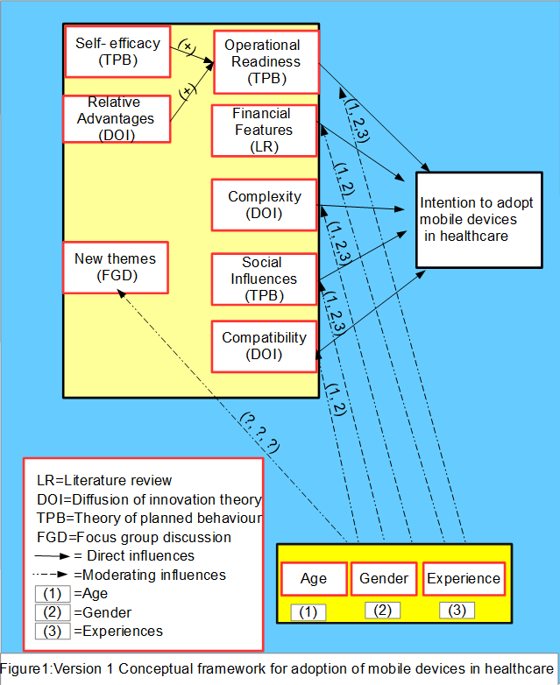
Study to investigate factors influencing adoption of mobile devices in the health care environment
Vasundhara, Rani, Sood, University of Southern Queensland, Australia, Vasundhara.Rani@usq.edu.au
Dr. Abdul Hafeez, Baig, University of Southern Queensland, Australia, Abdul.Hafeez-Baig@usq.edu.au
Prof. Raj, Gururajan, University of Southern Queensland, Australia, Raj.Gururajan@usq.edu.au
Prof. Nilmini Wickramasinghe, Director -Health Informatics Management Epworth HealthCare,
Professor Health Informatics Management Faculty of Health | Deakin University, Australia, Nilmini.work@gmail.com
Objective
Mobile devices have tremendous potential to improve the healthcare domain. However, use of mobile devices in healthcare is slow. Therefore, the aim of the research is to understand factors influencing adoption of mobile devices in the healthcare environment and to develop a model for the adoption of mobile devices.
Proposed Model
The conceptual framework given in figure developed from the literature. Further, a mixed method approach will be used to achieve the objectives of this study. A qualitative approach (focus group technique) will be used to refine the conceptual framework and determinants that are influencing healthcare professionals (HCPs) to adopt mobile devices in the healthcare domain. A quantitative approach (web survey) will be used to test the hypotheses and validate the conceptual framework.
Contributions
In theoretical contribution this research will provide further understanding regarding the key factors that could predict the adoption of mobile devices in the healthcare context.
In practice, this research has potential to reform policies for using mobile devices in the Australian healthcare context.
This research will also open future avenues for conducting research from other perspective such as patient’s perspective and will add to the body of knowledge.
Track name: IS Adoption and Diffusion Track No.: T17

