Slide 1
Making sense of learning analytics to establish a holistic ecosystem for student development and support
Fernando F. Padró
Acting Director, Learning and Teaching Services
Student Retention & Success Conference
22 June 2016
The Pullman Albert Park, Melbourne, Vic

Slide 2
Key points that are being covered
Methodology is not a starting point, but one that follows a number of other decisions
The antecedent points of reference that shape methodological decisions
  What does the unit (and its staff) need & want?
  What is the context for the evidence – what needs to be provided and what type of interpretation is needed?
  What assumptions does the unit (and its staff )have? What are the assumptions of students, academic staff, senior leaders and other external stakeholders hold about the unit and its programs?
  What is the theoretical grounding of the unit’s practice? How consistent is it with the rest of the institution’s mindset?
  What is practical given internal expectations, regulatory compliance requirements, timelines and resource limitations?
  (These are presented in terms of points to consider and what USQ has done per each point of reference)
What USQ’s SDS has accomplished and next steps in the learning analytics saga

Slide 3

Methodology is not the driver behind the establishment of a culture of evidence and quality in learning assistance programs (LAPs). Vision is.
Key drivers are decisions around:
knowledge acquisition,
information distribution,
information interpretation and
organizational memory (cf. Huber, 1991)
What’s important is to get the right data
and getting the data right lest you get it
wrong and the information has no real
meaning for you (cf. Dringus, 2012)

Slide 4
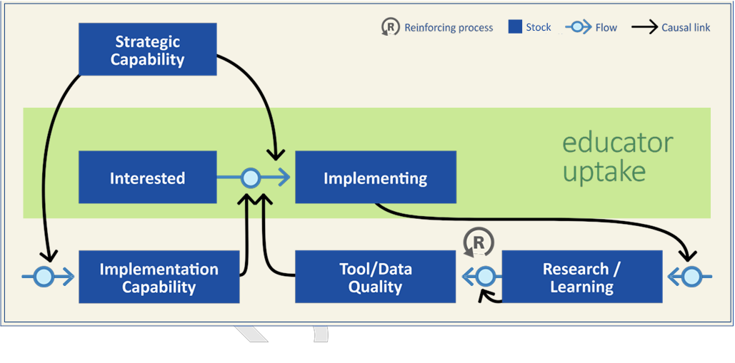
Model of system conditions for sustainable uptake of learning analytics (Colvin et al., 2015)

Slide 5

Vision & methodology emanate in large part from addressing the following questions (Donaldson, 2009)
What does the unit (and its staff) need & want?
What is the context for the evidence – what needs to be provided and what type of interpretation is needed?
What assumptions does the unit (and its staff )have? What are the assumptions of students, academic staff, senior leaders and other external stakeholders hold about the unit and its programs?
What is the theoretical grounding of the unit’s practice? How consistent is it with the rest of the institution’s mindset?
What is practical given internal expectations, regulatory compliance requirements, timelines and resource limitations?
5
4
3
2
1

Slide 6
1. What does the unit (and its staff) need & want?
This is about establishing purpose – objective(s), utility and supporting literature, if any (Saunders & Cooper, 2009)
Formulate decisions and planning around funding, programs, and resources
Finding the happy medium between being too management-centric or too student-centric (Marshall, Orrell, Cameron, Bosanquet, & Thomas, 2011) or research-centric
Demonstrate compliance and reporting
Program evaluation to determine effectiveness, efficiencies, and/or impact (for the purpose of increasing unit credibility) – performance evaluation and learning analytics should be seen as complementary (Newcomer & Brass, 2016). Need to answer 2 questions: [1] best approach, [2] best way to make it happen (cf. Baizerman, 2009)
Expand your understanding of what you do by performing internal research
Publication of research findings and practice to enhance reputation, meet institutional research goals, publicize the unit outside and within the university, and/or enter into the larger debate on topics of your practice
Creating a culture of evidence and quality for its own sake and/or drive the above points

Slide 7
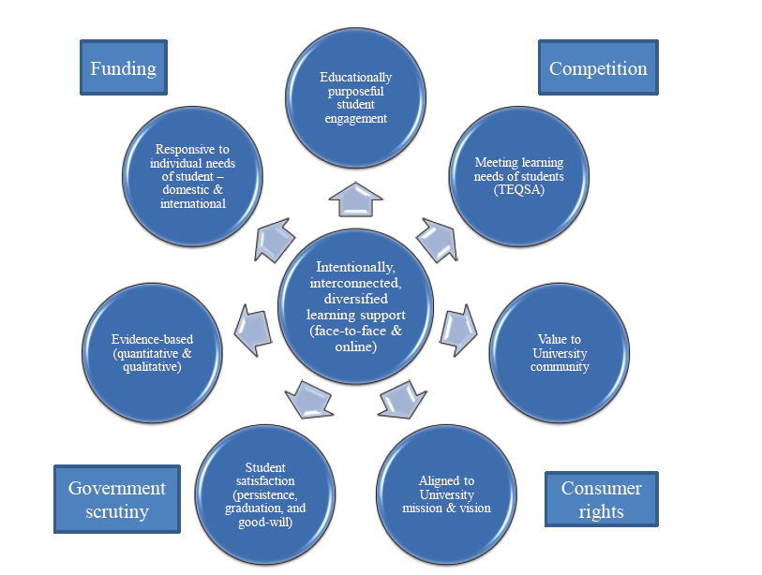
Underpinning of USQ’s Evaluation Framework
(Padró & Fredericks, 2013)

Slide 8
LTS student development and support programs’ purpose: approach and structure shaping needs & wants
Keimig (1983) hierarchy of programs
Learning assistance for individual students (L2 – Learning Centre)
Course-related services (L3 – Meet-Up)
Comprehensive learning support system (L4 – suite of face-to-face and online assisted and self-help programs)
CAS (2012) standards for LAPs
Programs must promote student learning and development outcomes
Clearly articulated assessment plan to document achievement of stated goals and learning outcomes
Chickering & Reisser (1993)
7 vectors of student development
developing competence
managing emotions
moving through autonomy towards interdependence
developing mature relationships
establishing identity
developing purpose
developing integrity

Slide 9
2. What is the context for the evidence and its use?
Understanding context yields practical knowledge and influences organisational decision making (Volkov, 2011).
Determining the audience, what they want and why they want it
Identifying the relationship between the unit and its programs with the rest of the institution
Figuring out program alignment within unit to determine how to best report student learning activity for the unit (i.e., separate, together, both, special considerations)
Figuring out what type of evidence one has available, where it’s located and how accessible it is
Ascertaining the appetite for qualitative versus quantitative data – even mixed methods for that matter and degree of sophistication in what you’re generating
Finding out how much access to external institutional databases one has to be able to perform the desired data analyses
Identifying timelines and required formats
Aligning contextual needs with unit preferences and must do to meet internal obligations
Identifying and establishing relationships with other units/areas within the institution to access data and formulate analyses

Slide 10
Mapping out the context – similar to Macfadyen, Dawson, Pardo, & Gašević’s (2014) RAPID Outcome Mapping Approach (ROMA) to ascertaining policy challenges

Slide 11
USQ’s SPARS Model (Kek, 2012)

Slide 12

3a. What assumptions does the unit (and its staff )have?
3b. What are the assumptions of students, academic staff, senior leaders and other external stakeholders hold about the unit and its programs?
Perform a unit SWOT analysis or similar exercise where all staff are able to identify what their perspectives and values which drive individual and unit assumptions related to how the unit actually performs (what it does and how it does it) and how the unit actually should perform and identify the reasons behind these assumptions.
Performing an environmental scan (including literature review and/or at least informal benchmarking) within and outside university to identify existing preferences related to student learning – including TEQSA, professional association benchmarks, criteria, guidelines or standards (e.g., CAS Standards from the USA)
Identify similarities and differences between the unit’s assumptions and those of internal and external stakeholders to help understand which data/evidence is valued internally and externally.

Slide 13
Forming the institutional cultural paradigms (Schein, 1985):
Relation of university and unit to its own environment
Rules defining what is real and what is not
The right thing to do
The nature of how people act
What is the “right” way to relate to each other
“[The use of the term “model” refers to a set of assumptions and beliefs which together represent reality” (Tichy,1983, p. 38).
“By paying explicit attention to the underlying assumptions and boundaries of relevance, the applicability of existing paradigms will be clarified” (Løwendahl and Revang, 1998, p. 770)

Slide 14
Interactions between student, institution and external environment and potential assumption points (similarities & dissimilarities): A student success ecology (Kek, Padró, Kimmins, Frederiks, & Ayriss, in press)
Co-curricular/ student development & support
Teachers’ teaching approaches
MACRO-SYSTEM
EXO-SYSTEM
Family
Teachers’ individual characteristics
Laboratory
MESO-SYSTEM
Belief systems
MICRO-SYSTEM
STUDENT
Social interchanges
Residential colleges/ halls
Teachers/ Tutors
Study groups
Faculty/ department culture
Classrooms
House/ room-mates
Societies/ Fratenities
Library
University policy, vision & mission
Culture
Source: Adapted from Bronfenbrenner’s (1979, 2006) bio-ecological development systems

Slide 15
4a. What is the theoretical grounding of the unit’s practice?
4b. How consistent is it with the rest of the institution’s mindset?
Unit’s vision and overarching conceptual framework of what it does identifying where the connections between activities and how data/evidence demonstrates the level of success these activities have
Aligning expectations and reporting requirements to come up with a useful reporting strategy. Determining strategy on how to bring together existing evidence and create new evidence to be able to perform meaningful analyses to provide an analysis and interpretation deemed useful and valuable
Identify indicators and types of evidence that will generate desired evaluative and research evidence relating to unit performance and student success that meets the unit’s and institution’s overall needs.

Slide 16
USQ Theoretical Framework for Student Development Support programs (Kek, Padró, Kimmins, Frederiks, & Ayriss, in press)
Institutional Level
Peer-assisted Learning - Meet-Up Programs
University structural factors such as faculty, level of study, mode of study
The Learning Centre - Learning Consultations
Presage
Process
Product
Personal / Demographic
Motivational
Learning & Developing
Progression
Student Level
Family
Academic achievement
+ Other factors – theoretical/ evidence
Source: Adapted from Kek (2006, 2011, 2012), Bronfenbrenner (1979), Biggs (2003)

Slide 17
5. What is practical given internal expectations, regulatory compliance requirements, timelines and resource limitations?
Establish and operationalise methodology (-ies) that will meet unit and institution needs re evidence, timelines and format
Formalise relationships through agreements to collect various data from needed sources where institutional data is collected – this can be an early process time inhibitor. A university already has between 30 to 35 percent of the information it needs within its databases (Nichols as cited in Saunders & Wohlgemuth, 2009)
Base decisions on staff capacity to perform agreed-to methodology
Decisions of methodology are bounded by resource limitations beyond that of staff – connectivity between databases, sophistication of databases, completeness of databases, etc.
Data collection, analysis, interpretation, reporting and use need to be seen through the fitness for purpose lens
Remember to remember that evaluation focus evidence, analysis and interpretation tends to be different than research although the two activities are more related than not (Scriven, 2016)

Slide 18
Key elements of an analytics framework
(Padró & Kek, 2013)
AUSSE/UES/SES
Grades
Graduation rate
Persistence
Retention
Student demographics
Student satisfaction data
Transfer rates
Identify Tier 1 data – that which exists (technical analytical)
Form Tier 2 data – Issues intelligence
Create Tier 3 data –Context intelligence
National policy preference
Co-curricular student engagement activities data
Learning Centre data
Other student learning support activities data
Institutional emphasis for data collection & analysis:
Customer service (transactional) or Student development
Adapted from Terenzini, 2013; Padró & Frederiks, 2013)

Slide 19
Strategy used to develop a comprehensive database and analytical framework: Weick’s (1984) small wins
‘Small wins provide information that facilitates learning and adaptation. Small wins are like miniature experiments that test implicit theories about resistance and opportunity and uncover both resources and barriers that were invisible before the situation was stirred up’ (p. 44).
Why?
    Schuh (2009) thus suggests starting modestly with a few assessment projects
    Weick’s ‘small wins’ approach provide projects that are concrete, complete and of moderate importance. The goal is to amass a series of small wins based on small but significant tasks that reveal a larger pattern when looking at the different building blocks.
    Shifting the emphasis of the definition of quality assurance from a demonstration for those who are not directly involved that all is well (Padró, 2013) to “an effort to monitor and correct ordinary operations so that a high level of effectiveness is attained and maintained” (Stake, 2004, p. 186).
    To move beyond the transactional evaluative level to an outcomes level (Stake, 2004), there must be a capacity to access other databases to increase capacity building at the analytical phase of program evaluation.

Slide 20
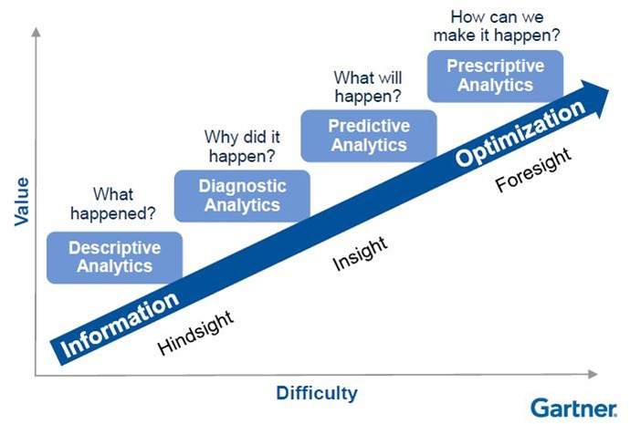
Our view is to answer and progress our analytics capacity as suggested in the Gartner analytics maturity model (http://blogs.gartner.com/matthew-davis/top-10-moments-from-gartners-supply-chain-executive-conference)

Slide 21
Learning Centre database creation and processes
Database created manually as of 2012-2014, capturing data from S2 2008 onward
Formative user surveys
Entry number: Semester, Year (e.g. S1, 2012): Type of week: Teaching Mid-semester break Exam period End semester break Orientation Week Location: Toowoomba Springfield Fraser Coast Broad support area (Academic Language and Learning, Mathematics) Type of contact (Drop in, booked) Actual time spent with student (in minutes) Contact type (Face to face, phone, email) Academic Language and Learning specific assistance options: Question analysis Research strategies Reading strategies Referencing Assignment structure Logical presentation ideas Sentence structure Exams Oral Other Learner advisor comment (optional) Course code Course level (Undergraduate or Postgraduate) Faculty from where the course is offered Enrolment type (on-campus, external or online) Enrolment Location (Toowoomba, Springfield, Fraser Coast) Date and time Appointment status (Complete, did not show) Student number Student first name Student last name Contact details (Supplied by students in online booking system)
RightNow database
TimeTrade software
PeopleSoft database
Annual Report

Slide 22
Meet-Up database creation and processes
Database similar to Learning Centre as of 2013
Historical Formative assessments
Entry number: Semester, Year (e.g. S1, 2012): Type of week: Teaching Mid-semester break Exam period End semester break Orientation Week Location: Toowoomba Springfield Fraser Coast Broad support area (Academic Language and Learning, Mathematics) Type of contact (Drop in, booked) Actual time spent with student (in minutes) Contact type (Face to face, phone, email) Academic Language and Learning specific assistance options: Question analysis Research strategies Reading strategies Referencing Assignment structure Logical presentation ideas Sentence structure Exams Oral Other Learner advisor comment (optional) Course code Course level (Undergraduate or Postgraduate) Faculty from where the course is offered Enrolment type (on-campus, external or online) Enrolment Location (Toowoomba, Springfield, Fraser Coast) Date and time Appointment status (Complete, did not show) Student number Student first name Student last name Contact details (Supplied by students in online booking system)
RightNow database
Historical Annual reports
PeopleSoft database

Slide 23
Early findings: Historical – forensic
reconstruction of data (Kimmins, Kek, & Padró, 2013)
Used to determine if we were in the right direction regarding analytics and gauging the appropriateness of using Weick’s ‘Small Wins’ approach
Two courses from 2001 & 2002 – rebuilt from existing data remnants & did a forensic reconstruction of student data from USQ historical data
Comparison of retention rate and academic attainment for students who participated in Meet-Up and students who did not using a independent-samples t-test
Results
Course 1 & 2: Significant difference in retention (p=.007 at a confidence level of 99%) in favour of students who participated in Meet-Up
Course 1: Statistically significant improvement (p= .001) in academic achievement along with improved retention, with Meet-Up participants, with final grades result at half-way between a C and a B in contrast to non-participants whose mean was at a C (a 0.55 grade increase in the scale used), and an 18% increase in retention
Course 2: Statistically significant increase (p=.048) in retention, a 7.72% increase; a comparison of means between Meet-Up participants and non-participants showed Meet-Up participants had a 0.10 increase in grades in the scale used (1.83 to 1.73, with C=2 and F=1).

Slide 24
Recent results: Mixed methods
Quantitative: hierarchical multiple regression – prediction
Qualitative: thematic analysis – identifying/analysing/reporting of patterns/themes within the data
(Kek, Padró, Kimmins, Frederiks, & Ayriss, in press)
From Archival data of 1,277 students:
5 significant predictors of academic achievement in the final model
N courses enrolled in a semester(β =
0.23)
Gender (β = −0.13)
Residency status (β = 0.12)
Mode of study (β = 0.13)
T spent on writing (β = 0.07)
3 significant predictors of progression
Gender (β = −0.08)
Time spent on learning assistance in writing and academic learning and language (β = 0.09)
N courses enrolled in a semester (β = 0.22)
Qualitative themes (purposive sampling):
Students engage in our LAPs for “help”, “support”, “empathy” or “care” to “finish the program” while for some success also meant growing as an individual
Interview data also indicated that students who engaged with a number of the LAPs reported that they had gained both cognitive and affective successes
9 out of 21 students interviewed were 1st in family. These seemed to link LAP involvement and academic success with academic achievement & affective development. LAP participation by these students helps them get a sense of control over their own academic success by promoting self-belief/self-efficacy.

Slide 25


Overall findings from early attempts at using multiple forms of evidence are corroborated by recent and more sophisticated analyses
USQ’s LTS learner assistance programs (LAPs) on student success have a modest impact on student learning
These findings are consistent with studies at universities regarding this type of student support (Arendale, 2010)
But where we are is at the Gartner’s “hindsight” and “insight” levels of analytics maturity, still developing capacity at both levels, still putting the puzzle together

Slide 26
Looking into the future: next steps
Findings so far relate to the impact of the various programs on student learning – at Keimig’s (1983) L2 and L3 levels of LAP programs. The need is to determine whole of program impact, which is an eventual step.
Next steps:
  Continue to explore and identify new analytical techniques and tools to use to build a more comprehensive analytics framework and capacity
  Continue to build the linkage between the Unit’s internal databases, USQ’s institutional databases and its data warehouse (T1 with T2) to create a more seamless and streamlined access to data and capacity to perform analyses. Simultaneously increase capacity to generate useful data from outsourced 24/7 academic support program database
  Enhance scheduling software ability to collect data to the level of detail the manually created database was able to attain and improve accuracy of data.
  Generate annualised reports based on a fully integrated analytical framework to meet regulatory compliance, evaluative and research objectives.

Slide 27
Where we need to go next (Norris & Baer, 2013, p. 23)

Slide 28
Key points that were being covered
Methodology is not a starting point, but one that follows a number of other decisions
The antecedent points of reference that shape methodological decisions
  What does the unit (and its staff) need & want?
  What is the context for the evidence – what needs to be provided and what type of interpretation is needed?
  What assumptions does the unit (and its staff )have? What are the assumptions of students, academic staff, senior leaders and other external stakeholders hold about the unit and its programs?
  What is the theoretical grounding of the unit’s practice? How consistent is it with the rest of the institution’s mindset?
  What is practical given internal expectations, regulatory compliance requirements, timelines and resource limitations?
  (These are presented in terms of points to consider and what USQ has done per each point of reference)
What USQ’s SDS has accomplished and next steps in the learning analytics saga

Slide 29
If you have questions, please feel free to ask them now or contact me
This PowerPoint presentation will be made available electronically.
Contact: Fernando F. Padró, PhD
  Acting Director, Learning and Teaching Services
  fernando.padro@usq.edu.au

Slide 30
References
Arendale, D. R. (2010). Access at the Crossroads-Learning Assistance in Higher Education. San Francisco: Jossey-Bass, Wiley. Baizerman, M. (2009). Deepening understanding of managing evaluation. In D.W. Compton & M. Baizerman (Eds.), Managing program evaluation: Towards explicating a professional practice. New Directions for Evaluation, 121, 87-98. Chickering, A. W., & Reisser, L. (1993). Education and Identity. (2nd ed.). San Francisco: Jossey-Bass. Colvin, C., Rogers, T., Wade, A., Dawson, S., Gašević , D., Shum, S.B., Nelson, K., Alexander, S., Lockyer, L., Kennedy, G., Corrin, L., & Fisher, J. (2015). Student retention and learning analytics: A snapshot of Australian practices and a framework for advancement. Sydney, NSW: Office of Learning & Teaching. Council for the Advancement of Standards in Higher Education [CAS] (2012). CAS professional standards for higher education. (8th ed.). Washington, DC: Author. Donaldson, S.I. (2009). Epilogue: A practitioner’s guide for gathering credible evidence in the evidence-based global society. In S.I. Donaldson, C.A. Christie, & M.M. Mark (Eds.), What counts as credible evidence in applied research and evaluation practice? (pp. 239-251). Los Angeles, CA: SAGE. Dringus, L.P. (2012). Learning analytics considered harmful. Journal of Asynchronous Learning Networks, 16(3),87-100. Huber, G.P. (1991). Organizational learning: The contributing processes and the literatures. Organization Science, 2(1), 88-115. Keimig, R. T. (1983). Raising academic standards: A guide to learning improvement. San Francisco: Jossey-Bass. Kek, M.Y.C.A. Padró, F.F., Kimmins, L., Frederiks, A., & Ayriss, P. (under review). Exploring the contributions of co-curricular learning programs on student success: The case with a learning advising program. Higher Education Research & Development. Kek, M.Y. C. A. (2012, 2 August). Integrated Student Learning Journey Initiative (ISLJI) Final Paper: The Integrated Student Learning Journey – Student Personalised Academic Road to Success (SPARS): A Framework for the Provision of Adaptive and Student-Directed, On-line, On-demand, Integrated Study Support to Students. Paper submitted to the Director, Learning and Teaching Support, Office of Pro-Vice Chancellor (Learning, Teaching and Quality), University of Southern Queensland. Kimmins, L., Kek, M.Y.C.A., & Padró, FF. (August 2013). Meet-Up program summary report, S1 2013. Unpublished report. Toowoomba, QLD: University of Southern Queensland, Learning and Teaching Services. Løwendahl, B., & Ø. Revang (1998). Challenges to existing strategy theory in a postindustrial society. Strategic Management Journal, 19, 755-773. Macfadyen, L.P., Daswon, S., Pardo, A., & Gašević, D. (2014). Embracing big data in complex educational systems: The learning analytics imperative and the policy challenge. Research and Practice in Assessment, 9, 17-28.

Slide 31
References
Marshall, S. J., Orrell, J., Cameron, A., Bosanquet, A. & Thomas, S. (2011). Leading and managing learning and teaching in higher education. Higher Education Research & Development, 30(2), 87-103. Newcomer, K., & Brass, C.T. (2016). Forging a strategic and comprehensive approach to evaluation within public and nonprofit organizations: Integrating measurement and analytics within evaluation. American Journal of Evaluation 2016, 37(1), 80-99. Norris, D.M., & Baer, L.L. (2013). Building organizational capacity for analytics. EDUCAUSE. Retrieved from https://net.educause.edu/ir/library/pdf/PUB9012.pdf Padró, F.F., & Frederiks, A. (2013). Evaluating the impact of the Learning Centre on student learning and satisfaction. In Design, develop, evaluate: The core of the learning environment. Proceedings of the 22nd Annual Teaching Learning Forum, 7-8 February 2013. Perth: Murdoch University. Padró, F.F. (2013). High stakes testing assessment: The dues ex machine of quality in education. In J. Bower & P.L. Thomas (Eds.), De-testing and de-grading schools: Alternatives to accountability and standardization. (pp. 27-43). New York: Peter Lang. Padró, F.F., & Kek, M.Y.C.A. (2013, 9 April). Student engagement and student satisfaction: Two measures arguing for independent review criteria of standards for student support services in national quality assurance schemes. Presentation given at 2013 International Network of Quality Assurance Agencies in Higher Education (INQAAHE) Biennial Conference, Taipei, Taiwan. Saunders, K. & Cooper, R.M. (2009). Instrumentation. In J.H. Schuh (Ed.),, Assessment methods for Student Affairs. (pp. 107-139). San Francisco: Jossey-Bass. Saunders, K. & Wohlgemuth, D.R. (2009). Using existing databases. In J.H. Schuh (Ed.), Assessment methods for Student Affairs. (pp. 23-50). San Francisco: Jossey-Bass. Schein, E. H. (1985). Organizational culture and leadership. San Francisco: Jossey-Bass. Schuh, J.H. (2009). Assessment as an essential dimension of contemporary student affairs practice. In J.H. Schuh (Ed.) & Associates, Assessment methods for student affairs. (pp. 1-22). San Francisco: Jossey-Bass. Scriven, M. (2016). Roadblocks to recognition and revolution. American Journal of Evaluation, 37(1), 27-44. Stake, R.E. (2004). Standards-based & responsive evaluation. Thousand Oaks, CA: SAGE. Tichy, N.M. (1983). Managing strategic change: Technical, political, and cultural dynamics. New York: John Wiley. Volkov, B. B. (2011). Beyond being an evaluator: The multiplicity of roles of the internal evaluator. In B. B. Volkov & M. E. Baron (Eds.), Internal evaluation in the 21st century. New Directions for Evaluation, 132, 25-42. Weick, K.W. (1984). Small wins: Redefining the scale of social problems. American Psychologist, 39(1), 40-49.

