Slide 1
The Crown Rot ‘Deadhead’ Phenomenon in Durum Wheat
Noel Knight and Mark W Sutherland
Centre for Crop Health ● University of Southern Queensland ● Toowoomba
EGA Bellaroi (2014)
crown rot affected field plants exhibiting both living and senescing stems
Comparison of stems using:
visual discolouration
F. pseudograminearum biomass
vascular colonisation
18 cm
12 cm
6 cm
Senescent
0 cm
Non-senescent

Slide 2
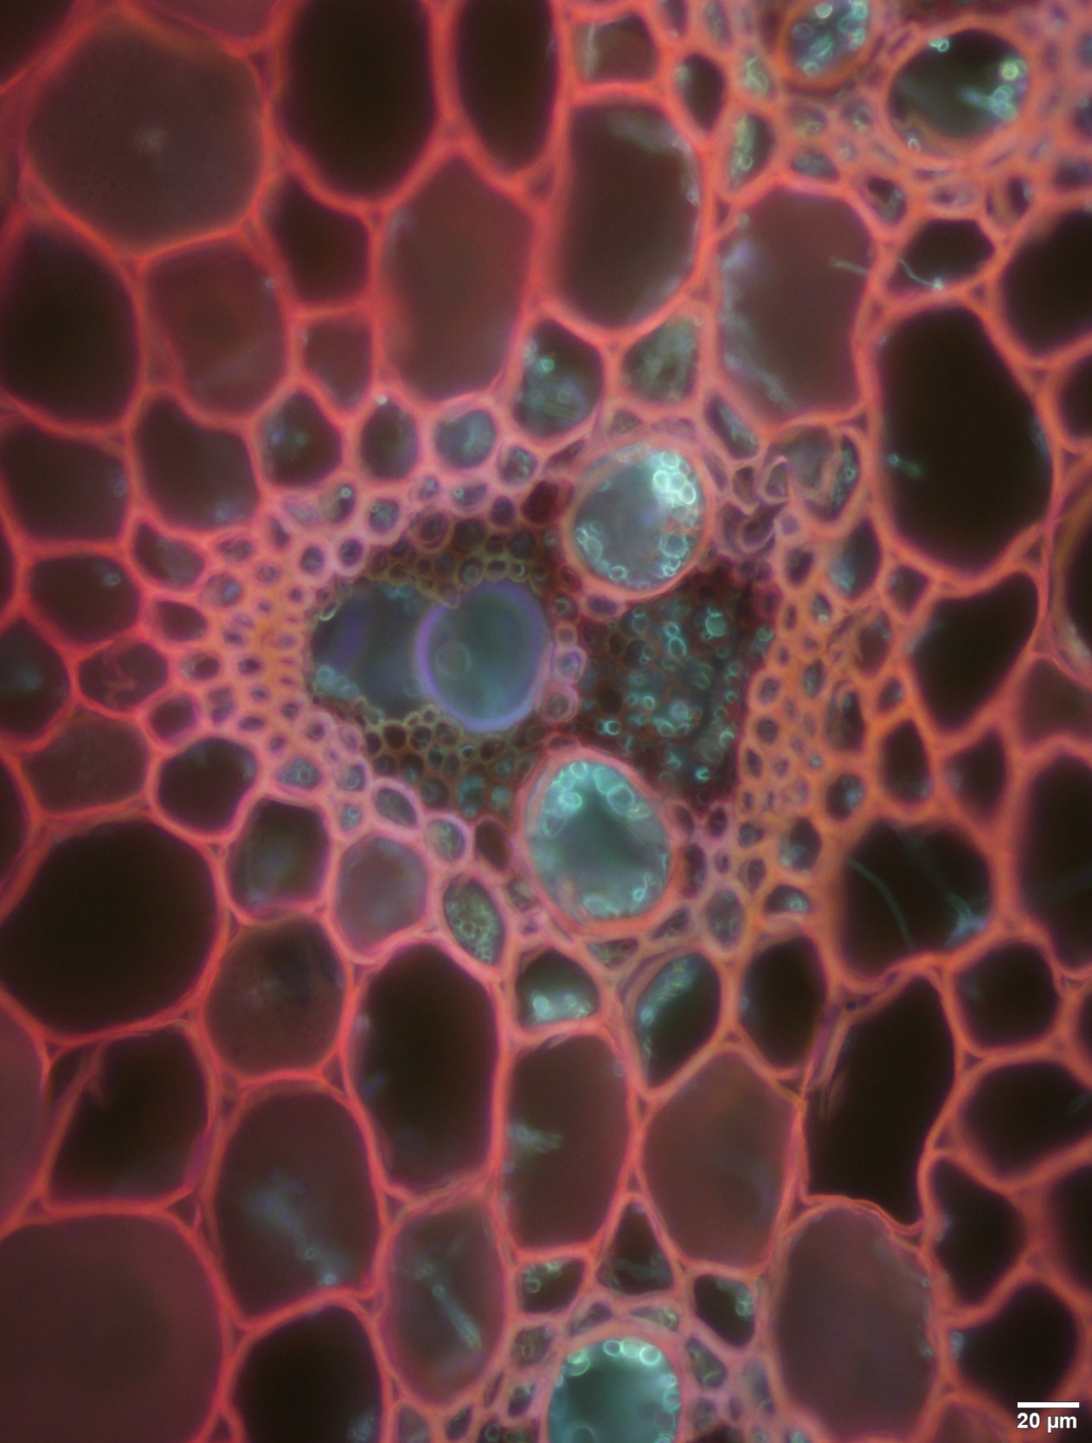

Slide 3
Vascular Colonisation
EGA Bellaroi 2014
Section at 1 cm
No Colonisation
Xylem Colonisation
Section at 7 cm
Xylem and Phloem Colonisation
Phloem Colonisation
Section at 13 cm
Senescent
Non-Senescent

