Slide 1
From rags to riches: Democratisation of the photographic art
Associate Professor Michael Sankey
Director, Learning Environments and Media
QFP5 Conference: Photography & Fictions. 23-25 April 2014. Brisbane.

Slide 2
My journey
Studied Photography at Prahran CAE 1979-81
Worked on & off in various studios in Melbourne and Geelong and freelance (1982 – 87)
Geelong Advertiser newspaper (1988 – 89)
USQ Senior Photographer (1990 – 2001)
Academic – educational technology and multimodal learning (2001 – present)
Exhibiting variably, but now a heavy user of social media: Instagram, Flickr, Tumblr, etc. But why?
The Internet is now my gallery (2.5 billion users)

Slide 3
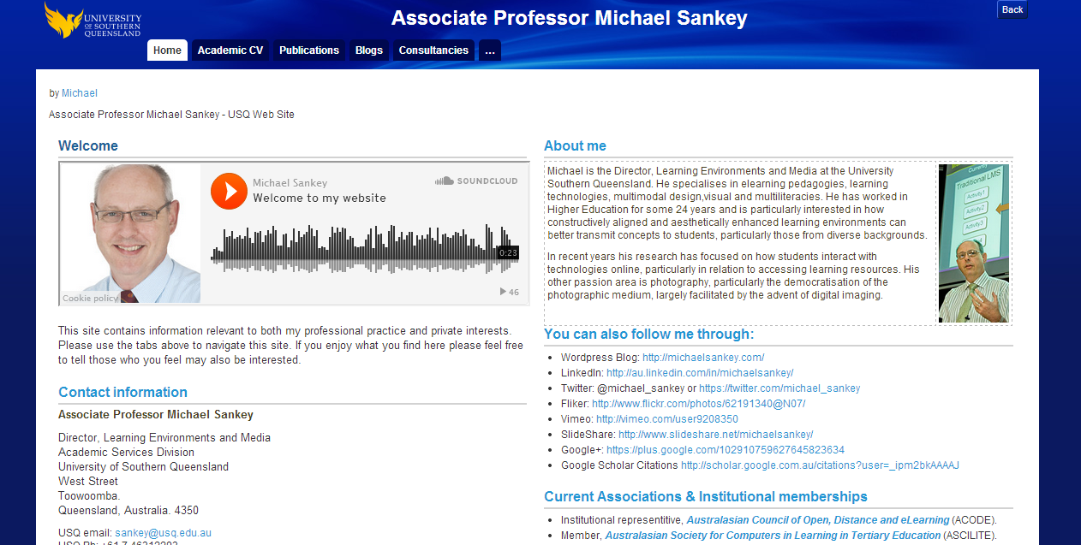
For more about me:
https://eportfolio.usq.edu.au/view/view.php?id=18

Slide 4
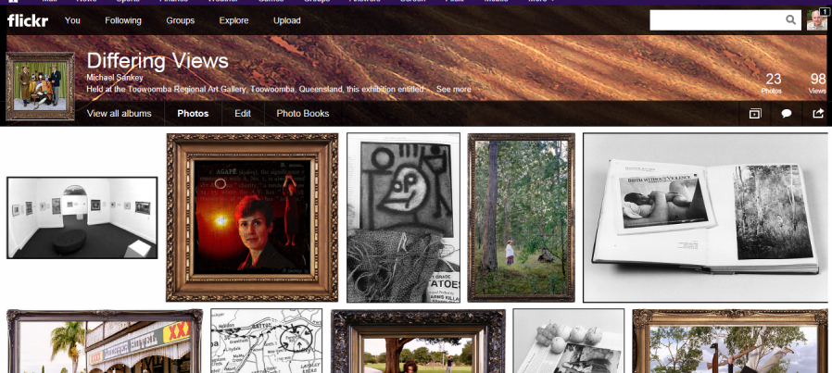
Flickr
https://www.flickr.com/photos/62191340@N07/

Slide 5
Instagram
http://instagram.com/michael_sankey#

Slide 6
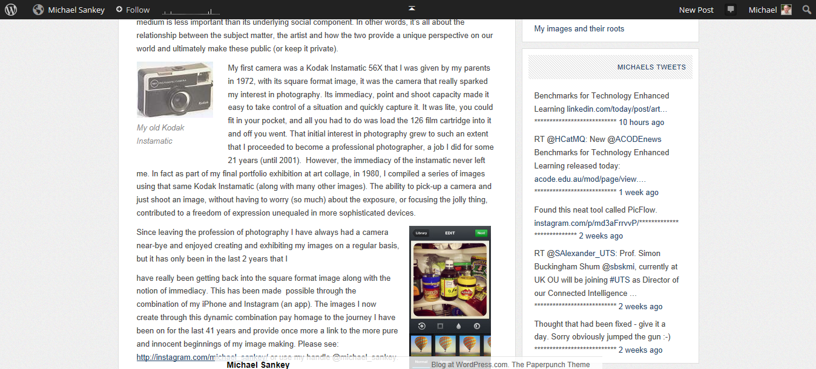
Wordpress Blog
http://michaelsankey.com/

Slide 7
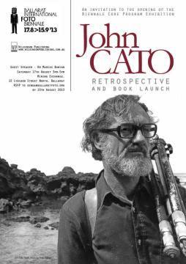
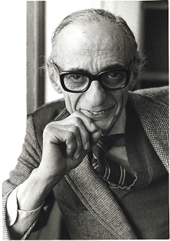
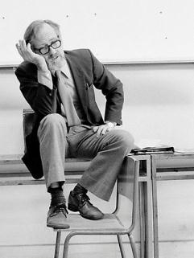
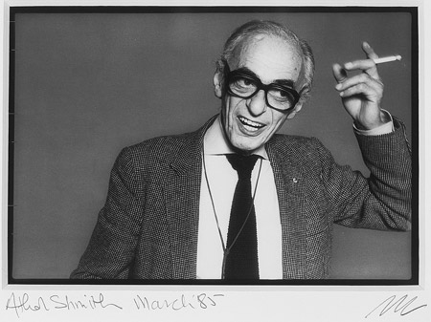
Jerrems, C. (1976)
John
Cato
1929
-
2011
Athol Shmith
1914-90
Hurst, M. (2013)
Lawrence, M. (1985)

Slide 8
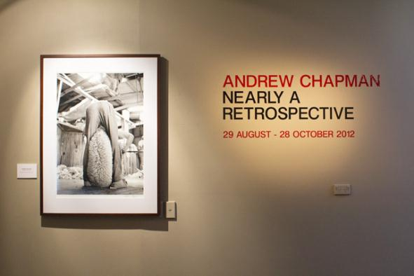
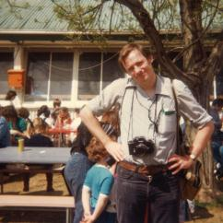
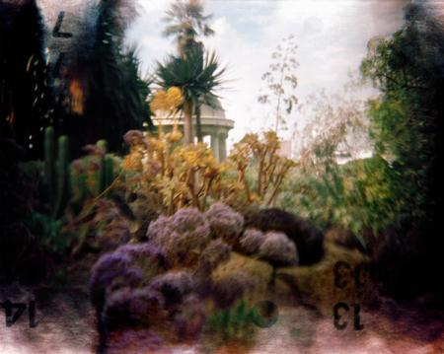
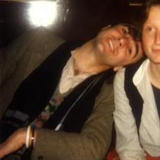
© Barbara Oehring (2012)
1980
© Christopher Köller (2011)
1980

Slide 9
The USQ Media Services crew
5 video/audio producers
5 graphic designers
3 photographers
3 multimedia developers

Slide 10
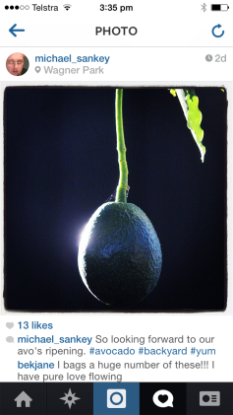
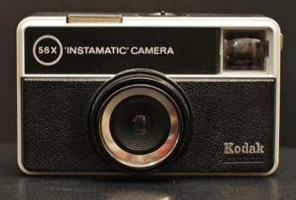
My practice
1972
2011
With lots of devices in between

Slide 11
Now down to business
I will investigate the three main [modern] phases of photography:
Analogue
Digital
Mobile

Slide 12
As the various photographic forms and formats have changed over the years, largely aligned with the impact of the medium/cameras used, it’s interesting to note how the different forms of photography; social, constructed, manipulated and even commercial, are now largely facilitated by the online space, and how this has introduced a new universal immediacy and a heightened sense of intermediality to our art.

Slide 13
Intermedial
multimodal practice
2014
The days of analogue
the later days
The days of digital
Early 1990’s
The days of mobile
2007
The WWW
1930s
Facebook
2.5+ billion users
Early 1990’s
2004
Instagram
800+ million users
2010
150+ million users
1978
My practice

Slide 14
The modalities and modes of media
(Elleström, 2010)

Slide 15
The paradox of democratisation
There is a dual paradox testing the resilience of those who have fought to see photography accepted as ‘art’:
Until recently the ‘traditional’ arts have not generally been welcoming of photography; dogged by the claim that it was too instant and effortless to be ‘real’ art (O’Hagan, 2011).
As our cultural artefacts are democratised (popularised), the more uncertain the place of the artist becomes.
With the advent of digital/mobile photography, production has moved more into the realm of the ‘conceptual’, with new levels of intermediality (Ellenstrom 2010).
But the things that made photography so attractive cannot be ignored. So for those who make judgments about such things, the distinctions between art photography & conceptual art (using photography) become quite blurred (O’Hagan, 2011).
And we see the evolution of two distinct spaces for the dissemination of ‘art’ photography, the physical and the digital, and a mash-up of these; the intermedial space.

Slide 16
I will demonstrate this by investigating, visually, the shift in perceptions associated with my image making over the years.
From the ‘interaction of media' towards the ‘interaction with media'.
I will demonstrate that the idea of ‘media borders' have started to dissolve, or blur how individual's perceive media and reality; demonstrating that the image is being perceived not just as a form of intermedial representation, but as an environment in and of itself.

Slide 17
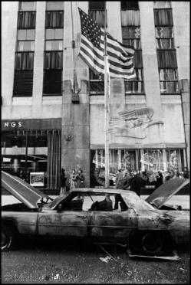
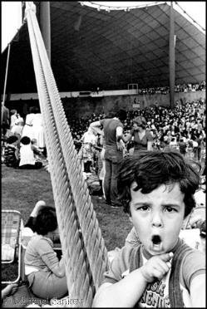
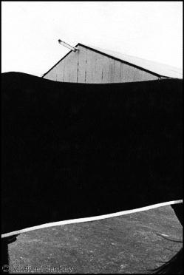
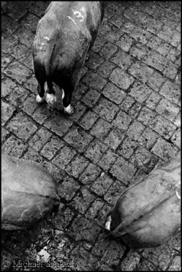
The analogue era

Slide 18
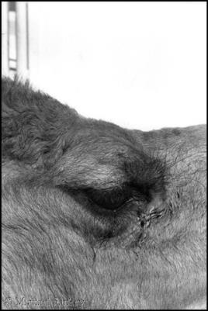
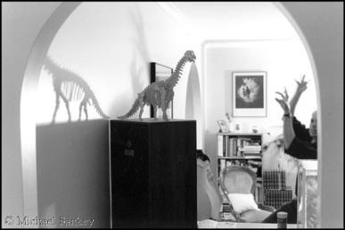

Slide 19
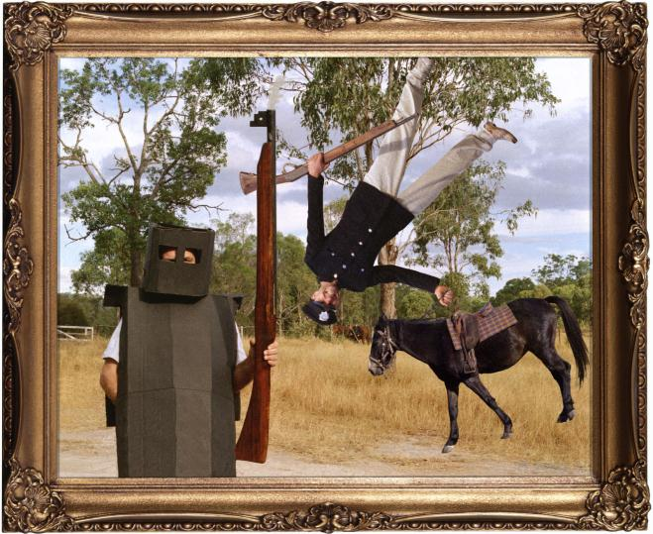
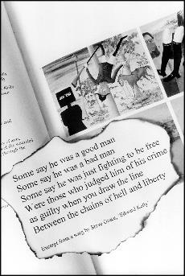
The digital era
Death of Constable Scanlon, appropriated
Death of Constable Scanlon (Ned Jones)

Slide 20
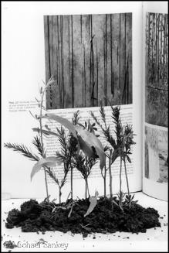
Sherbrook Forest (A Williams Forest)
Sherbrook Forest, appropriated

Slide 21
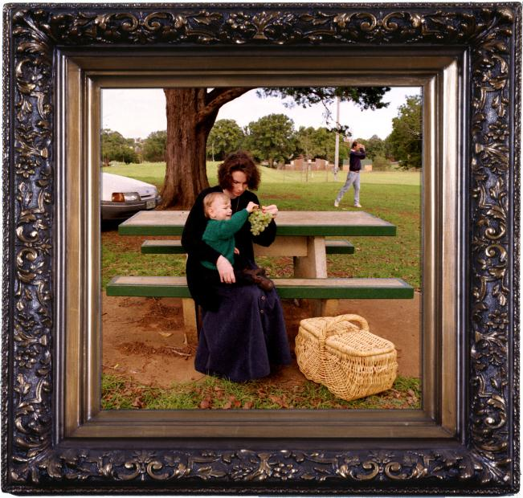
The rest on the flight to Egypt, appropriated
The rest on the flight to Egypt
(Susanna and Child)

Slide 22
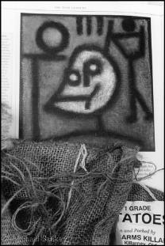
Death and Fire, appropriated
Death and Fire (Light of My Life)

Slide 23
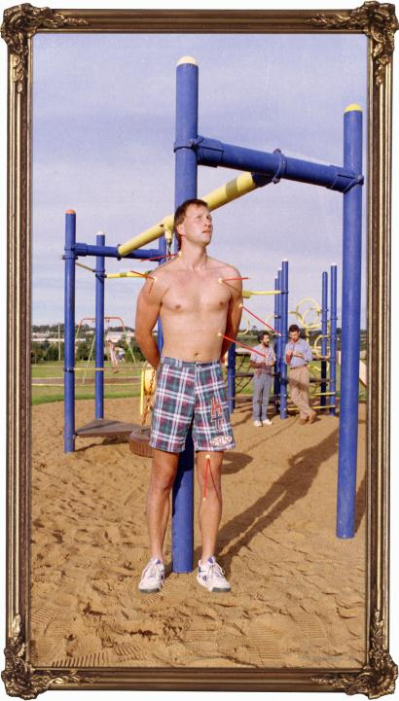
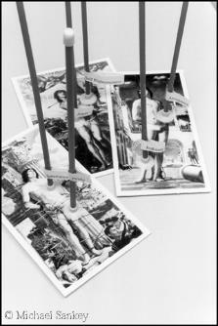
Saint Sebastian (Saint Andrew)
Saint Sebastian appropriated

Slide 24
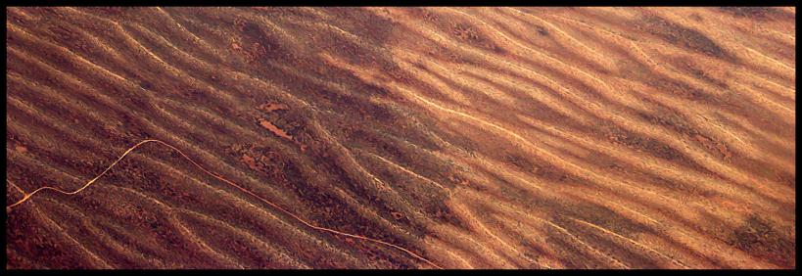
Desert channels from 30,000 feet

Slide 25
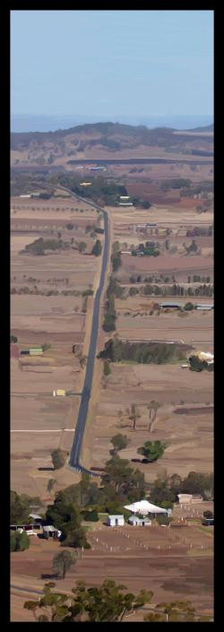
Road to Sugerloaf
Scanlon Falls

Slide 26
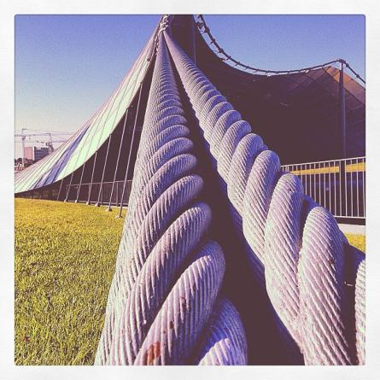
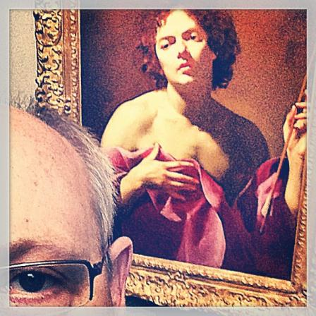
The mobile era
The Sydney Myer Music Bowl revisited. Last here in 1977. This time no Teddy Bears Picnic
Keeping an eye on Saint Sebastian

Slide 27
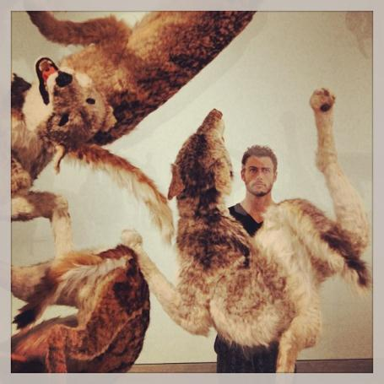
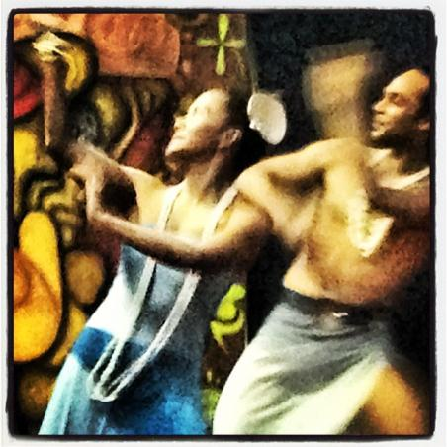
@Joelsankey at #qagoma @qagoma Cai Guo-Qiang #wolves
Fijian dancers at the ACODE dinner night

Slide 28
Revisiting
The Death of Constable Scanlon revisited. With homage to Sydney Nolan

Slide 29
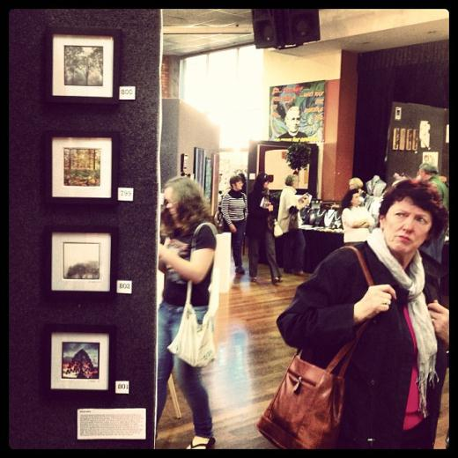
The decisive moment
Instagram on Instagram

Slide 30
We see that contemporary visual practice is very much informed by what has gone before.
Particularly in relation to nostalgia and pathos as we re-investigate ideas and probe new boundaries.
This leads us to re-evaluate how pre-digital media relations and the historical paradigms of intermediality are distinguishable in contemporary image production.
It’s important to understand this context, as the medium is continuously mutating, relocating and expanding, drawing on its connections from the ‘old' to the ‘new', whilst still being incredible fluid, thanks to the democratising processes that inform our evolving practices.

Slide 31
Where I might have called my practice ‘multimodal’, and it still is, the internet allows me to be far more intermedial.
In other words, intermediality, for me, has largely been facilitated by the online space.
Or, the online space has made it possible for my intermedial practice to flourish; to be disseminated and to be experienced more broadly.
So, intermediality (which incorporates notions of multimodality) is not just about the medium of photography – it’s also about how and where the viewer experiences and interacts with my work.

Slide 33
References
Ellestrom, L. (2010). Media Borders, Multimodality and Intermediality. Palgrave Macmillan.
Hurst, M. (2013) ‘Between Sunshine and Shadow: The Photographs of John Cato’. Open Journal. Available online from: http://www.openjournal.com.au/john-cato-bifb/
Jerrems, C. (1976) ‘Athol Shmith’. Wikipedia entry Available at: http://en.wikipedia.org/wiki/Athol_Shmith
Johnson, S. (2011) ‘The Digital Photography Revolution’. The Minimalist Photographer. Available online at: http://minimalistphotography101.com/democratization-of-photography/
Köller, C (2011) Parádeisos - Temple of the Winds, Royal Botanical Gardens, Melbourne, 2007
Lawrence, M. (1985). ‘Athol Shmith’. Gelatin silver photograph, National Portrait Gallery, Canberra, Australia.
Miller, T. (2013) Situating images: Photography, writing, and cinema in the work of Guy Debord. In K. Beckman and L. Weissberg (Ed’s) On Writing with Photography. University of Minnesota Press, Minneapolis.
Oehring, B. (2012) ‘Andrew Chapman – Nearly a Retrospective’. Available from: http://barbaraoehringphotography.blogspot.com.au/2012/09/andrew-chapman-nearly-retrospective.html
Prats, F. (2013) ‘On mobile photography, Photography with a capital ‘P’ and postphotography, from an anti-digital dualist perspective’. iPhoneographs, Zone Zero.com, Available at: http://v2.zonezero.com/index.php?option=com_content&view=article&id=1399&catid=2&Itemid=7&lang=en#
Sandor, K. (2010) Photo/graphic Traces in Dubravka Ugresic's: The Museum of Unconditional Surrender. In L. Ellestrom. (Ed) Media Borders, Multimodality and Intermediality. Palgrave Macmillan.

