Slide 1
Quality Online/Digital Learning: Ensure Academic Integrity through Authentic Assessments and Student Engagement
INQAAHE Conference 2021 June 7-10

Slide 2
Reem Albuainain, PhD
Acting CEO
Bahrain Polytechnic
Reem.AlBuainain@polytechnic.bh
Jameel Hasan, EDD
Acting Director Quality & Measurements
Bahrain Polytechnic
Jameel.Hasan@polytechnic.bh
Yaping Gao, EDD
Senior Academic Director
Quality Matters, USA
ygao@qualitymatters.org

Slide 3
Presentation Outline
Introduction & Overview
From F2F to Remote Teaching to Quality Digital Learning
Applying Alignment Principle to Achieve Excellence
Ensuring academic integrity via authentic assessments
Providing quality digital learning environments
Establishing teaching presence to engage students
Ensure Student Success during Transition at Bahrain Polytechnic and Looking Forward

Slide 4
Congratulations!
1st & ONLY
Member Institution in Bahrain!
Source: Quality Matters, 2021: https://www.qmprogram.org/qmresources/subscriptions/subscribers.cfm?program=0
Notes:
I want to take this opportunity to congratulate Polytechnic University on becoming the VERY FIRST QM member institution in Bahrain in early June 2020 (June 8)! It takes tremendous leadership, vision, as well as long-time commitment to make changes to ensure a better learning environment for our students. So, special thanks go to:
Dr Reem Al Buainain, Deputy CEO
Dr Jameel Hassan, Manager, Institutional Reviews
Dr Rogelio JR Levardo, Acting Manager of the Teaching and Learning Unit, conference manager

Slide 5
1,500+ QM Member Institutions
CANADA
40+
UK
FRANCE
U.S.A.
SPAIN
1300+
JORDAN
PAKISTAN
CHINA
JAPAN
DOMINICAN REPUBLIC
KUWAIT
MEXICO
SAUDI ARABIA
BAHRAIN
INDIA
JAMAICA
BARBADOS
QATAR
VIETNAM
UAE
CAMBODIA
COLOMBIA
KENYA
MALAYSIA
PAPUA NEW GUINEA
30+ COUNTRIES
PARAGUAY
SINGAPORE
FIJI
CHILE
SOUTH AFRICA
AUSTRALIA
Source: Quality Matters, 2021: https://www.qmprogram.org/qmresources/subscriptions/subscribers.cfm?program=0
Notes:
The QM community has over 1500 member institutions from 50 US states, the District of Columbia, Puerto Rico, Guam, and 30 countries outside USA across 6 continents (North America, South America, Europe, Africa, Asia, Mid-East region, Australia, and South Pacific region).
American University Arkansas State University California State University Columbia University Cornell University Drexel University Embry-Riddle Aeronautical University George Washington University Georgetown University Indiana State University John Hopkins University Northwestern University Pennsylvania State University Purdue University Texas A&M University University of Arizona University of California University of Florida University of Illinois University of Maryland

Slide 6
Kingdom of Bahrain
Source of picture: https://wallpapercave.com/manama-wallpapers

Slide 7
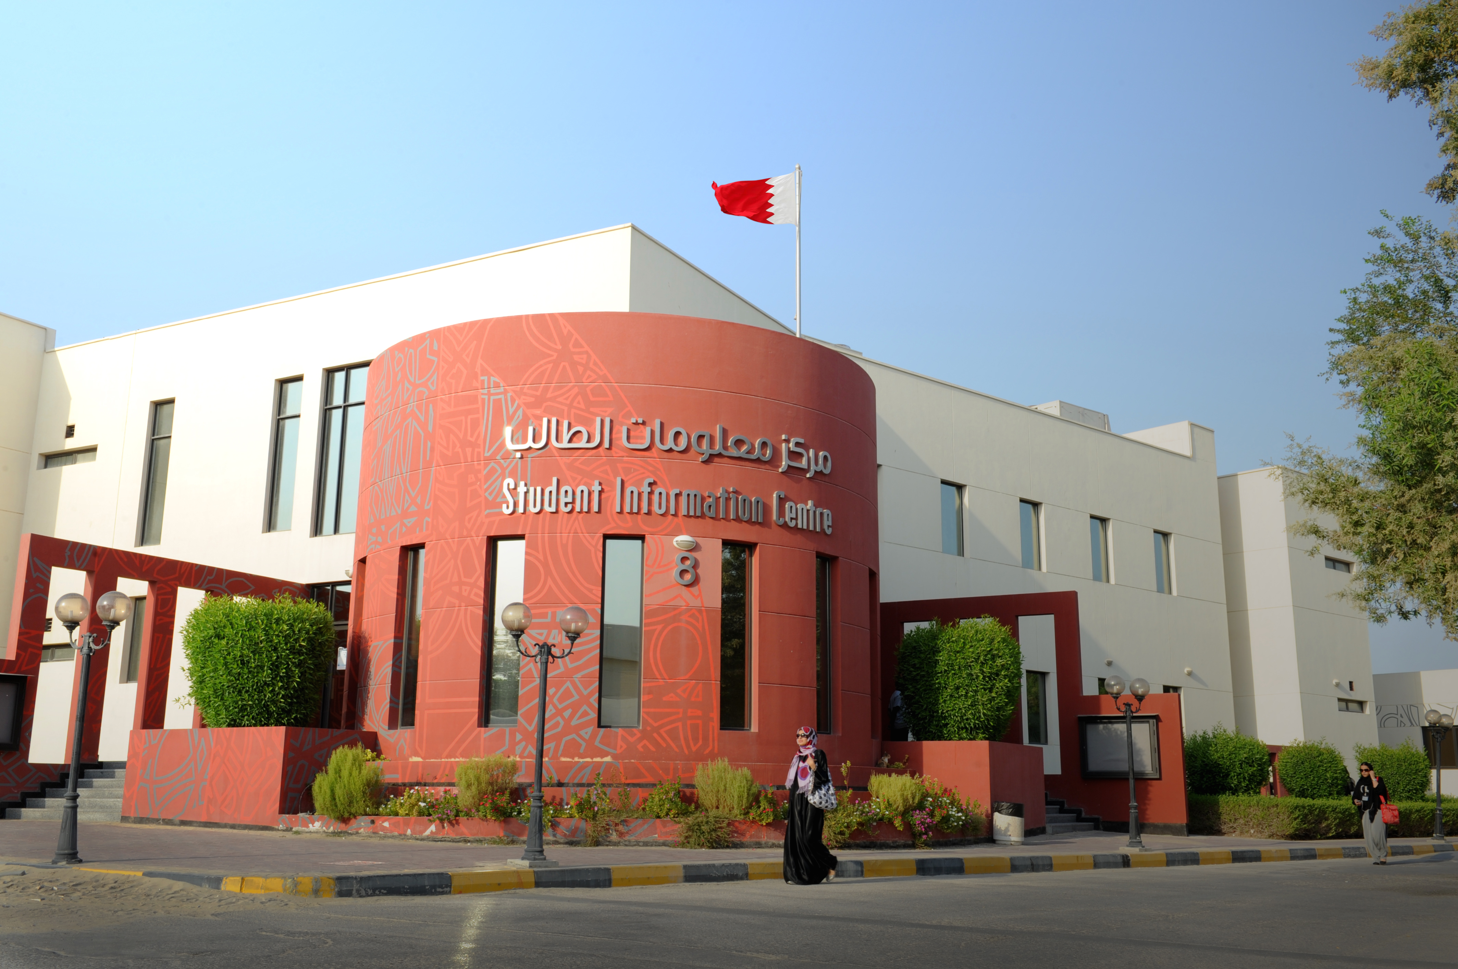
Bahrain Polytechnic

Slide 8
Digitally Disrupted Education: Good for Industry?

Slide 9
Main Challenges: Remote Teaching
In one-two words, what do you think is the major challenge with moving to online offering?
- The 'Social' learning experience, Student engagement (with peers and content) and Motivation (intrinsic).
- Staying connected with students , Passive students, encouraging collaboration, reliability of assessments these are the major challenges I am facing as an online technical Trainer
- Double, if not triple the effort, than face-to-face delivery method.
- Technology challenges; informal 'social learning'
- Engagement
- The major challenge is the (availability and the readiness) of competent capacity to change
- Creating an "engaging content"
- Lecturer competency
- Disconnection, literally and figuratively!
- Engagement, assessments reliability, preparation efforts, connectivity issues, distractions, skills and competencies of facilitators
- Adaptability struggle, technical issues, time management, self-motivation
- Assuring parents, employers and students that the quality of what they receive is just as good as f-f delivery. However, the latter id itself dependent on certain elements being attended to well.
- Resistance to change
- Assessment integrity
- Empathy
- Acceptance & engagement
- 24/7 tech support.
- Coping and adaptability
- Assessment and engagement
- Culture change
Source: Hasan, Jameel 2021, LinkedIn: Main Challenges: Remote Teaching

Slide 10
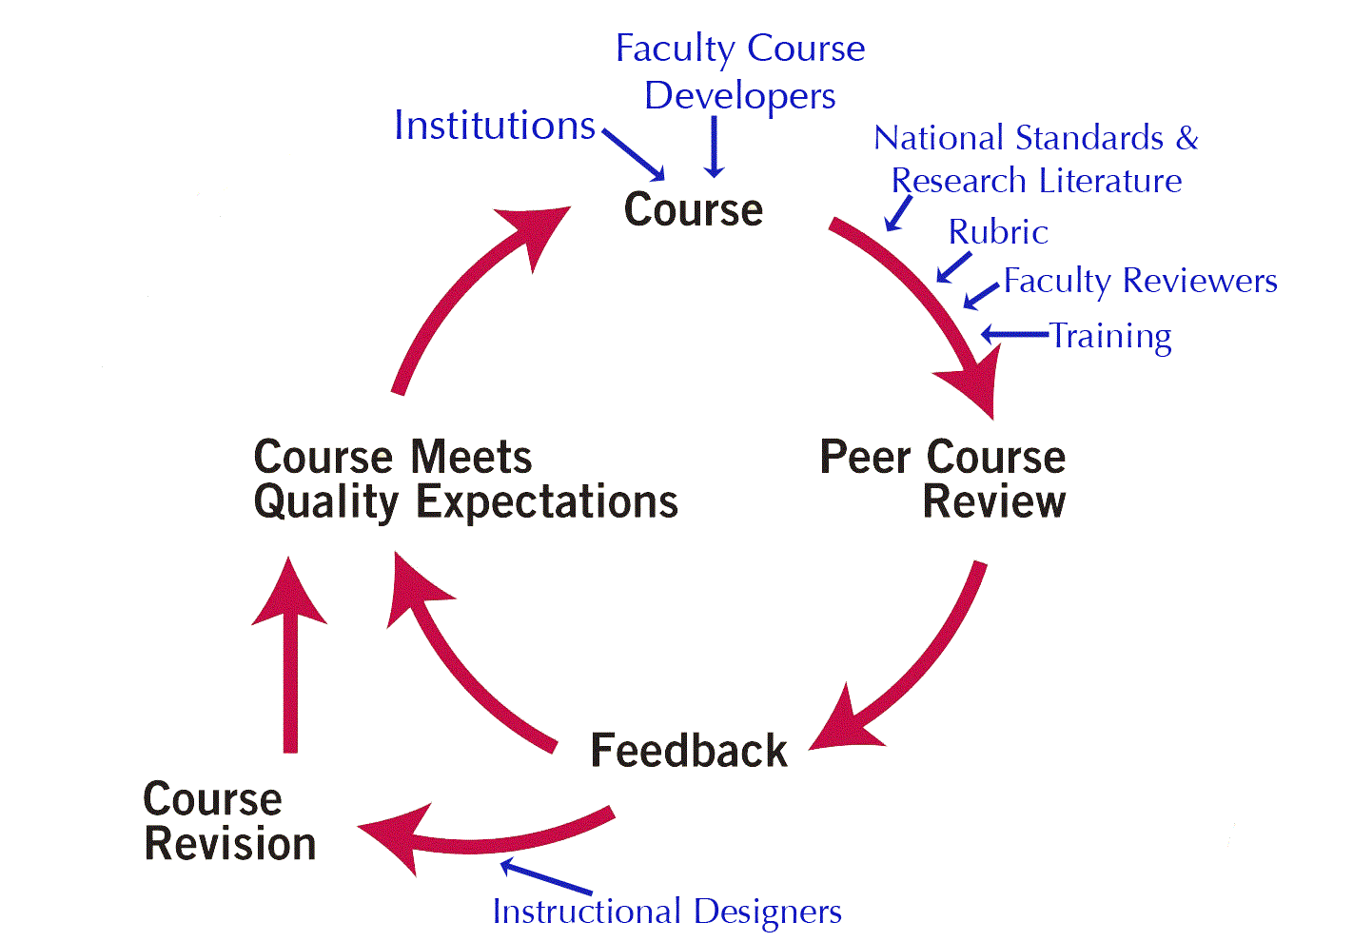
Quality Matters Process
Research-Supported Rubrics & Standards
Professional Development Offerings & Pathways
Peer Review Process for Courses and Programs
Guidance towards Continuum of Excellence
Notes:
Curated QM-focused research: https://www.qualitymatters.org/index.php/research/curated-research-resources
QM Research library: https://www.qmprogram.org/qmresources/research/

Slide 11
From F2F Instruction to Remote Teaching
F2F vs Remote: difference in structure & delivery
Allow flexibility & accommodation (avoid total conversion)
Ensure academic integrity in assessments
Instructor’s teaching presence & support
Student engagement, engagement, engagement!
Key: faculty training & paradigm change

Slide 12
Source: Quality Matters. (2020, March) https://www.qualitymatters.org/qa-resources/resource-center/articles-resources/ERI-Checklist
Notes:
https://www.qualitymatters.org/qa-resources/resource-center/articles-resources/ERI-Checklist

Slide 13
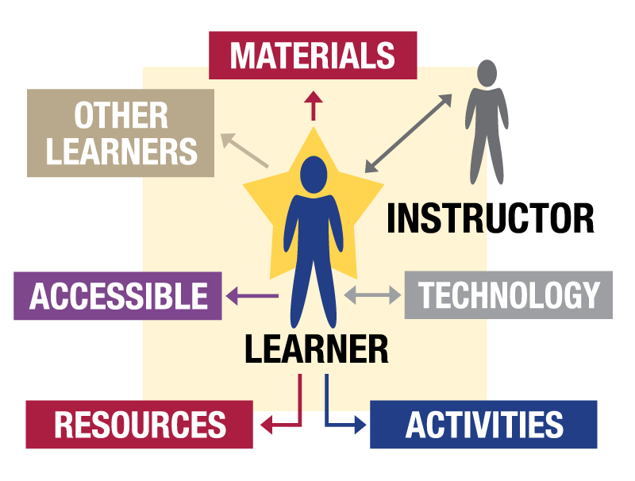
From Remote Teaching to Quality Online
Phase 1 – ALIGN objectives with assessment/content/activities
Phase 2 – ENGAGE learners with meaningful interactions and active learning
Phase 3 – CONNECT course components / support / services
Key: Purposeful & deliberate course/program planning & design
Notes:
https://www.qualitymatters.org/bridge

Slide 14
Source: Quality Matters. (2020, June) https://www.qualitymatters.org/bridge
Notes:
https://www.qualitymatters.org/bridge

Slide 15
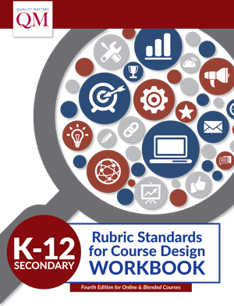
QM Rubric Standards for Course Design
Quality at Course Level
Higher Education Rubric
Higher Education Publisher Rubric
K-12 Secondary Education Rubric
K-12 Secondary Ed Publisher Rubric
Continuing & Professional Ed Rubric

Slide 16
QM Higher Education Rubric
General Standards
Course Overview & Introduction
Learning Objectives
Assessment & Measurement
Instructional Materials
Learning Activities & Learner Interaction
Course Technology
Learner Support
Accessibility & Usability
Source: Quality Matters. (2018, July) https://www.qualitymatters.org/qa-resources/rubric-standards/higher-ed-rubric

Slide 17
QM Higher Edu Rubric
Alignment Principle lays the foundation to build a solid course.
By James Fowlkes and Brenda Boyd

Slide 18
Quality Teaching & Learning in Online & Digital Environments
Quality at Institution Level
Guidelines & criteria from US-based accrediting bodies
Quality at Program Level
Program design, teaching & learning support, student outcomes
Quality at Course Level
Alignment of course components to support student success

Slide 19
Alignment for Institutional Goals
Institution
accreditation, enrollment, completion, institutional culture, governance etc. etc.
1
Program
outcome/competency, curriculum, assessment, academic rigor, faculty development etc. etc.
2
Course
objectives, assessment, content, engagement, interaction, support etc. etc.
3
Notes:
At the course level, learning objectives or outcomes, assessments, instructional materials, student engagement and interaction, support for faculty and students, etc.
At program level, program outcomes or competencies, curriculum mapping, program assessment, academic integrity, faculty development, student support and resources, etc.
At institution level, accreditation, enrollment, completion rate, instructional culture, governance, stakeholders etc.

Slide 20
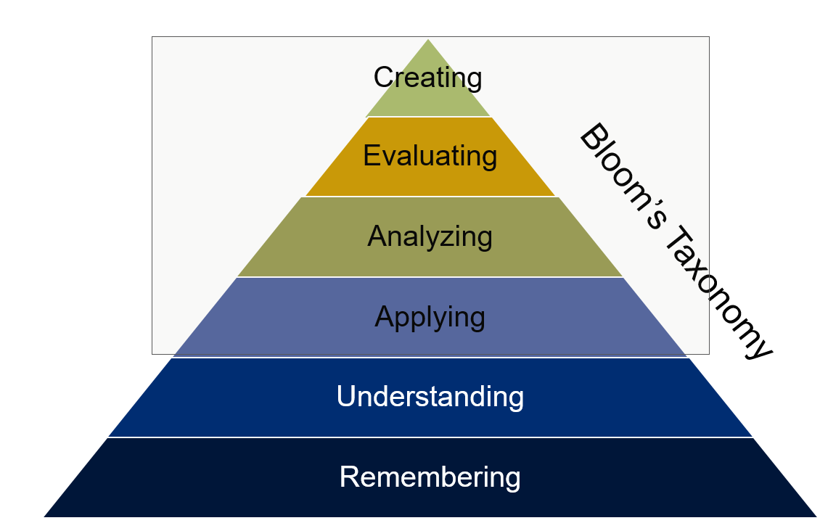
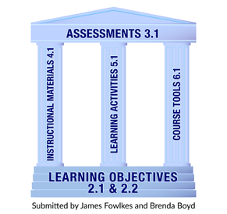
Alignment – Course Level
Between Objectives & Assessments
Among Course Components
Through Engagement and Services
Notes:
https://www.qualitymatters.org/sites/default/files/PDFs/StandardsfromtheQMHigherEducationRubric.pdf
Three main considerations for alignment: 1) Alignment between learning objectives and assessments, 2) Alignment among course components, and 3) Alignment through interaction, engagement and support services
All of these are needed in the online environment in order to create a user-friendly learning-centered ecosystem to help students succeed. We will come back very soon to explore each of these three considerations in more depth.

Slide 21
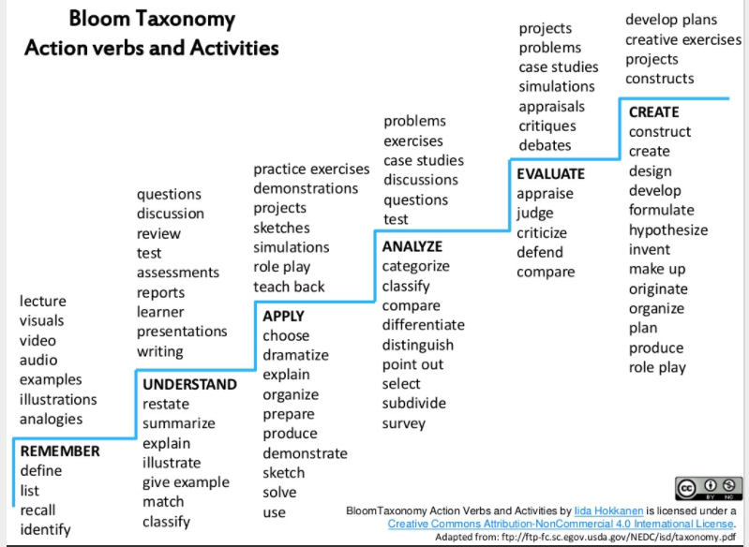
Align Objectives with Activities
Source: Hokaanen, Iida. (2015, August)
Notes:
https://www.slideshare.net/IidaHokkanen/bloom-taxonomy-action-verbs-and-activities
This is a quick illustration on what types of learning activities and assessments can be used and designed to assess the measurable learning objectives or outcomes, which are stated with action verbs at the appropriate cognitive levels.

Slide 22
Align Course Components
General Standards for HE Course Design
Course Overview & Introduction
Learning Objectives
Assessment & Measurement
Instructional Materials
Learning Activities & Learner Interaction
Course Technology
Learner Support
Accessibility & Usability
Alignment principle lays the foundation to build user-friendly learning-centered quality courses.
Notes:
There needs to be Alignment not just between learning objectives/outcomes and assessments. When the alignment principle is applied to the entire course, it means the main components in a course need to be aligned and support each other. Everything used or built in the course has a purpose, which is to help students achieve the stated learning objectives or outcomes.

Slide 23
Align via Interaction
Learner-Content
Learner-Instructor
Learner-Learner
Cognitive interaction with instructional materials when assessment is aligned (L-C)
Interaction via instructor prompt and feedback on assignments and activities (L-I)
Potential interaction with peers depending on type of course and assignment type (L-L)
Notes:
Strengthen course design alignment with interaction. Interaction can take various forms, whether online, hybrid, or F2F. Students engage by interacting with content / instructional materials, they interact with you as instructor, and they interact with one another as peers when appropriate. You’ll always have interaction between students and instructional materials, regardless of what format the course is being taught. Interaction between students and instructor is particularly important in the online and digital learning environments. Student satisfaction surveys show again and again that instructor’s presence and interaction is key to their success. Peer interaction between students depends on natures of the course, types of assignments, and the class size etc. Design for student to student interaction whenever it is appropriate.

Slide 24
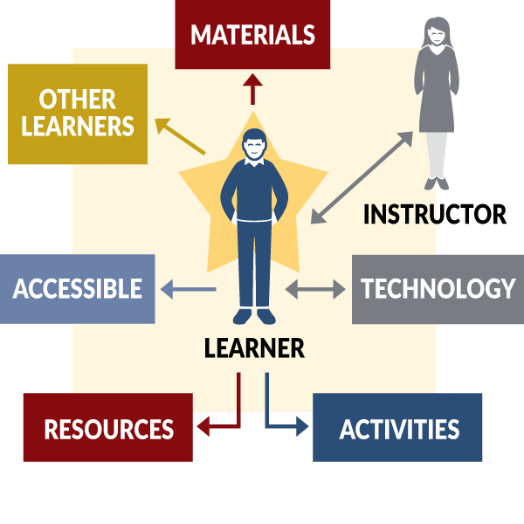
Align via Engagement
SRS 5.1: The learning activities promote the achievement of the stated learning objectives or competencies.
SRS 5.2: Learning activities provide opportunities for interaction that support active learning.
SRS 3.4: The assessments used are sequenced, varied, and suited to the level of the course.
SRS 3.5: The course provides learners with multiple opportunities to track their learning progress with timely feedback.
SRS 6.2: Course tools promote learner engagement and active learning.
Notes:
Engagement and interaction don’t happen automatically unless we purposefully design them into the online environment. Shown here are just some of the Quality Matters Higher Education Rubric Standards that can be used in the design of learning activities and assessments and use of technology tools to ensure that students have opportunities for cognitive engagement and interaction. The digital environment for an online course should be a user-friendly student-centered eco-system.

Slide 25
From F2F Instruction to Remote Teaching

Slide 26
Putting the pieces together
QM Alignment Principle in Action

Slide 27
As part of this research, a focus group of Bahrain Polytechnic instructors addressed the questions:
- In relation to your experience to move from F2F Instruction to Remote Teaching, what do you understand to be the key requirements of QM alignment principle?
- In what ways has your application of QM alignment helped you move from F2F instruction to remote teaching?
- In what ways has your application of QM alignment created challenges for you?
- What improvements should be made?

Slide 28
Case Study 1: Student Engagement
To what extent you were engaged in the following virtual classroom activities?
Source: Edhrabooh, Kubra, (2021) Adapting Innovative Strategies to Enhance Students’ Engagement in an Online Context.

Slide 29
Case Study 2: Authentic Assessments
Considering the modified Quantitative Business Methods (QBM) assessments, to what extent the new assessment mode helped you in:
Source: Benamer, Fadwa and Adam, Araz, (2021) Authentic Assessments: Quantitative Business Methods

Slide 30
Case Study 2: Authentic Assessments
List the skills that you have developed during your experience with the new mode of assessments?
- Critical thinking, information gathering, fast and effective learning, managing myself, independent thinking, problem solving, make good notes and organise materials.
- Self Learning, time management, self responsibility, ability to research
- Critical and thinking skills
- So many skills such as self learning. Find methods to learn certain topics that specifically work for me, Communication: by reaching out and discussing and problem solving and also being able to research in depth to once again, find different explanations that help me understand more in depth so that I excel in class
- Reading quicker, finding answers in between the lines , Paraphrasing and The ability to read the answer and understand it first and then explain it with my own way
- Time management and problem-solving and thinking outside the box.
- Giving more time to studies to understand rather than just memorizing, increase in knowledge due to more research
- Ability to think , search and organize the points easily while solving the exam.
- Researching skills, IT skills and teamwork skills
- Giving more time to studies to understand rather than just memorizing, increase in knowledge due to more research
- Depending on myself, Relying on my capabilities of getting the correct answer, Trusting myself more
- Self Learning, time management, self responsibility, ability to research
Source: Benamer, Fadwa and Adam, Araz, (2021) Authentic Assessments: Quantitative Business Methods

Slide 31
From F2F to Remote Teaching to Quality Digital Learning
Impacts on instructors and Learners
Impacts on learning outcomes
Impacts on learning
Impacts on teaching
QM Alignment Principle in Action

Slide 32
From F2F to Remote Teaching to Quality Digital Learning
Impacts on instructional materials
Impacts on assessments
Impacts on course technology
QM Alignment Principle in Action

Slide 33
Pockets of Exemplarism
Finding the pockets of enthusiasm
Fostering them as pockets of excellence, and then
Having them seen and copied as pockets of exemplarism
Source: Hornblow, Dave and Hasan, Jameel and Morris, Ian (2019) Recognition of Bahrain’s National Qualifications Framework in the wider world and Hasan, Jameel (2015) In search of a programme review framework for a polytechnic in Bahrain: the experience of a Bahraini quality coordinator.

Slide 34
Concluding Thoughts:
Encourage an ongoing quest for ‘pockets of enthusiasm’ within the institution community so that they can be widened and deepened the online quality practice.
Source: Hornblow, Dave and Hasan, Jameel and Morris, Ian (2019) Recognition of Bahrain’s National Qualifications Framework in the wider world and Hasan, Jameel (2015) In search of a programme review framework for a polytechnic in Bahrain: the experience of a Bahraini quality coordinator.

Slide 35
Impact of QM Standards
Improved student success
Higher GPA and overall grades
Greater student engagement
Higher rate of assignment submissions
Increased student interaction
Lower withdrawal rate
Higher satisfaction on course evaluation
Notes:
Curated QM-focused research: https://www.qualitymatters.org/index.php/research/curated-research-resources
QM Research library: https://www.qmprogram.org/qmresources/research/

Slide 36
QM PD Pathway for Academic Staff:
Improving Online Teaching Skills
Introduction to Online Teaching
Teaching Online Certificate (7-workshops)
Designing or Improving Your Online/Blended Courses
Specific Topics: Assessments, Engagement, Accessibility etc.
Becoming Peer/Master Reviewer or Program Reviewer
Applying QM Rubric
Peer Reviewer Course / Master Reviewer Certification
Reviewer Course Program Reviews
Becoming QM Certified Facilitators (F2F or Online)
Applying QM Rubric
Improving Your Online Course
Designing Your Online Course
Notes:
https://www.qualitymatters.org/professional-development/workshops
https://www.qualitymatters.org/professional-development/courses

Slide 37
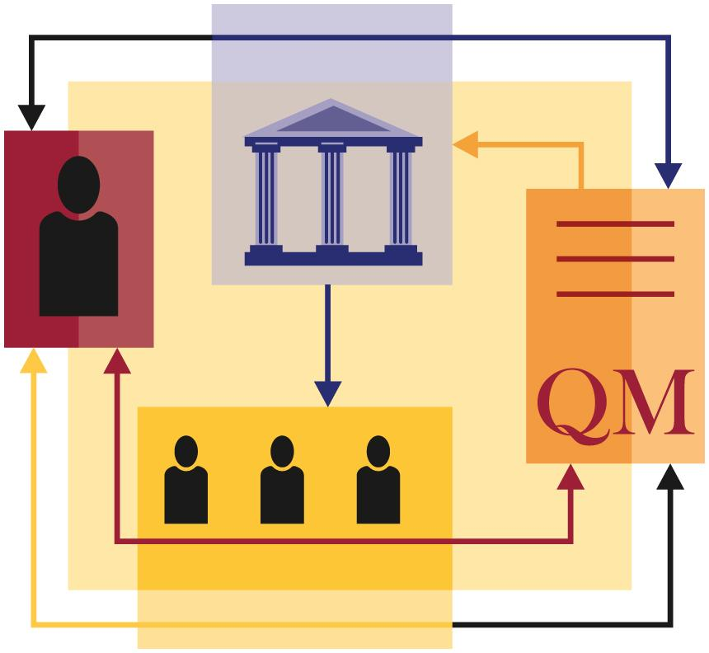
Adapting QM to Institutional Goals
Strategic goals & accreditation needs
Benchmarking & establishing QA process
Quality as institutional culture
Adoption & adaptation based on resources
Faculty-centered governance & buy-in
Ongoing faculty development
Improved courses & programs to help students succeed
Notes:
Possible photo?

Slide 38
Quality Learner-Centered Environments to Help Our Students Succeed!

Slide 39
…to this
From this …

Slide 40
References
Benamer, Fadwa and Adam, Araz, (2021) Authentic Assessments: Quantitative Business Methods, Bahrain Polytechnic, Manama, Kingdom of Bahrain.
Edhrabooh, Kubra, (2021) Adapting Innovative Strategies to Enhance Students’ Engagement in an Online Context. In: AUBH E-Learning Conference 2021: Innovative Learning and Teaching: Lessons from COVID-19. 24th – 26 May 2021, Manama, Kingdom of Bahrain.
Hasan, Jameel. (2021, June). Main Challenges: Remote Teaching [Post]. LinkedIn. https://www.linkedin.com/feed/update/urn:li:activity:6796409469623390209/
Hasan, Jameel (2015) In search of a programme review framework for a polytechnic in Bahrain: the experience of a Bahraini quality coordinator. [Thesis (PhD/Research)]
Hokaanen, Iida. (2015, August). Bloom Taxonomy Action Verbs and Activities. https://www.slideshare.net/IidaHokkanen/bloom-taxonomy-action-verbs-and-activities
Hornblow, Dave and Hasan, Jameel and Morris, Ian (2019) Recognition of Bahrain’s National Qualifications Framework in the wider world. In: INQAAHE 15th Biennial Conference 2019: Quality Assurance, Qualifications, and Recognition: Fostering Trust in a Globalised World , 25-28 Mar 2019, Sri Lanka .
Quality Matters. (2018, July). QM Course Design Rubric Standards. https://www.qualitymatters.org/qa-resources/rubric-standards/higher-ed-rubric
Quality Matters. (2020, June). QM Bridge to Quality Course Design Guide, Basic Edition. https://www.qualitymatters.org/bridge
Quality Matters. (2020, March). QM Emergency Remote Instruction (ERI) Checklist. https://www.qualitymatters.org/qa-resources/resource-center/articles-resources/ERI-Checklist
Quality Matters. (2021, June). QM Member Institutions/Organizations. https://www.qmprogram.org/qmresources/subscriptions/subscribers.cfm?program=0

Slide 41
Please contact us: ygao@qualitymatters.org Reem.AlBuainain@polytechnic.bh Jameel.Hasan@polytechnic.bh

